Slide 1
Wellness Within Reach:
Empowering Self-Care Strategies for Mental Health in the Workplace
Presentation by Sara Gray, Executive Director of NAMI KDK

Slide 2
The National Alliance on Mental Illness
Our mission is to provide FREE mental health support, education, and advocacy to individuals, family members, and communities.

Slide 3
The National Alliance on Mental Illness
NAMI is the largest mental health grassroots organization in the United States.
We are comprised of NAMI National, NAMI state agencies, and NAMI affiliates
We are a nonprofit organization, and are fully supported by grants, donations, and fundraisers.

Slide 4
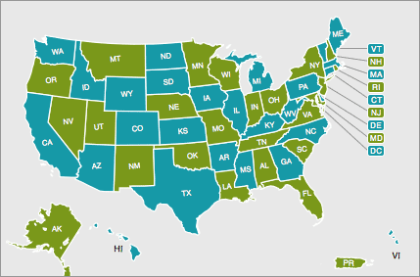
How to locate your local affiliate?
Find Your Local NAMI
This link will allow you to search state and zip code.

Slide 5
Let’s Set Our Foundation… Why Are We Here?
I am here today because all of us experience stress. The balancing act of work, home, and community at times are hard to navigate. Today we are here to discuss mental health strategies for self-care and tell you about your local NAMI.

Slide 6
Stressors Affect All of Us
Community Stressors
Poverty, Racism, Natural Disasters, Violent Incidents, and Persistent Health Problems
What Does a Portrait of Community Stress Look Like?
Home Life Stressors
Financial Challenges, Primary Relationship (Partners, Children, and Extended Family), Serious Illnesses, and Death of a Love One
Work Stressors
Workloads, Job Insecurity, Interpersonal Issues With Bosses & Coworkers, Work That is not Engaging, Not Enough Autonomy, and Compensation

Slide 7
Our Goals/Learning Objectives
Define Mental/Emotional Health, common mental health conditions and their symptoms, risks of mental health conditions, and recognize strategies to fight the stigma
Develop a toolkit of self care strategies that include:
Self-Care with or without a time constraint
When to reach out for professional help
Gain an understanding of the National Alliance on Mental Illness and how we can be of service to provide resources, support groups, and educational opportunities

Slide 8
What Is Mental Health?
Mental Health is defined as our social, emotional, and psychological well-being.
Many factors, including family history, biological factors, environmental factors, and life events can contribute to our mental health.
Our mental health can determine how we think, feel, and act.
Mental health conditions are common.
Mental Health is not something only people with diagnosed mental health conditions need to nurture.

Slide 9
Emotional Health
“Emotional Health can lead to success in work, relationships and health. In the past, researchers believed that success made people happy. Newer research reveals that it’s the other way around. Happy people are more likely to work toward goals, find the resources they need and attract others with their energy and optimism- key building blocks of success” (APA, 2022).

Slide 10
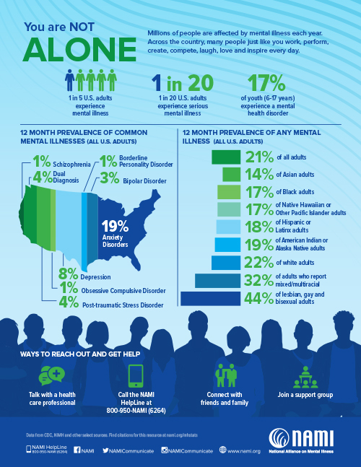

Slide 11
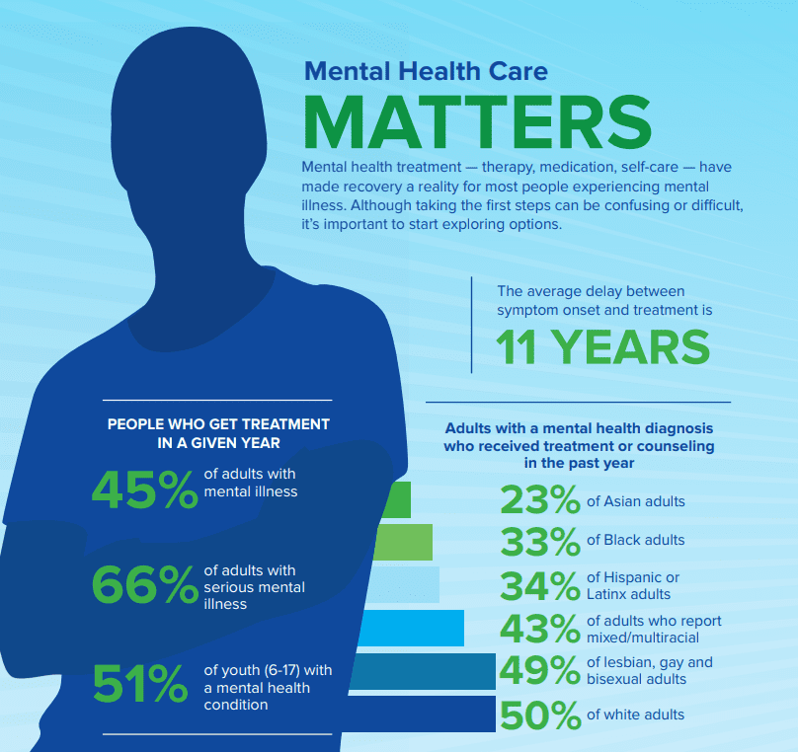
Mental Health Care Matters

Slide 12
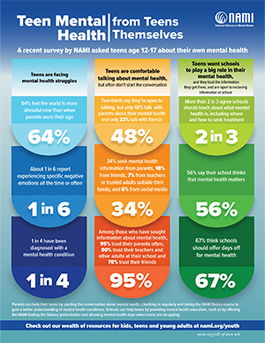
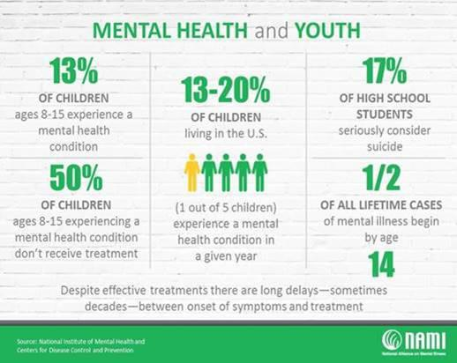
Mental Health Data and Youth

Slide 13
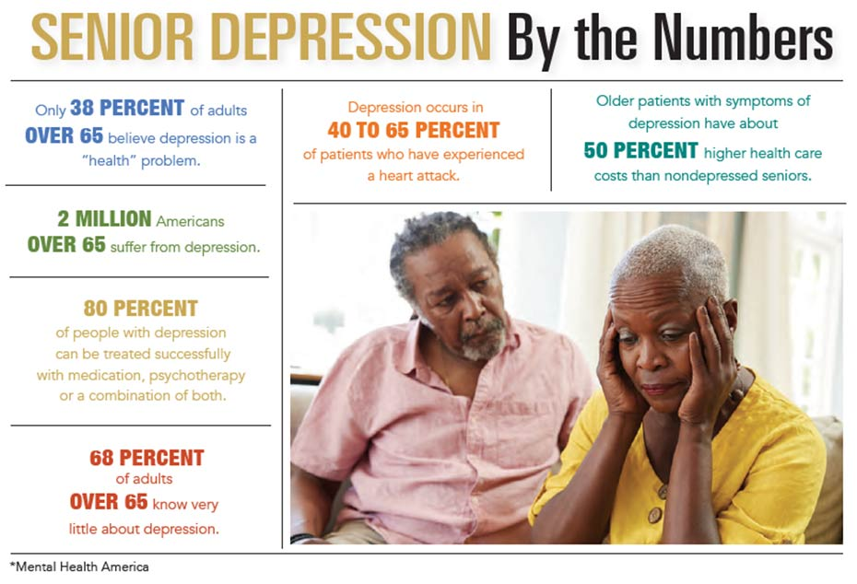
2 Million Americans over 65 Experience Depression

Slide 14
Major Warning Signs of Mental Health Conditions
Change in Appetite or Sleep
Withdrawal and isolation
Helplessness or hopelessness
Fatigue
Having low or no energy
The inability to experience pleasure
Thoughts of harm to yourself or others
Engagement in risky behaviors
Agitation

Slide 15
Ways to Protect Emotional Health
Reaching out for help
Finding a support network
Being physically active
Engage in activities that bring you joy
Helping others
Develop coping skills that work for YOU
Maintaining mindfulness

Slide 16
Mental Health Stigma
Stigma is defined described as:
“A mark of disgrace associated
with a particular circumstance,
quality, or person.” (Oxford Languages)
Mental health stigma is prevalent, and many don’t seek treatment due to fear of judgement.

Slide 17
How Do We Fight Stigma?
Educate yourself and others
Recognize the symptoms
Talk to a loved one
Talk to a mental health professional
Watch your and other’s language (Crazy, psycho, etc)
Encourage treatment
Offer a safe space, free of judgement

Slide 18
The Purpose of Our Presentation: Self-Care
We are exposed to various stressors, traumas, and burnout in the workplace. Bearing this in mind, we must have a toolkit to protect ourselves, and create a positive culture of self care in the workplace and at home.

Slide 19
What is Self-Care?
Self-care can mean a lot of things, but it is our:
ability to refill and refuel oneself in healthy ways
engagement in behaviours that maintain and promote physical and emotional well-being
behaviors that lessen the amount of stress, anxiety, or emotional reaction experienced when working with clients
(Gentry 2002, p. 48)(Myers et al. 2012, p. 56)(Williams et al. 2010, p. 322) (Polsuns & Gall, 2020)

Slide 20
Barriers to Self-Care
Guilt
Stigma
Time Constraints
Lack of Resources
Financial
Community
Unrealistic Expectations
Change is Hard

Slide 21
Barriers to Self-Care Continued…
• We may ignore the signs of stress, hoping they go away, and work ourselves to burnout
We are not immune to stigma
Professionals may feel professional embarrassment
Fear of harm to professional reputation
Feel as though they should not experience negative mental wellness, due to expertise
Stigma is a huge barrier to seeking professional help, and may keep professionals from reaching out for themselves
(Sherman, 1996)(Barnett, 2009)

Slide 22
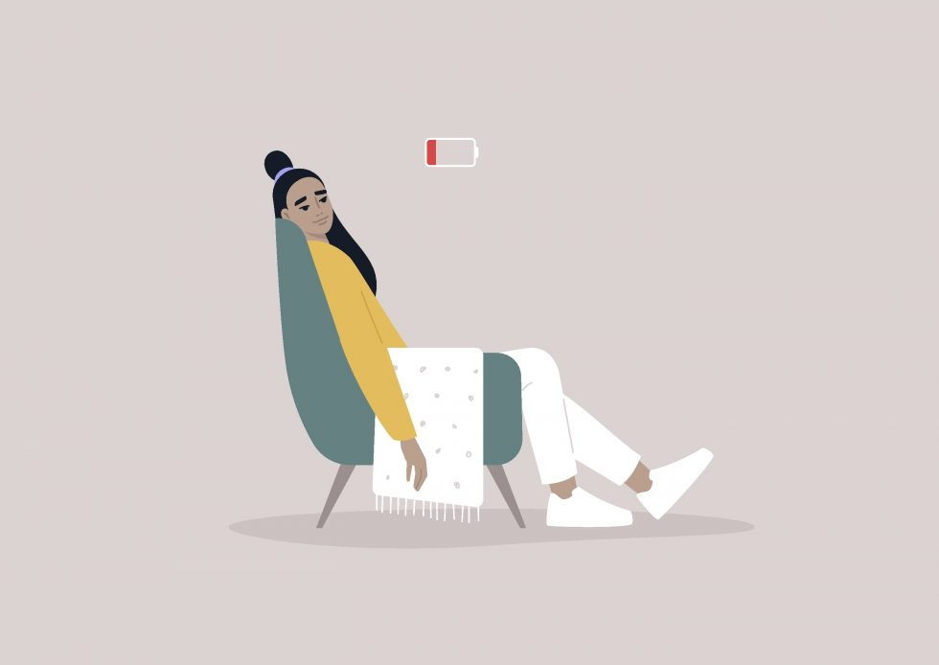
“Self-care means giving yourself permission to pause.” ~Cecilia Tran

Slide 23
Importance of Self-Care
Preventing and managing long-term stress can lower your risk for other conditions like heart disease, obesity, high blood pressure, and depression.
You can prevent or reduce stress by:
Planning ahead
Deciding which tasks to do first
Preparing for stressful events

Slide 24
Self-Care on a Time Crunch
Breathing exercises are a quick way to get stress levels in check.
Some strategies we will practice are:
Belly Breathing
4 7 8 Breathing
Square Breathing

Slide 25
Belly Breathing
“Belly breathing is easy to do and very relaxing. Try this basic exercise anytime you need to relax or relieve stress.
Sit or lie flat in a comfortable position.
Put one hand on your belly just below your ribs and the other hand on your chest.
Take a deep breath in through your nose, and let your belly push your hand out. Your chest should not move.
Breathe out through pursed lips as if you were whistling. Feel the hand on your belly go in, and use it to push all the air out.
Do this breathing 3 to 10 times. Take your time with each breath.
Notice how you feel at the end of the exercise.” (University of Michigan)

Slide 26
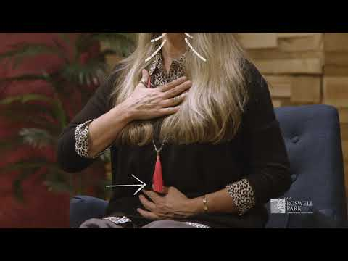
Belly Breathing Exercise

Slide 27
4 7 8 Breathing
“This exercise also uses belly breathing to help you relax. You can do this exercise either sitting or lying down.
To start, put one hand on your belly and the other on your chest as in the belly breathing exercise.
Take a deep, slow breath from your belly, and silently count to 4 as you breathe in.
Hold your breath, and silently count from 1 to 7.
Breathe out completely as you silently count from 1 to 8. Try to get all the air out of your lungs by the time you count to 8.
Repeat 3 to 7 times or until you feel calm.
Notice how you feel at the end of the exercise” (University of Michigan)

Slide 28
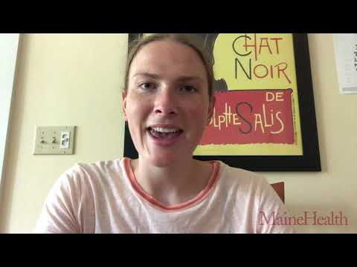
4 7 8 Breathing Exercise

Slide 29
Square Breathing
Breathe in for a slow count of four
Hold for four counts at the top of your breath
Let go and exhale slowly for four counts
Hold for four counts at the bottom of your breath
Repeat

Slide 30
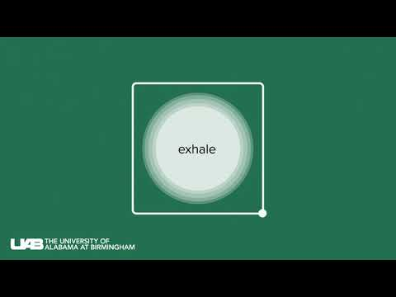
Square Breathing Exercise

Slide 31
Self-Care When You Have Time
When you have time for self care is when you should be capitalizing on your favorite activities. We must remember, self care does not only fit a certain mold, but rather how we define it.
Self care in your free time might look like socializing, creating, reading, writing, exercising, enjoying nature, and a variety of other activities.

Slide 32
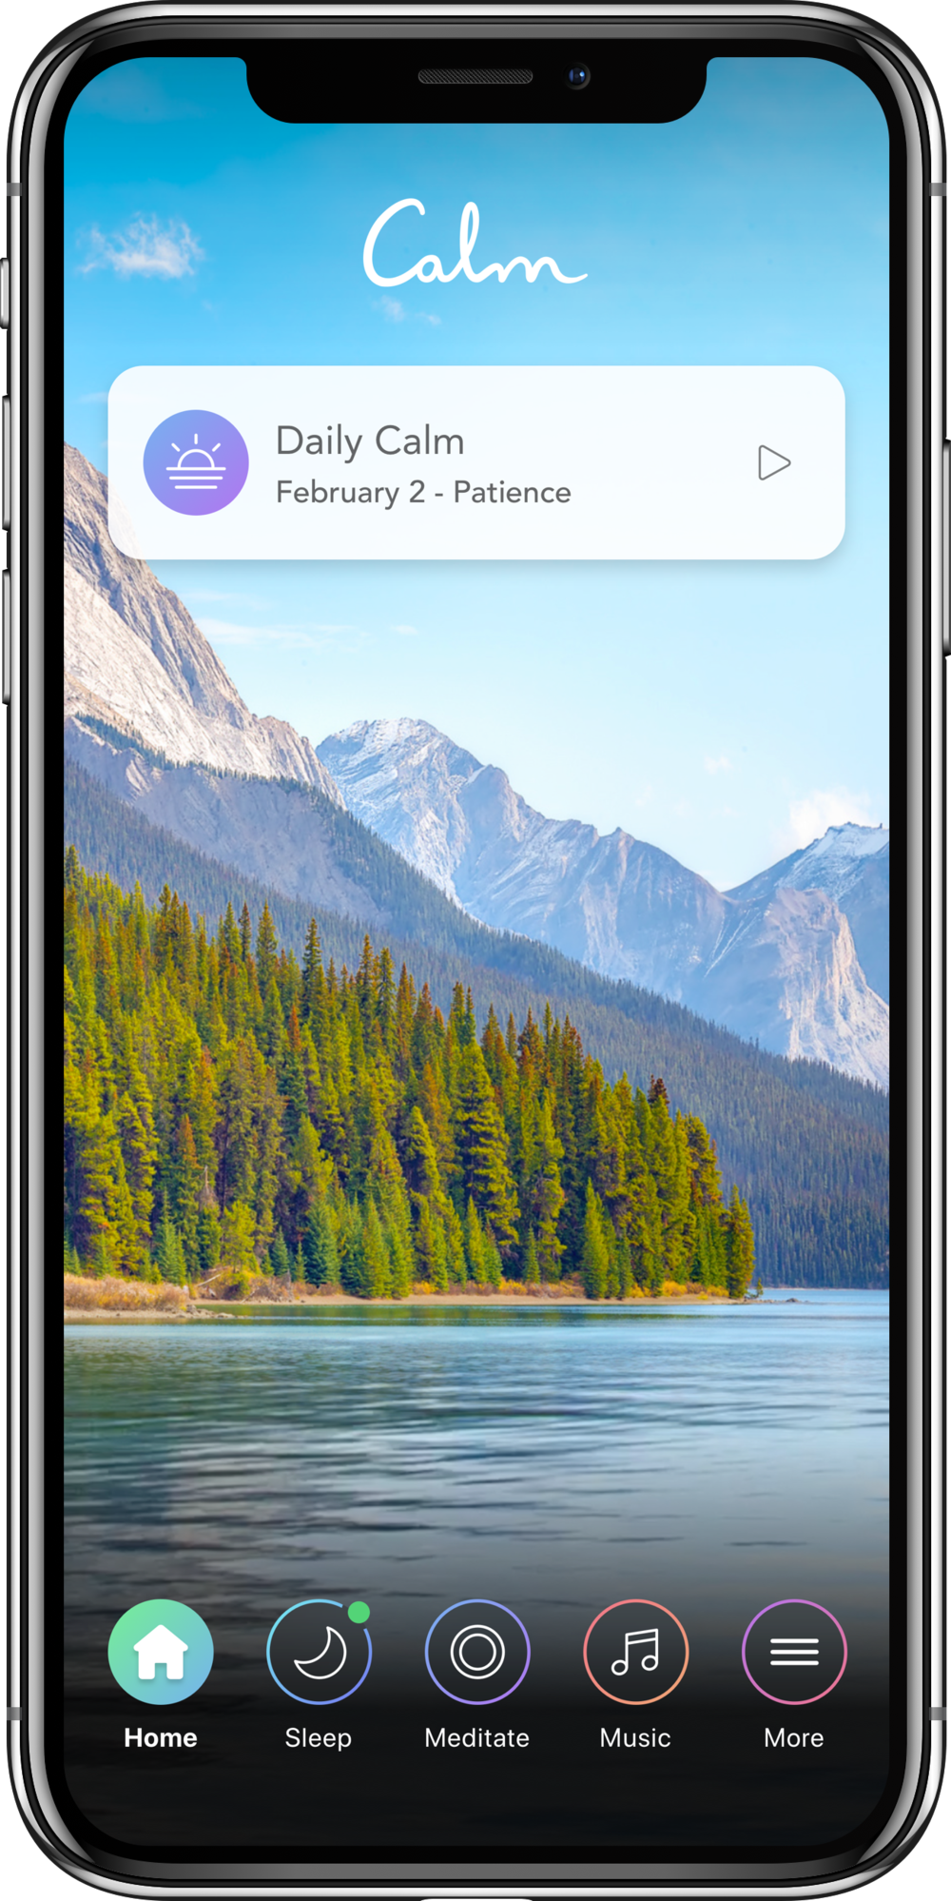
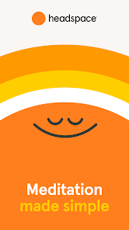
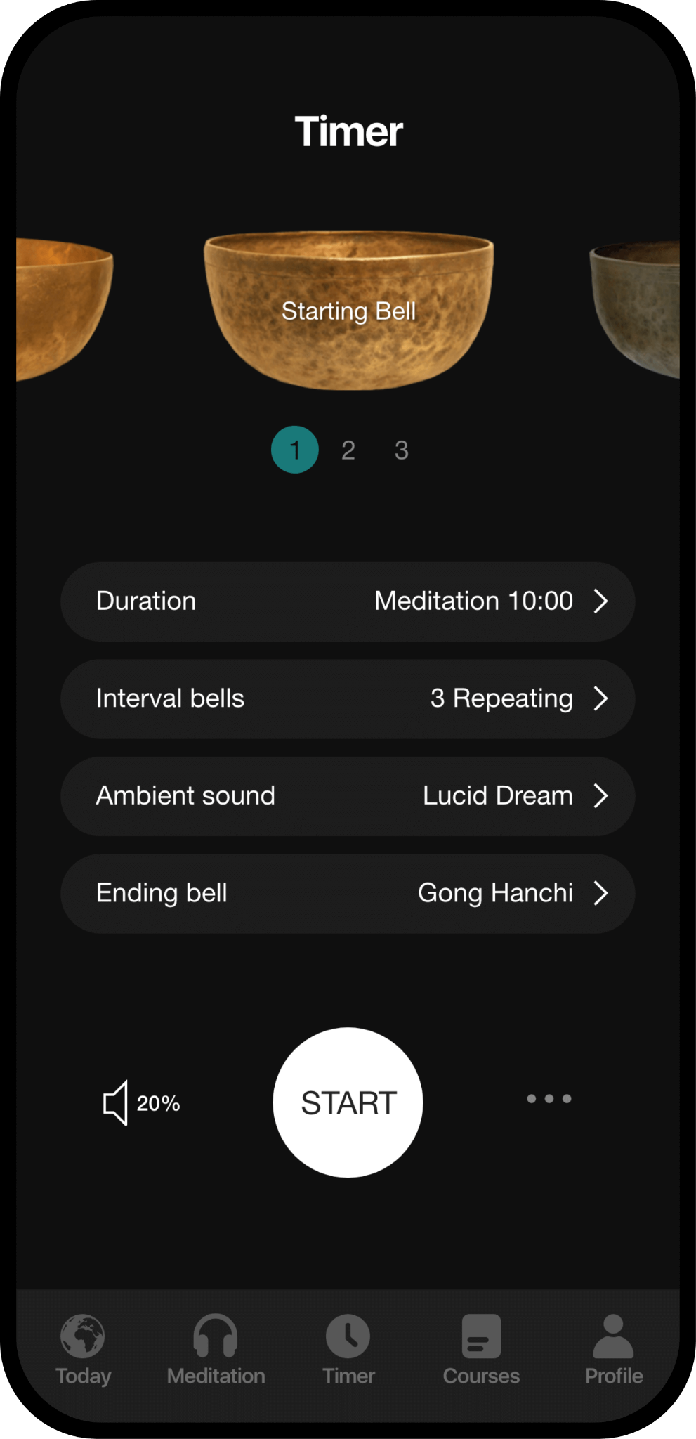
Using Technology to Our Advantage
There are plenty of free to low cost phone applications that are user friendly.
Calm
Headspace
Happify
Foundations
Insight Timer

Slide 33
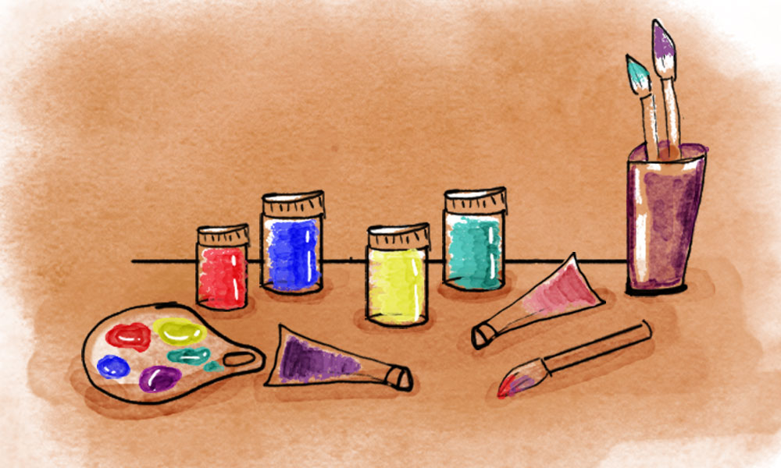
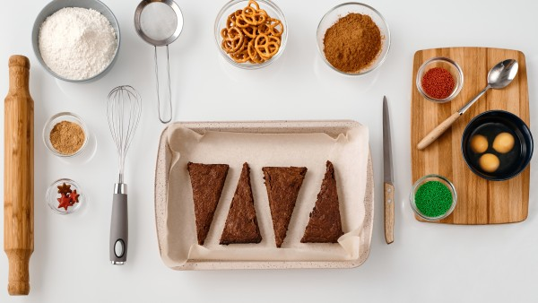
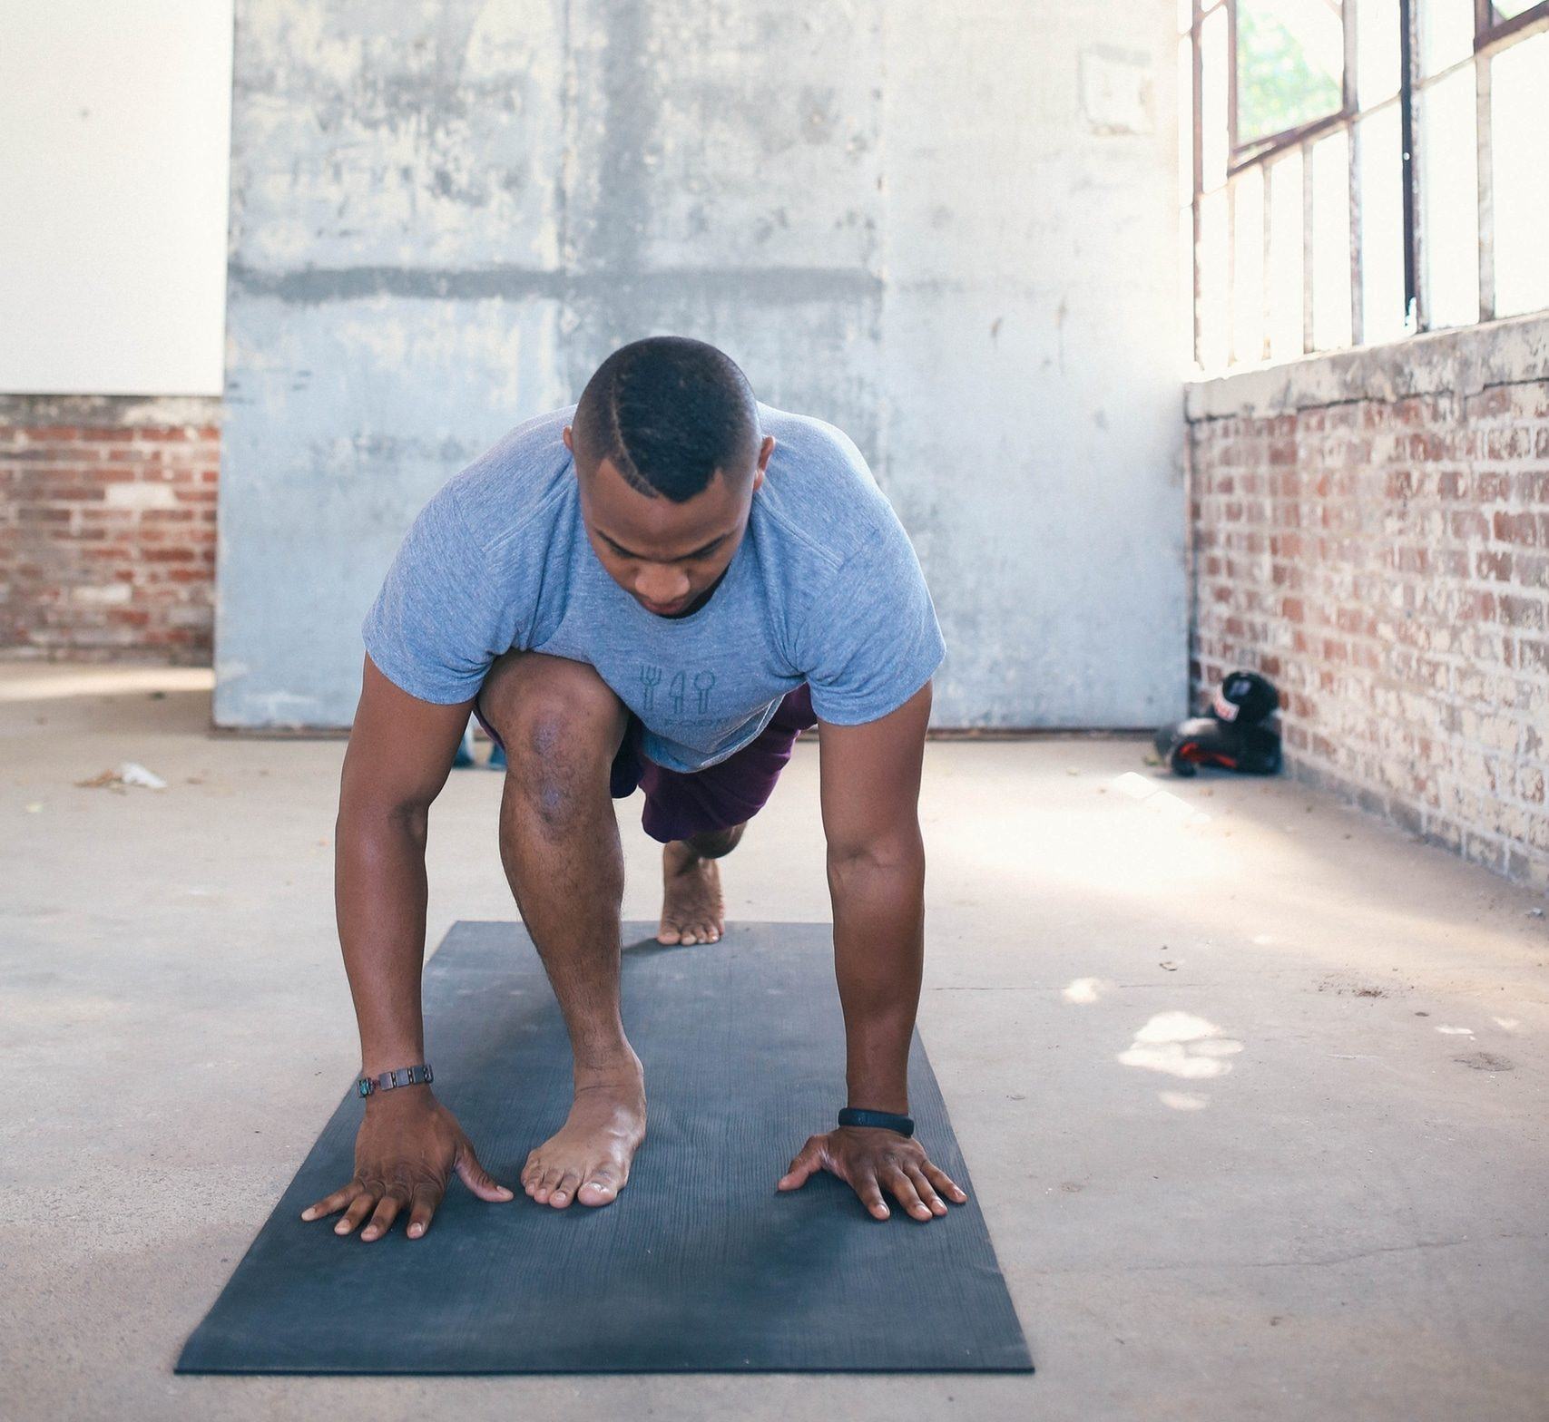
Finding Coping Strategies That Work for You
In order to create consistent behavior, it is important that you are engaging in self care activities that you find enjoyable. Capitalize on your hobbies if you can and get creative! Some ideas:
Creating art
Baking/Cooking
Exercise
Reading
Meditating

Slide 34
Benefits of Community Fitness
Motivation
Shared Goals
Sense of Belonging

Slide 35
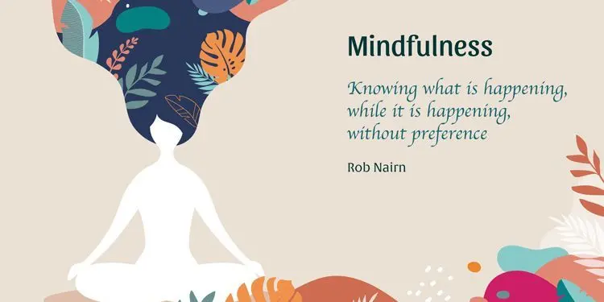
Some Suggestions from NAMI

Slide 36
Mindfulness
Mindfulness is a human ability to be present in the moment, without letting our anxiety or feelings of being overwhelmed overcome us.
With mindfulness, we can take the day minute by minute and learn to accept and tolerate our emotions as what they are.
Mindfulness allows us to shift our intention, attention, and attitude, so we can be calmer and more focused.

Slide 37
Expressive Writing
Expressive writing is the act of writing about our thoughts and feelings as they naturally come to us.
We can write generally or about specific stressors, and it is a great way to organize our thoughts and get it all out.
Researchers suggest writing about 15 minutes for a few days in a row to really begin to feel the effects.

Slide 38
Expressive Writing and Mindfulness: Health Benefits
expressive writing and mindfulness have a few positive impacts including:
Improved immunity
Lower blood pressure
Improved mood or affect
Reduced depressive symptoms
Improved working memory
Reduction of ruminative or anxious thought patterns

Slide 39
Resources & Strategies
Using care that is supplemental to that of sessions is important. As we have discussed, creating self care that is enduring requires it to be something habitual. We must be given strategies that they can take outside of the office, so that they can work to promote a wellness-minded lifestyle.
Be familiar with community resources
Peer support groups, such as those at NAMI, are great in addition to professional services
Utilize Apps and technology and use it as a part of stress management
Breathing, mindfulness, and expressive writing exercises

Slide 40
When to Reach out for Professional Help
Everyone deals with stress and low mood occasionally, but being aware of your functioning and the warning signs of mental health conditions can indicate when you need to reach out to help.
If your stress is interfering with your work or personal life to an extreme level, it may be time to reach out.
Remember, you don’t need to hit a certain threshold before reaching out. Sometimes needing extra support is the only reason necessary to reach out to a professional.

Slide 41
How to Reach Out
Some good places to start:
Ask for resources from your local NAMI affiliate
Your primary care physician
Reach out to a psychologist or psychiatrist
Call crisis/helplines for insight

Slide 42
Meet The Staff at NAMI KDK
Executive Director Sara Gray Program Coordinator Kim Mebane
Spanish Programs Luisa Cicero

Slide 43
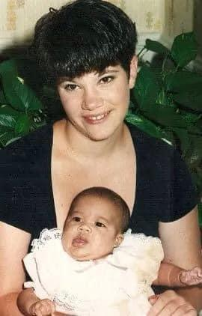
How did I become part of NAMI?
My Story

Slide 44
NAMI is a peer-led educational model
Staff, Interns, and community volunteers are all peers
All of our NAMI community is impacted by mental Illness
Diagnosed with a mental health condition
Love someone diagnosed or have symptoms of a mental health conditions

Slide 45
NAMI KDK’s Services
Support Groups:
Connections
Family Support Groups
Spanish
BIPOC
LGBTQ+
Senior Circle
Expressive Writing/Conversemos
Youth

Slide 46
NAMI KDK’s Services
Educational Presentations, Classes, and Resources (English & Spanish)
Ending the Silence: a program aimed at sharing the facts about mental health and one of our Volunteers own personal journeys. Aimed for middle and high schoolers, but can be modified for different settings.
In our Own Voice: Similar to Ending the Silence but less structured, Volunteers have the opportunity to share their experience with mental health conditions
Family to Family: 8 week course for family members and loved ones of those with mental health conditions
NAMI Homefront: Mental Health Resources For Military Service Members, Veterans And Their Families: 6 week course

Slide 47
Sharing Hope and Compartiendo Esperanza
Sharing Hope and Compartiendo Esperanza: is a three-part video series that explores the journey of mental wellness in Black and Latinx communities through dialogue, storytelling and a guided discussion on the following topics:
Youth and Mental Wellness: “How Do You Heal?”
Community Leaders and Mental Wellness: “The Art of Healing”
Families and Mental Wellness: “Smiling On Our Journey”

Slide 48
Key Takeaway
All of us experience stress. There are strategies that may help but there may be times we need professional help. The goal today was to discuss self-care and our mental health. The hope is if we can share these personal, vulnerable stories of those in our communities, perhaps others will feel more comfortable speaking out and getting help.
These are topics we don’t always encounter, and knowing the warning signs can inform us about what steps to take.
Additionally, we want people to begin the conversation about mental health, and end the stigma surrounding mental health conditions and their treatment.

Slide 49
For More Information and to Contact Us
PLEASE REACH OUT TO US
My email: saragray@namikdk.org
Program Coordinator Kim Mebane: programs@namikdk.org
Spanish Programs Luisa Cicero: spanishprograms@namikdk.org
NAMI KDK main email: info@namikdk.org
NAMI KDK Website: https://www.namikdk.org/

Slide 50
References
https://www.apa.org/
https://www.mentalhealth.gov/basics/what-is-mental-health
https://onemindpsyberguide.org/
https://www.uofmhealth.org/health-library/uz2255
https://www.mentalhealthfirstaid.org/2020/08/where-to-seek-professional-mental-health-support/
Ahmedani, B.K.(2011) Mental health stigma: Society, individuals, and the profession. Journal of social work values and
ethics, 8(2), 41-416.
American Psychological Association. (2017). Ethical principles of psychologists and code of conduct (2002, amended effective
June 1, 2010, and January 1, 2017). http://www.apa.org/ethics/code/index.html
Barnett, J.E. & Cooper, N. (2009). Creating a culture self-care. American Psychological Association, 1-5.
Posluns, K., Gall, T.L. Dear Mental Health Practitioners, Take Care of Yourselves: a Literature Review on Self-Care. Int J
Adv Counselling 42, 1–20 (2020). https://doi.org/10.1007/s10447-019-09382-w

Slide 51
Questions, Comments, and Concerns?

