Slide 1
EVALUATE YOUR STRATEGY:
Maintenance Excellence with Kaizen Webinar
Presenter: Jesse Brady | Technical Specialist
Notes:
Record for staff not in attendance.
https://imec.box.com/v/TeamHuddlesPast

Slide 2

Jesse Brady
Technical Specialist

Slide 3
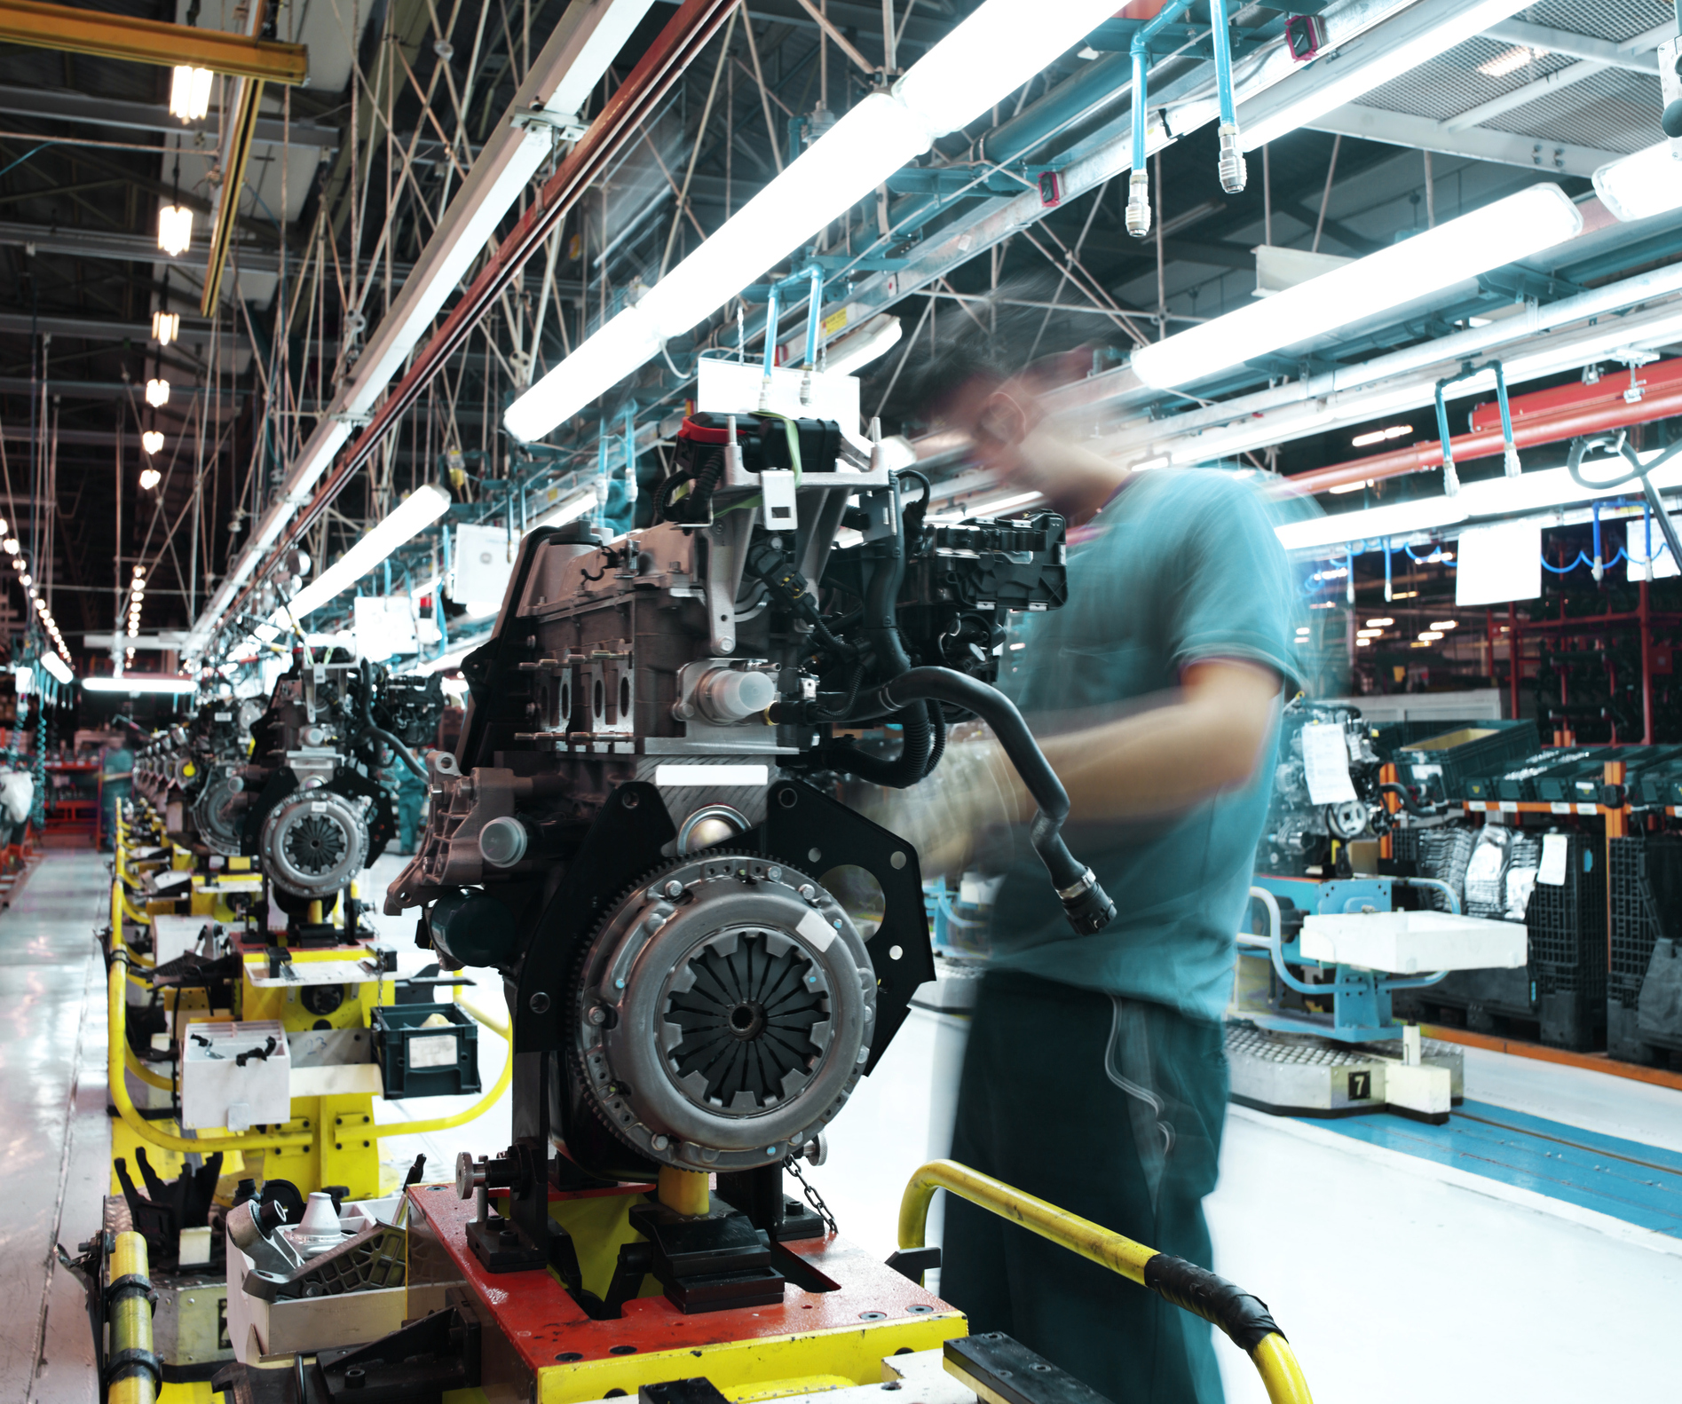
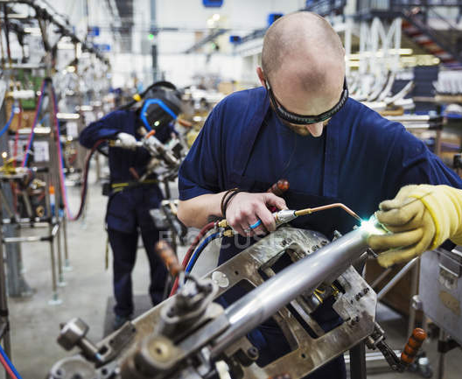
Target Audience
Maintenance Personnel
Production Operators
Supervisors
Leads
Planners

Slide 4
Project Cadence
Day 1
Classroom Training
Maintenance Process Assessment
Day 2
Assessment Debrief & Classroom Training
Kaizen Area Selection & Planning
Day 3
Kaizen Event
Day 4
Kaizen Event

Slide 5
Training Agenda & Objectives
Maintenance Excellence
Planning
Safety
Metrics / KPIs
Visual Controls
Strategy
Objectives
TPM Kaizen Event
What is TPM
What is Lean
Steps in the Process
Evaluate Equipment
Identify/Correct Deficiencies
Optimize your Maintenance Strategy

Slide 6
Maintenance Planning
Asset Management
ERP / CMMS
Equipment Evaluation Form
Identify Spare Parts
ERP / CMMS
Inventory Tracking Spreadsheet
Critical Spare Parts List

Slide 7
Equipment Evaluation
Production
  Utilization
  Back Ups
  Affect
Maintenance
  Know deficiencies
  Spare Parts
  Lead Time for Parts
Safety
  Guards
  Housekeeping
Systems

Slide 8
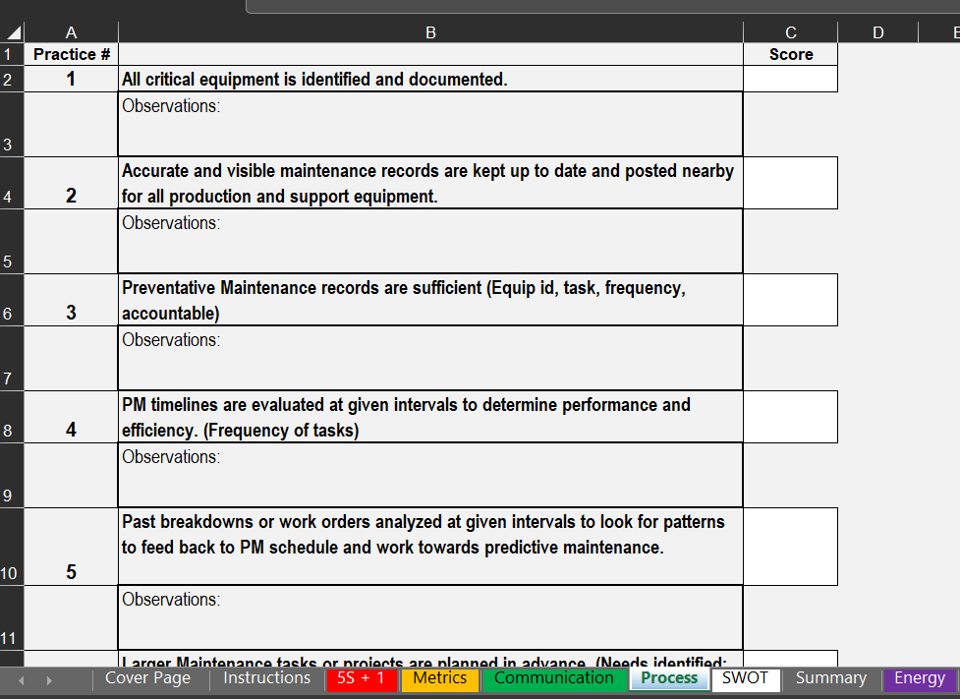
Maintenance Assessment
Determining Current State
Housekeeping
5S
Safety
Metrics
OEE
Uptime/Downtime
Communication
Critical vs Non-Critical
Process
Records
PM Sheets
Maintenance Planning

Slide 9
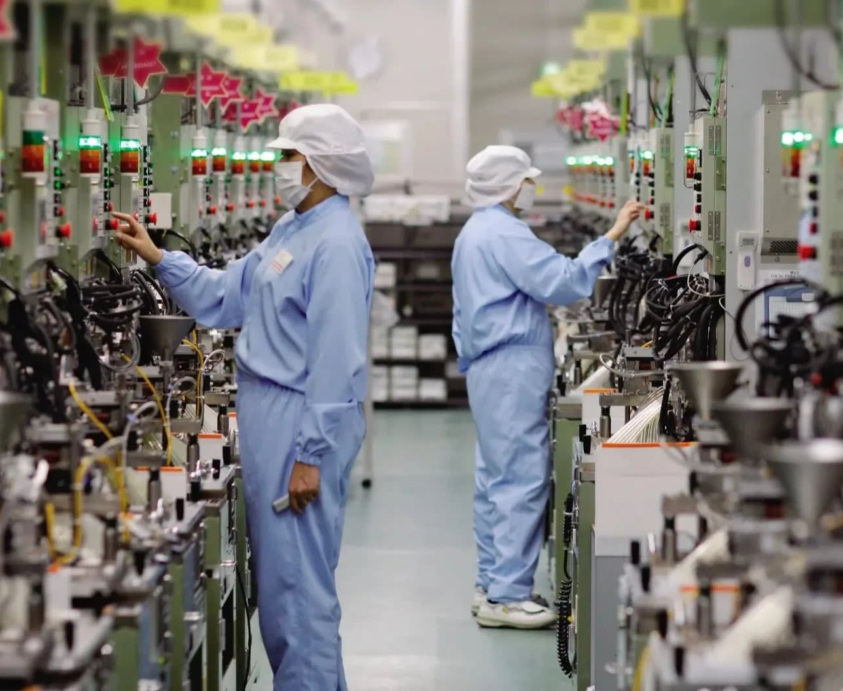
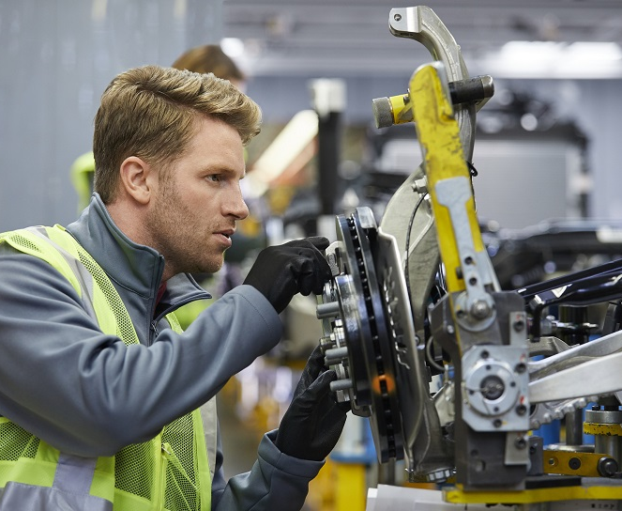
Safety
PPE
Procedures
  Start Up / Shut Down
  Safety Device Verification / Validation
  LOTO Procedures at Machine
LOTO Program
  Affected vs Authorized Identified?
  Hazards Identification
  Equipment – Locks, Isolation Devices, etc
Training
  LOTO
  Arc Flash
  Records / Competence
  SDS Records/Awareness

Slide 10
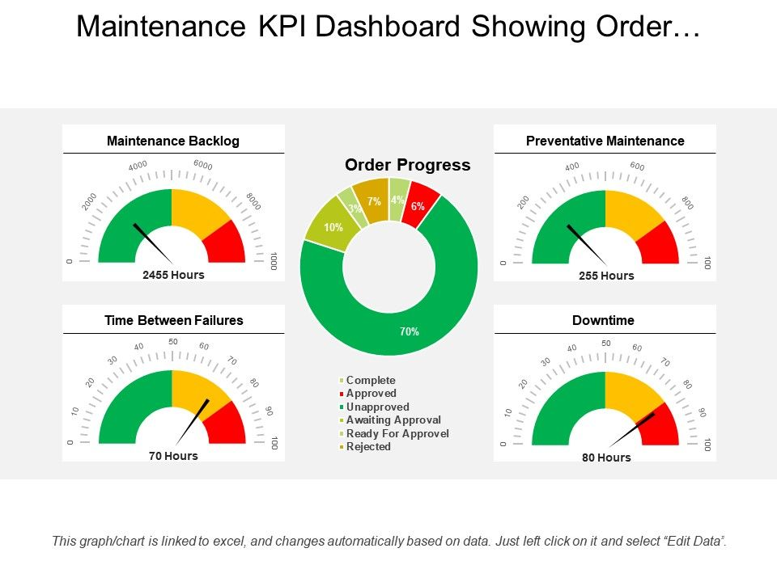
Metrics
Common Maintenance Metrics
Maintenance Backlog
Time Based
  Mean Time to Repair
  Mean Time between Failures
% Planned / Unplanned
Rework
Overall Equipment Effectiveness (OEE)

Slide 11
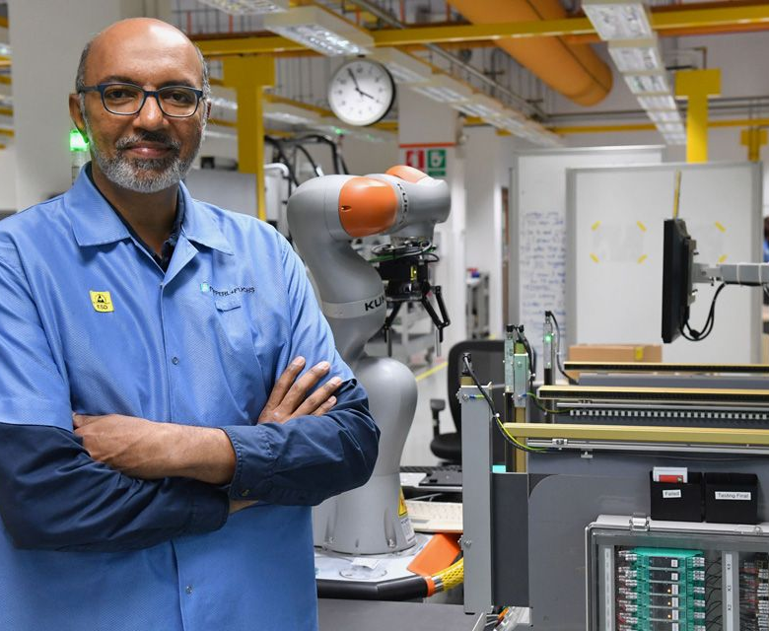
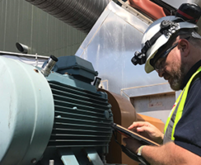
Housekeeping
5S
S1 – Sort
S2 – Set
S3 - Shine
S4 – Standardize
S5 – Sustain

Slide 12
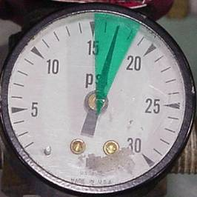
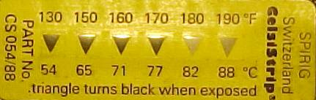
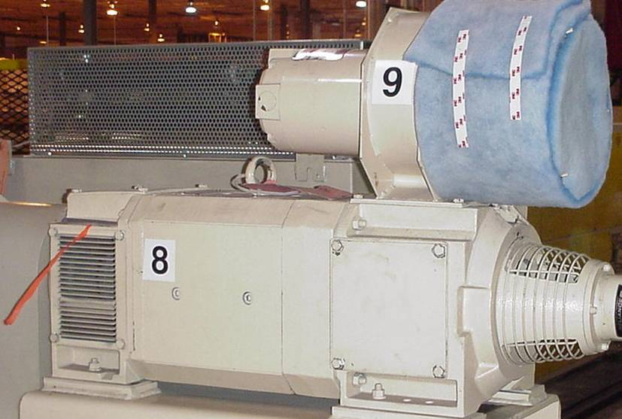
Visual Controls
Heat Strips
Gauge Marking
Numbering
Air Ribbons
Easy-to-Inspect Filters

Slide 13
Proactive Maintenance Strategies
Preventative
Time Based
Predictive
Condition Based
Prescriptive/Maintenance 4.0

Slide 14
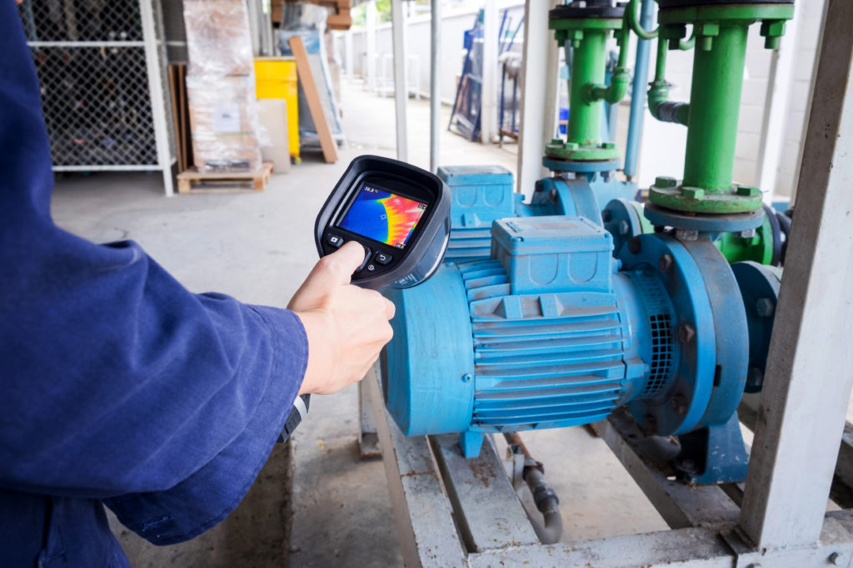
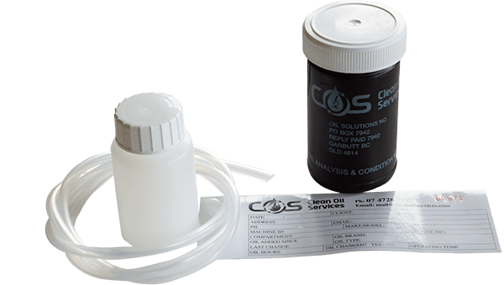
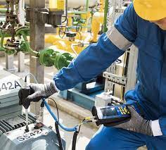
Predictive Maintenance Techniques
Vibration Analysis
Ultrasonic Analysis
Infrared Analysis
Oil Analysis
Lasor Alignment
Motor Circuit Analysis

Slide 15
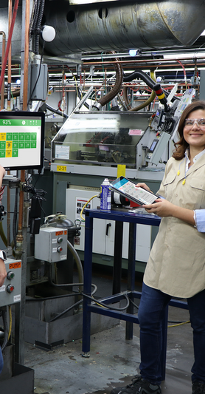
Definition of TPM
TPM is a process that maximizes the productivity of equipment for its entire life cycle and will extend the life of the equipment.
Through the participation of all employees, TPM creates an environment that encourages improvement efforts in safety, quality, cost, delivery, and creativity.

Slide 16
Focused Improvement Strategy
Plan
  Choose critical equipment
  Measure baseline
  Solicit champion
  Create timetable
Focused Improvement
Act
  Lessons learned
  Best practices
  Document/Standardize
Sustaining TPM
Implementing
TPM
Do
  Clean to inspect
  5S and visual controls
  Countermeasures
  PM and checklists
Check
  Check measurements
  Compare objectives
  Countermeasures

Slide 17

Focused Improvement
Each team will focus on one of the following:
  Develop countermeasures and modifications
  Apply visual controls
  Develop daily operator PM
  Develop planned maintenance checklist
  Develop critical spare parts list
Team tasks include the following:
  Inspect equipment
  Identify and analyze problems
  Recommend improvements
  Apply 5S principles and visual controls
  Develop preventive maintenance checklists
  Identify critical spare parts

Slide 18
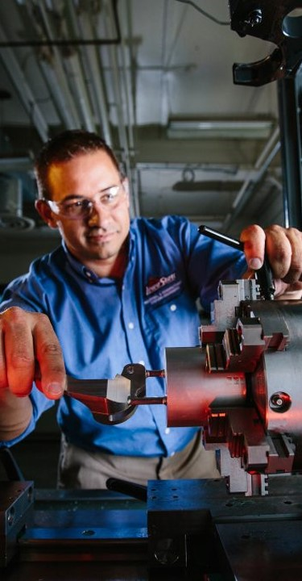
Kaizen Planning
Identify Equipment/Area
Determine Supplies Needed
Cleaning Supplies
Parts/Tools
Additional Resources
Develop Gameplan

Slide 19
Thank
You!

