Slide 2
SomerCor is a non-profit lender certified by the Small Business Administration to originate and service SBA 504 loans to buy, expand or refinance major fixed assets
According to the Illinois Manufacturers Association, Illinois is the fourth largest manufacturing state in the country, with more than 18,000 companies employing over 590,000
SomerCor is proud to support small businesses in the manufacturing sector through the SBA 504 program and by working with partners like IMEC
Manuel “Manny” Flores President & CEO
312-360-3300
mflores@somercor.com
Find us at www.somercor.com

Slide 3
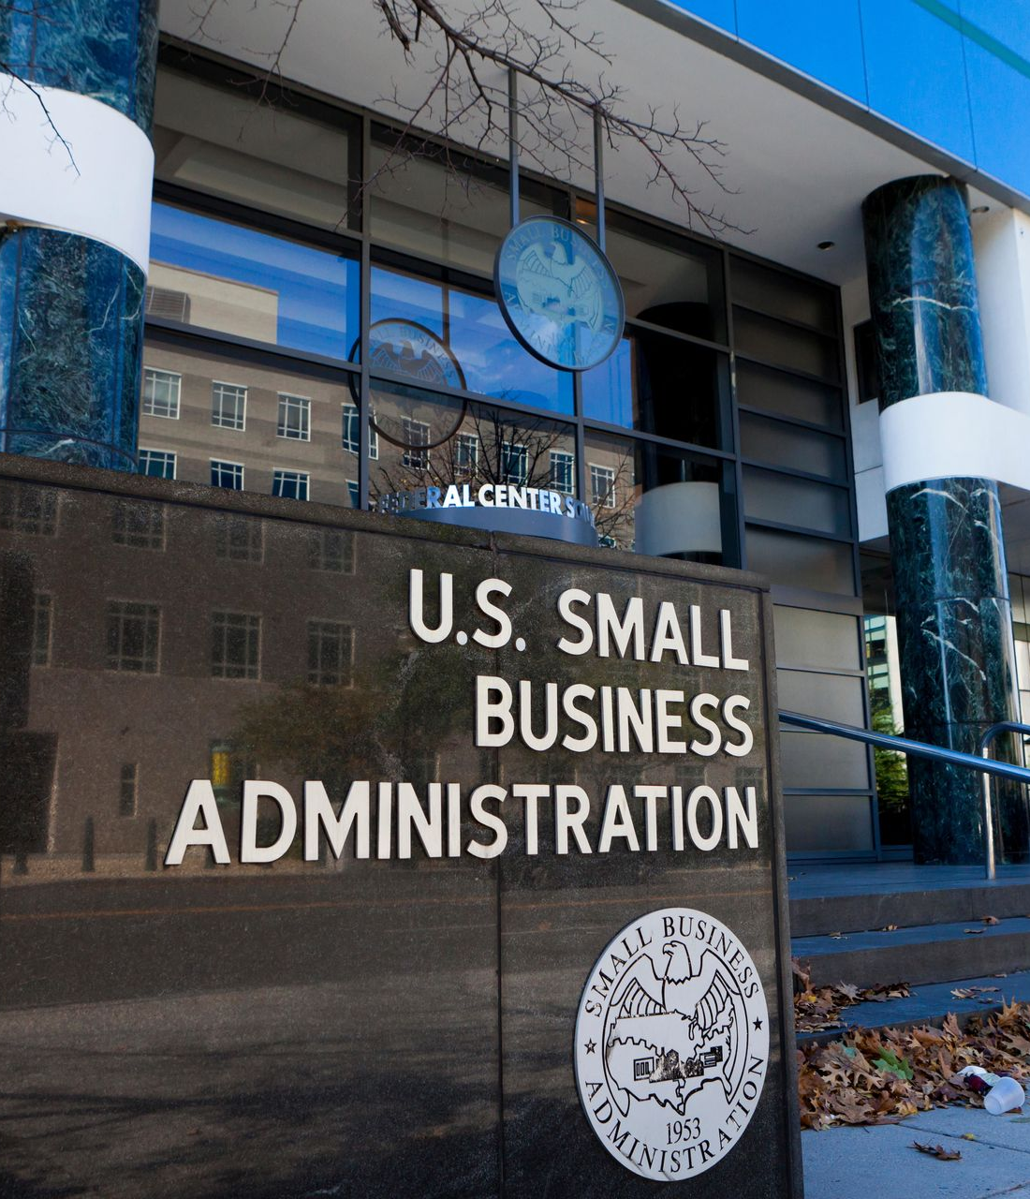
PRESENTATION GUIDEPOSTS
SBA 504 Program Introduction
504 Loan Program Basics
504 Loan Structure
Application Process
Growth Opportunities for Manufacturers
Provides Access to Ownership
Flexibility to Expand Capacity
Save Money by Going Green
New Equipment for New Product
Automation for Acceleration
Leverage Equity for Cash Out

Slide 4
SBA 504 PROGRAM BASICS
What is the SBA 504 program?
Provides lending solution for small business owners to buy, expand or refinance major fixed assets – such as commercial real estate, equipment, and machinery
The 504 program mission supports:
Job Creation/Retention
Community Development
MBE, WBE and Veteran-Owned Businesses
Functions as a public-private partnership with three key players – a small business borrower, a Certified Development Company like SomerCor, and a third party lender
Who can use the SBA 504 Program?
For-profit business
Under $15MM in tangible net worth
Prior 2 years average after tax net income under $5MM
For CRE at least 51% applicant occupancy (60% for new construction)
The 504 works for all these industries and more:
manufacturing
health care
storage facilities
restaurants
education & childcare
franchises
hospitality
professional services
retail
senior care facilities

Slide 5
SBA 504 PROGRAM BASICS
What are the benefits of the SBA 504?
Higher SBA loan amount for manufacturing
Maximum SBA 504 debenture for each manufacturing project is $5.5 million ($5 million for all other industries)
There is no limit on the number of SBA 504 loan projects allowed to manufacturers so long as the aggregate amount is below $16.5 million.
Below-Market Interest Rates Means Lower Monthly Payments:
While interest rates are rising, the 504 effective rate remains below-market
Less Money Down Means Freed Up Working Capital:
Up to 90% financing for established businesses - this financing structure frees up working capital that would normally be designated for paying off loans to instead be reinvested back into the business
Long-Term Fixed Financing Means No Surprise Balloon Payments:
Borrowers have the option of 10, 20 or 25 year loan terms - this eliminates surprise balloon payments and allows for more accurate long-term planning

Slide 6
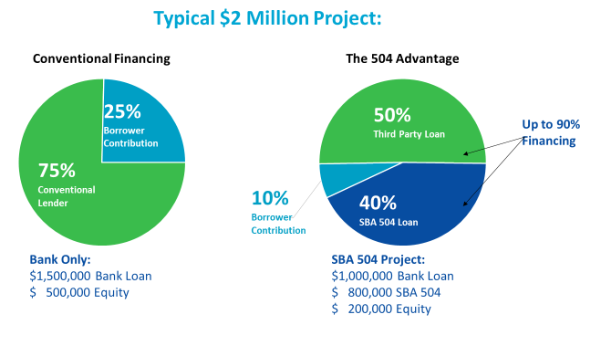
SBA 504 LOAN STRUCTURE
For businesses that are growing and need to expand and renovate to meet demand, the SBA 504 loan structure requires less money down, and provides long-term, fixed financing at below market interest rates.
Eligible costs that can be funded with a 504 Loan:
Land and building acquisition
Construction
Remodeling
Equipment
Fixtures
Certain soft costs and professional fees
Ineligible Uses
Working capital
Inventory
Goodwill
Business stock
Vehicles
Franchise fees
Legal fees

Slide 7
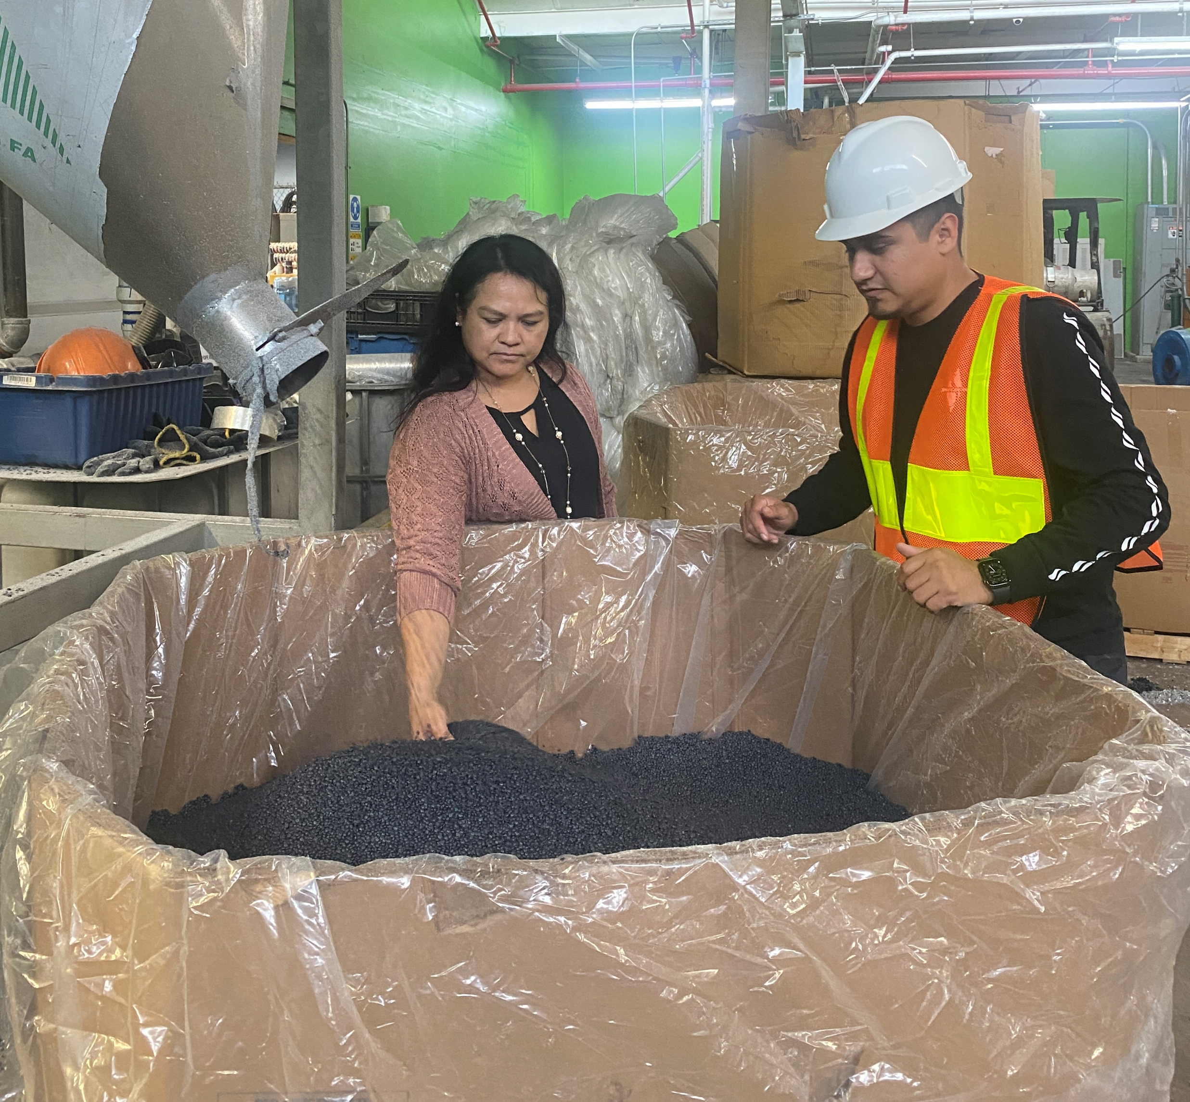
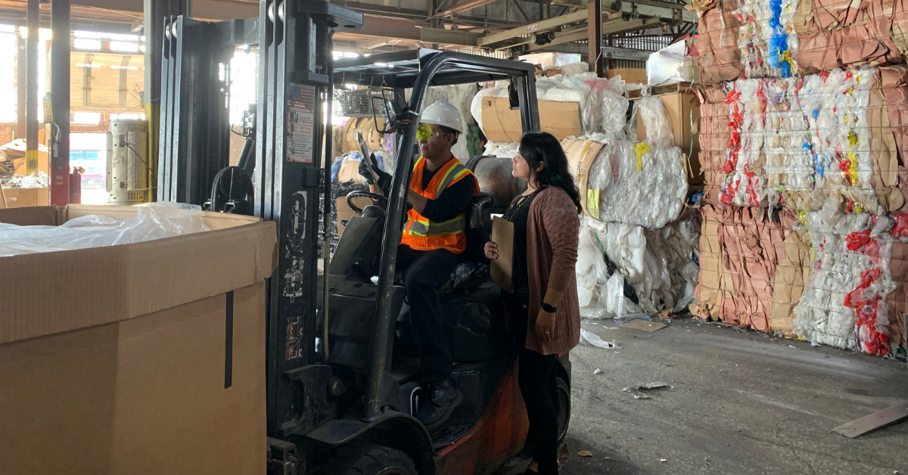
PROVIDES ACCESS TO OWNERSHIP
Manufacturers can use the SBA 504 loan to purchase commercial real estate – taking advantage of the borrower-friendly terms. SomerCor client, R&J Trucking and Recycling used the SBA 504 loan to purchase a 197,000 square foot building to serve as both a warehouse and office space. Even more critical to the long-term growth of the business, the monthly mortgage on their new location is 30% lower than what they paid in rent – leading to more than $75,000 in annual savings.

Slide 8
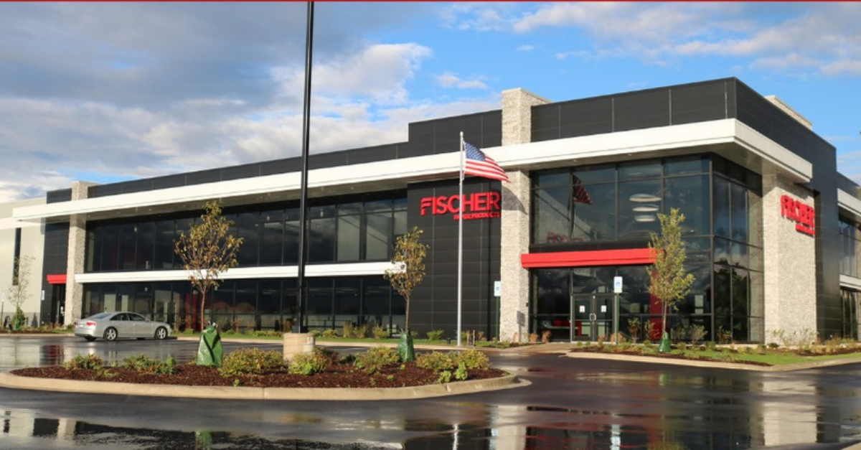
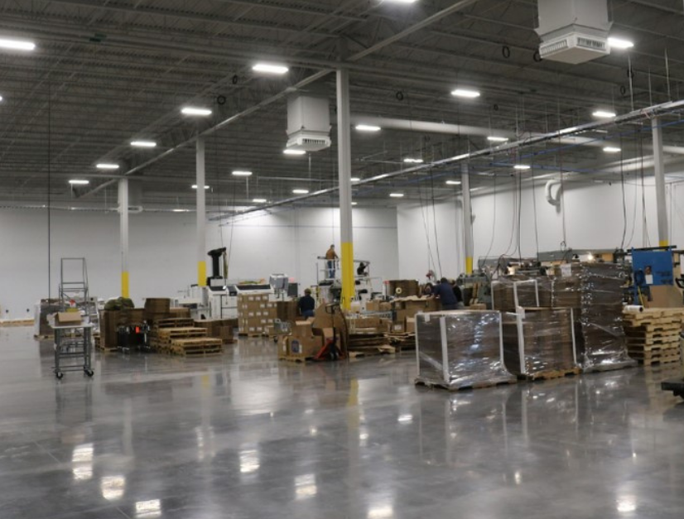
FLEXIBILITY TO EXPAND CAPACITY
Manufacturers can use the SBA 504 to expand, construct, or renovate a new or existing facility – personalized for optimum efficiency, safety, and the flexibility to grow. Fischer Paper Products used the 504 program to build a 162,000sqft state-of-the-art space built to company specifications that merged all operations under one roof.

Slide 9
SAVE MONEY BY GOING GREEN
The SBA 504 Green Loan Program is a great opportunity for borrowers to incorporate energy efficient elements or renewable energy technologies into their commercial real estate projects. In addition to the borrower-friendly terms of loan, making energy efficient upgrades reduce energy costs over the long-term. It is also an opportunity to tie company brand identity to the fight against climate change. To be eligible for an SBA 504 Green Loan, borrowers must meet one of these metrics:
Reduce energy consumption by at least 10 percent (compared to historical consumption) through building upgrades.
Generate at least 15% renewable energy (solar, wind, geothermal, hydropower, and biomass) through property upgrades.
Increase the use of sustainable design, including design that reduces the use of greenhouse gas emitting fossil fuels or low-impact design that reduce the use of non-renewable resources and minimize environmental impact.
Projects that meet one of the above benchmarks secure additional borrower benefits:
Larger SBA/CDC Loan Amount – SBA maximum contribution increases to a $5.5 million cap (from $5 million) with no maximum total project limit.
Higher Option for Aggregated Lending – Borrowers can have multiple SBA 504 Green Loans up to $16.5M aggregate, with no maximum total project size

Slide 10
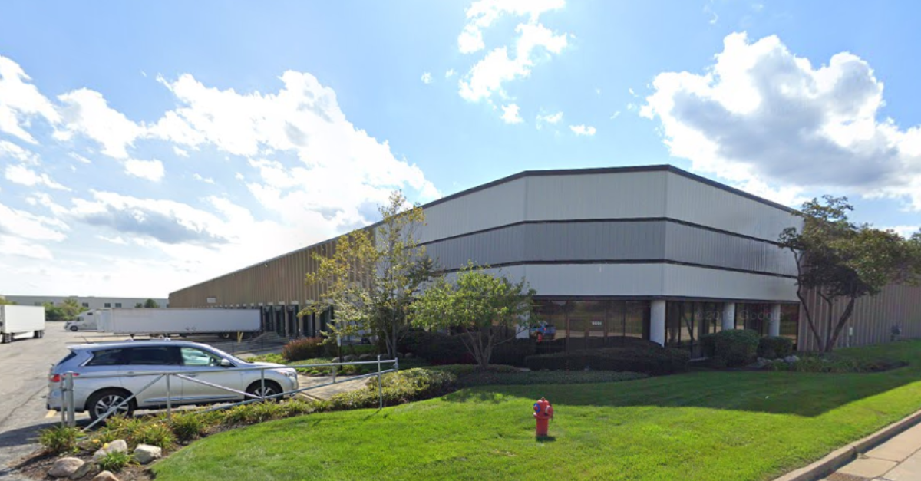
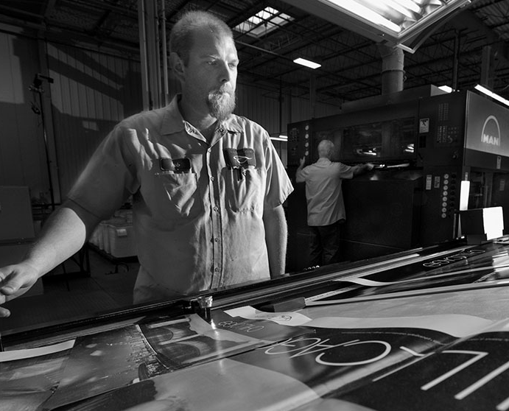
NEW EQUIPMENT FOR NEW PRODUCT
Manufacturers can use the SBA 504 to purchase new equipment in support of new product lines. SomerCor client, Accord Carton, used the SBA 504 loan to purchase a new machine to build a six-pack carrier product line primarily sold to the beer industry. As a result, they built enough new business to support a membership in the Brewers Association and participate in the annual Craft Brewers Conference.

Slide 11
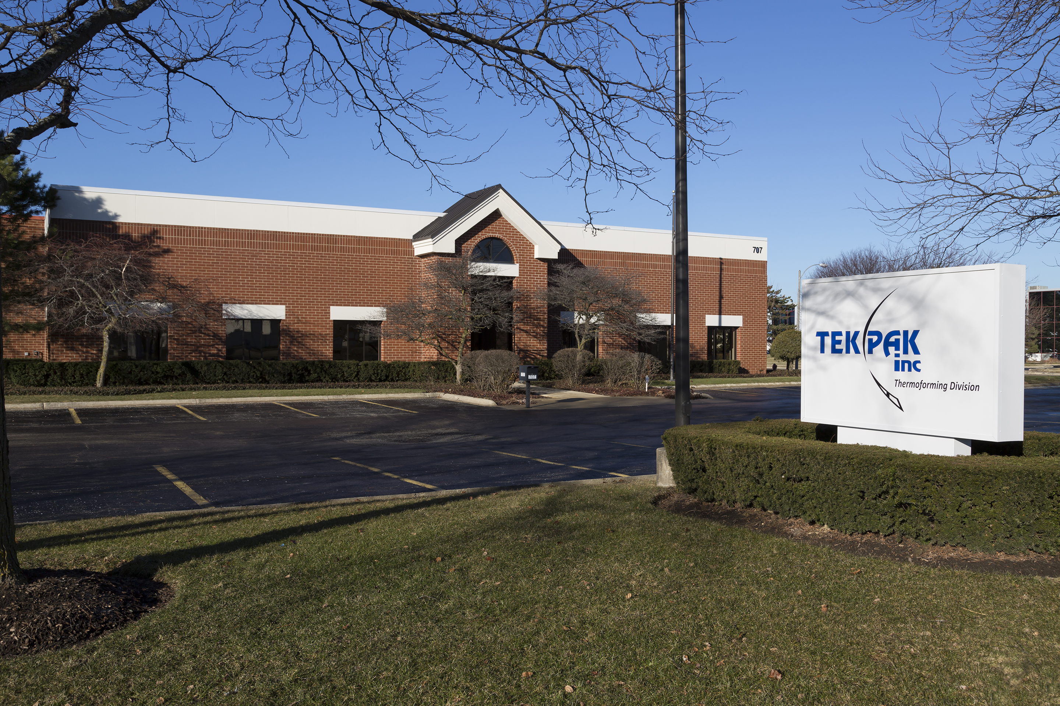
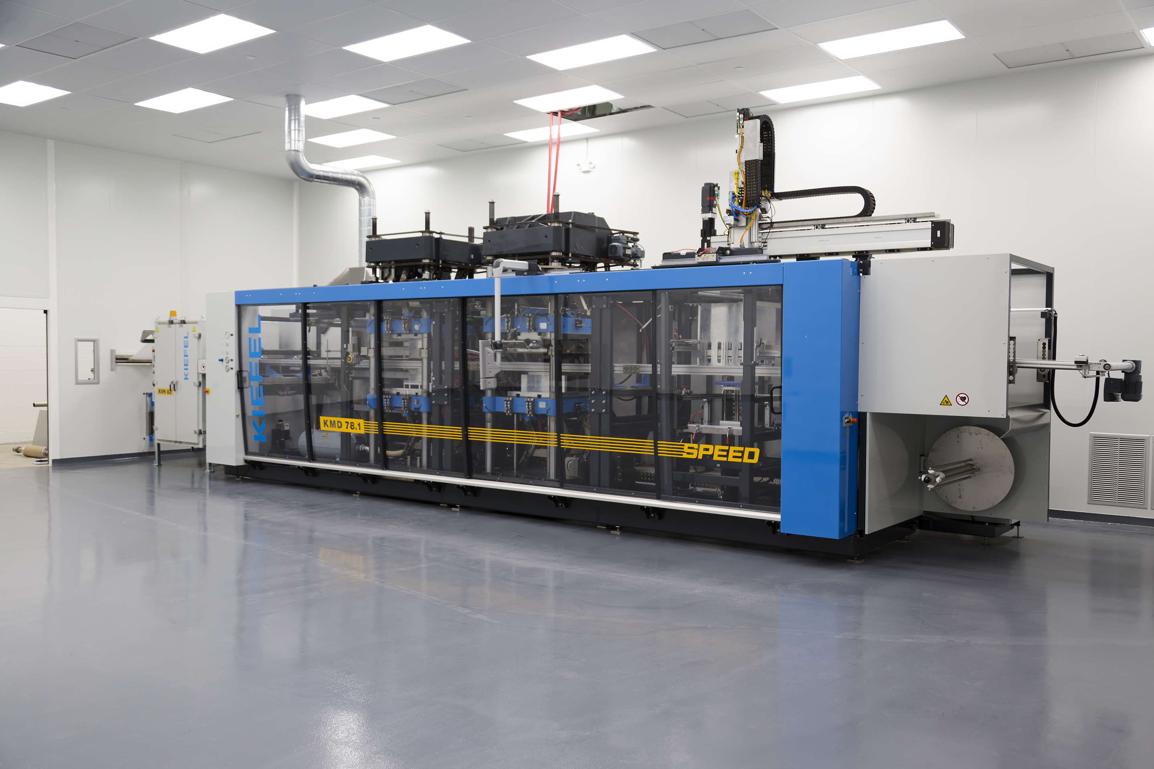
AUTOMATION FOR ACCELERATION
Hiring, training, and maintaining skilled team members is an area of focus for manufacturers. In addition to talent acquisition and apprenticeship initiatives, incorporating new equipment can expand capacity for current product lines and streamline operations to address workforce costs. SomerCor client, Tek Pak, has accessed multiple SBA 504 loans to purchase Kiefel thermoforming machines to increase capacity. In 2021 lead times for their thermoforming services extended to 12 weeks, leading to significant overtime costs. With the purchase of this equipment their production capacity will increase by 40% and augment the company's capacity to meet demand without the additional payroll costs.

Slide 12
LEVERAGE EQUITY FOR CASH OUT
For companies looking to refinance existing loans and/or access additional capital, the 504 refi is a trusted, strategic debt restructuring solution, especially during times of economic uncertainty.
Small businesses can use the refi to leverage built-up equity and take money out for eligible working capital expenses - the cash out piece ranges up to 20% of the appraised value of the commercial property
Eligible Operating Expenses for Cash-Out Funds:
Salaries (non-owners)
Rent
Utilities
Inventory
Business line of credit and business credit card debt
Ineligible Uses of Cash-Out Funds:
Capital expenditures
Personal expenses
Acquiring a new business or business partnership buyout

Slide 13
SBA 504 APPLICATION PROCESS
Ready to apply? Contact your business lender or reach out directly to SomerCor. Be prepared with the following items to start the application process:
Company Information
Last three years corporate tax returns for business
Last three years corporate tax returns for all affiliates (if any)
Interim financial statements (within 90 days)
Schedule of existing company debt (creditor, balance, monthly payment)
Most recent aging of accounts receivable and payable
Two-year income and expense projections
Owner Information (for each 20% or more owner of the business or real estate)
Personal financial statement (lender form is acceptable)
Personal Data Sheet
Last three years federal income tax returns
Project Information
Detailed breakdown of project costs (include copies of all purchase agreements, construction estimates, equipment quotes, etc.)
Real estate appraisal and environmental reports

Slide 14
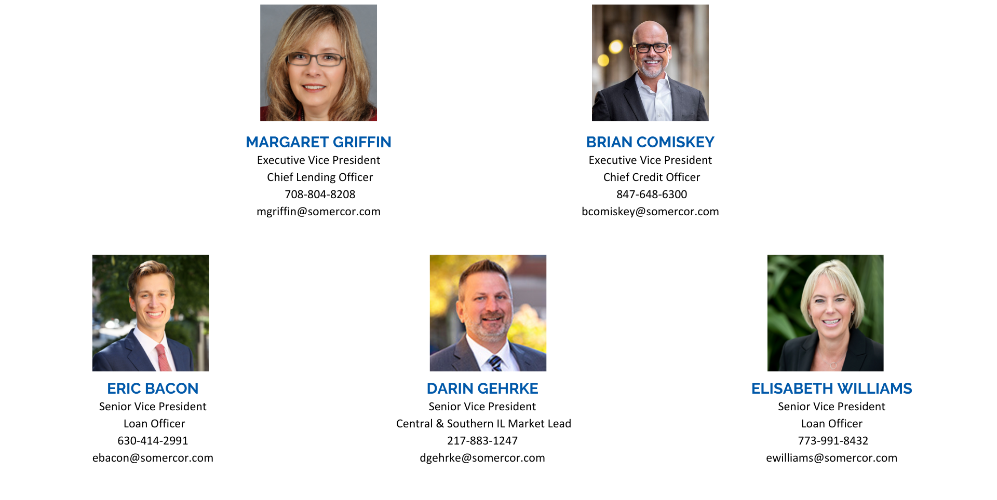
SOMERCOR LOAN ORIGINATION TEAM

