Slide 1
DEFINE
YOUR
GOALS.
Developing a Strategic Plan for Your Organization Webinar
Presenters: Cary Moreth | Opticor Business Solutions, LLC
Date: December 14, 2022
Notes:
Record for staff not in attendance.
https://imec.box.com/v/TeamHuddlesPast

Slide 2
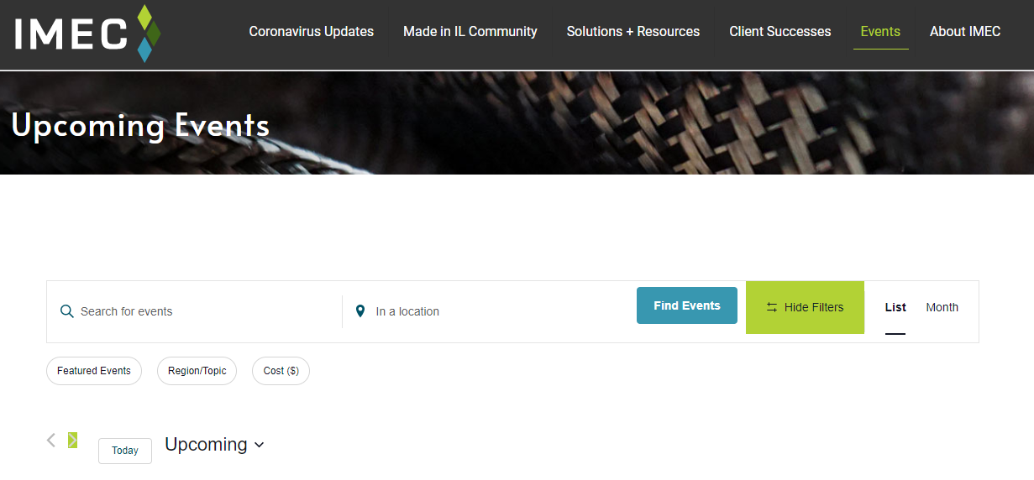
UPCOMING IMEC EVENTS
Visit www.IMEC.org/Events/ for the complete list of upcoming events.

