Slide 1
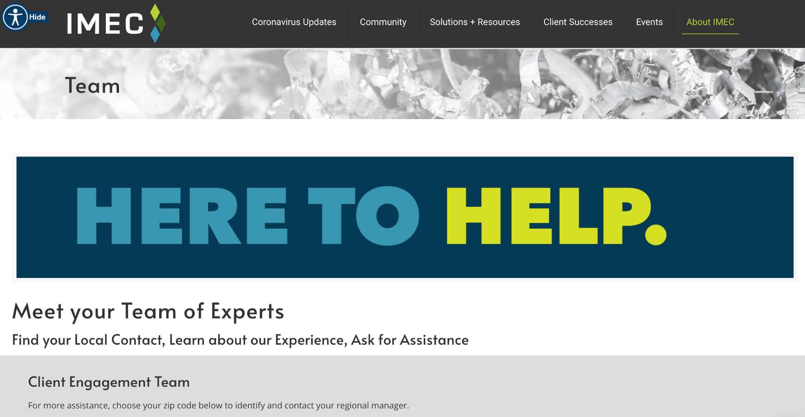

Slide 3
#1 COMPLIANT of B2B BUYERS?

Slide 4
NOT enough INFO
on
Website

Slide 5
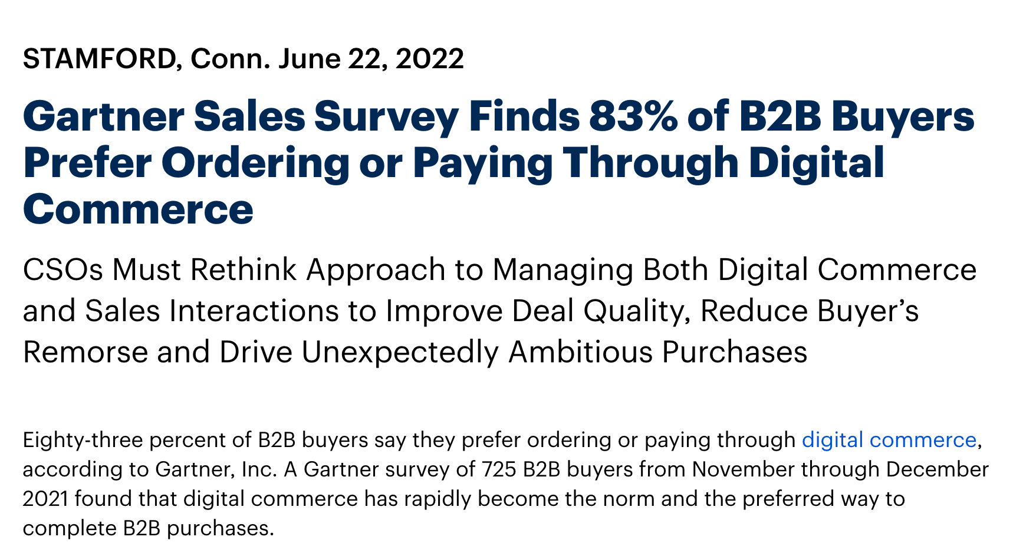
https://www.gartner.com/en/newsroom/press-releases/2022-06-22-gartner-sales-survey-finbds-b2b-buyers-prefer-ordering-paying-through--digital-commerce

Slide 7
COMPLIMENTARY WEBSITE AUDIT

Slide 8
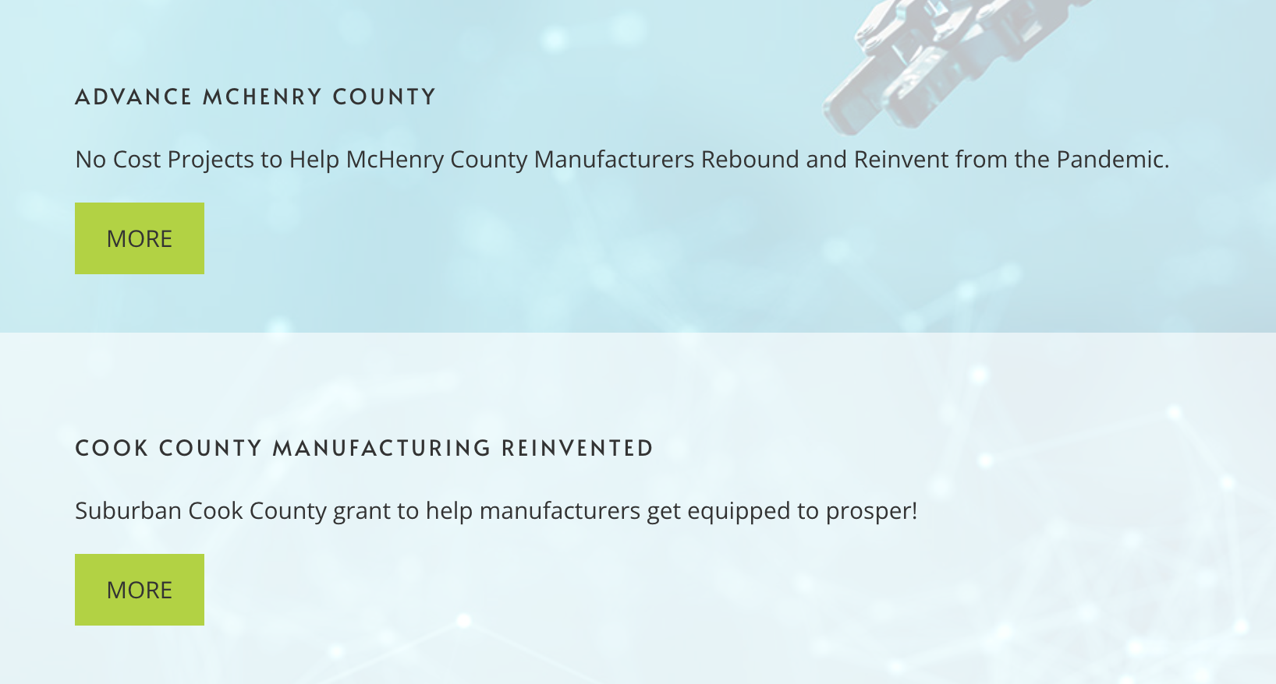
Exciting Grant Program

Slide 9
READY TO START SPREADING YOUR SEO AWESOMENESS?

Slide 12
Key to SEO Success
K.Y.S
H.Y.S

Slide 13
K.Y.S = KNOW YOUR SOULMATE
H.Y.S. = HELP YOUR SOULMATE

Slide 14
K.Y.S = Know Your SOULMATE

Slide 15
MAINTENANCE MURRAY

Slide 17
Engineering Chucky Jr or Sr

Slide 20
WHO IS
YOUR
SOULMATE?

Slide 22
Keyword research is simply understanding what people (Soulmates) are asking
and then...
Depositing yourself into the conversation

Slide 23
RIKs

Slide 24
RIKs
Ridiciously Important Keywords

Slide 25
CORE STRENGTHS
Notes:
What are you absolutely best at - without blurring the message - if you have to explain a joke it’s not funny - or said it to the wrong audience

Slide 26
Niche Down Your Keyword Search Strategy

Slide 27
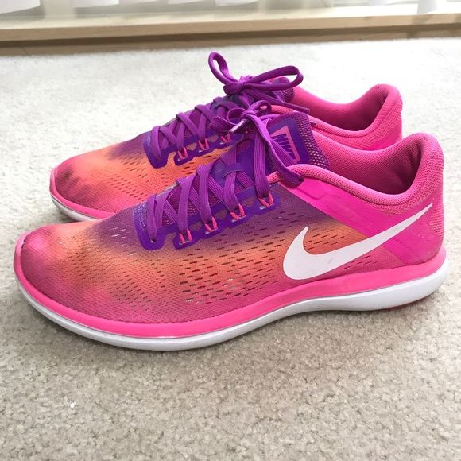
Shoes
Running Shoes
Pink Running Shoes
Pink Nike Running Shoes
Pink Running Shoes with Purple Shoelaces

Slide 28
BRAG PARTY
WHAT ARE YOU ABSOLUTELY BEST AT?
aka Your Top Keywords…

Slide 29
Is Your Soulmate’s Problem the SAME keyword or phrase that you are targeting?

Slide 30
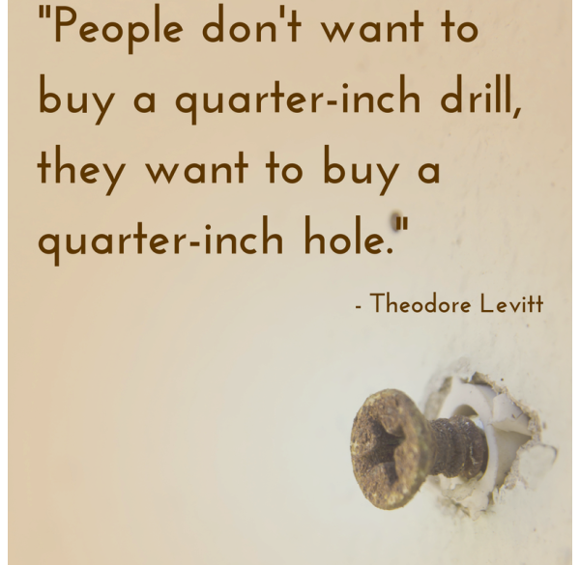

Slide 31
What is Cardboard Called?

Slide 32
ZARF
COFFEE SLEEVE
JAVA JACKET
“CARDBOARD THINGY on COFFEE CUP”

Slide 33
How to NOT Burn My Fingers While
Drinking Coffee

Slide 34
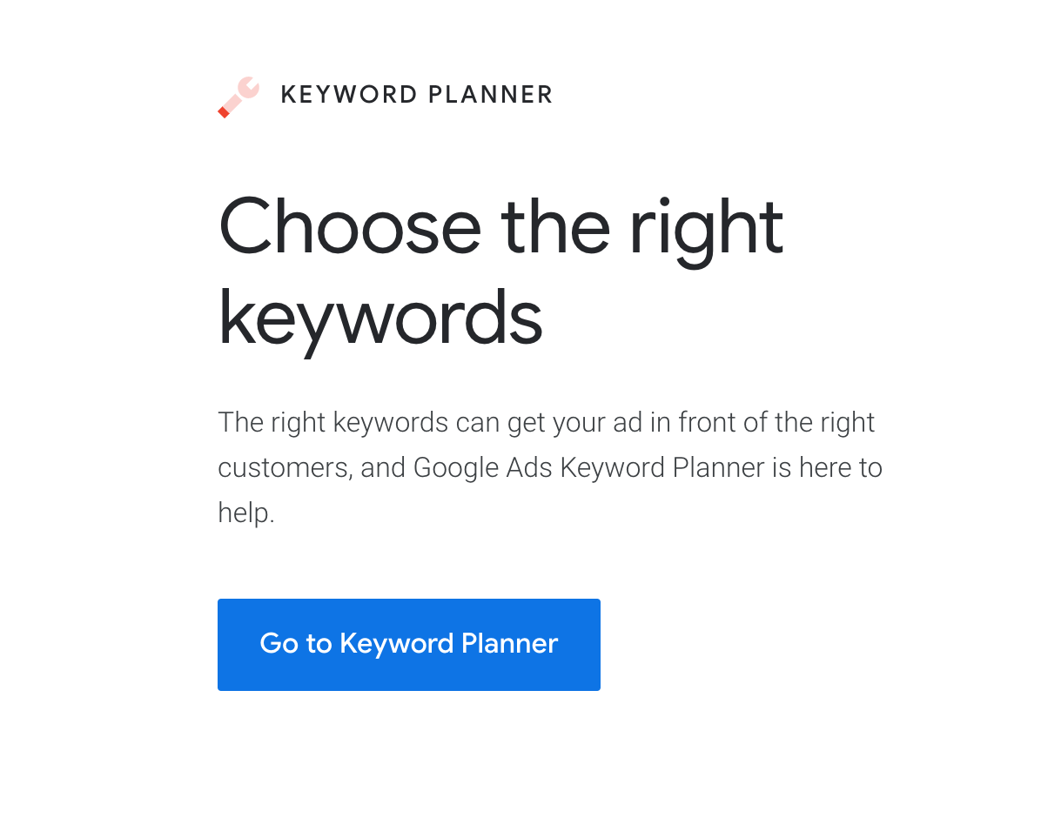
Google Keyword Planner

Slide 35
FREE
(our favorite word)

Slide 36
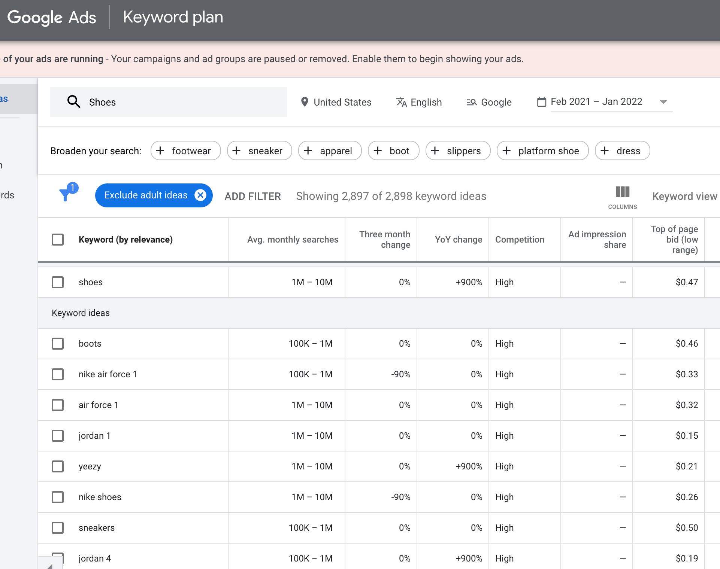

Slide 38
SWEETNESS
“NEVER DIE EASY”

Slide 39
H.Y.S = Help Your Soulmate

Slide 41
Do You Care?
Can You Help Me?
Can I Trust You?

Slide 42
Closed Mouths Don’t Get Fed

Slide 43
Teach - Educate - Inform - Be the Expert

Slide 44
#BLOGGING

Slide 45
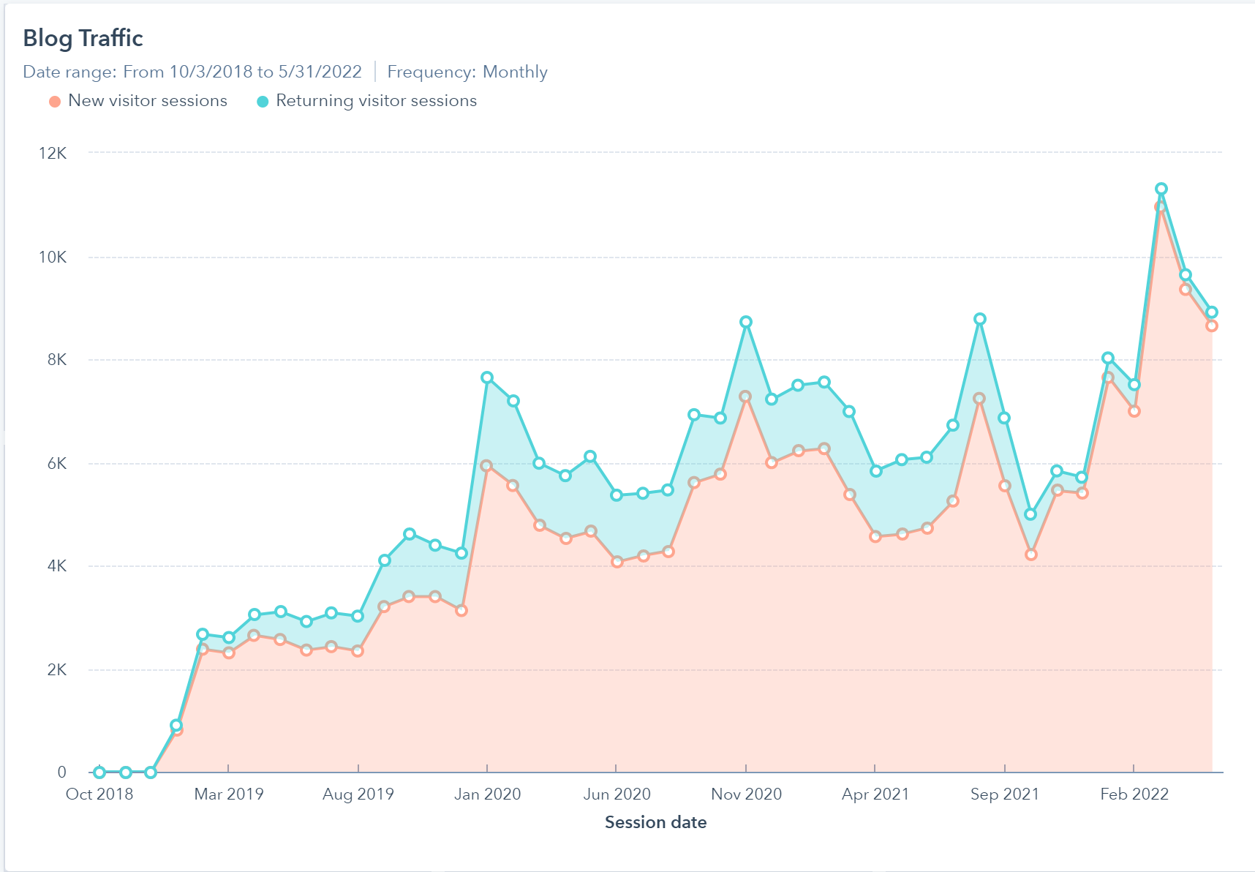
Blogging
8,911 visitors
Search Traffic
Started Blogging 2X/Month
2,666 visitors

Slide 46
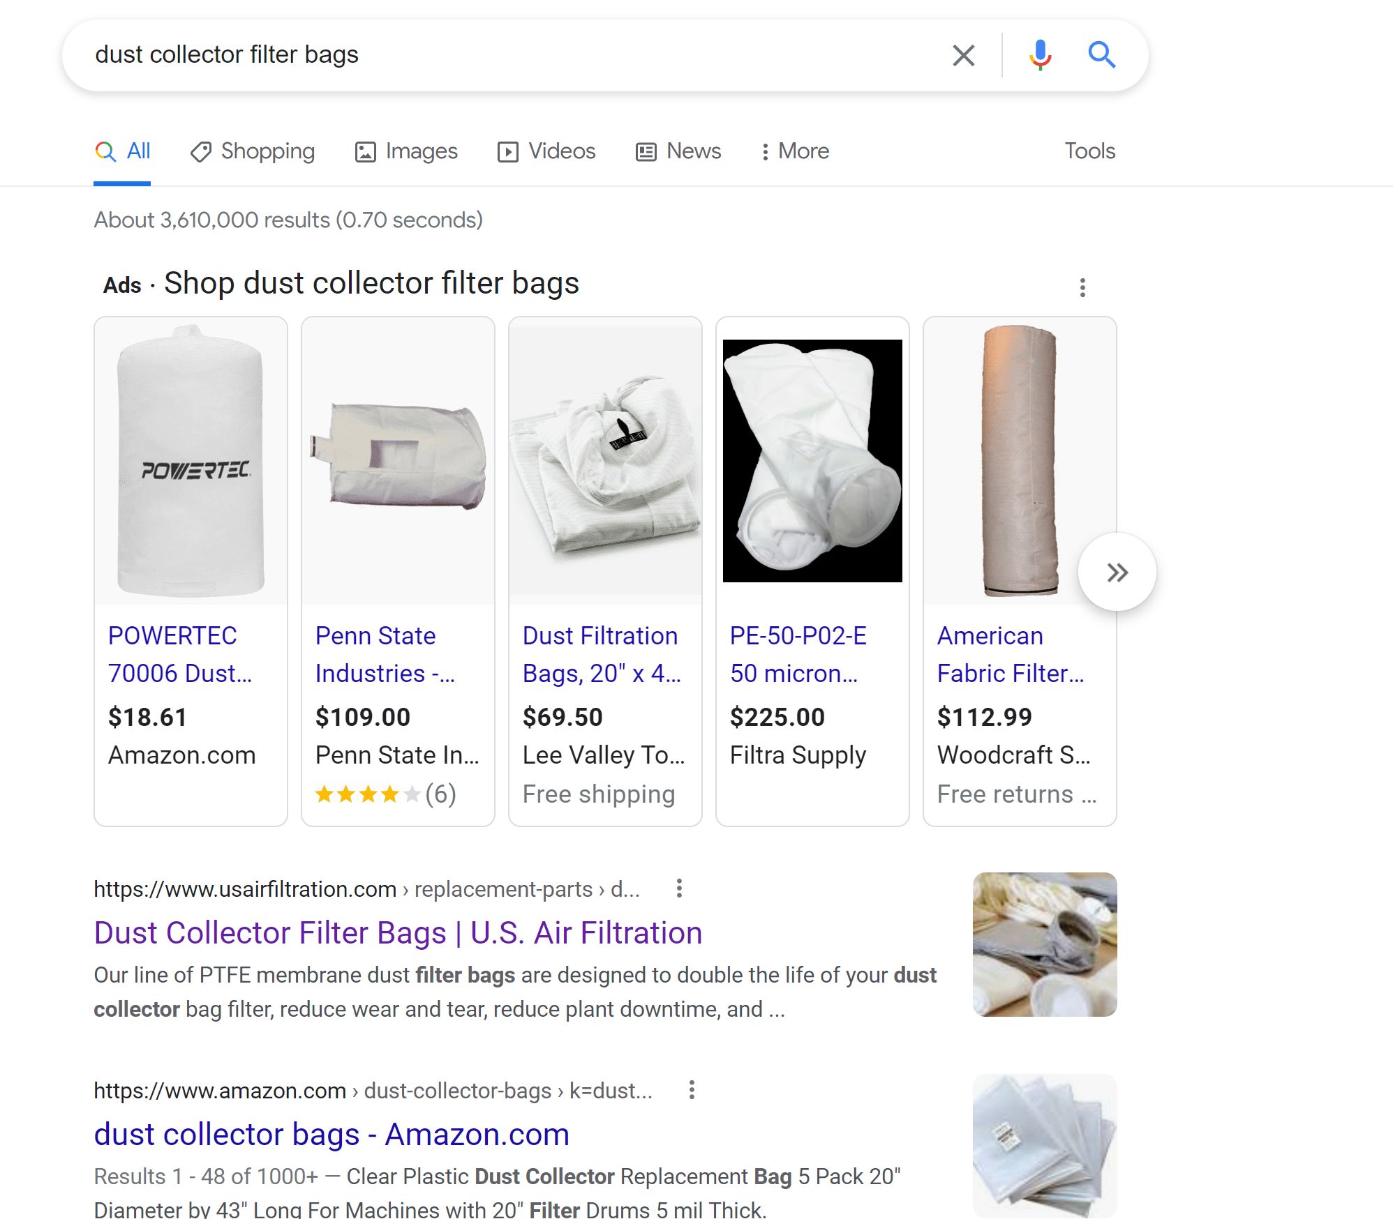
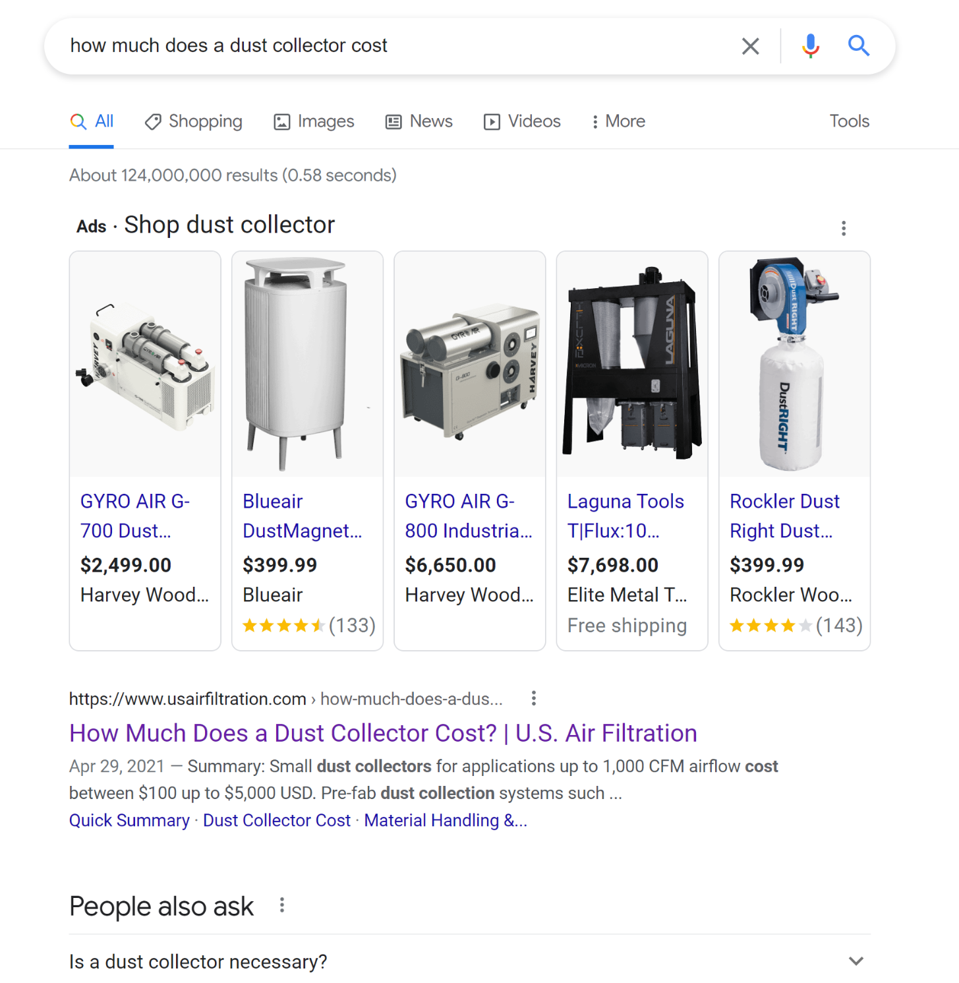
#1!!!
#1!!!

Slide 47
ENGINEERING ELSA

Slide 49
Create a List of Topics They Care About
Questions They Ask
How To’s / Guides
Checklist
Comparison

Slide 50
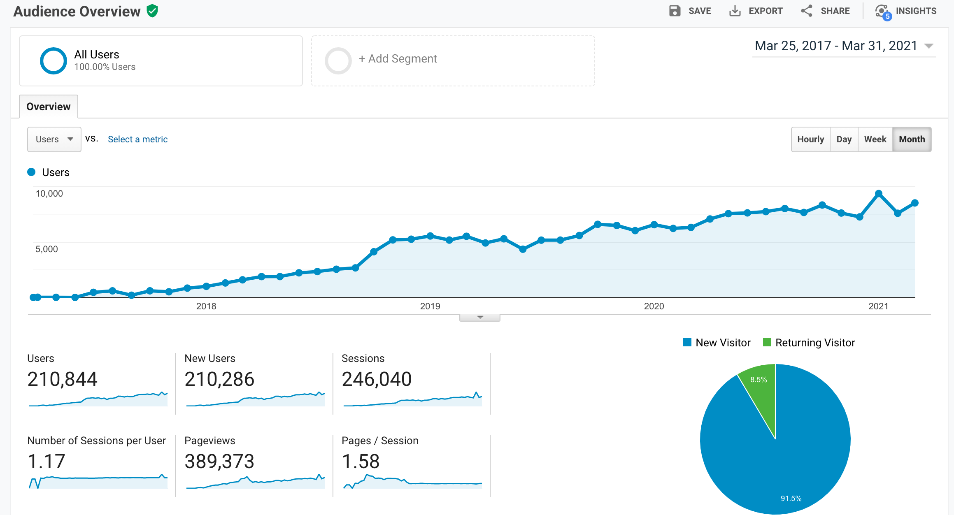
2300% TRAFFIC INCREASE

Slide 51
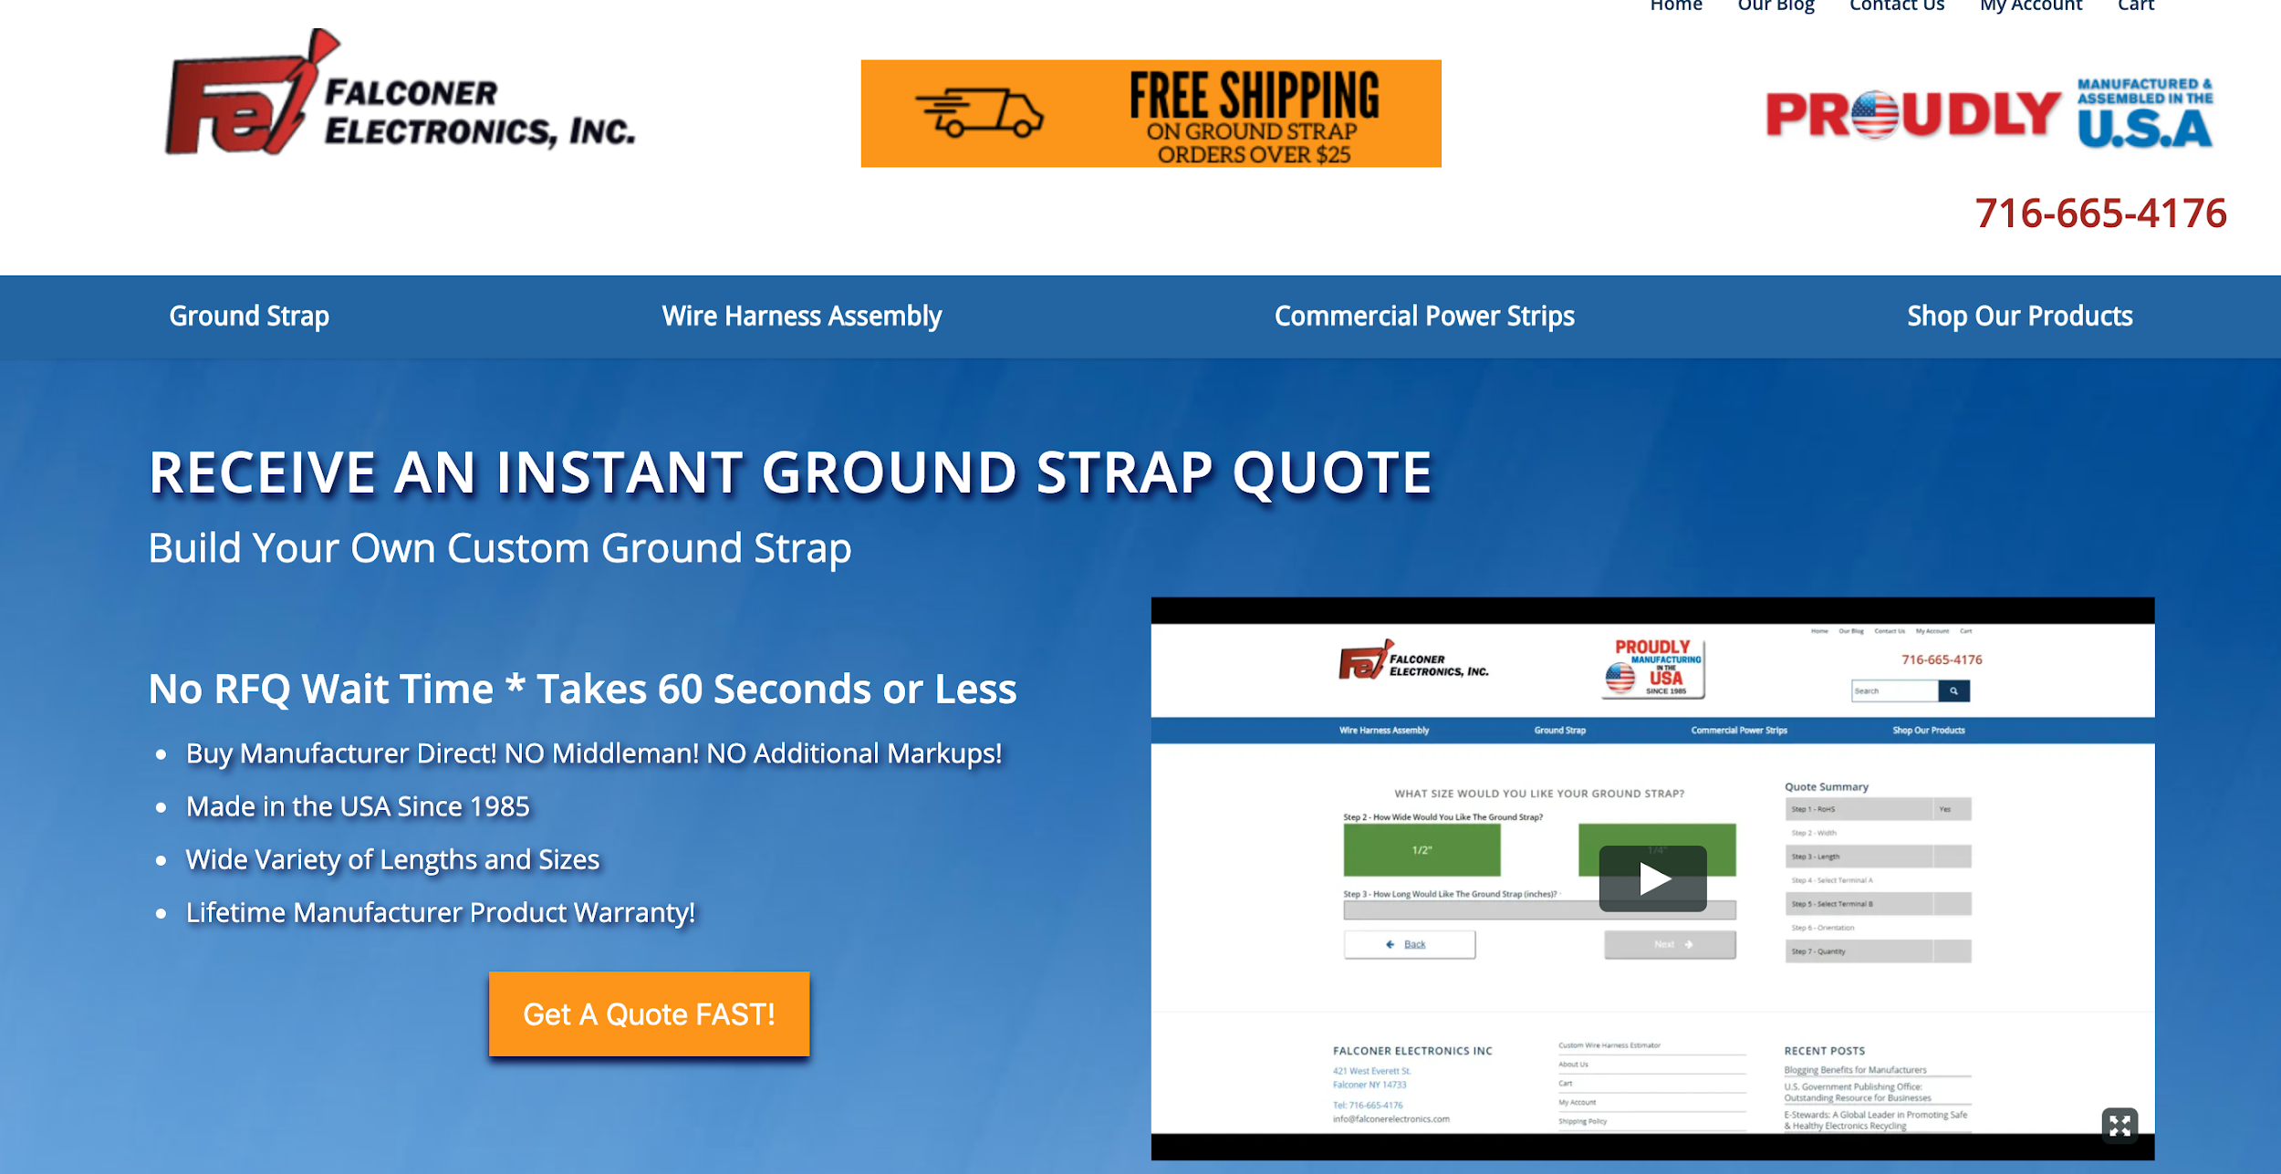

Slide 54
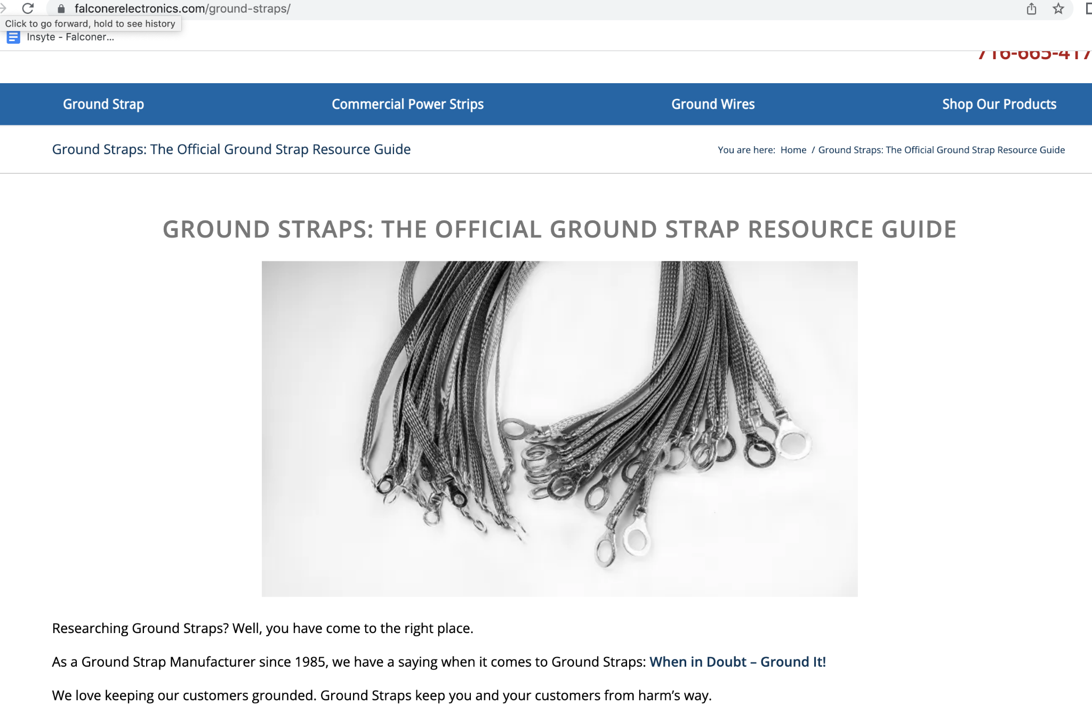

Slide 55
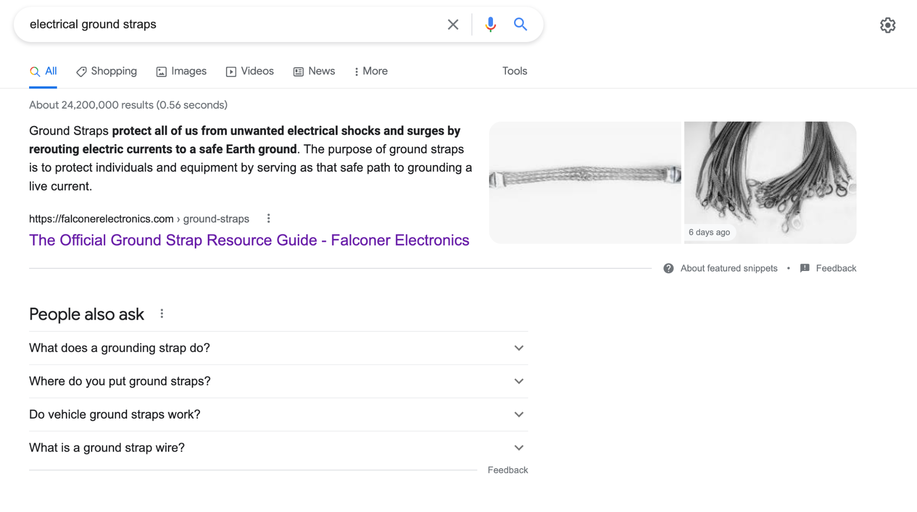

Slide 56
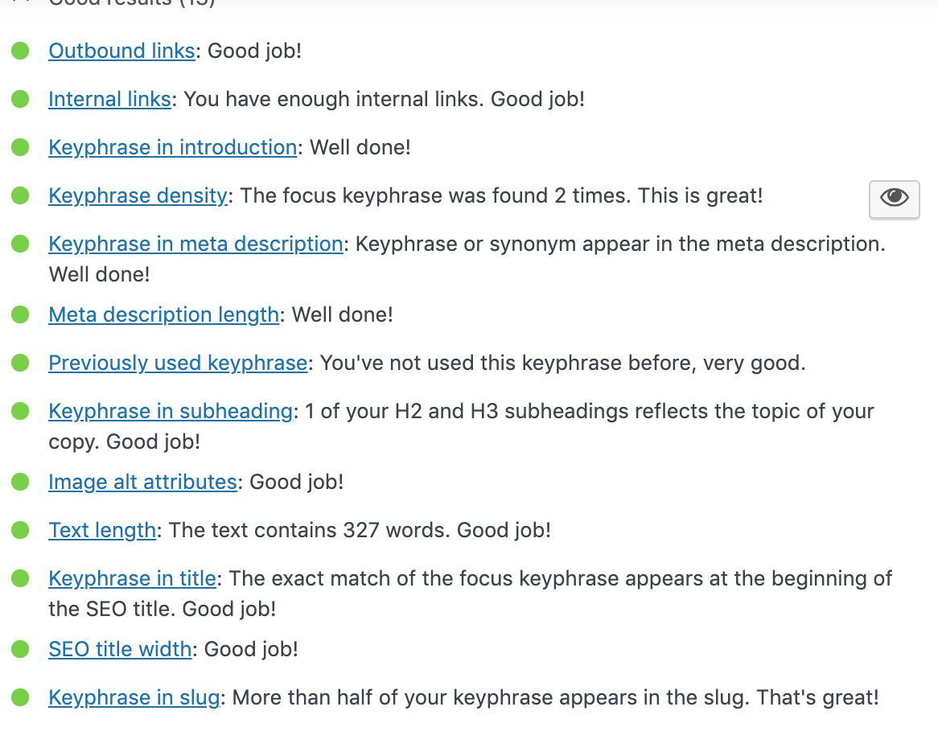
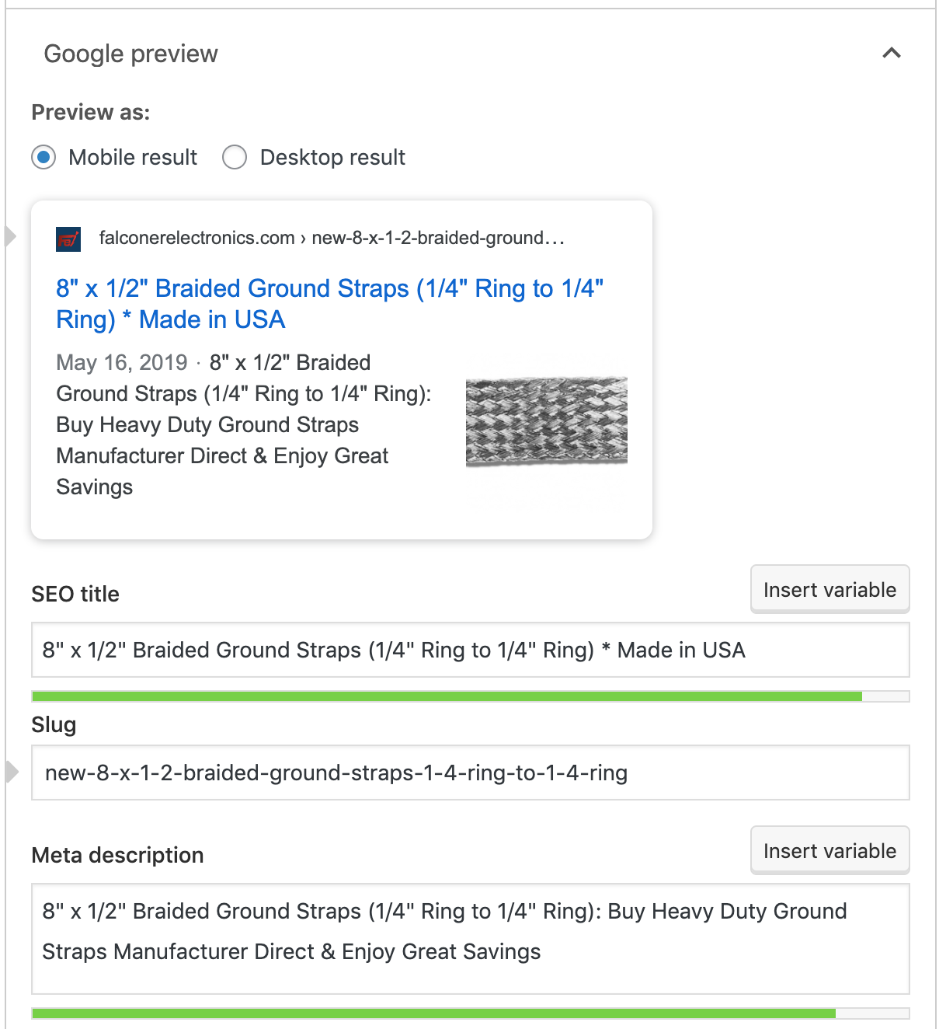
SEO YOAST

Slide 57
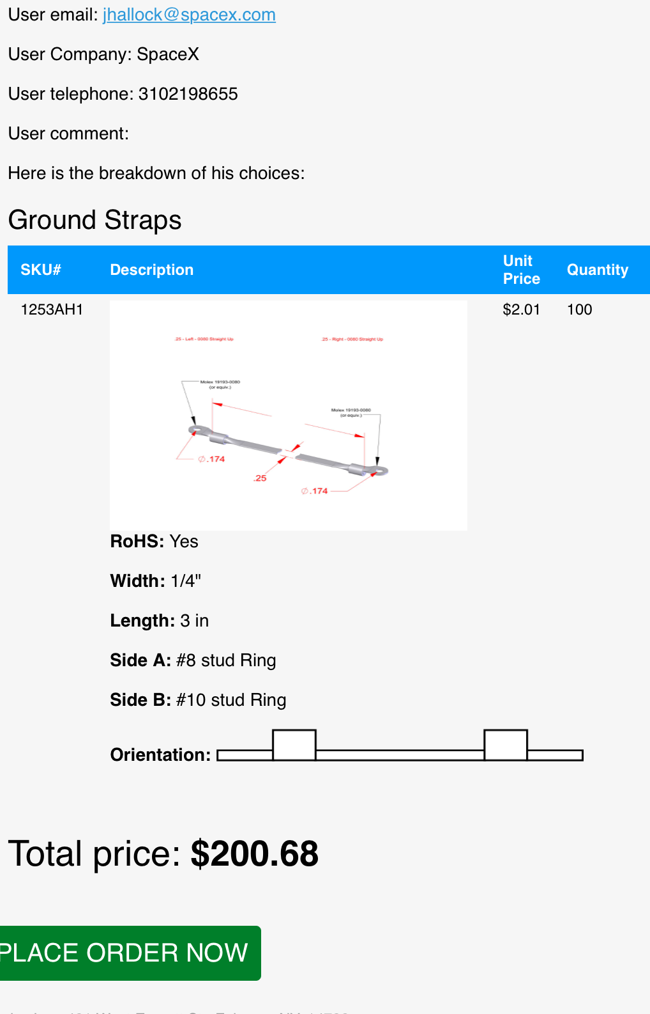
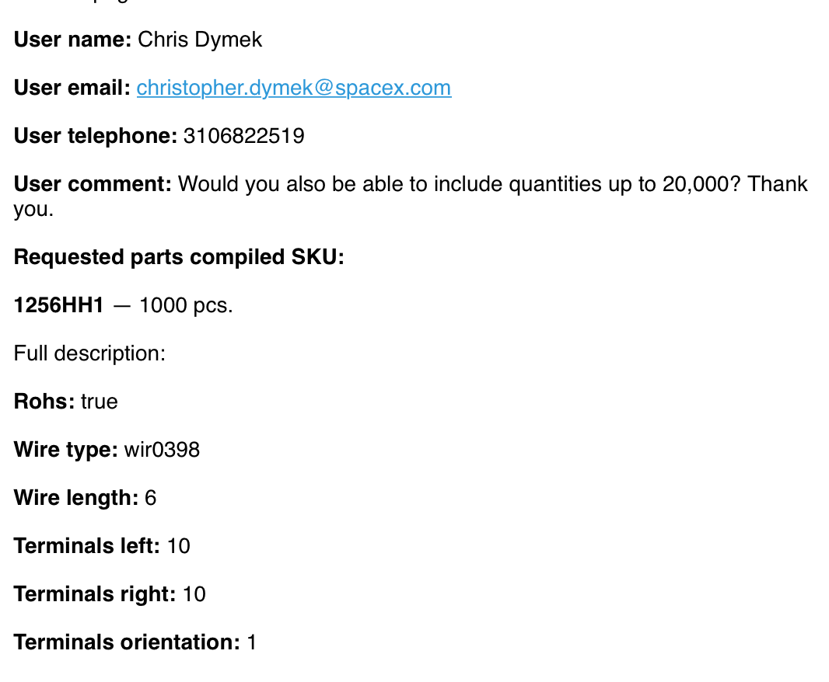

Slide 59
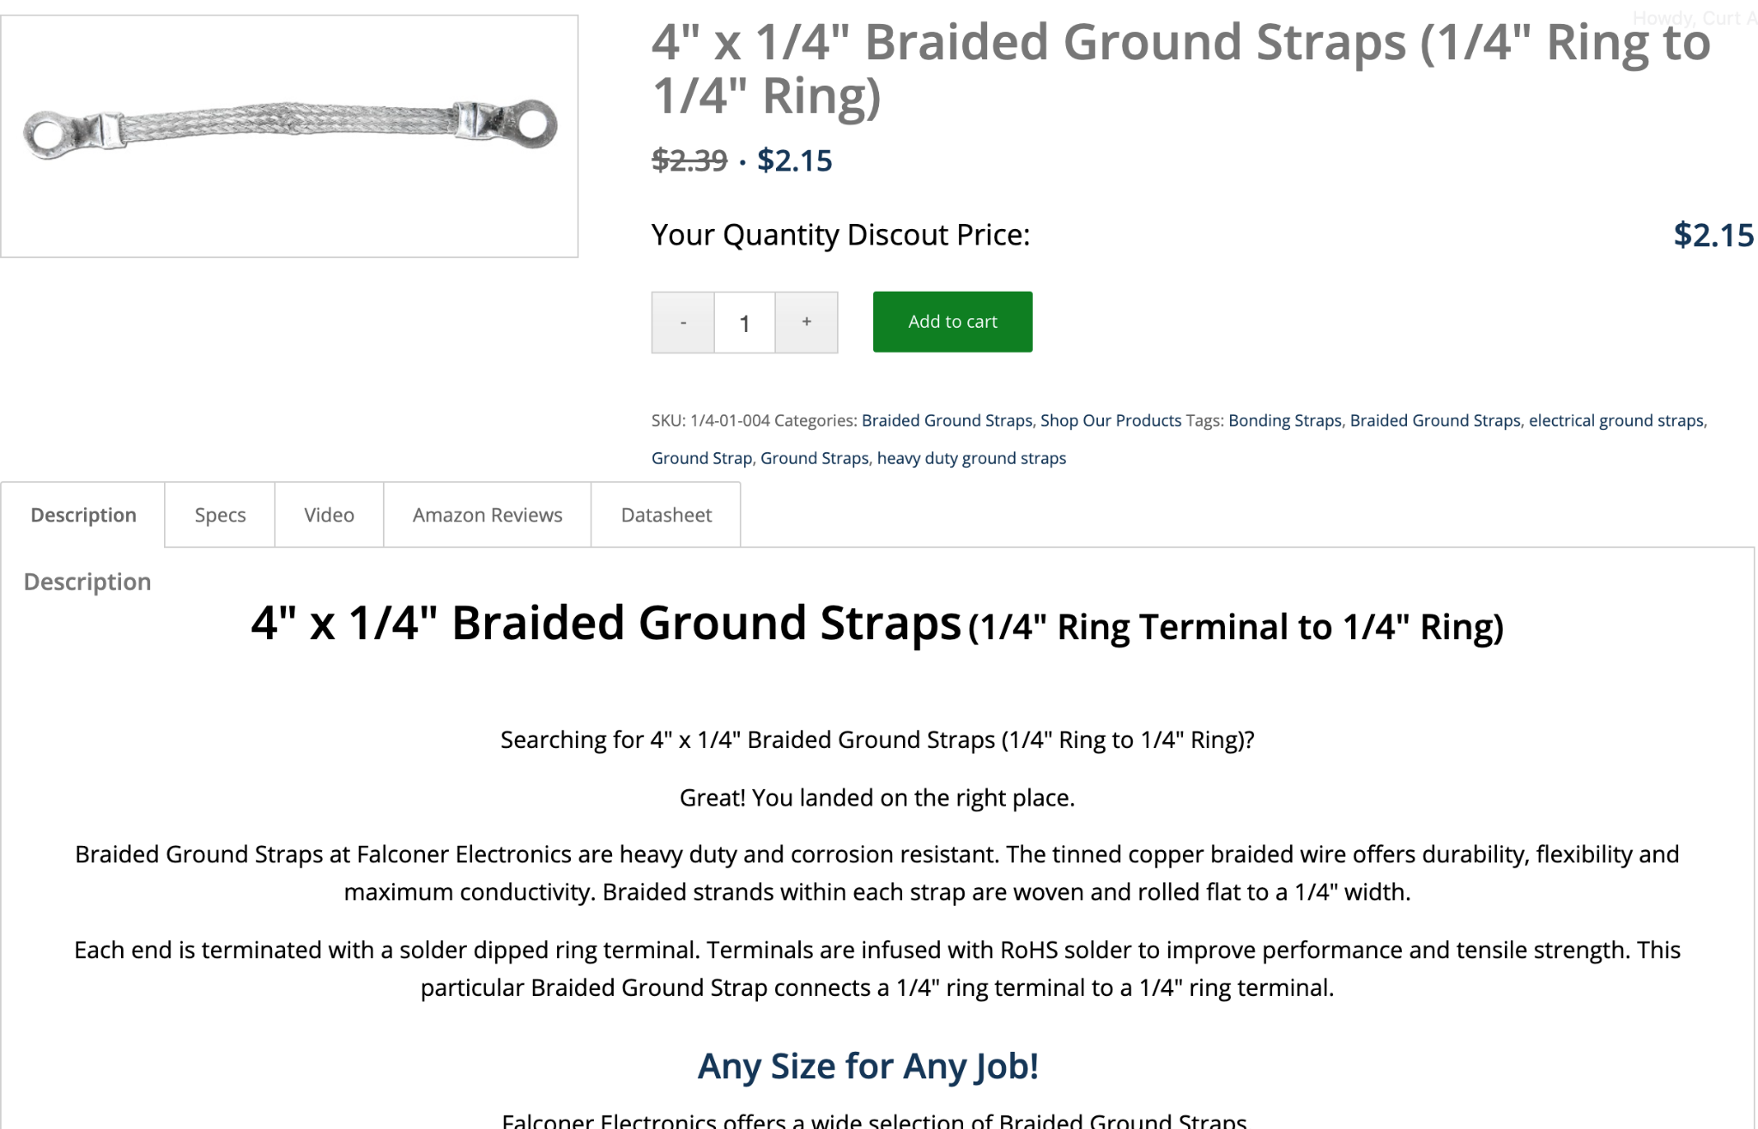

Slide 60
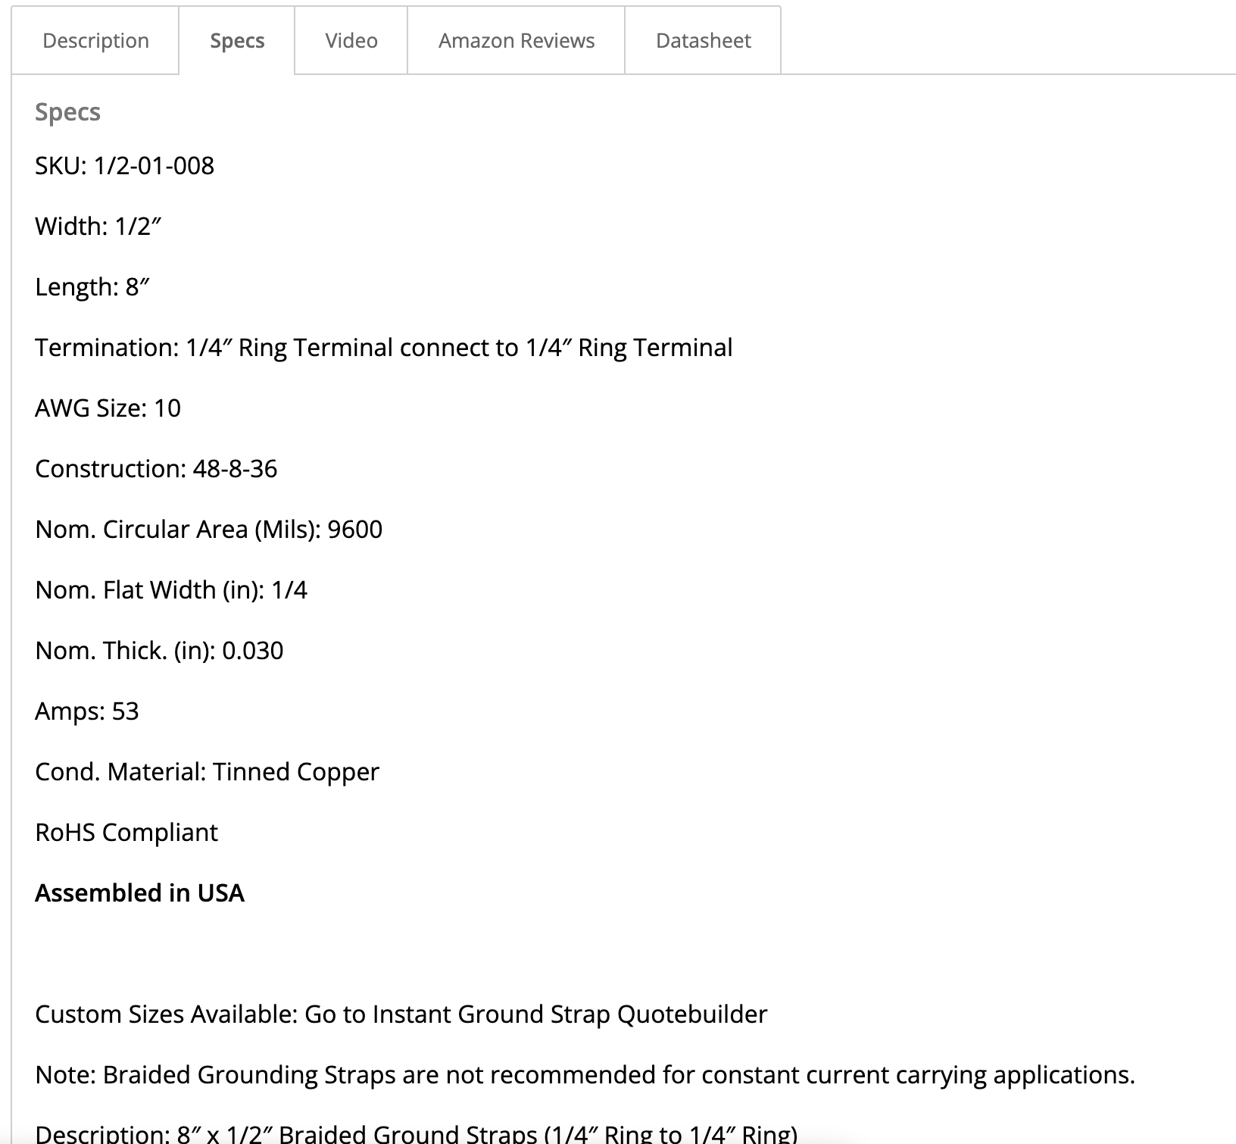

Slide 62
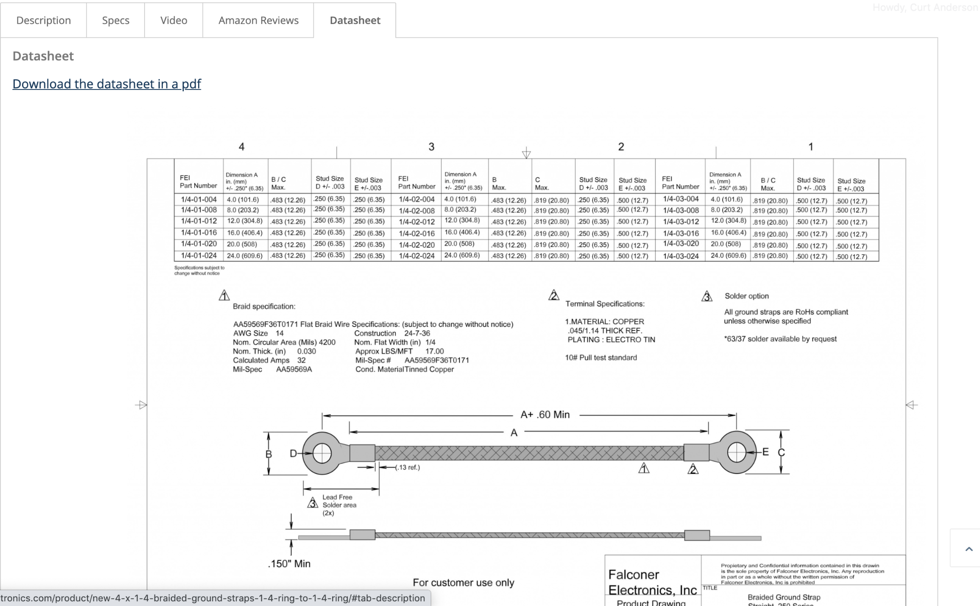

Slide 63
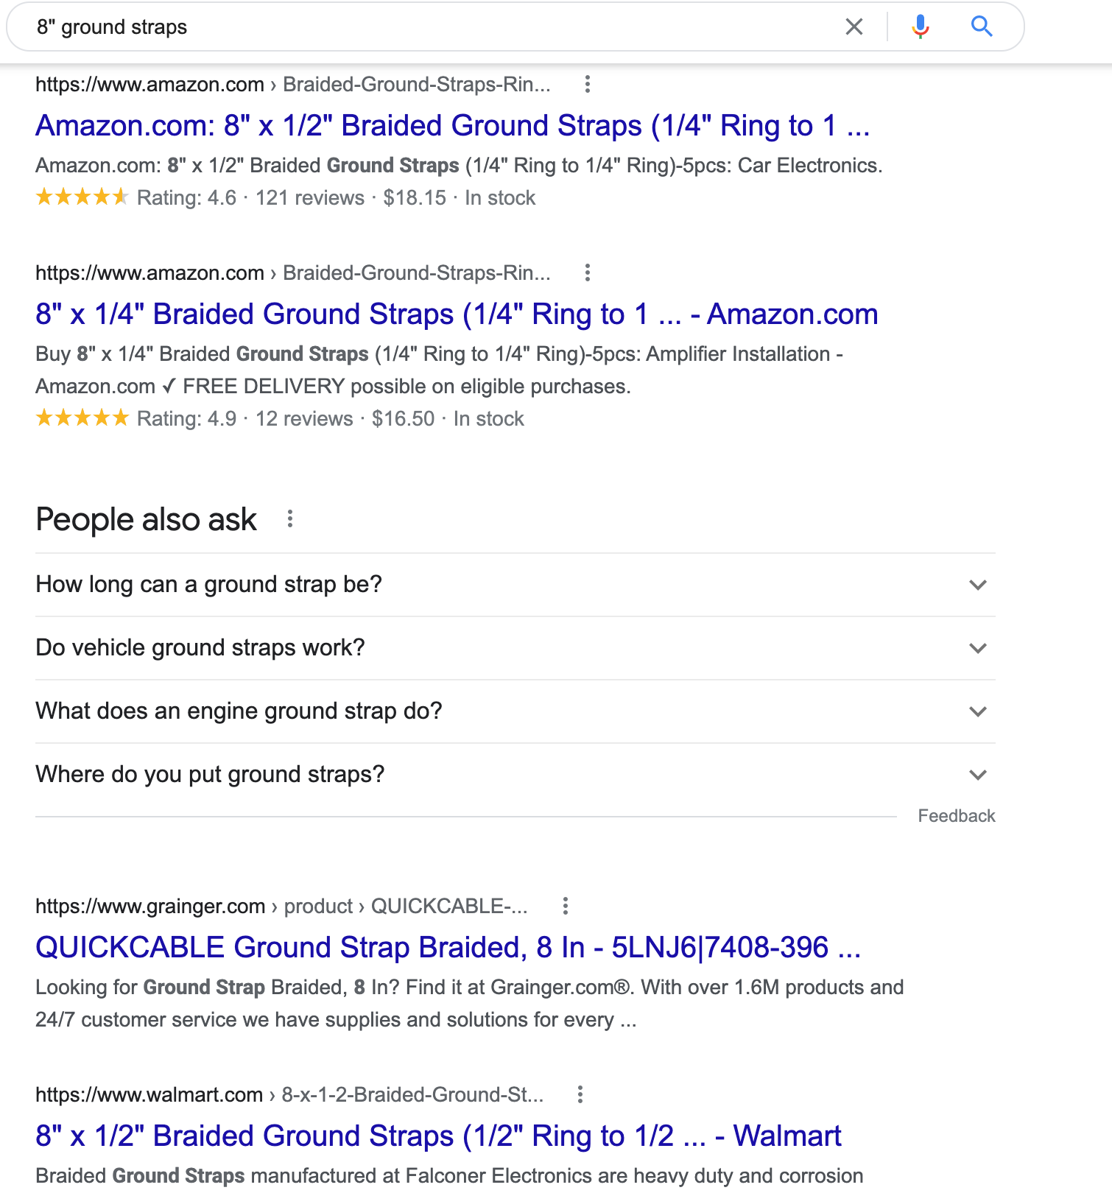
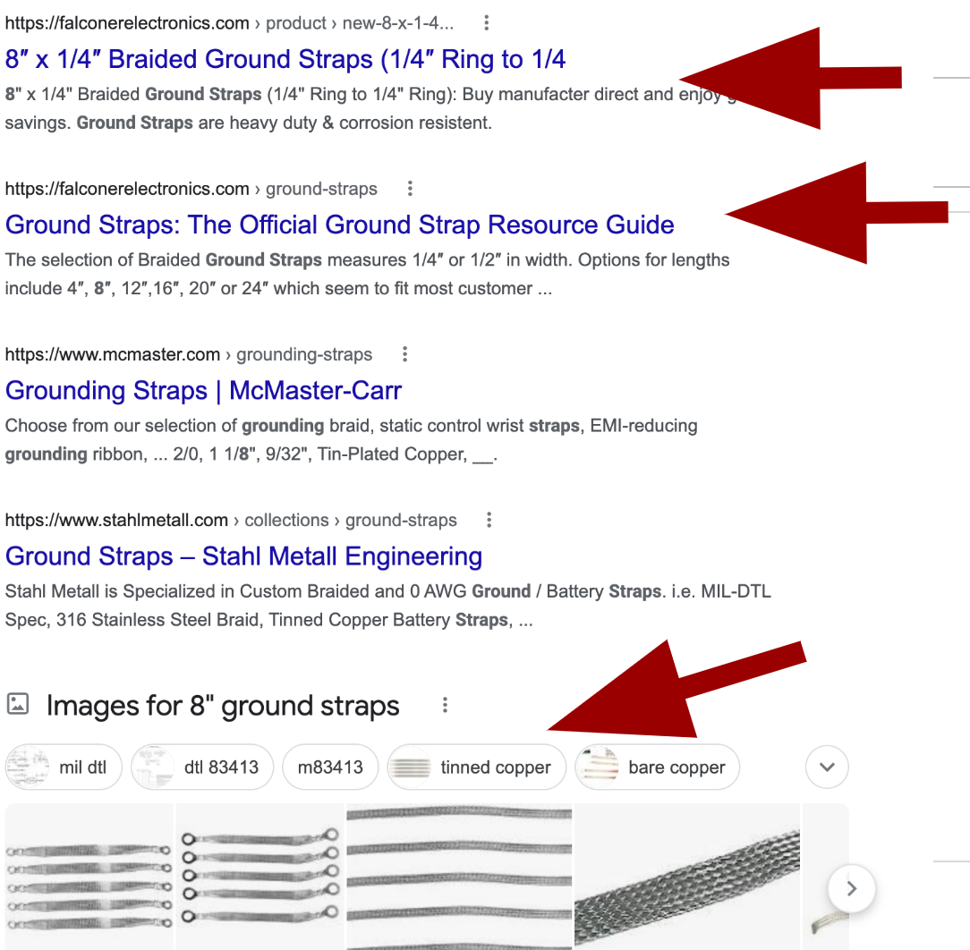
Search 8” Ground Straps

Slide 64
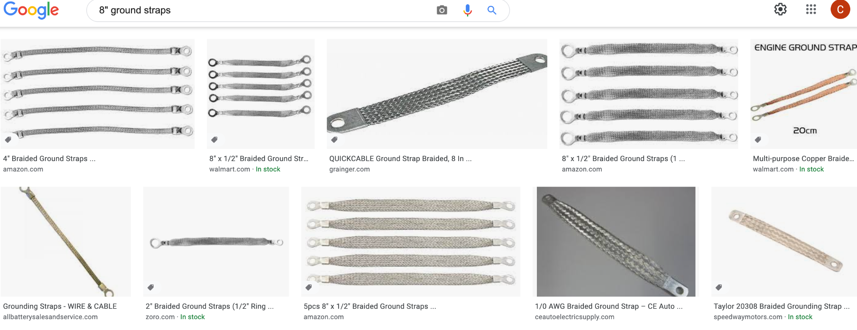

Slide 65
Dedicate Ourselves
to
Relentlessly Solving Problems
for
Our Soulmates

Slide 66
CONTENT IDEAS
What Questions to ask when purchasing Your Product
Benefits of Your Product/Service over the Bad Guys (competition)
What is Your Product / Service (Ex: Forging, dust collection, etc)
How Does Your Product Work?
Pricing of your product or service?

Slide 67
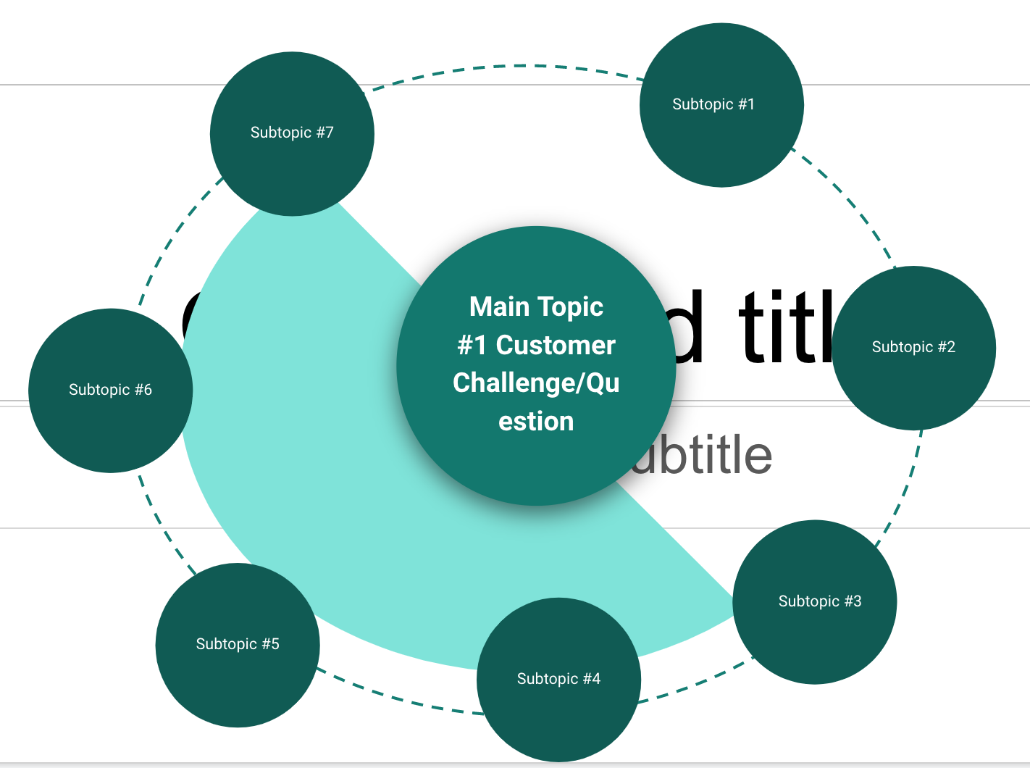

Slide 68
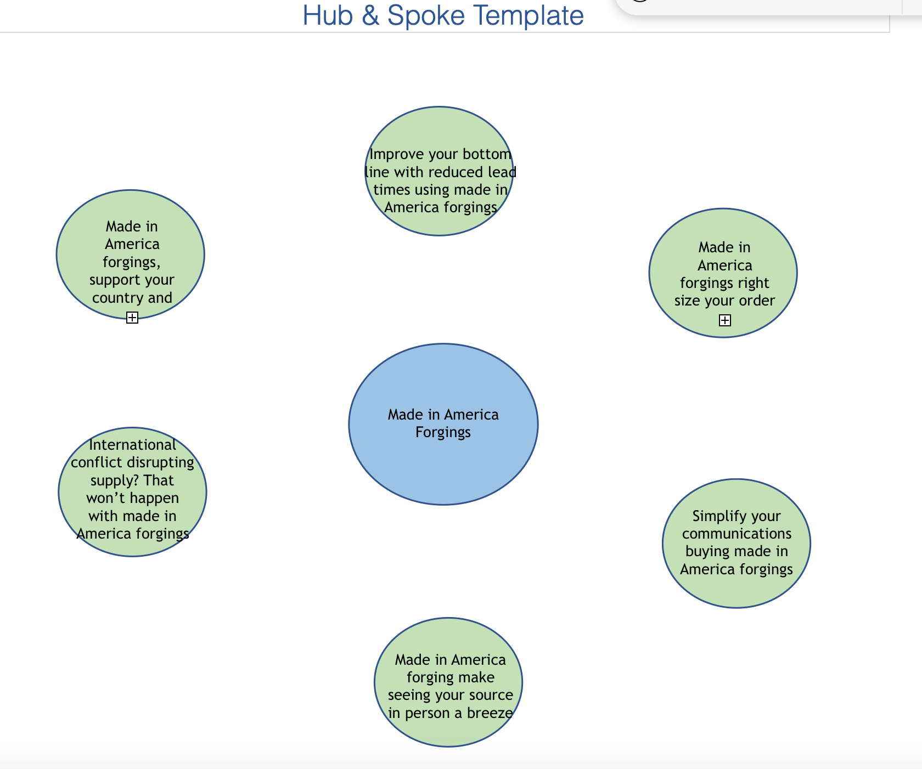

Slide 69
Title: Industrial Dust Collection Design
What Regulations Are Applicable to Dust Collectors?
How Does the Project Scope Affect the Ideal Type of Dust Collector?
What Are the Key Components of an Industrial Pulse Jet Dust Collector?
Comparison - Baghouse vs. Bin Vent vs. Cartridge Dust Collectors
The Industrial Dust Collector Design Process
How Much Does a Dust Collection System Cost?
Dust Collector Maintenance Considerations
Industrial Dust Collector Systems From U.S. Air Filtration
Make each subtopic listed above an H2 Tag

Slide 70
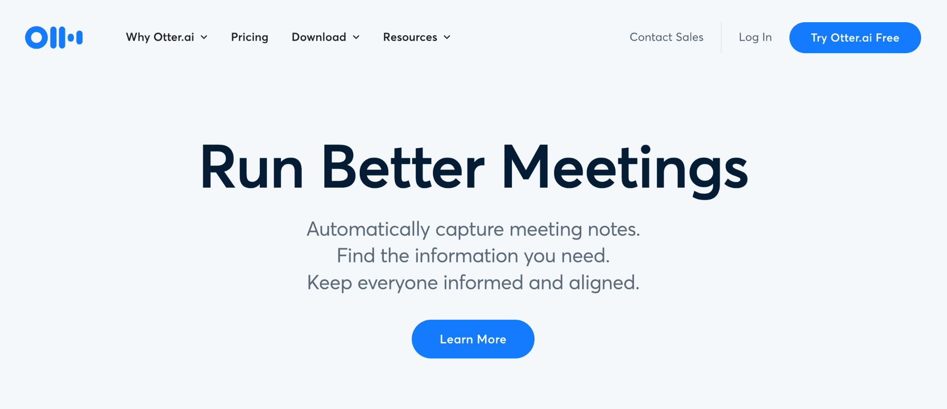
OTTER.AI

Slide 71
KILLER PILLAR

Slide 74
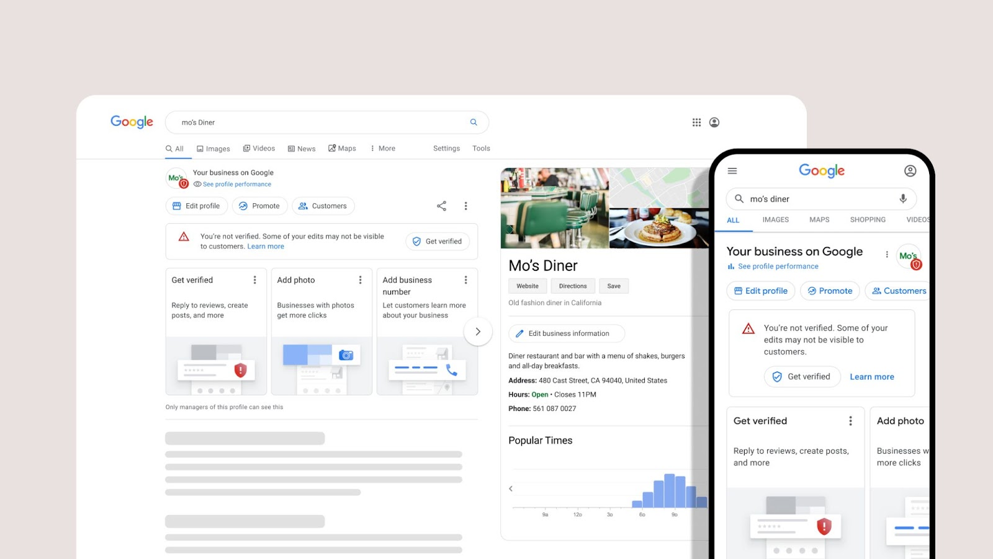
GOOGLE BUSINESS PROFILE

Slide 75
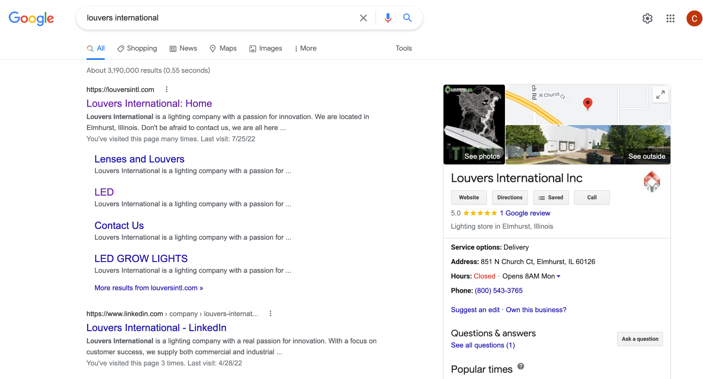

Slide 76
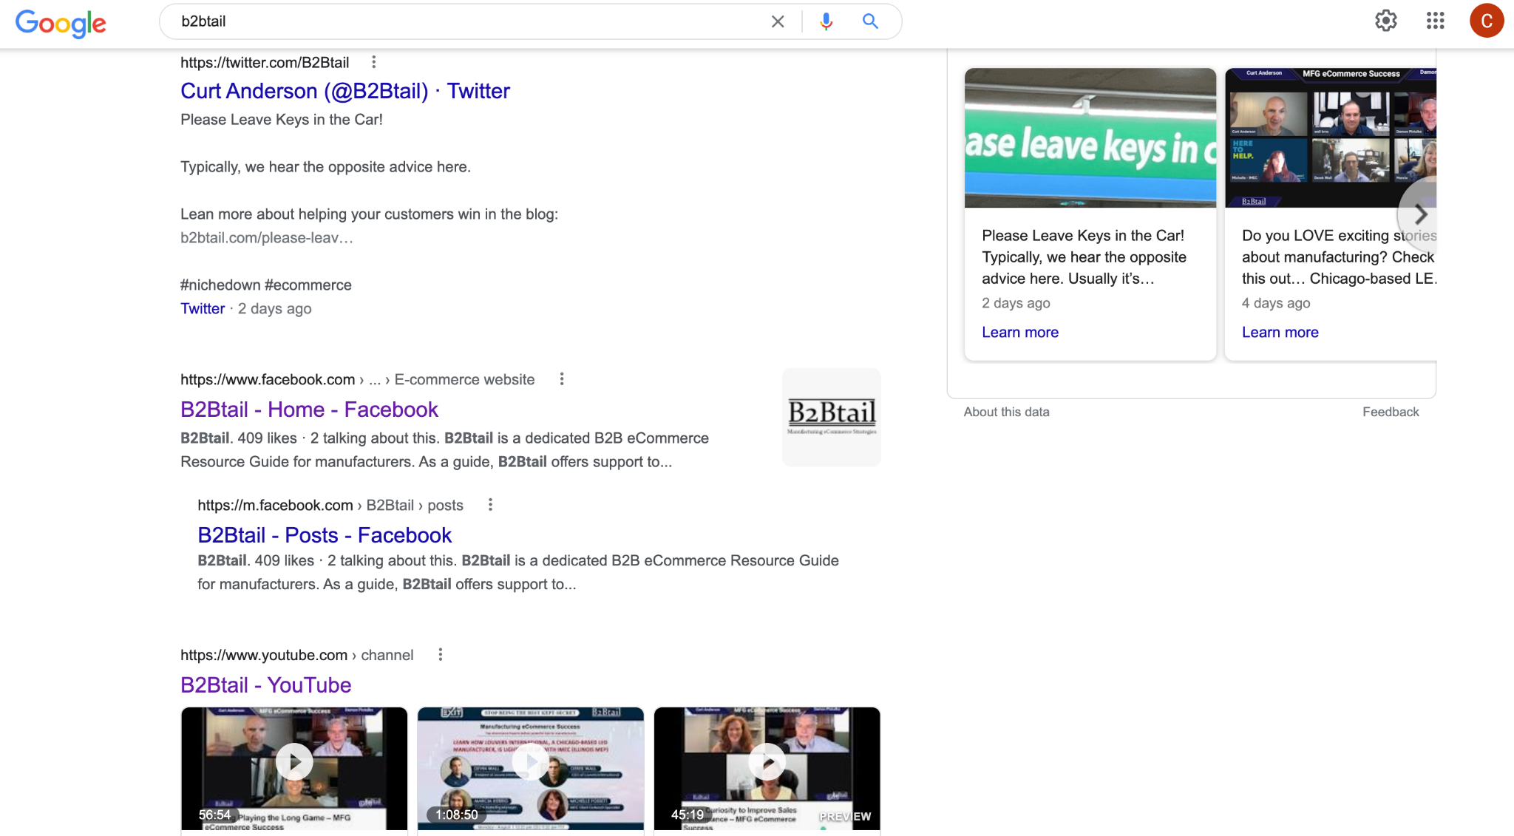

Slide 78
BACKLINKS

Slide 79
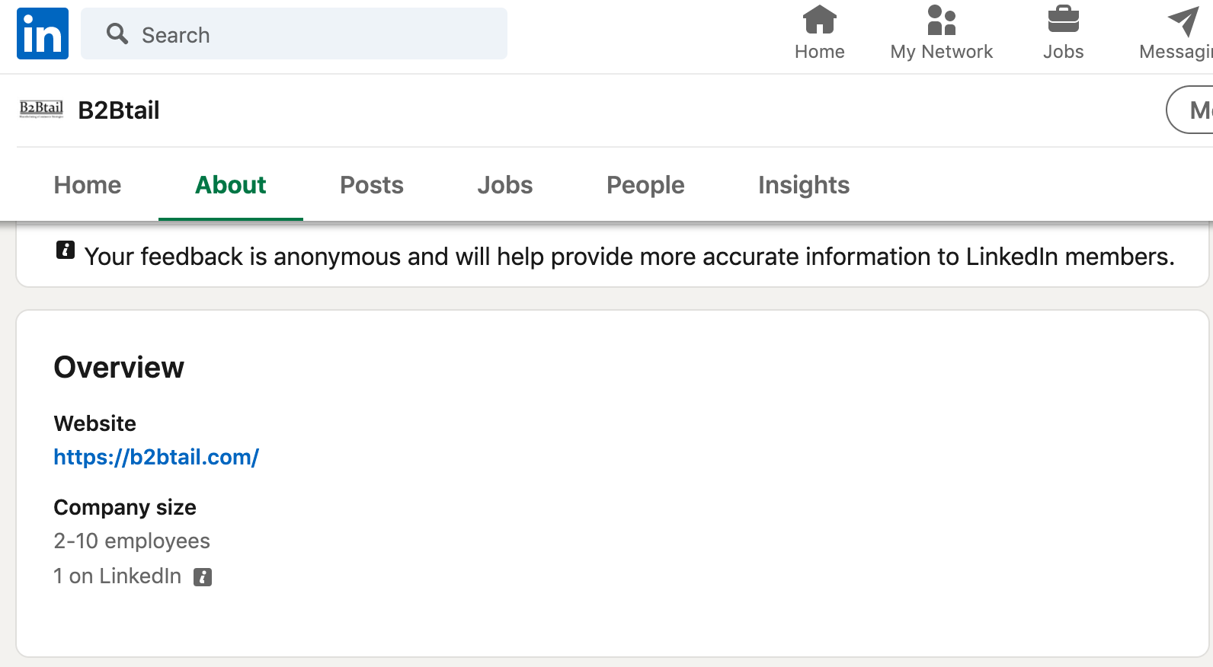
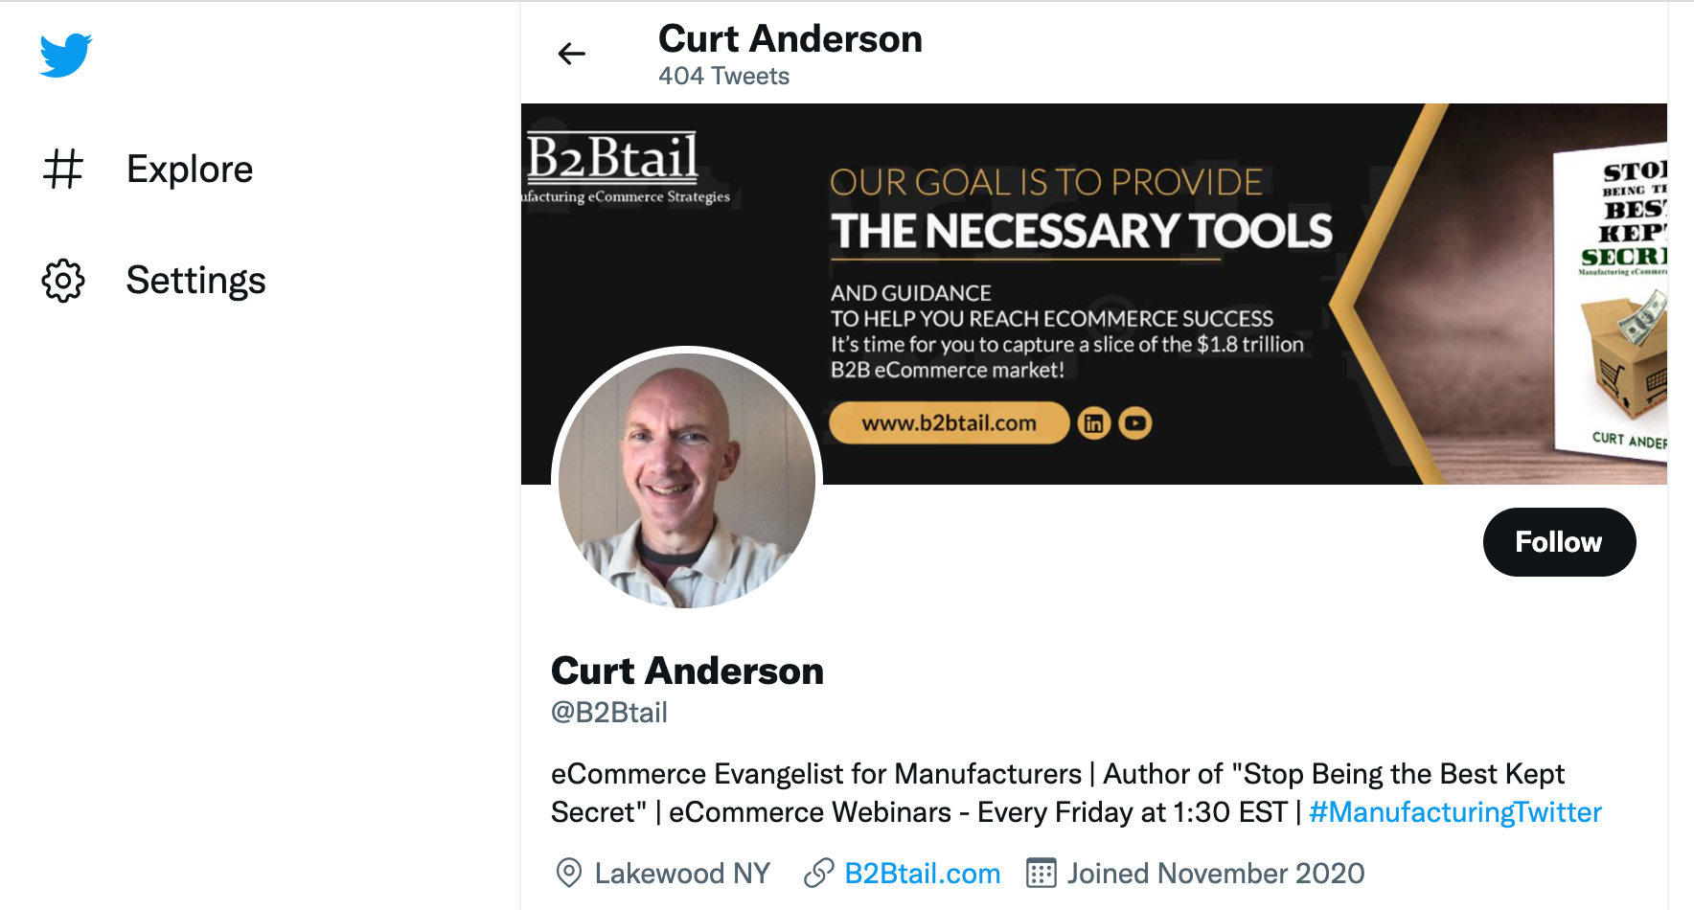

Slide 80
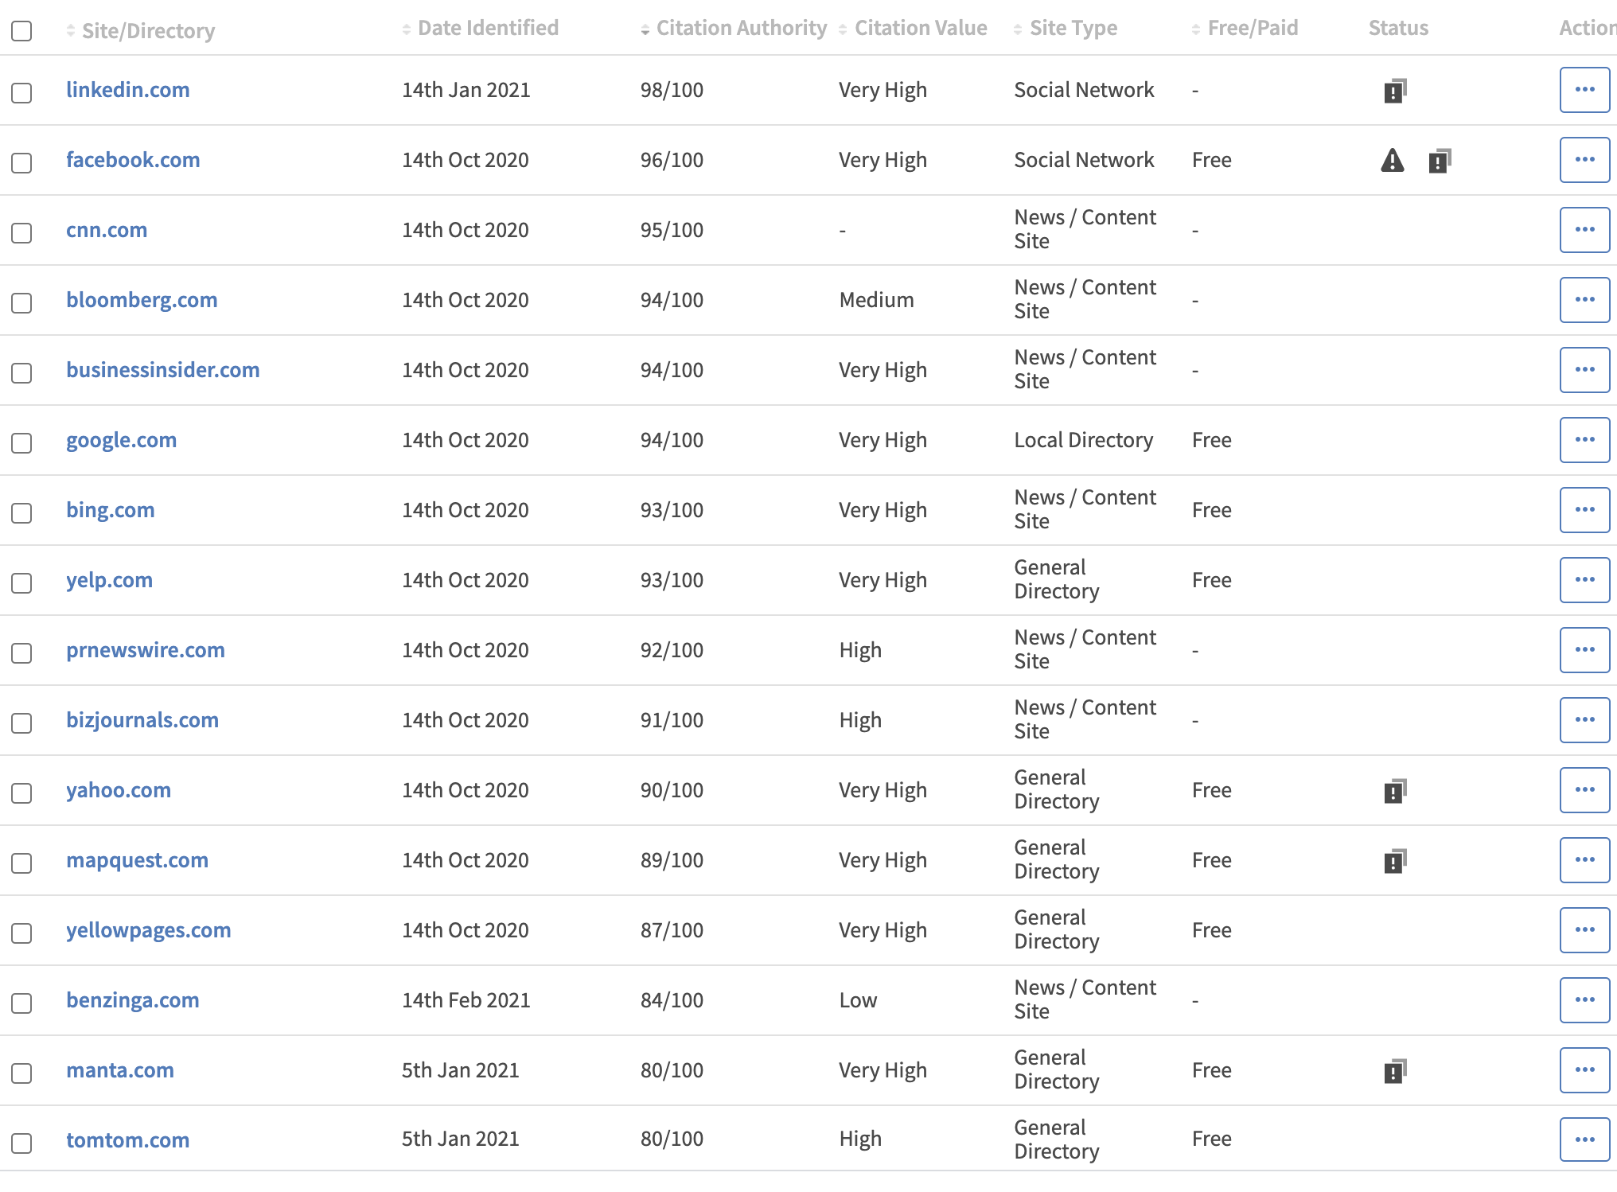

Slide 81
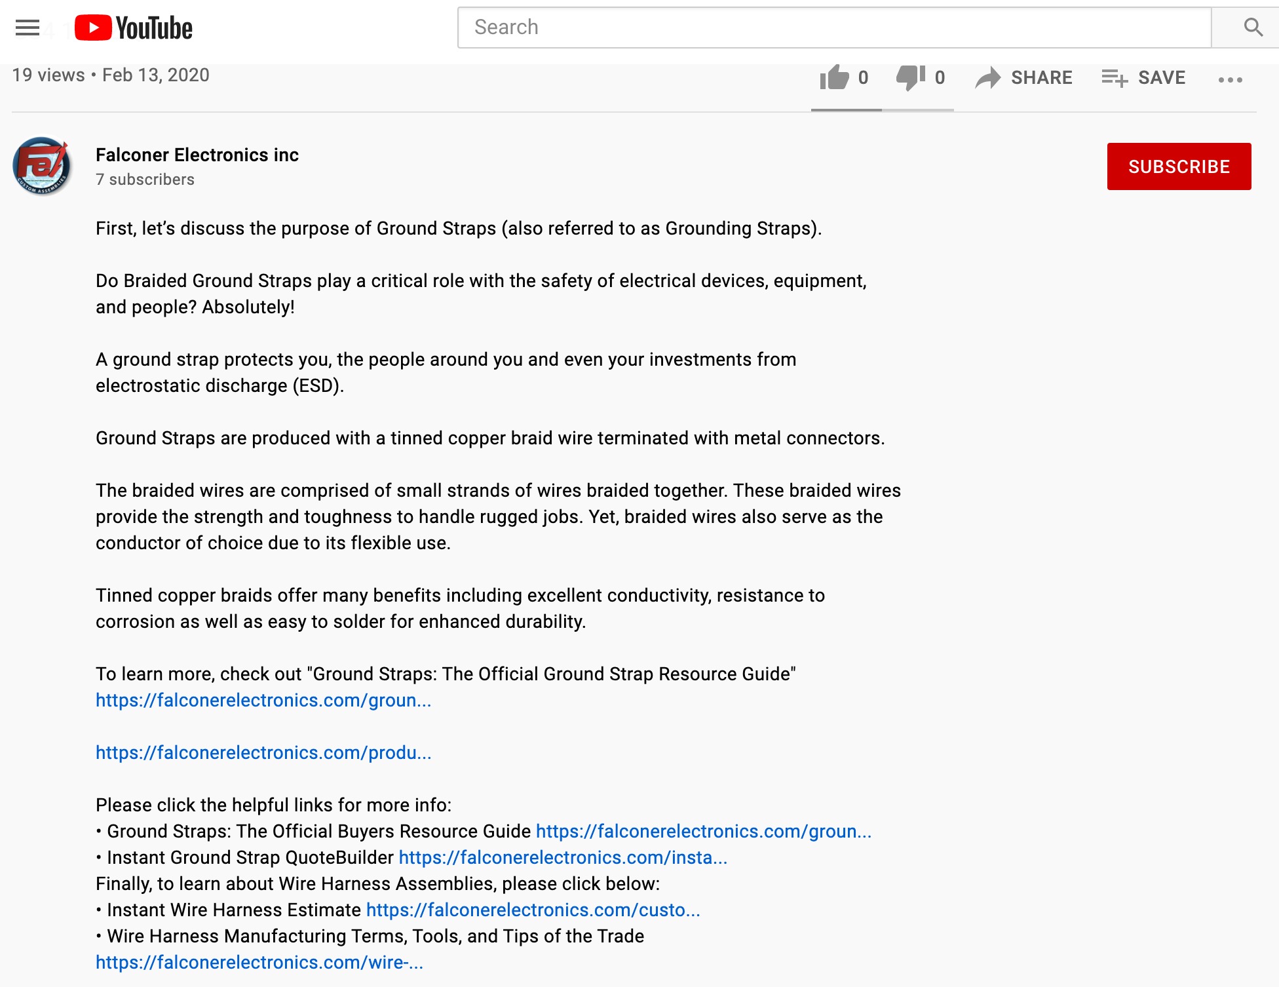

Slide 82
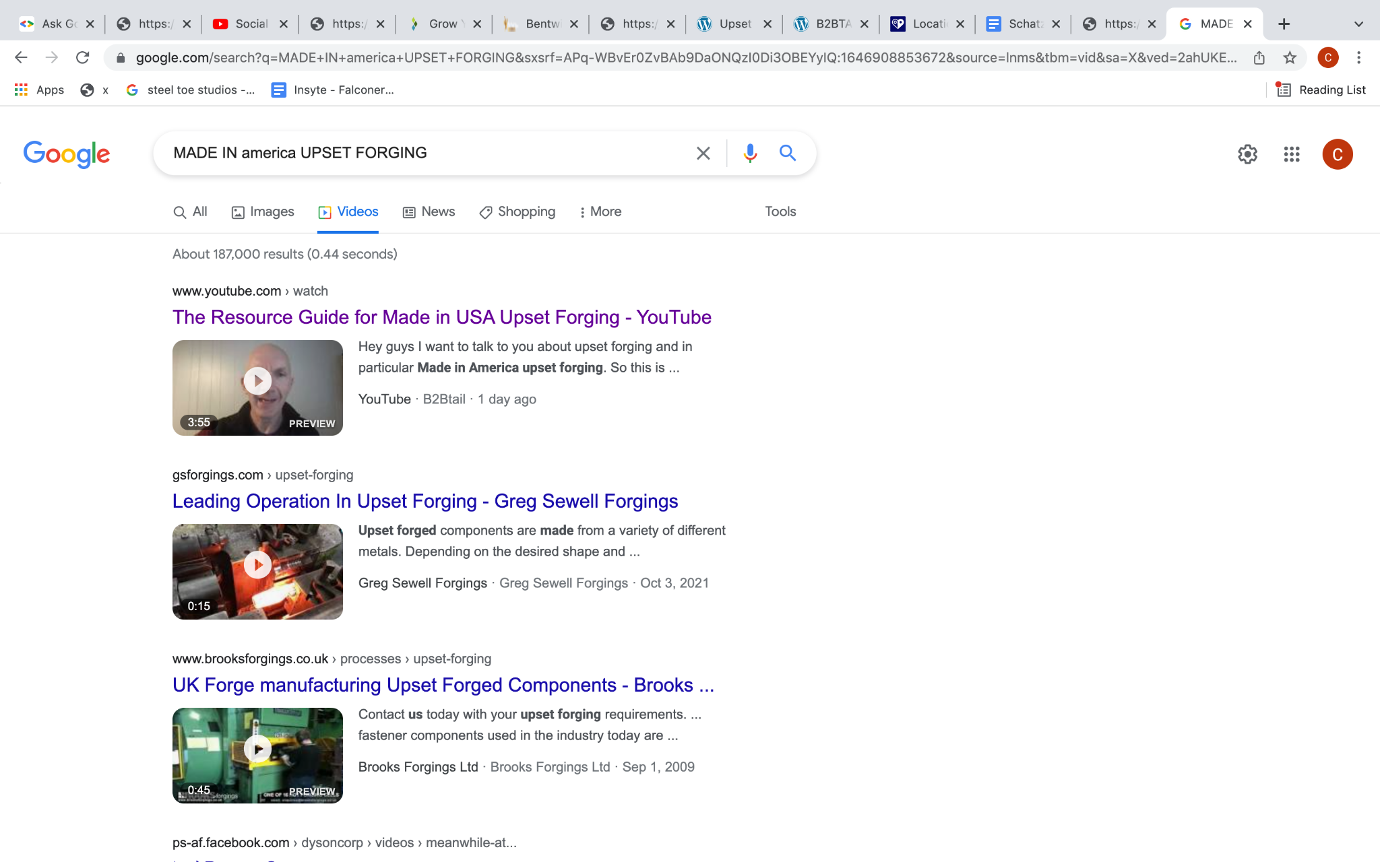

Slide 83
I REFUSE TO ALLOW THE
COMPETITION BEAT ME
at this
DIGITAL MARKETING GAME

Slide 84
K.Y.S = KNOW YOUR SOULMATE
H.Y.S. = HELP YOUR SOULMATE

Slide 85
Curt@B2Btail.com
COMPLIMENTARY WEBSITE AUDIT

Slide 86
https://www.linkedin.com/in/nicole-donnelly-dmg/
nicole@donnellymgroup.com
https://www.linkedin.com/in/curtanderson-b2b/
Curt@B2Btail.com

