Slide 1
MOVE
AHEAD
FASTER.
July 13, 2022

Slide 3
Agenda
Attendance Policies
Why so complicated
Why are people not coming to work
Training / culture to come to work
Going Beyond the Metric
Learning development
Putting new people as leaders (lack training, skills)

Slide 4
Attendance Policies
Attendance (almost suspending)
Flexible attendance (how to create and implement)
How to address attendance
Gain insight from different companies
Provide strategies

Slide 5
Why are people not coming to work
Why are people not coming to work
Training / culture to come to work

Slide 6
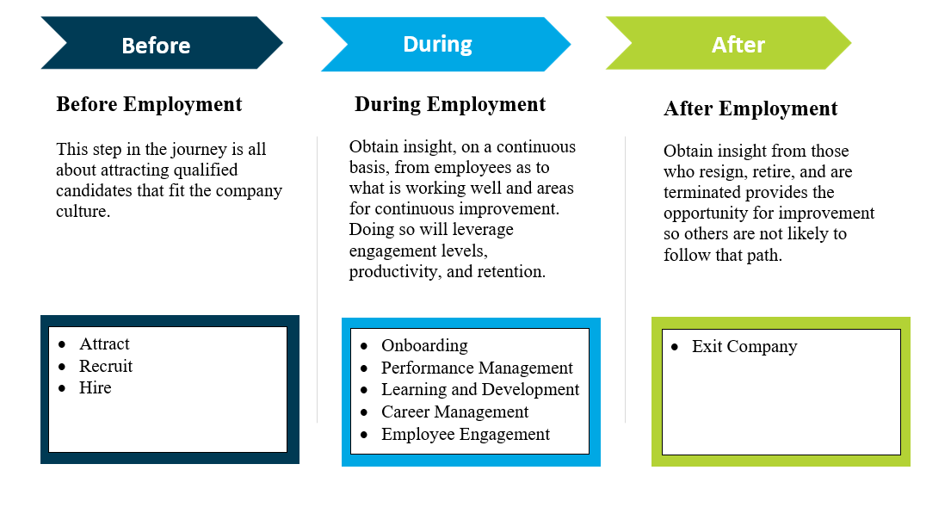
Employee Journey

Slide 7
Employee Engagement
Employee Engagement Survey
Pulse Survey
Stay Interviews
omnimporum ipsanis modici dolest fugiatissi nus dem qui quas que con pores
omnimporum ipsanis modici dolest fugiatissi nus dem qui quas que con pores
omnimporum ipsanis modici dolest fugiatissi nus dem qui quas que con pores

Slide 8
Succession Planning
Learning Development

Slide 9
Next Steps..

Slide 10
Q&A

Slide 11
Thank
You!

