Slide 1
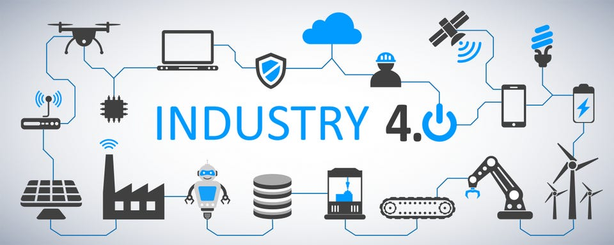
Presented in Partnership with:
&

Slide 2
CNC MANUFACTURING 4.0 AUTOMATION
HOW CNC MANUFACTURING 4.0 INTEGRATION CAN:
IMPROVE OPERATIONAL EFFICIENCY
PRODUCTIVITY,
CREATE BUSINESS OPPORTUNITY
AND
LOWER THE COST OF ISO, AS 9100, QMS, AND CMMC COMPLIANCE

Slide 3
CNC MANUFACTURING 4.0 AUTOMATION WEBINAR WILL :
THE BENEFITS OF IMPLEMENTING IT-OT SOLUTION.
DEFINITION OF IT, OT AND IT-OT CONVERGENCE.
THE DIFFERENCES BETWEEN INFORMATION TECHNOLOGY AND OPERATIONS TECHNOLOGY.
THE STEPS AND PROCESS TO MOVE TO INDUSTRY 4.0.
HOW AND OT AND IT-OT CONVERGENCE REDUCES COMPLIANCE AND SECURITY COSTS.

Slide 4
CNC MANUFACTURING 4.0
WHAT IS IT-OT CONVERGENCE?

Slide 5
CNC MANUFACTURING 4.0
“IT-OT convergence is a requirement to stay competitive in a future where cost pressures and resource constraints will continue grow. Data must securely traverse from the plant floor to the edge and the cloud in order to continuously optimize the business.”

Slide 6
CNC MANUFACTURING 4.0

Slide 7
CNC MANUFACTURING 4.0
IT INDUSTRY , ESPECIALLY CYBER SECURITY BASED ON:
CONFUSION AND COMPLEXITY
YOU DON’T UNDERSTAND YOUR NEEDS – WE DO
PAY US- LEAVE TO THE IT PROFESSIONALS

Slide 8
CNC MANUFACTURING 4.0
YOUR COMPANY’S SUCCESS DEPENDS ON
MANAGEMENT AND EMPLOYEES UNDERSTANDING THE WORDS, PROCESSES AND OBJECTIVES IN INFORMATION AND OPERATIONAL TECHNOLOGY

Slide 9
CNC MANUFACTURING 4.0
CONFUSION & COMPLEXITY
CLARITY & UNDERSTANDING
IS THE GOAL OF THIS WEBINAR

Slide 10
CNC MANUFACTURING 4.0
#1
UNDERSTAND THE TERMS

Slide 11
CNC MANUFACTURING 4.0
“THE CLOUD”
The INTERNET, simply "the Net," is the worldwide system of computer networks
COMPUTERS, SERVERS AND DEVICES THAT ARE CONNECTED TO THE INTERNET CAN BE ACCESSED ANYWHERE
CELL PHONES
RING CAMERAS

Slide 12
CNC MANUFACTURING 4.0
“NOT CLOUD”
INTRANET- is a private - internal - business network
YOUR DEVICES ON NETWORK BUT NOT CONNECTED TO THE INTERNET
EXTRANET- an extension of an intranet.
It lets approved third parties (such as vendors or customers) access restricted information.

Slide 13
CNC MANUFACTURING 4.0
INFORMATION TECHNOLOGY vs OPERATIONAL TECHNOLOGY
IT or INFORMATION TECHNOLOGY
Business and Enterprise systems that store, process and deliver information.
OPERATIONAL TECHNOLOGY (OT)
Use of hardware and software to monitor and control physical processes, devices, and infrastructure.
While operational technology is about control and safety systems and industrial process assets,

Slide 14
CNC MANUFACTURING 4.0
“IoT and IIoT”
IoT refers to a network of intelligently created physical objects
IIoT industrial internet of things is use of the internet of things (IoT) in industrial sectors and applications.
The ONLY difference is:
IoT is most commonly used for consumer usage,
IIoT is used for industrial purpose such as manufacturing, supply chain monitor and management system.

Slide 15
CNC MANUFACTURING 4.0 OR
EXPANDING THE IT-OT
the power of INFORMATION AND TECHNOLOGY
TO CUSTOMERS, SUPPLIERS AND OPERATIONS TO OPTIMIZE MANUFACTURING PROCESS

Slide 16
WHAT IS INDUSTRY 4.0?
In Industry 4.0 computers are connected and digitally connected to create and share information another to ultimately make decisions without human involvement.
Elements of INDUSTRY 4.0:
MERGING of INFORMATION AND OPERATION TECHNOLOGY
The Internet of Things and the Internet of Systems
New Technologies, including Internet of Things (IoT),
Cloud Computing and Analytics,
AI and Machine Learning
The networking of these machines provide the true power of Industry 4.0.

Slide 17
WHAT IS INDUSTRY 4.0?

Slide 18
CNC MANUFACTURING 4.0
PROGRESSING FROM
INDUSTRY 3.0 TO 4.0

Slide 19
CNC MANUFACTURING 4.0
INDUSTRY 3.0- FOCUS ON:
SHOP FLOOR
TASK AUTOMATON

Slide 20
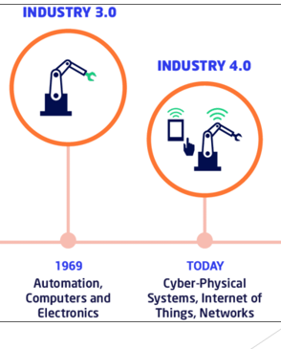
TASK AUTOMATION VS PROCESS AUTOMATION
OPERATIONAL TECHNOLOGY SCOPE
Task Process

Slide 21
TASK AUTOMATION VS PROCESS AUTOMATION
TASK AUTOMATION INDUSTRY 3.0:
FOCUS ON SHOP FLOOR
OPTIMIZE PRODUCTION BY :
REDUCING REPETITIVE TASKS
IMPROVING MACHINERY UTILIZATION

Slide 22
TASK AUTOMATION VS PROCESS AUTOMATION
TASK AUTOMATION INDUSTRY 3.0: FOCUS ON SHOP FLOOR
IMPROVING MACHINERY UTILIZATION BY AUTOMATION OF SHOP TASKS

Slide 23
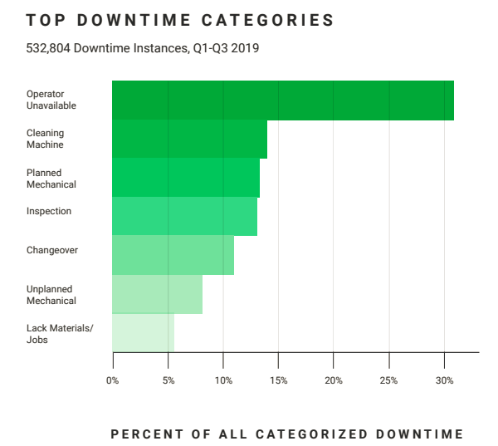
TASK AUTOMATION VS PROCESS AUTOMATION
TASK AUTOMATION
Reasons to Automate Tasks

Slide 24
TASK AUTOMATION VS PROCESS AUTOMATION
TASK AUTOMATION
INDUSTRY 3.0: FOCUS ON SHOP FLOOR
Automate Repetitive Tasks
LOADING & UNLOADING PARTS
BUY BAR FEEDER
ROBOTS AND COBOTS
SETUP
TOOL CRIB AUTOMATION
QUICK CHANGE CHUCKS

Slide 25
TASK AUTOMATION VS PROCESS AUTOMATION
TASK AUTOMATION
INDUSTRY 3.0: FOCUS ON SHOP FLOOR
PROS
HIGHER MACHINE UTILIZATION
LOWER LABOR COSTS
INCREASED PRODUCTIVITY

Slide 26
TASK AUTOMATION VS PROCESS AUTOMATION
TASK AUTOMATION
INDUSTRY 3.0: FOCUS ON SHOP FLOOR
CONS
HIGHER LABOR COSTS IF WORKERS NOT REASSIGNED TO NEW TASKS
DECREASED PRODUCTIVITY IF ORDERS DON'T DON’T INCREASE
HIGHER FIXED COSTS OF MACHINERY AND SOFTWARE
HIGHER OVERHEAD CREATES ADDITIONAL RISK TO COMPANY

Slide 27
TASK AUTOMATION VS PROCESS AUTOMATION
PROCESS AUTOMATION

Slide 28
TASK AUTOMATION VS PROCESS AUTOMATION
PROCESS AUTOMATION
INDUSTRY 4.0: FOCUS ON CUSTOMER & PROCESS
Industry 4.0 -
Computers and devices are digitally connected with one another and create and share information.
Communicate with one another to ultimately make decisions without human involvement.

Slide 29
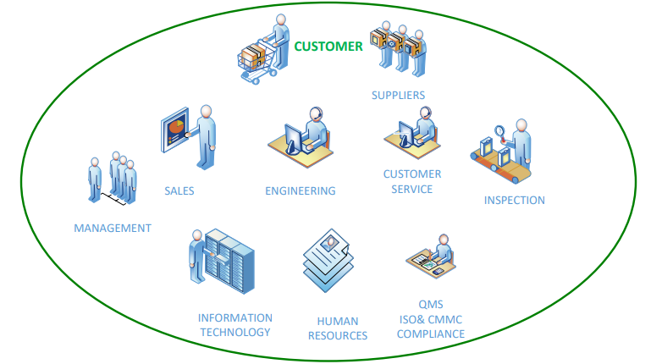
TASK AUTOMATION VS PROCESS AUTOMATION
PROCESS AUTOMATION- INDUSTRY 4.0: FOCUS ON CUSTOMER

Slide 30
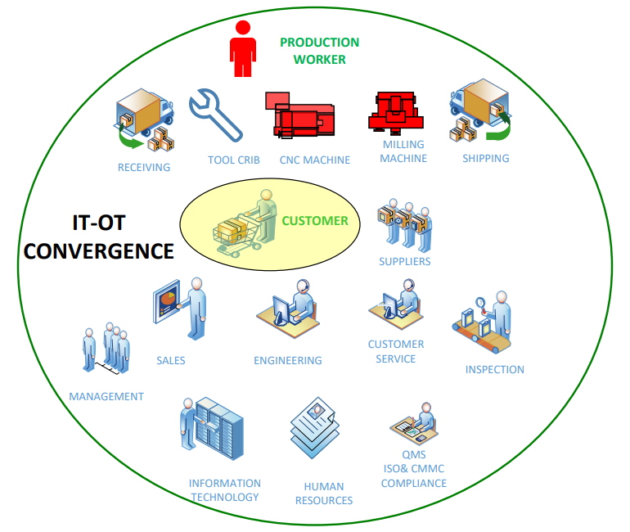
TASK AUTOMATION VS PROCESS AUTOMATION
CHANGE MANAGEMENT

Slide 31
TASK AUTOMATION VS PROCESS AUTOMATION
COMPLANCE

Slide 32
PROCESS AUTOMATION
INTEGRATION of OPERATIONAL TECH AND INFORMATION TECHNOLOGY:
Employ New Technologies
Enterprise Data Connectivity Management Tools
Internet of Things (IoT),
Cloud Computing and Analytics,
AI and Machine Learning
In Production Facilities and Operations
PROCESS integrating new technologies, throughout their operations.

Slide 33
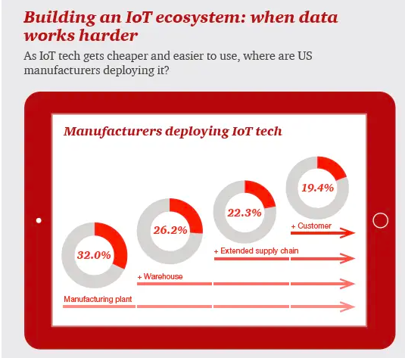
PROCESS AUTOMATION
INFORMATION IS THE FUEL FOR AUTOMATION

Slide 34
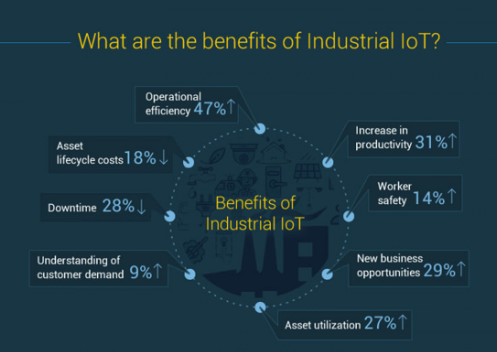
BENEFITS OF PROCESS AUTOMATION

Slide 35
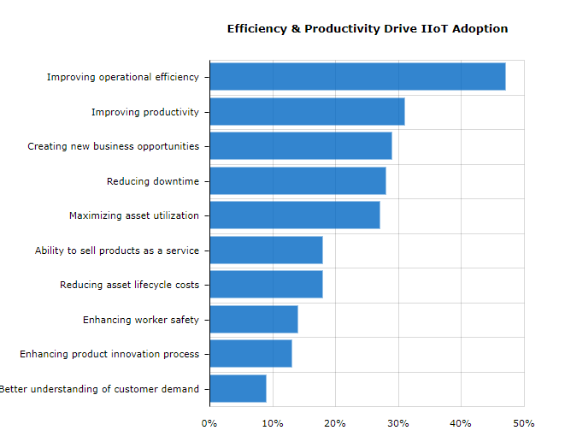
BENEFITS OF PROCESS AUTOMATION

Slide 36
ELEMENTS OF PROCESS AUTOMATION
INDUSTRY 4.0: FOCUS ON CUSTOMER & PROCESS
SCOPE :
CUSTOMERS AND PROSPECTS
ALL DEPARTMENTS
SUPPLIERS
INCLUDES:
DATA COLLECTION FROM
ENTIRE MANUFACTUIENG PROCESS,
CUSTOMERS
VENDORS

Slide 37
ELEMENTS OF PROCESS AUTOMATION
INDUSTRY 4.0: FOCUS ON CUSTOMER & PROCESS
INCLUDES:
DATA COLLECTION FROM
ENTIRE MANUFACTUIENG PROCESS,
CUSTOMERS
VENDORS
Enterprise data connectivity and management tools
IMPROVED WORKFLOW PROCESSING SPEED TO PATH TO PRODUCTION, AND DELIVERY
LOWER COSTS
VENDOR CONNECTIVITY ENABLES IMPROVED RAW MATERIAL DELIVER AND SUPPLY CHAIN BOTTLENECKS

Slide 38
ELEMENTS OF PROCESS AUTOMATION
INDUSTRY 4.0: FOCUS ON CUSTOMER
SHORTER SALES CYCLE
CONNECTIVELY WITH CUSTOMERS
IMPROVES PROPOSAL DELIVERY
ORDER PROCESSING
CHANGE MANAGEMENT
EASE OF CHANGING RECONNECT USE Microsoft teams and xxx AND COLLABORATE WITH COPTERS CLIENTS SALES, ENGINEERING, PRODUCTION AND VENDORS VIA IMPROVED PROCESSES REDUCE ALL COSTS
ENABLES EMPLOYEES TO MAXIMIZE OPERATIONAL TECHNOLCY IMPROVEMENTS
VENDOR CONNECTIVITY ENABLES IMPROVED RAW MATERIAL DELIVER AND SUPPLY CHAIN BOTTLENECKS

Slide 39
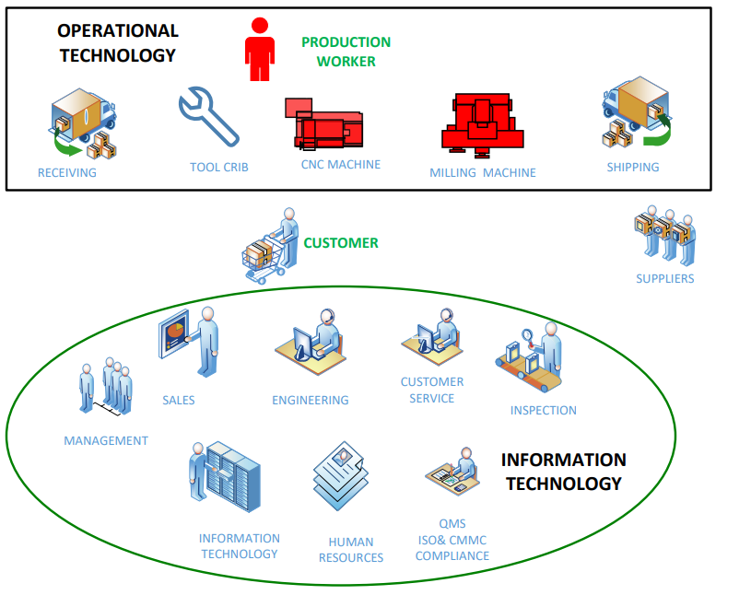
TASK AUTOMATION VS PROCESS AUTOMATION

Slide 40
TASK AUTOMATION VS PROCESS AUTOMATION

Slide 41
4.0- DESIGN AND IMPLEMENTATION PROCESS THE 6 Steps of the 4.0 Automation Implementation Process
DEFINE Objectives and Costs.
Stakeholders excepted results and objectives
EVALUATE IT NETWORK for automation.
EVALUATE SKILL SETS: Management, Operations and IT
DESIGN your AUTOMATION PLAN.
Data collation and analysis is Key
Customer is primary focus
Improved employee task management
Determine information technologies to be implemented
SELECT PROJECT LEADER
SET TIMELINE with milestones for successful implementation

Slide 42
4.0- DESIGN AND IMPLEMENTATION PROCESS THE 6 Steps of the 4.0 Automation Implementation Process
DEFINE Objectives and Costs.
Stakeholders excepted results and objectives

Slide 43
4.0- DESIGN AND IMPLEMENTATION PROCESS THE 6 Steps of the 4.0 Automation Implementation Process
DEFINE Objectives and Costs.
Stakeholders excepted results and objectives
EVALUATE IT NETWORK for automation.

Slide 44
4.0- DESIGN AND IMPLEMENTATION PROCESS THE 6 Steps of the 4.0 Automation Implementation Process
DEFINE Objectives and Costs.
Stakeholders excepted results and objectives
EVALUATE IT NETWORK for automation.
EVALUATE SKILL SETS: Management, Operations and IT.

Slide 45
4.0- DESIGN AND IMPLEMENTATION PROCESS THE 6 Steps of the 4.0 Automation Implementation Process
DEFINE Objectives and Costs.
Stakeholders excepted results and objectives
EVALUATE IT NETWORK for automation.
EVALUATE SKILL SETS: Management, Operations and IT.
DESIGN your AUTOMATION PLAN.
Data collation and analysis is Key
Customer is primary focus
Improved employee task management
Determine information technologies to be implemented

Slide 46
4.0- DESIGN AND IMPLEMENTATION PROCESS THE 6 Steps of the 4.0 Automation Implementation Process
DEFINE Objectives and Costs.
Stakeholders excepted results and objectives
EVALUATE IT NETWORK for automation.
EVALUATE SKILL SETS: Management, Operations and IT.
DESIGN your AUTOMATION PLAN.
Data collation and analysis is Key
Customer is primary focus
Improved employee task management
Determine information technologies to be implemented
SELECT PROJECT LEADER

Slide 47
4.0- DESIGN AND IMPLEMENTATION PROCESS THE 6 Steps of the 4.0 Automation Implementation Process
DEFINE Objectives and Costs.
Stakeholders excepted results and objectives
EVALUATE IT NETWORK for automation.
EVALUATE SKILL SETS: Management, Operations and IT
DESIGN your AUTOMATION PLAN.
Data collation and analysis is Key
Customer is primary focus
Improved employee task management
Determine information technologies to be implemented
SELECT PROJECT LEADER.
SET TIMELINE with milestones for successful implementation.

Slide 48
PROCESS AUTOMATION &CYBER SECURITY
How Raytheon Stopped Ransomware
$$$$$$ Wasted on attempting to BUY “Cyber Security”
Compliance results from:
Properly designed and maintained IT Networks
Policies and Procedures implemented that protect both the employee and company
Clearly defined Employee Job Descriptions to include responsibilities and tasks.
MOST IMPORTANT: Employees know and follow COMPANY POLICIES AND PROCEDURES

Slide 49
PROCESS AUTOMATION &CYBER SECURITY

Slide 50
PROCESS AUTOMATION &CYBER SECURITY

Slide 51
PROCESS AUTOMATION &CYBER SECURITY

Slide 52
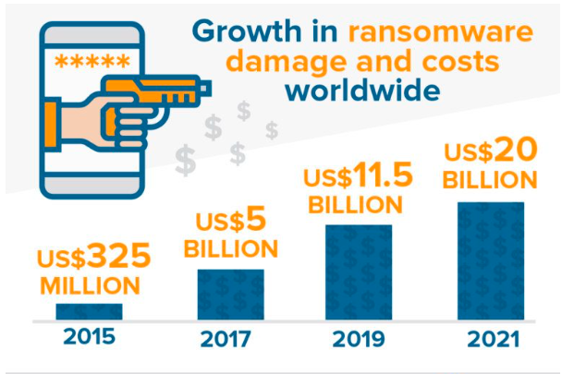
PROCESS AUTOMATION &CYBER SECURITY

Slide 53
PROCESS AUTOMATION &CYBER SECURITY
CYBER SECURITY COSTS GOING UP
2016-$33 BILLION
2021-$64 BILLION
RANSOMEWARE COST GOING UP
2016-$325 MILLION
2021-$64 BILLION

Slide 54
PROCESS AUTOMATION &CYBER SECURITY
IT AND CYBER SECURITY INDUSTRY HAVE FAILED
BUT…
BUSINESS KEEP PAYING MORE!
SOMETHING IS WRONG.

Slide 55
PROCESS AUTOMATION &CYBER SECURITY
PEOPLE

Slide 56
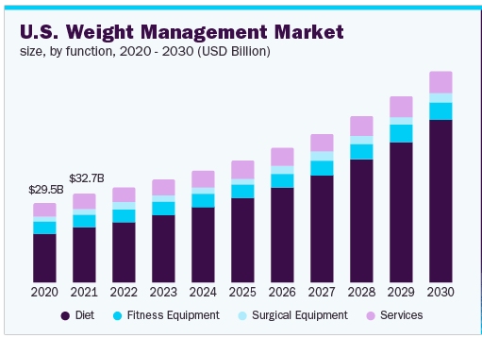
PROCESS AUTOMATION &CYBER SECURITY
What is the market size of the Weight Loss Services industry in the US in 2022? The market size, measured by revenue, of the Weight Loss Services industry is $33 BILLION in 2022

Slide 57
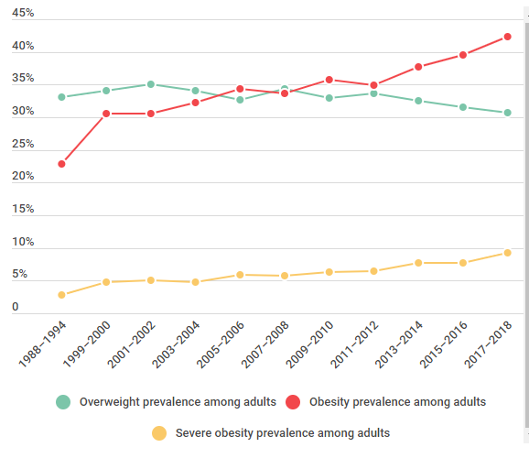
PROCESS AUTOMATION &CYBER SECURITY

Slide 58
PROCESS AUTOMATION &CYBER SECURITY
OVER 98% OF DIETS FAIL
WITHIN 3 YEARS OVER 98% HAVE GAINED ALL WEIGH BACK.

Slide 59
PROCESS AUTOMATION &CYBER SECURITY
WHAT IS THE PROBLEM WITH CYBER SECURITY?

Slide 60
PROCESS AUTOMATION &CYBER SECURITY
BUSINESS NEEDS TO TAKE CONTROL OF THEIR INFOMAITON SYSTEMS

Slide 61
PROCESS AUTOMATION &CYBER SECURITY

Slide 62
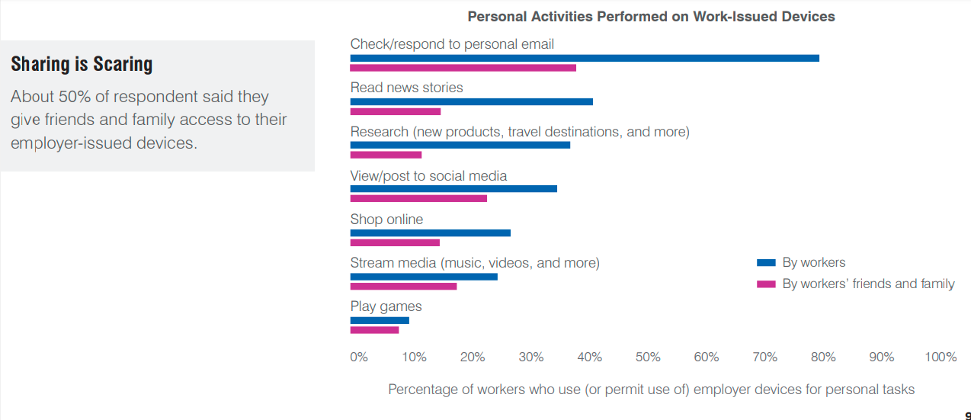
PROCESS AUTOMATION &CYBER SECURITY

Slide 63
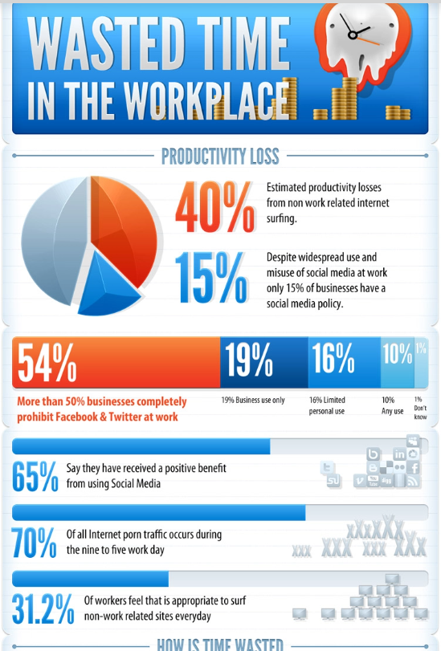
MANAGEMENT

Slide 64
QUESTIONS

Slide 65
JOHN CONNELL
FORTRESS DATA MANAGEMENT
375 WEST 83RD STREET
BURR RIDGE, IL 60527
EMAIL: JCONNELL@FORTRESSDM.COM
PHONE: 630-920-0153
CELL: 630-202-1127
WEB: WWW.FORTRESSDM.COM

