Slide 4
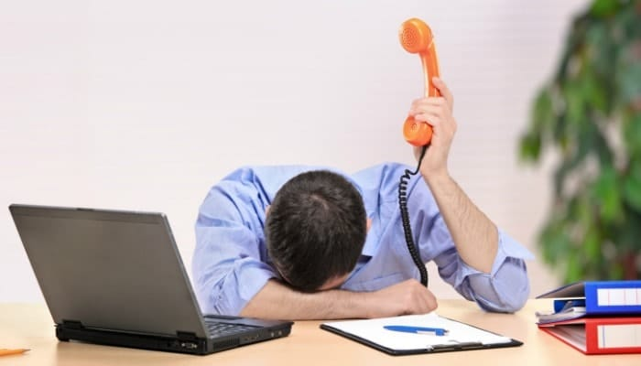
Who LOVES making
Cold Calls?

Slide 5
Who LOVES Blogging?

Slide 6
ARE YOU TIRED OF BEING
THE BEST KEPT SECRET?

Slide 7
FRUSTRATED & OVERWHELMED?

Slide 8
THERE MUST BE A BETTER WAY

Slide 9
CLOSED MOUTHS DON’T GET FED

Slide 10
WHO WANTS TO HEAR YOUR STORY?

Slide 11
THE BEST KEPT SECRET
TO HELP YOU…
STOP BEING THE BEST KEPT SECRET

Slide 12
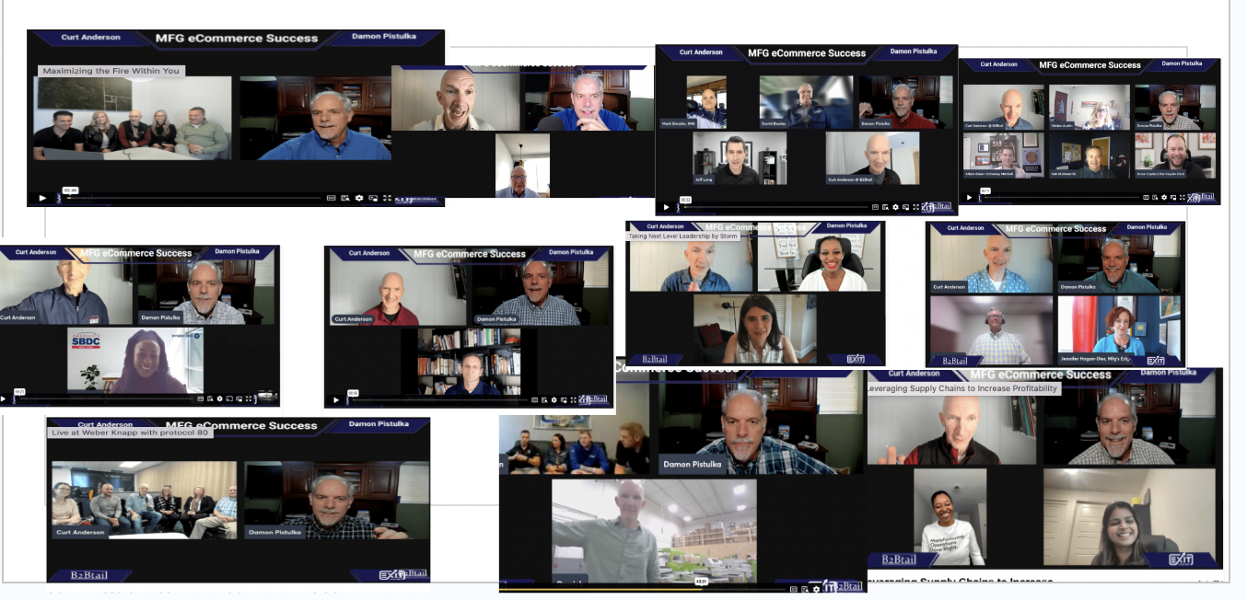
GO LIVE & THRIVE

Slide 13
LIVE STREAM Hands-Down The BEST ROI

Slide 14
…and THE BEST OPTION Your Time and Money

Slide 15
39 ½ MASSIVE BENEFITS OF LIVE STREAMING
Live Stream helps you to STOP BEING THE BEST SECRET
Target Soulmates - aka Ideal Customers
Greatly expand your reach - new Audience Potential
Wide Variety of Content Uses
Ease and Convenience
THE BEST tool for Business Development
Cost-Effectiveness - Cheap and effective way to create valuable content
Shine the spotlight on your soulmates / customers
Develop Street Cred by hanging out with Smart Peeps
Don't need to be the smartest person in the room
Learning opportunities - Free Coaching Lessons for amazing Subject matter experts
Helps you to Out-teach the competition
Become a content machine
One 30 minute Live Stream interview can become a months worth of content
A.I. Proof Your Business
Storytelling - share your entrepreneurial journey
Share your passion, experience and expertise
Feature Interview internal subject matter experts
Highlight case studies and success stories
awesome way to capture client testimonials - RECORDED - ON VIDEO
Target Soulmate 100 - build a vibrant referral partner network
Post on Social
Cut into clips - YouTube Shorts
FAQs for your website and email responses
Archive the library of other subject matter experts for you prospects
Build a Community
Build your company as a Thought Leader and Brand Authority
SEO Juice - Keyword Ranking Strategy
Google's E-E-A-T
Own your keywords
Product launches Demos - QVC
Stretch and punch above your weight - Interview Heroes & Industry Influencers
Convert to a podcast
Backlinks
Show off website
Get on site - with clients - Trade shows - conferences -
Beat the competition
Combines sales and marketing
Guests get JUICED with Live comments
½ Show off to your Mom

Slide 16
LIVE STREAM = ABSOLUTE BEST METHOD to….
Build AWESOME Relationships
Become a Content Machine
Capture Exciting Sales Growth Opportunities

Slide 17
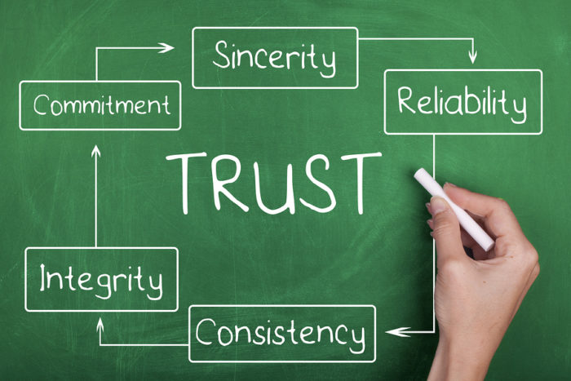
WHAT ARE YOU SELLING?

Slide 18
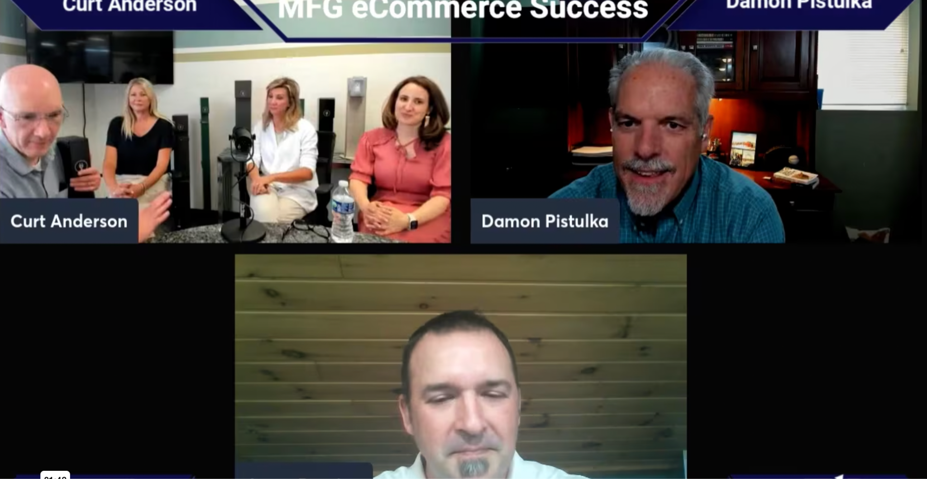
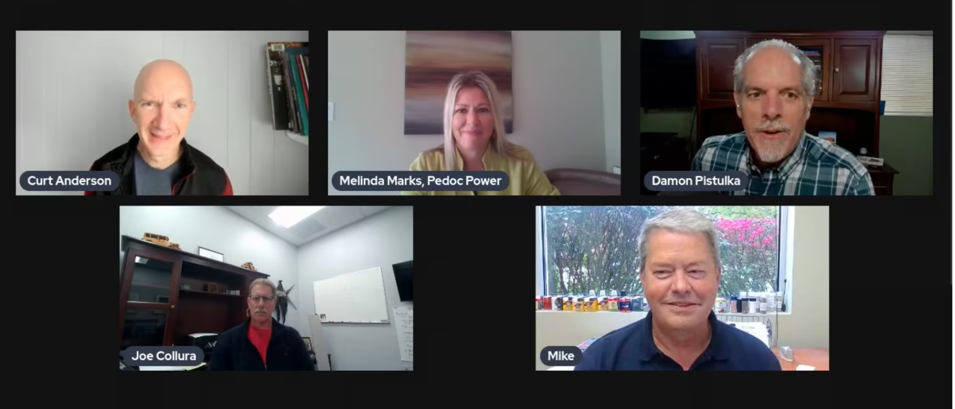
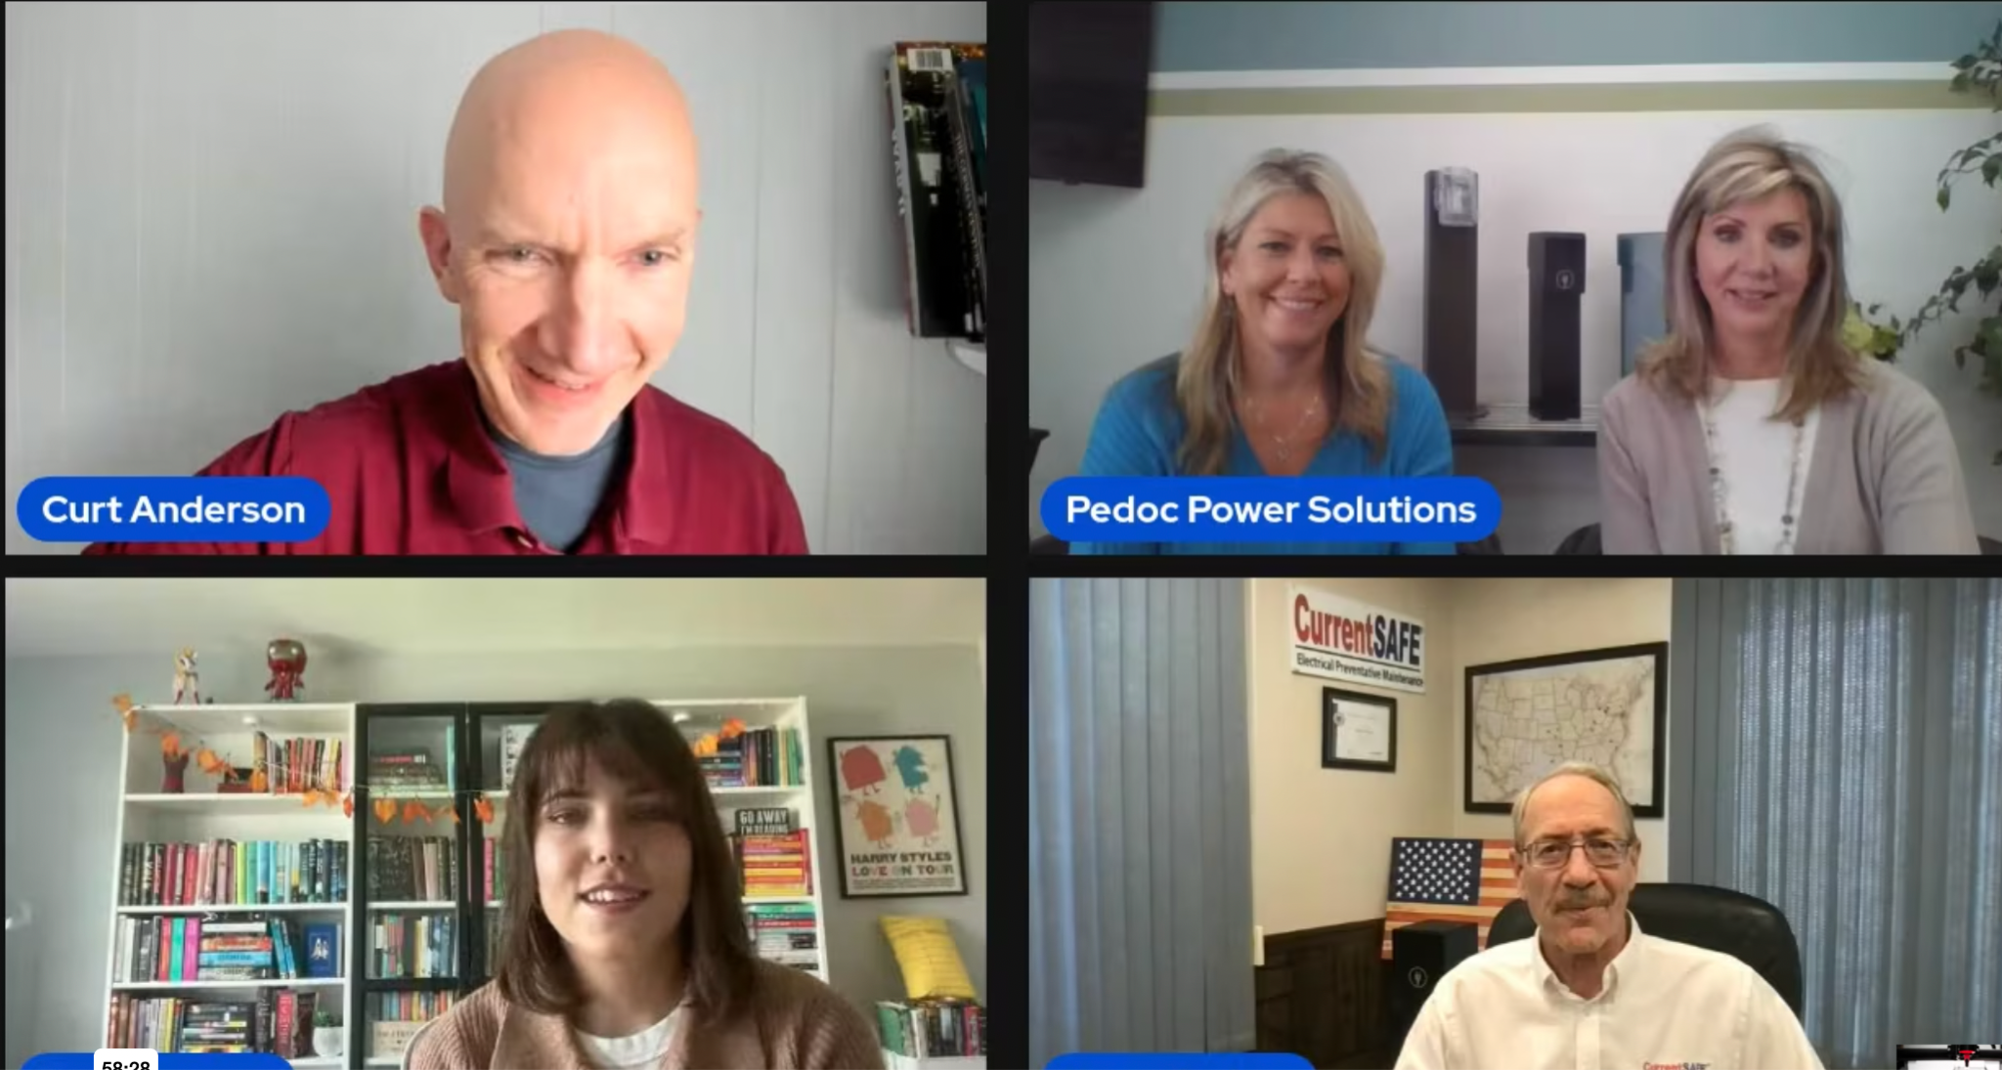
IMEC SUCCESS STORIES

Slide 22
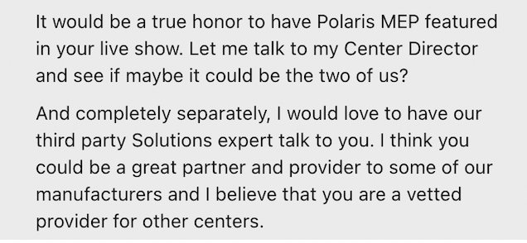

Slide 23
Beat the Competition

Slide 24
Out-Teach the Competition

Slide 25
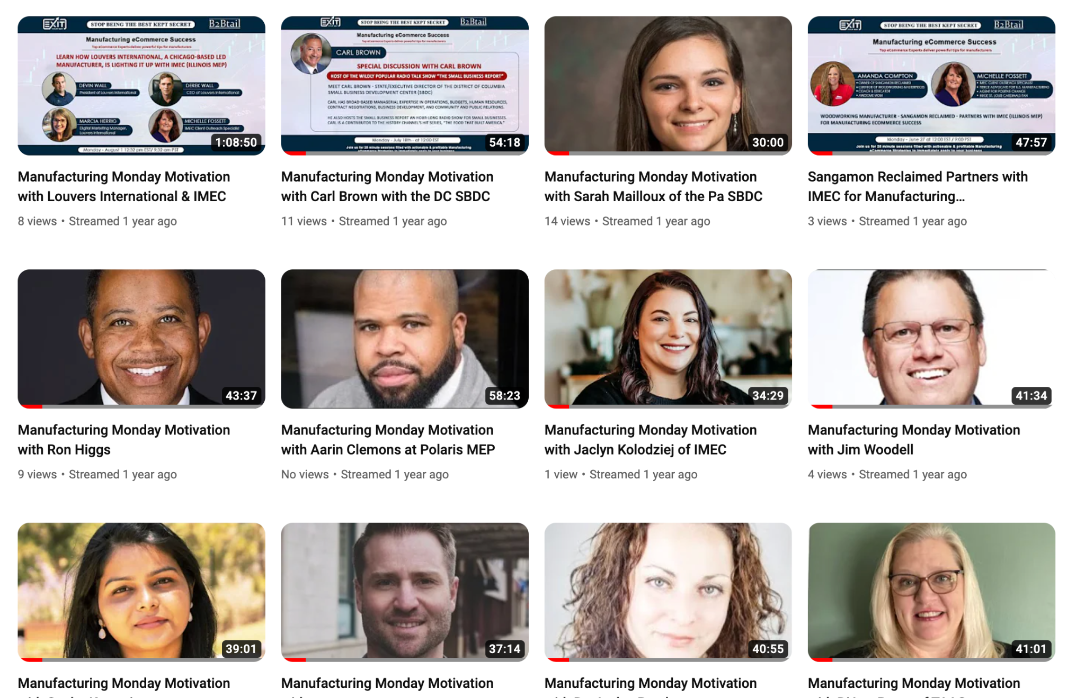
Interview Industry Experts

Slide 26
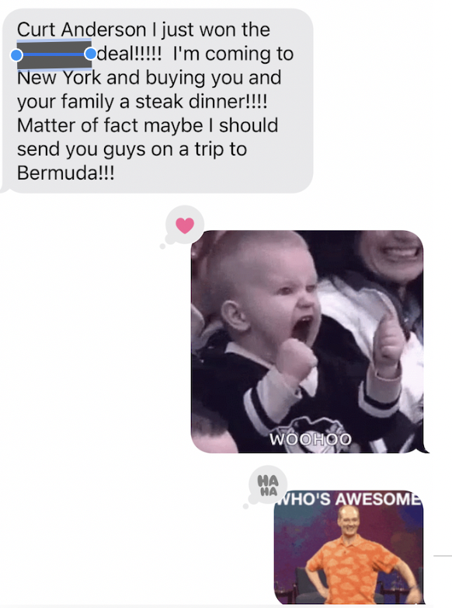

Slide 27
INTERVIEW YOUR HEROES

Slide 28
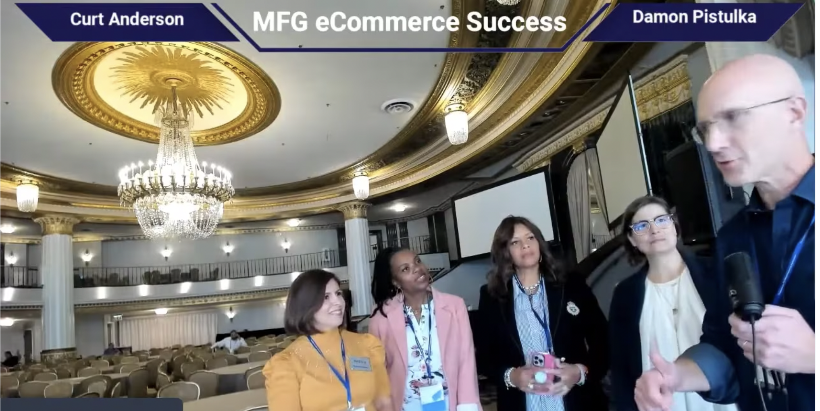
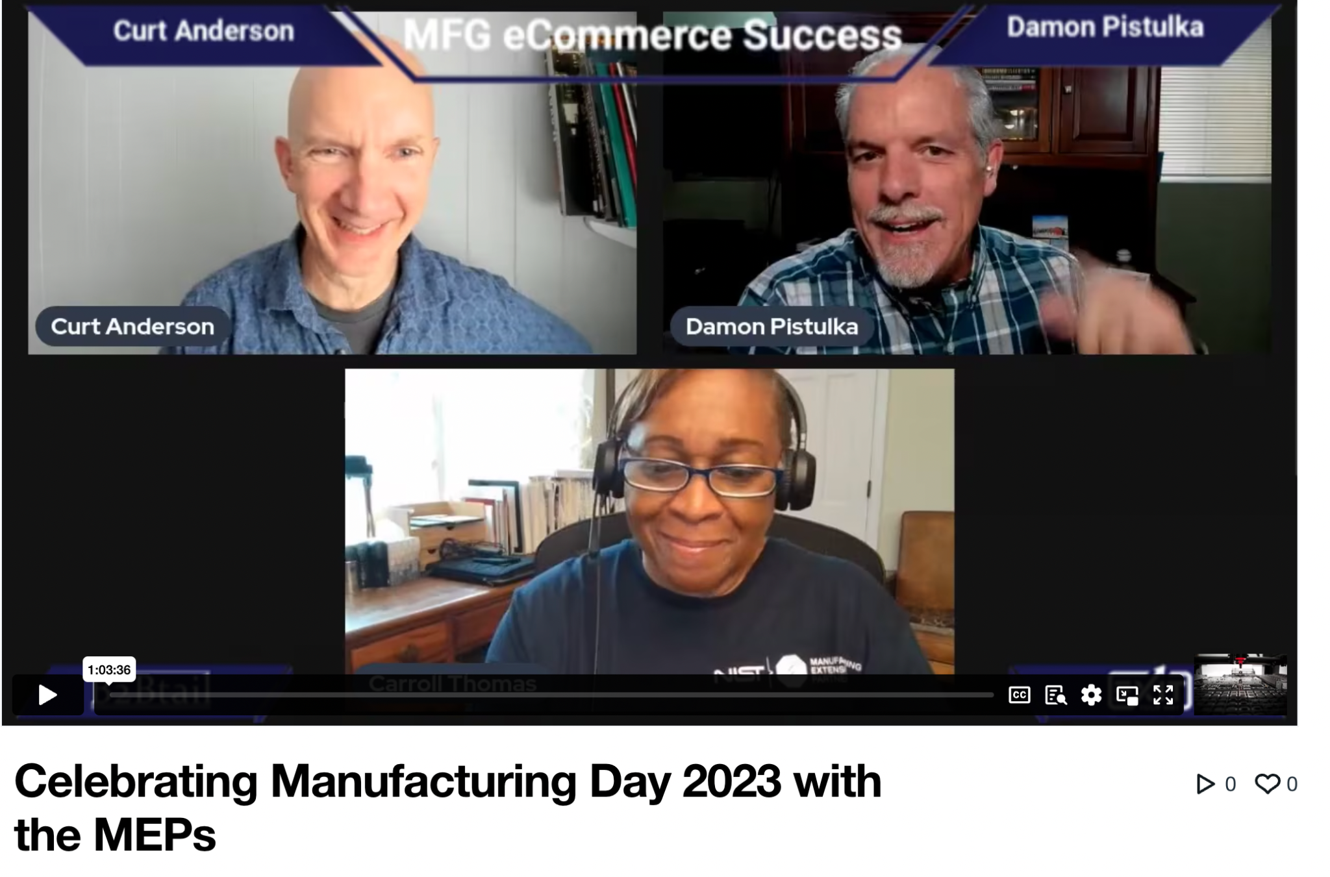
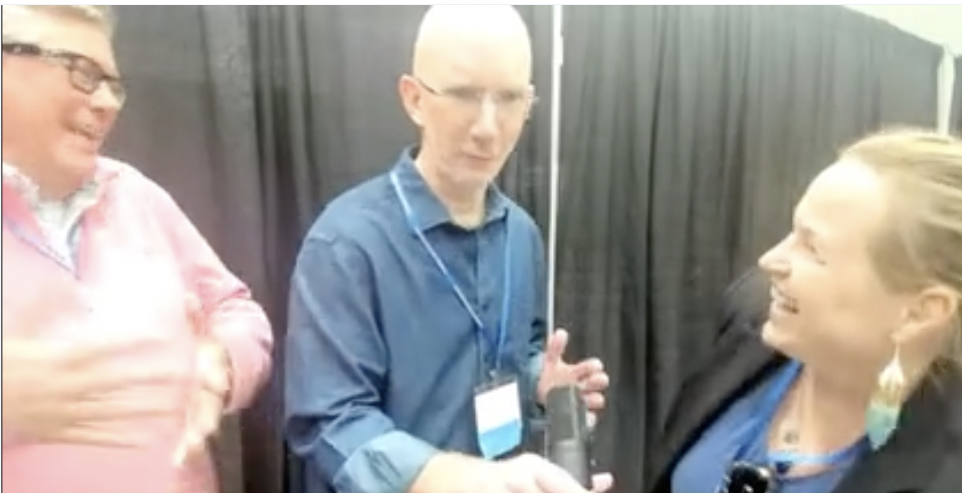
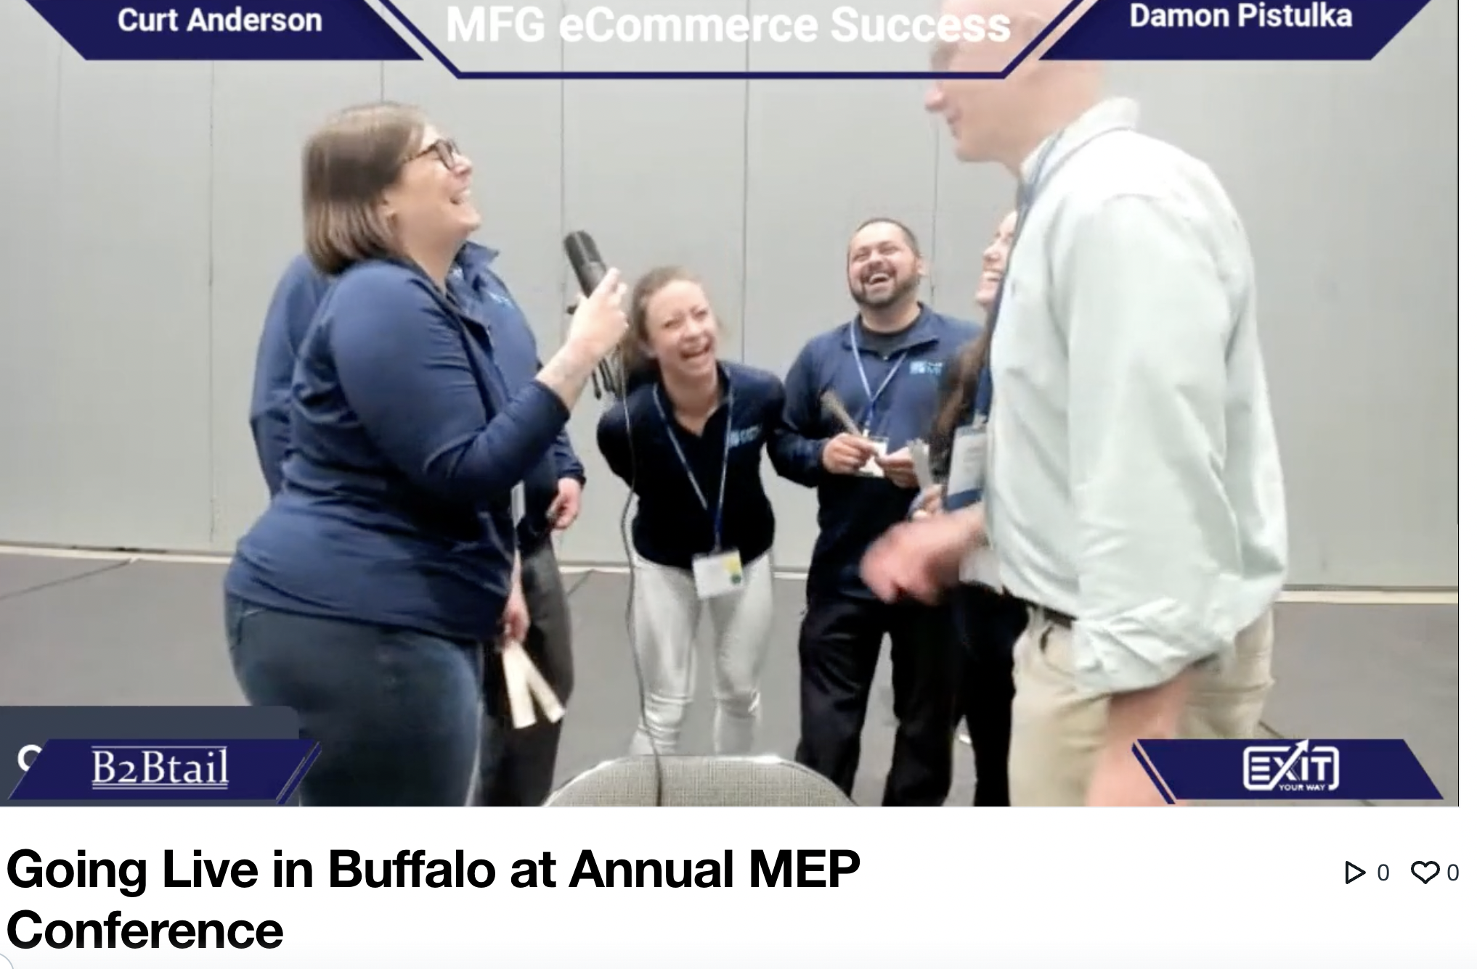
BECOME THE CHEERLEADER OF YOUR INDUSTRY

Slide 29
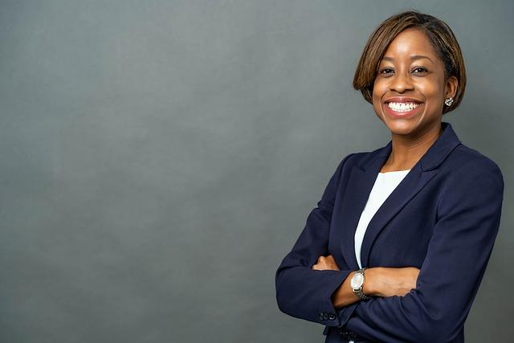
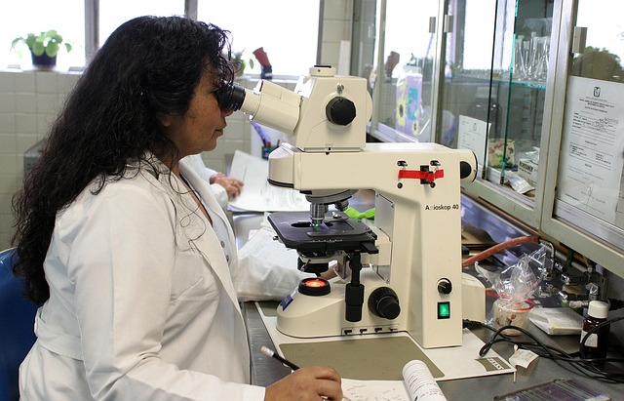
HIGHLIGHT YOUR INTERNAL EXPERTISE

Slide 30
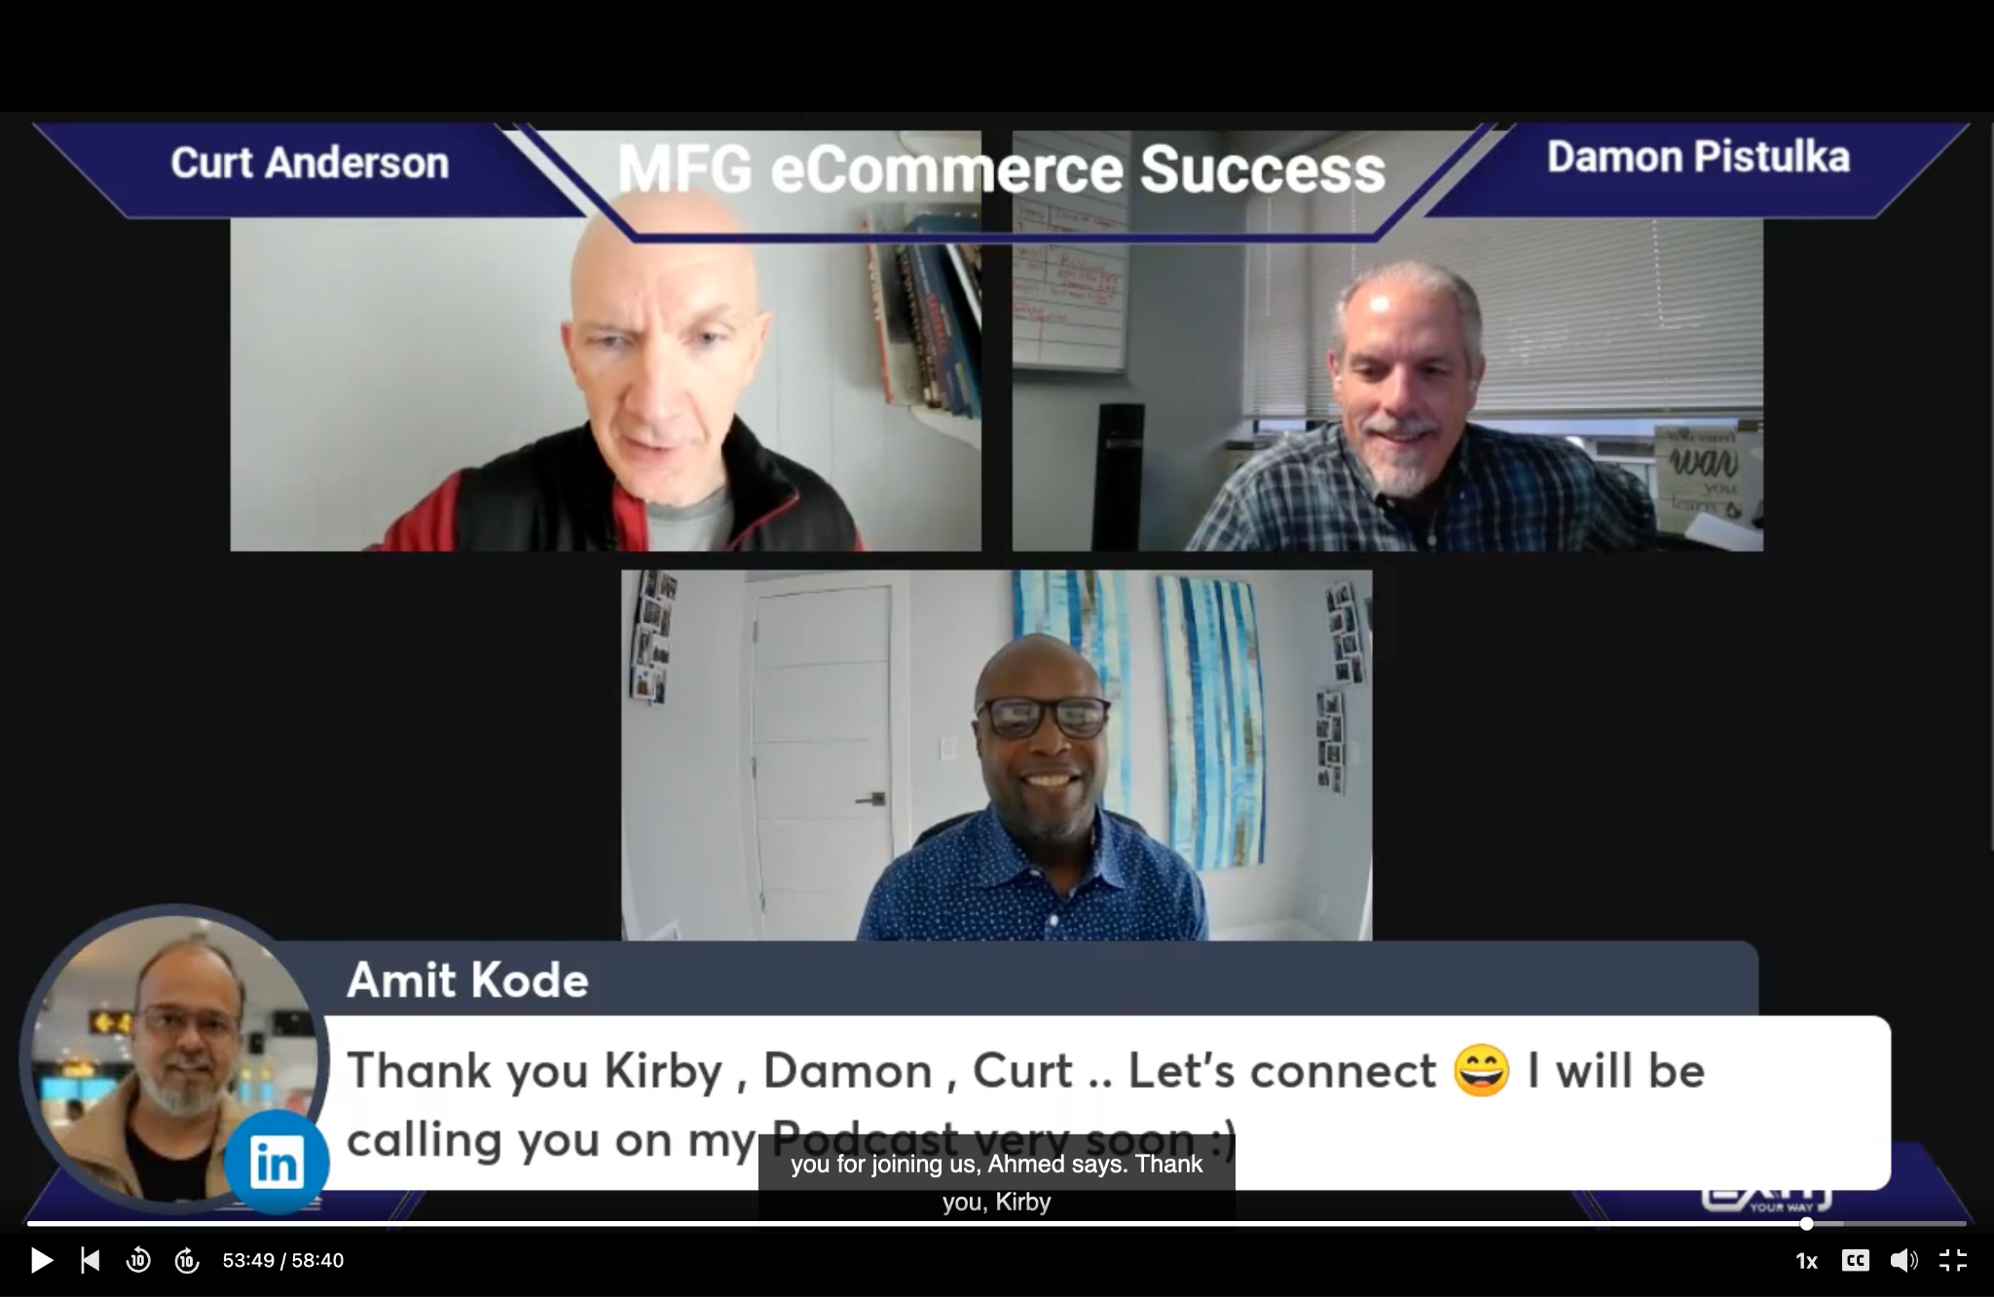

Slide 31
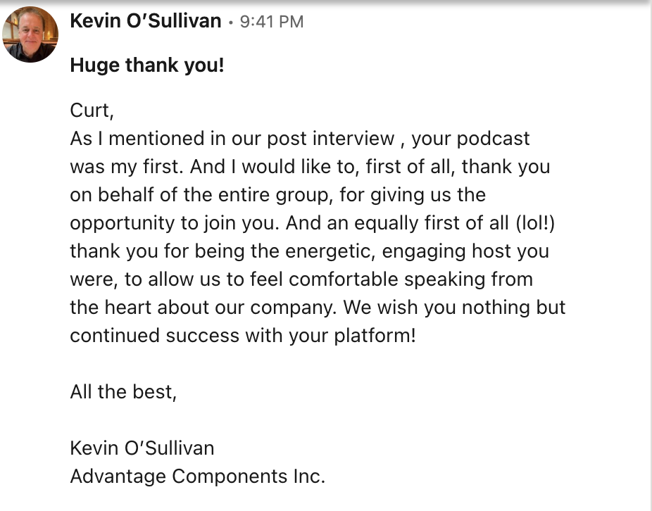
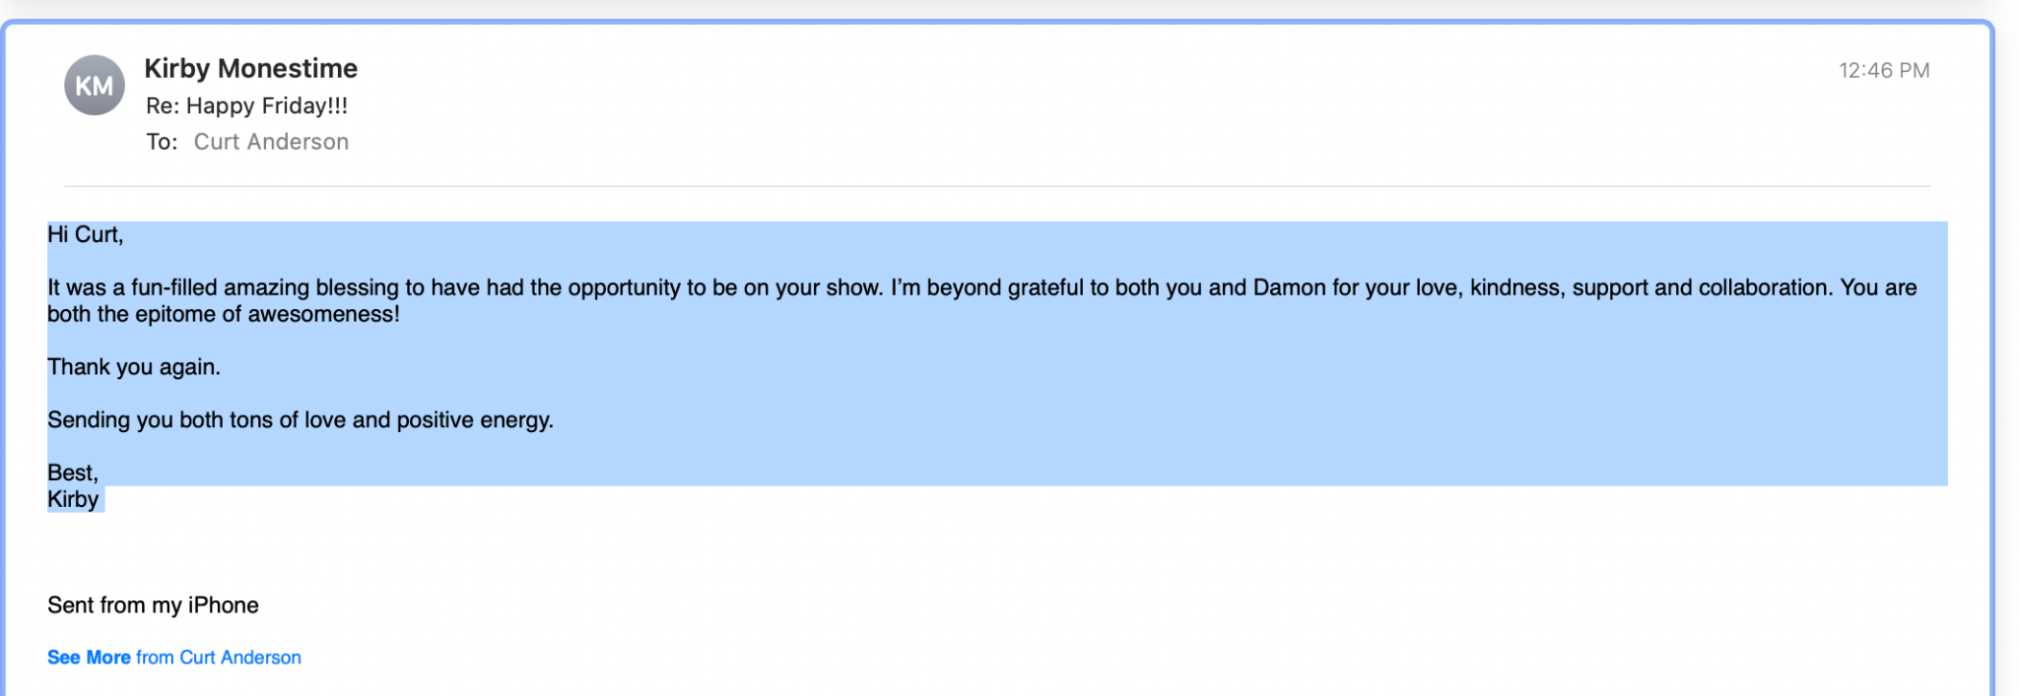
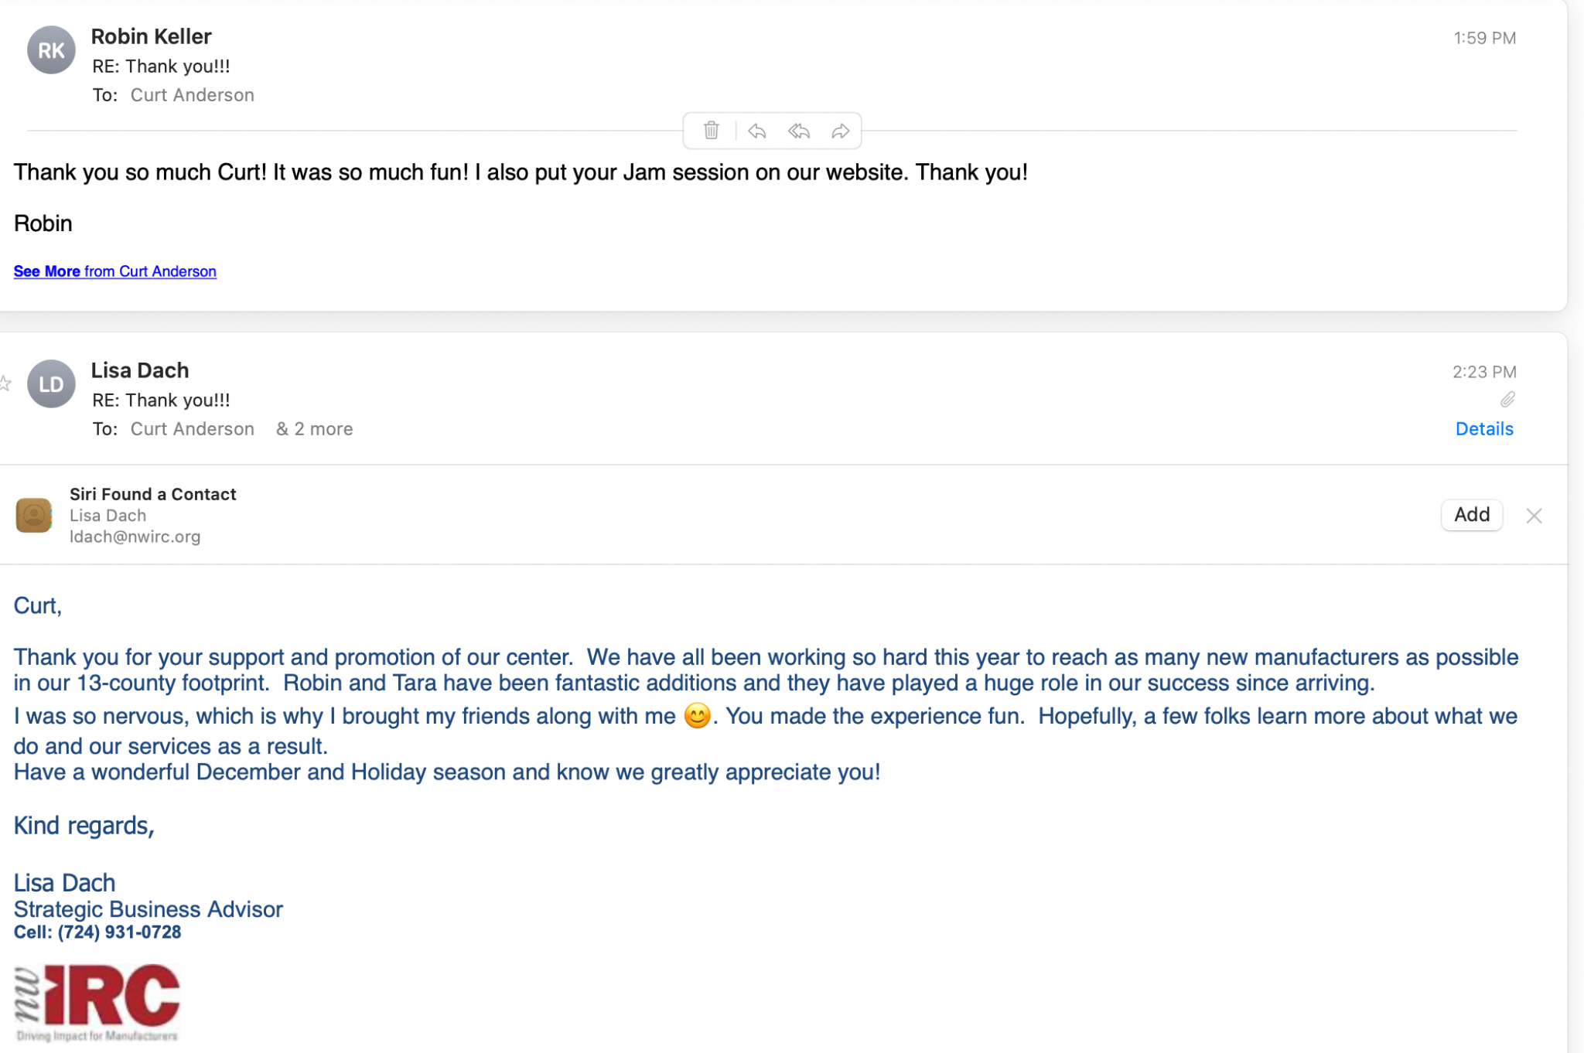
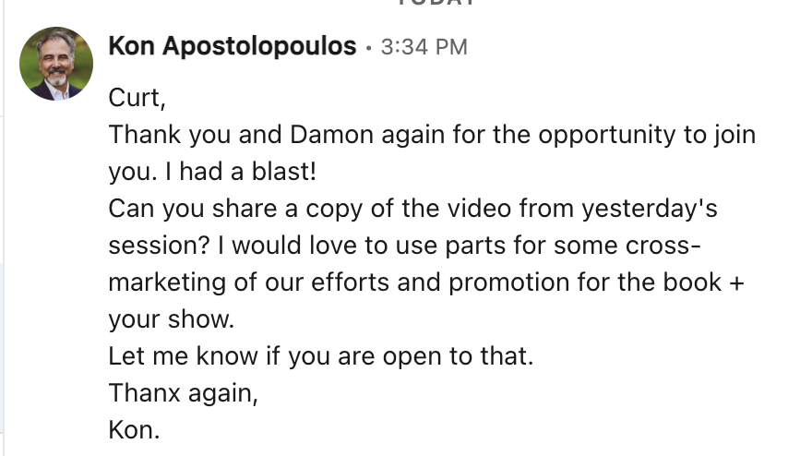

Slide 32
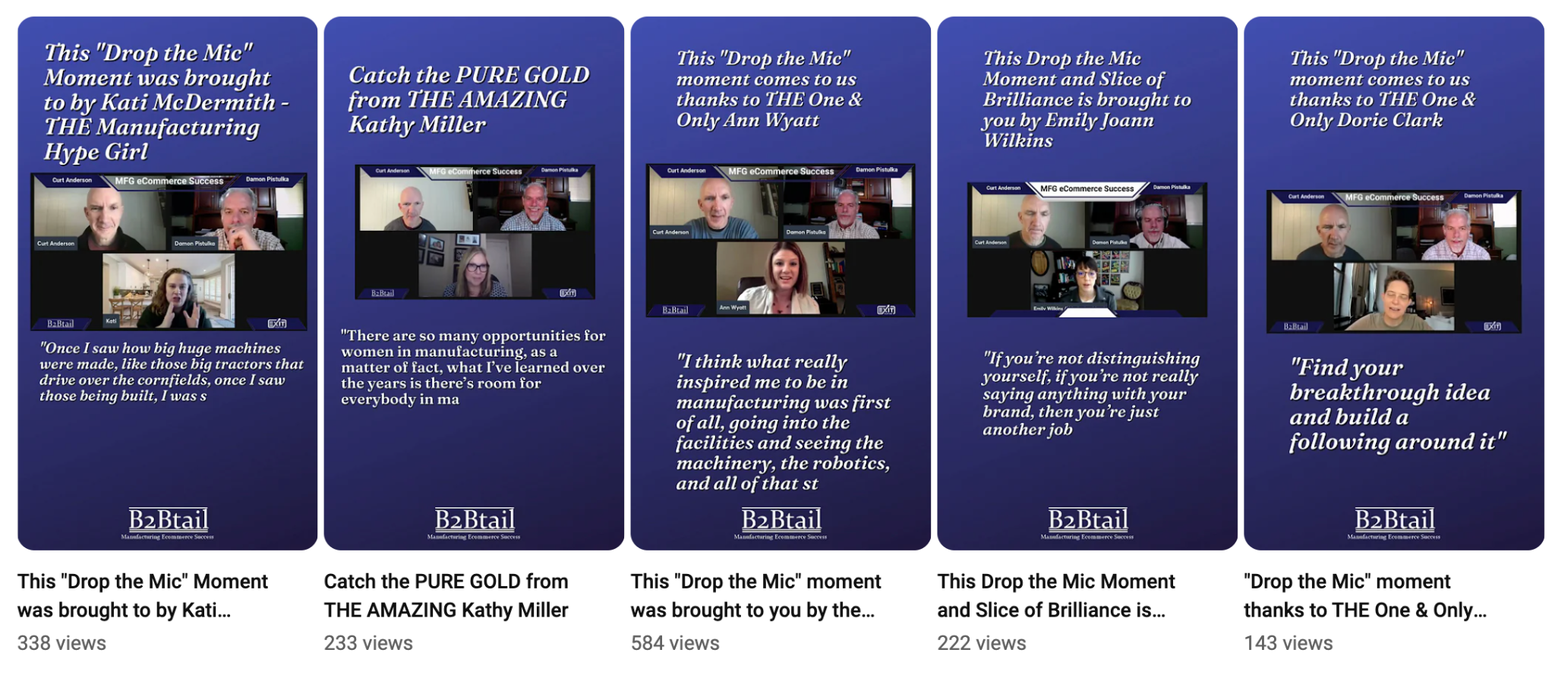
Cut Into YouTube Shorts

Slide 33
Convert to a podcast

Slide 34
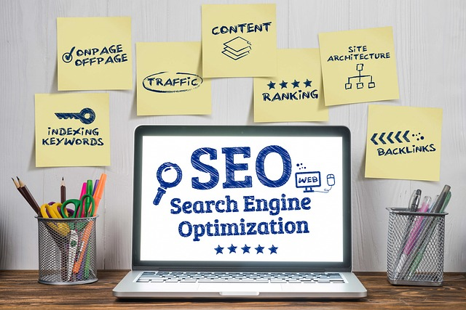
HUGE SEO BENEFITS
Google is longing for content on your niche keywords

Slide 35
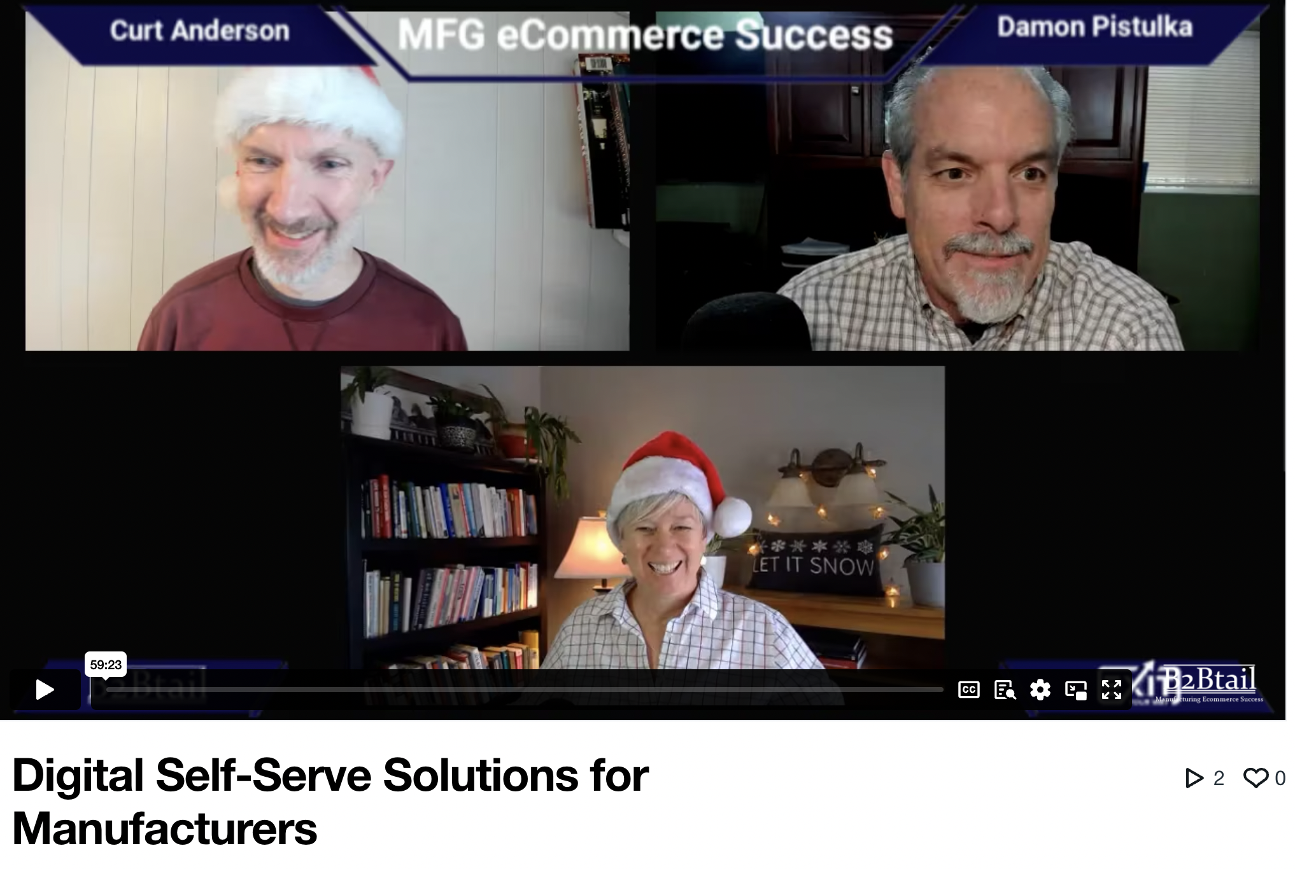
Live Stream Your Way to SEO Success!

Slide 36
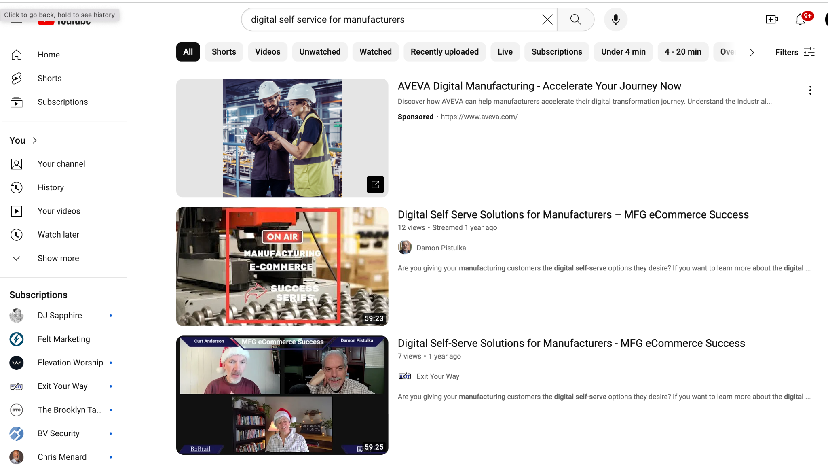

Slide 37
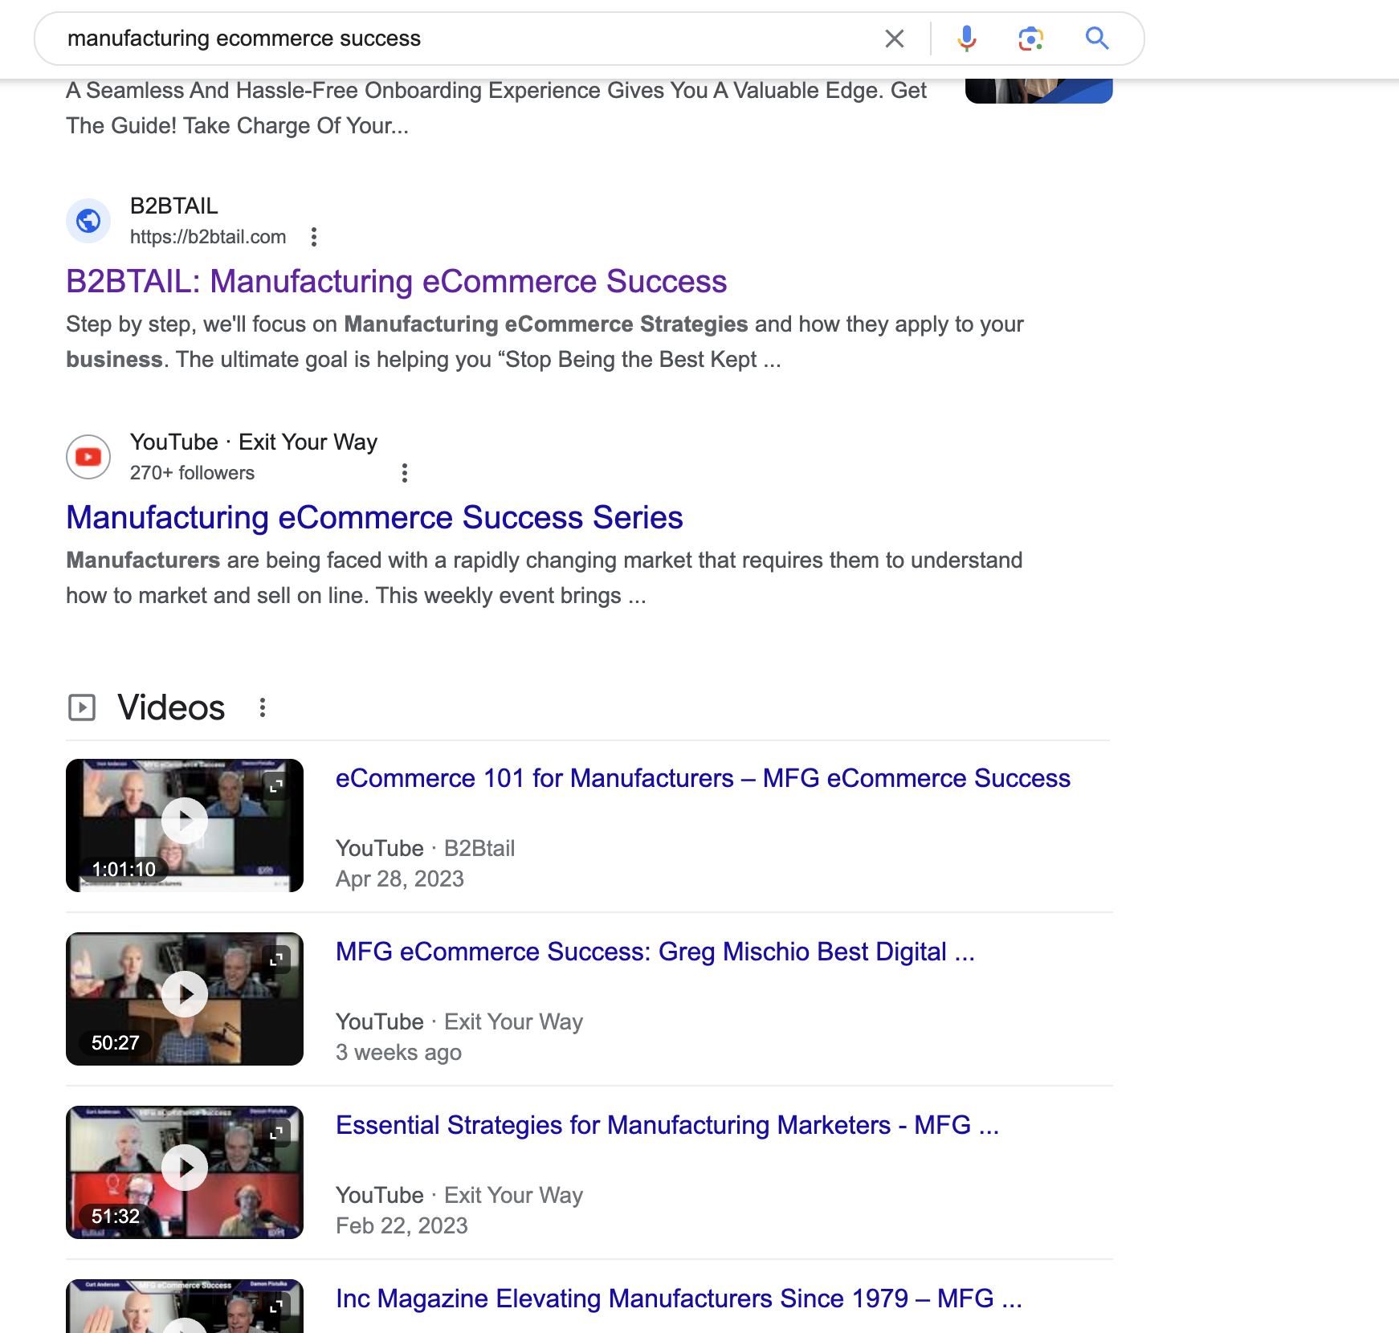
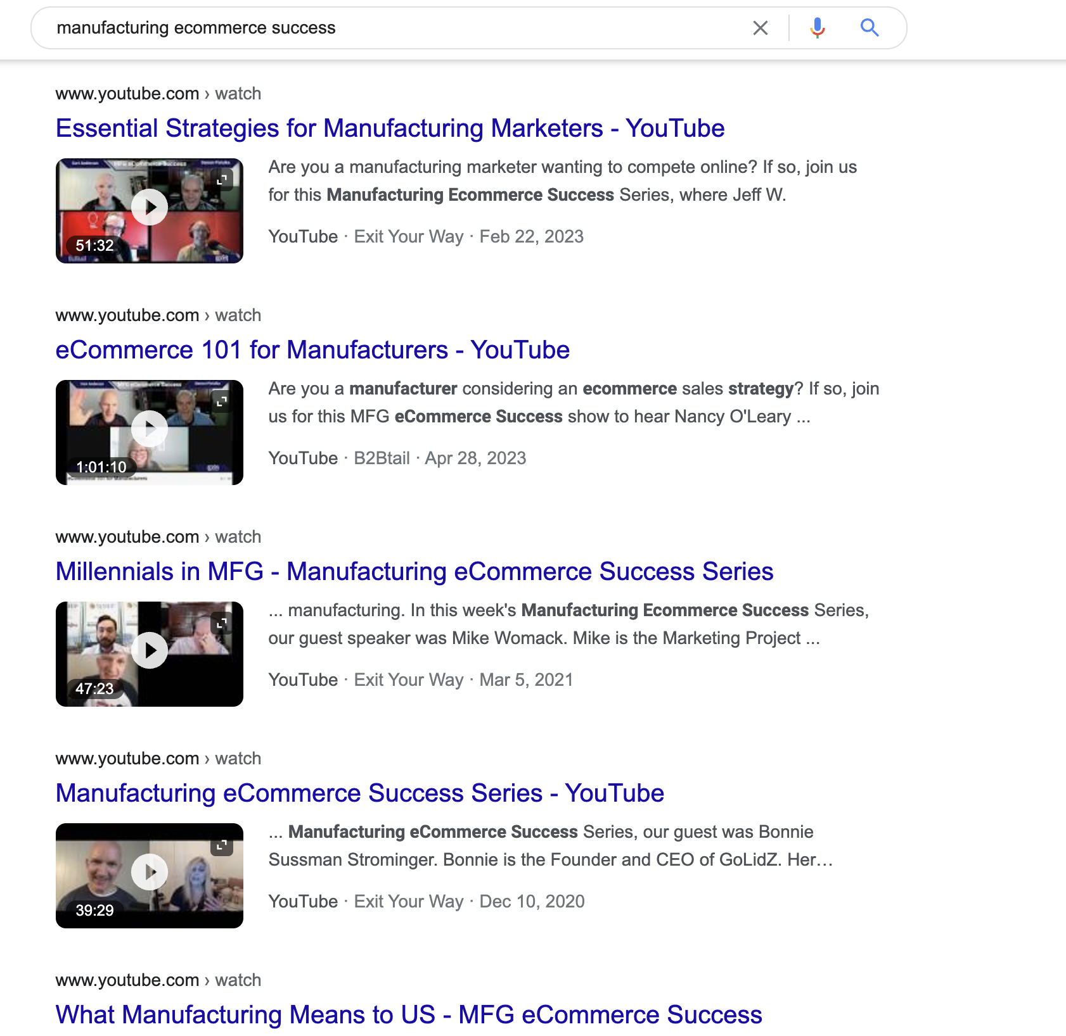
Manufacturing eCommerce Success

Slide 38
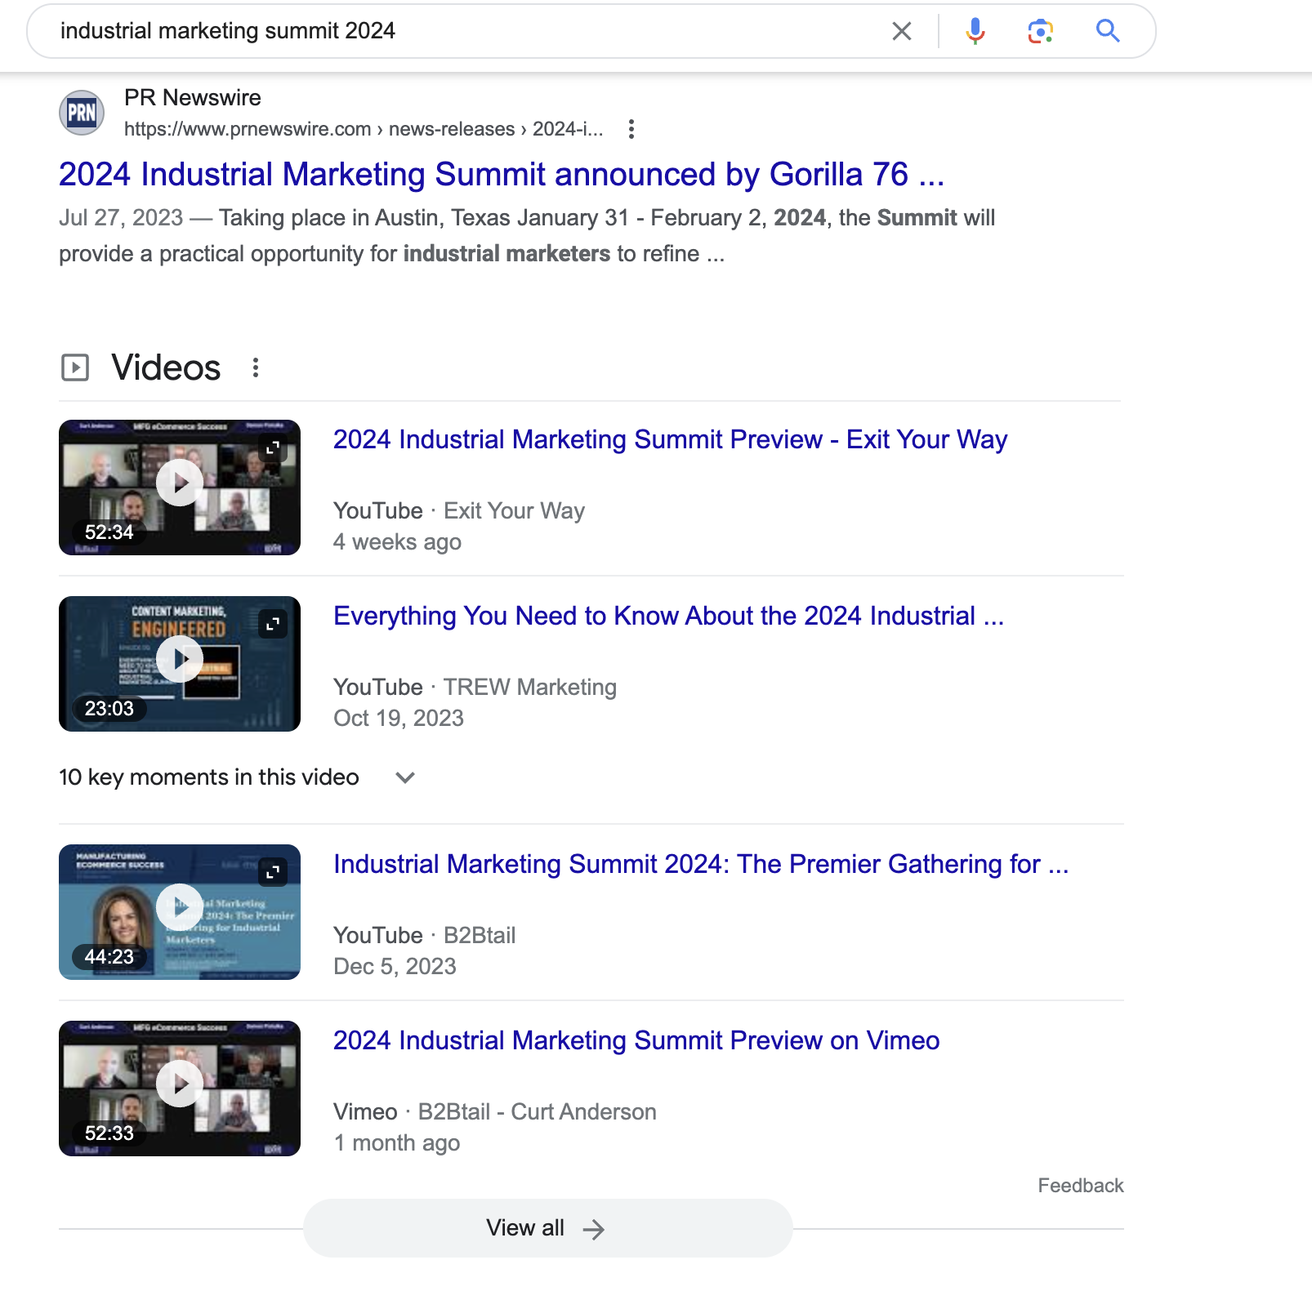
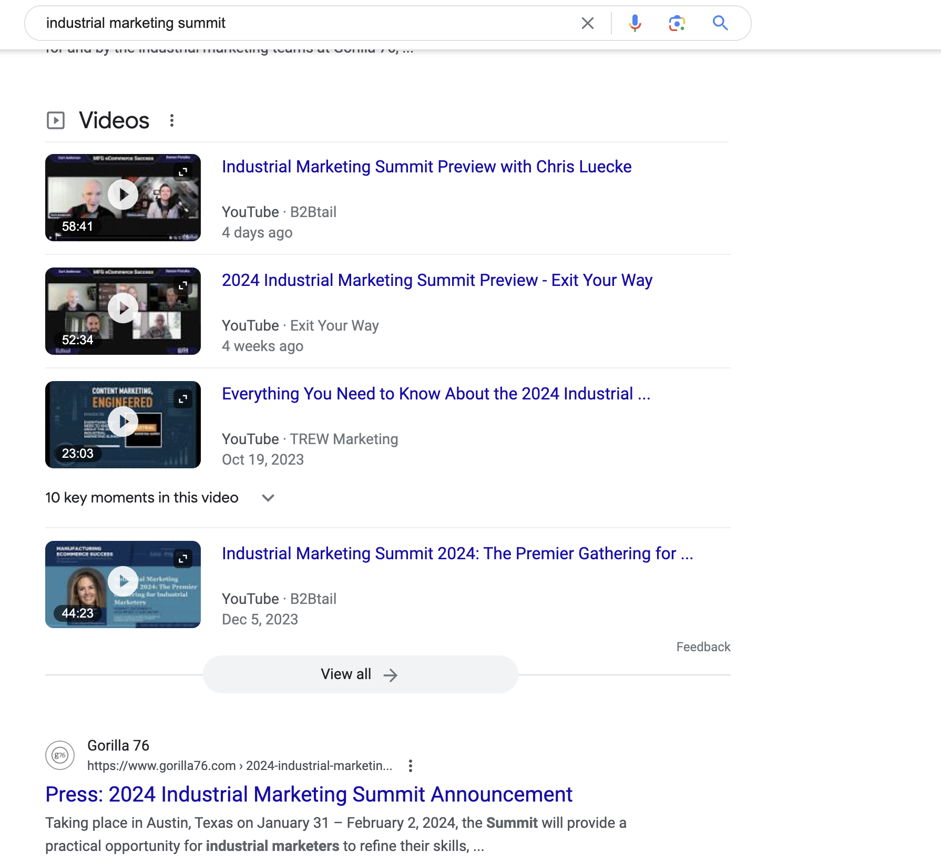
Industrial Marketing Summit 2024

Slide 39
A.I. Proof Your Business

Slide 40
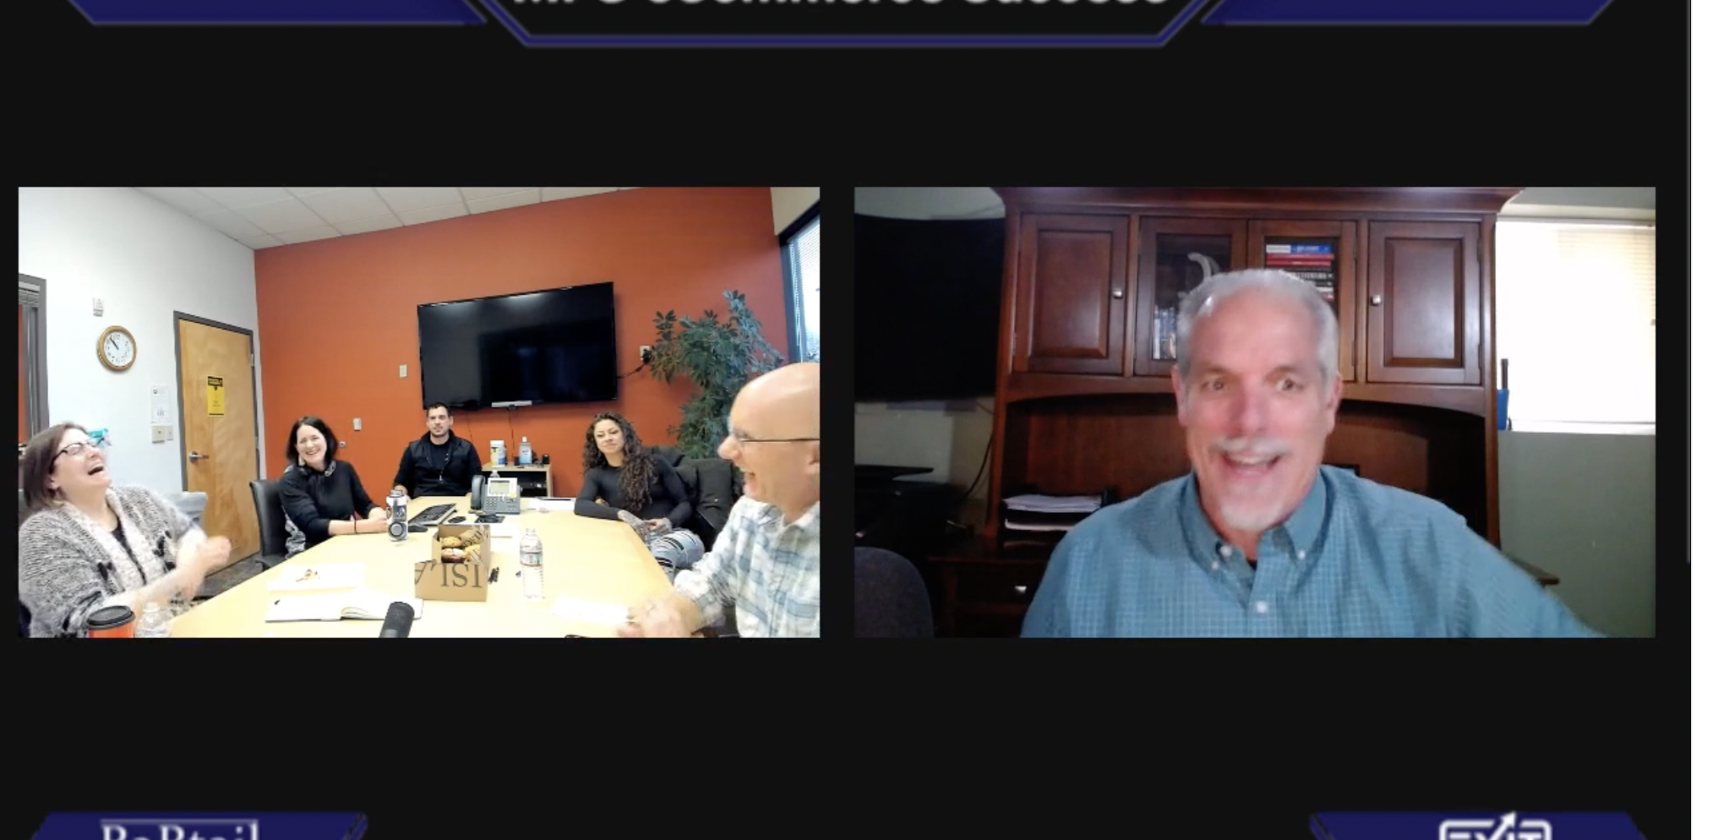
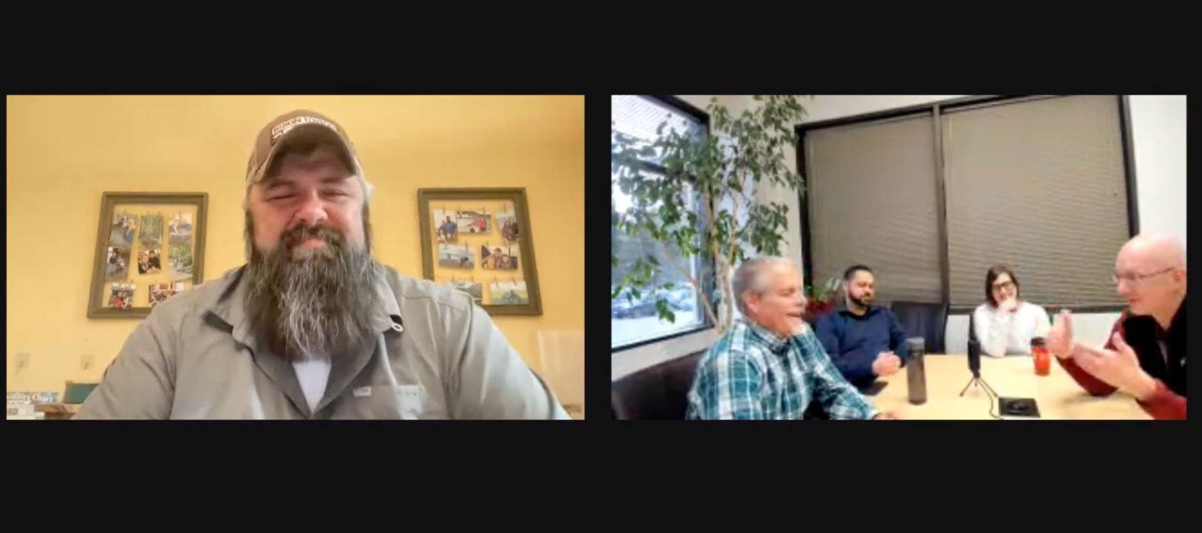
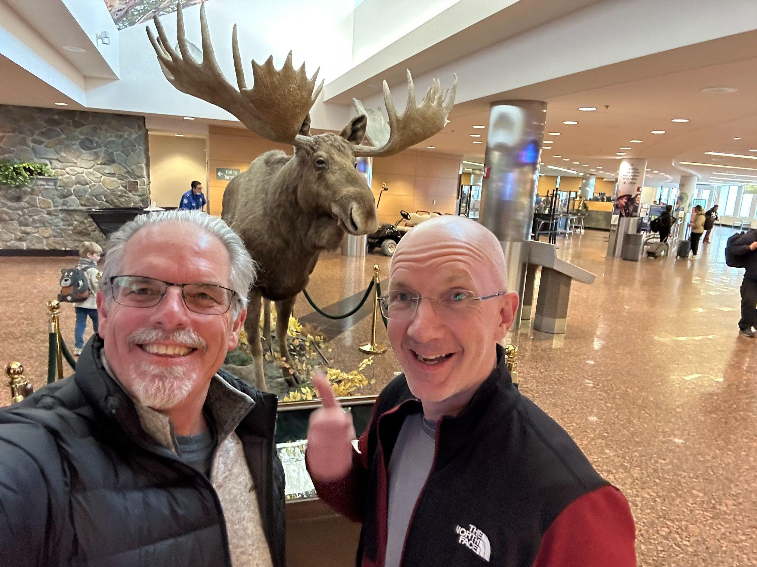
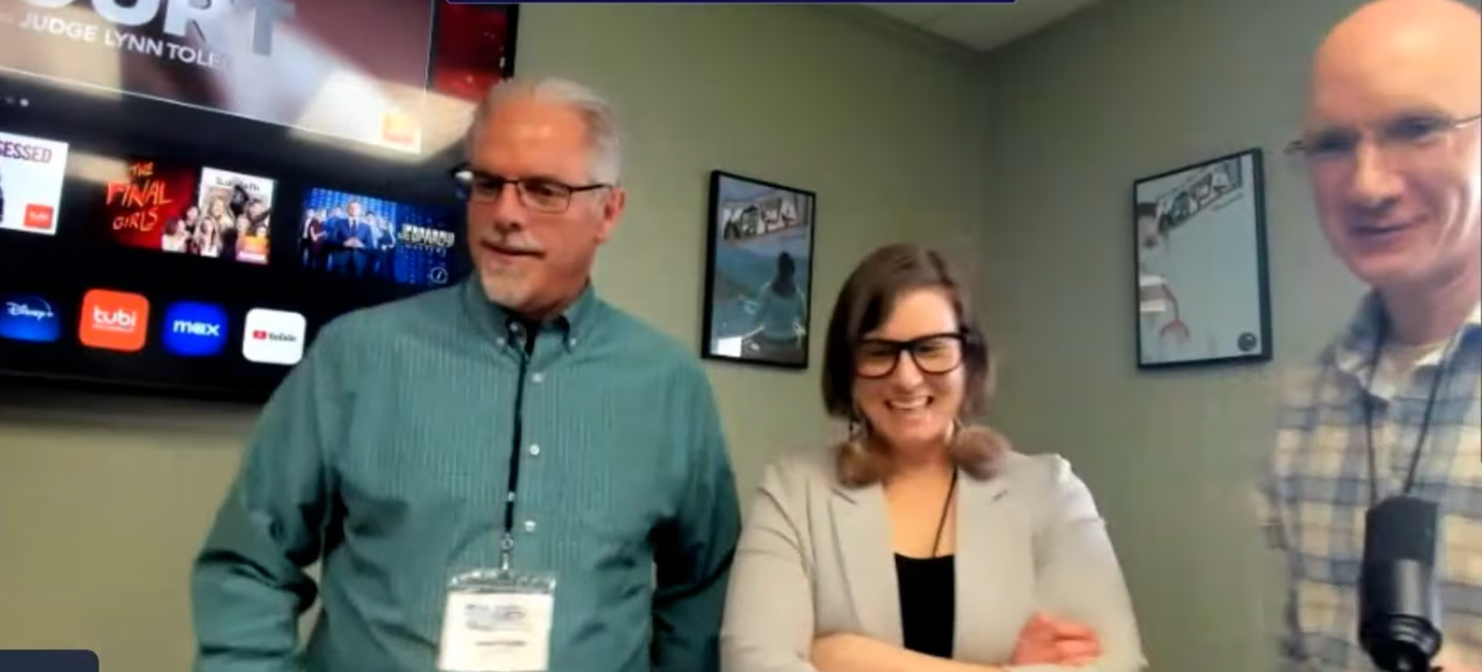
SOMETIMES YOU HAVE TO
GO TO ALASKA

Slide 41
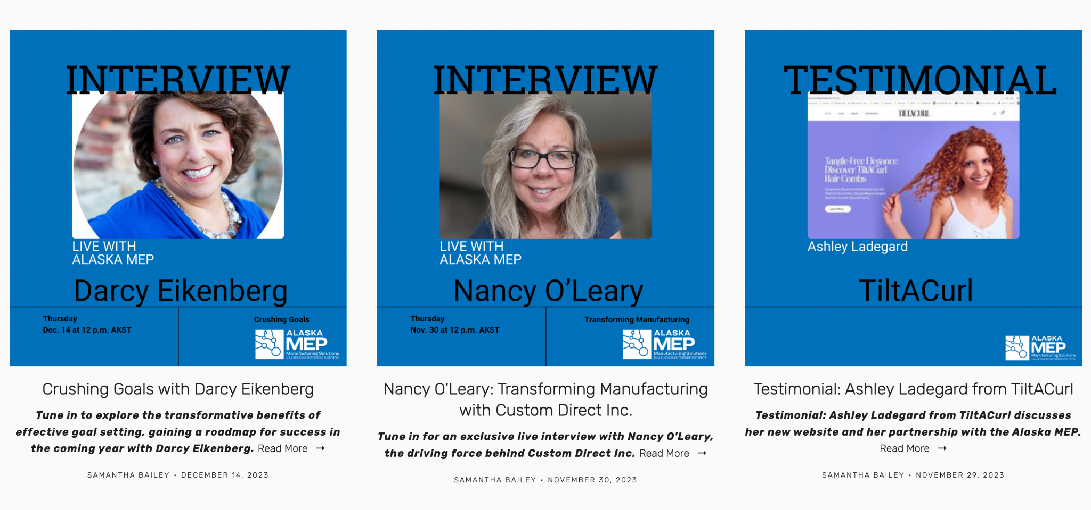

Slide 42
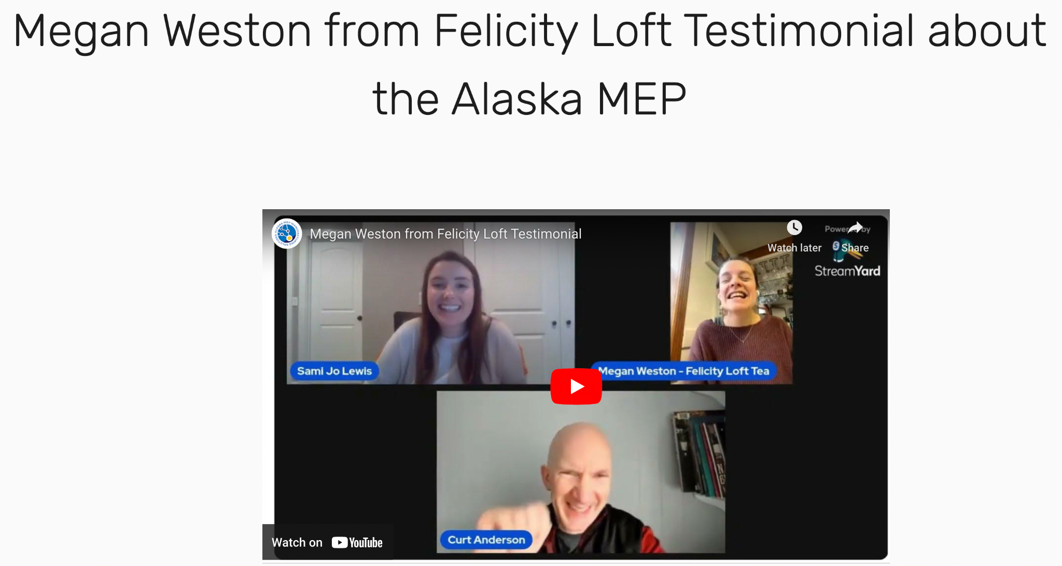
MEP Saved Client $58,000

Slide 43
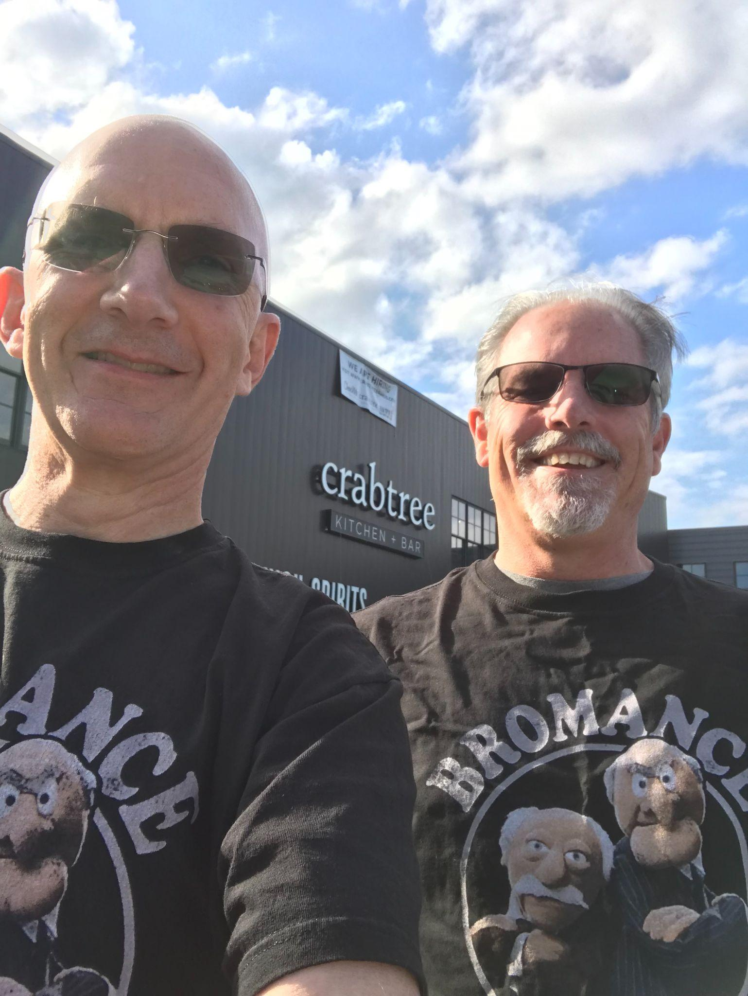
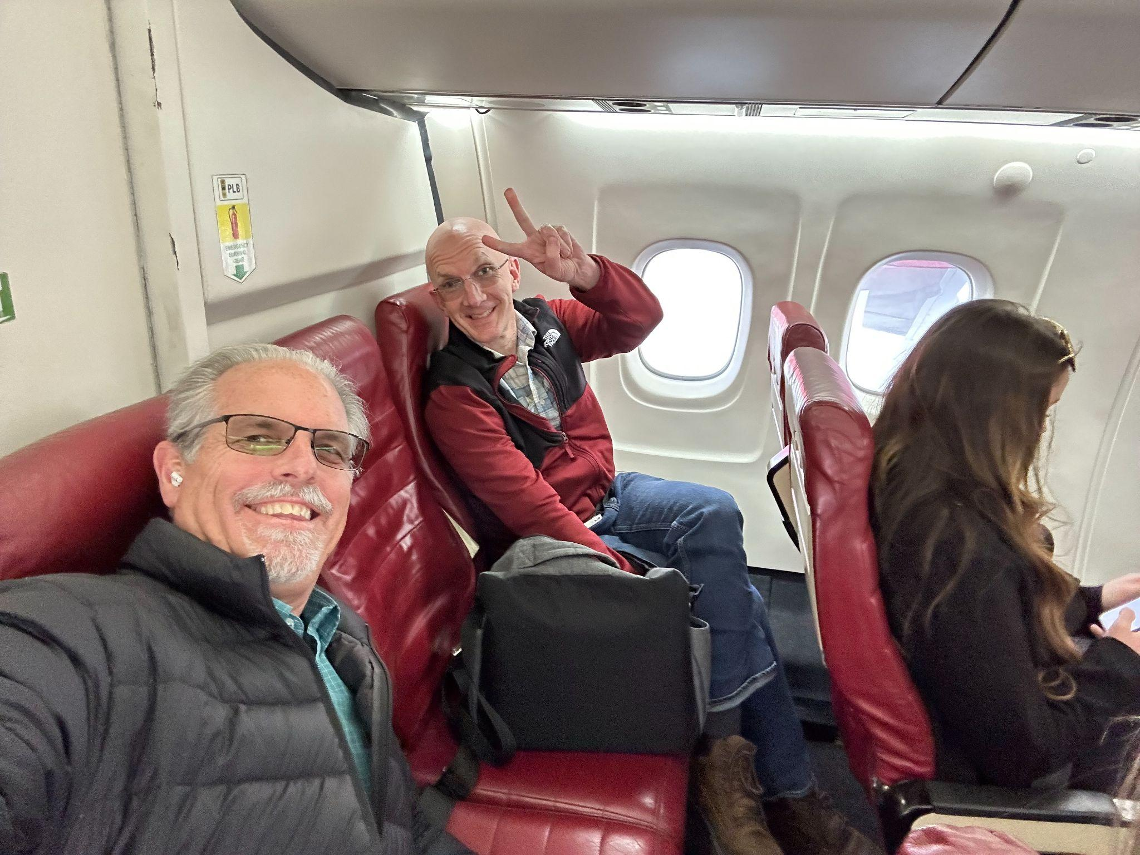
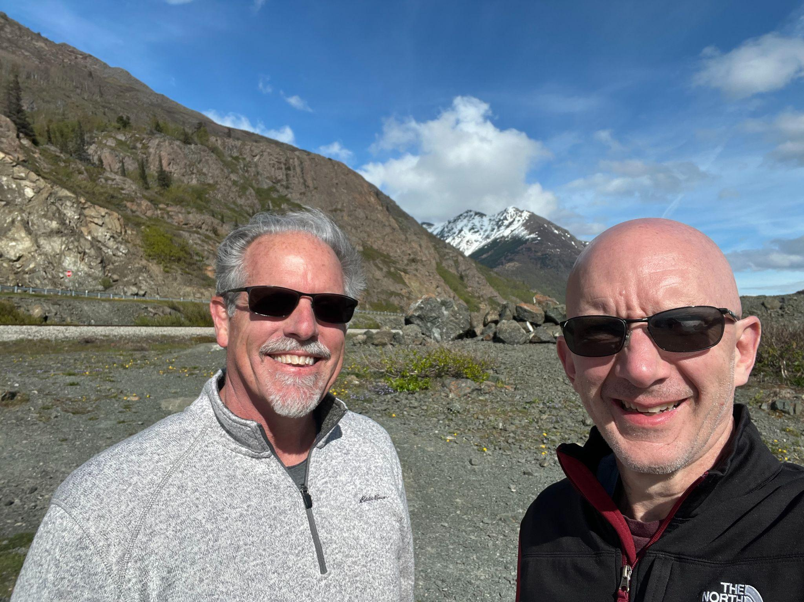
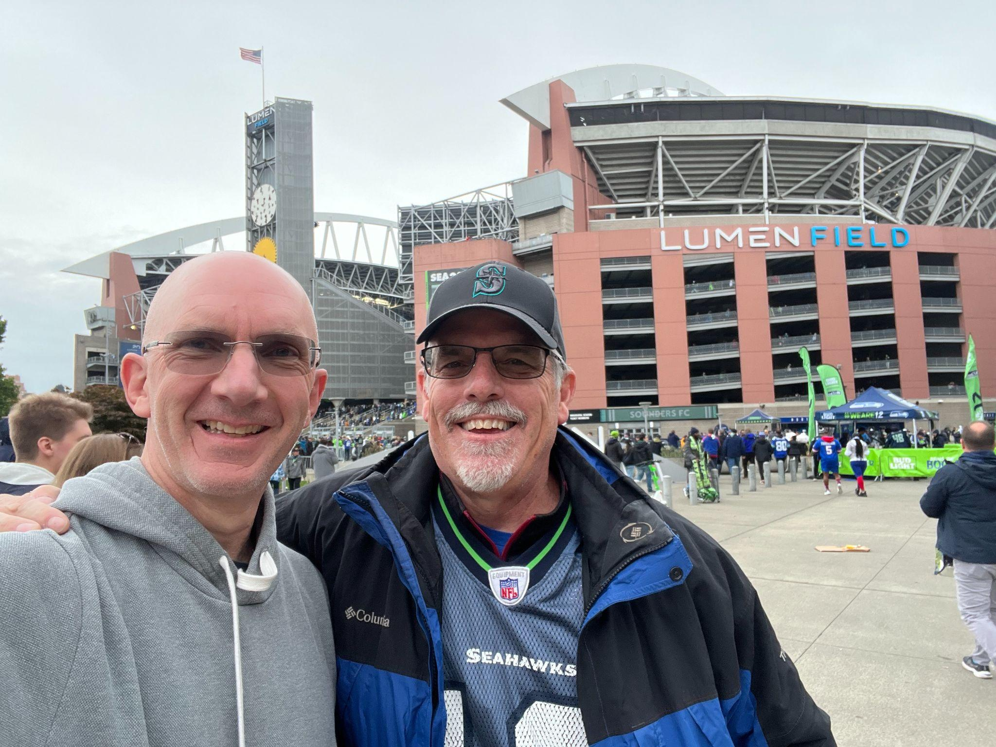
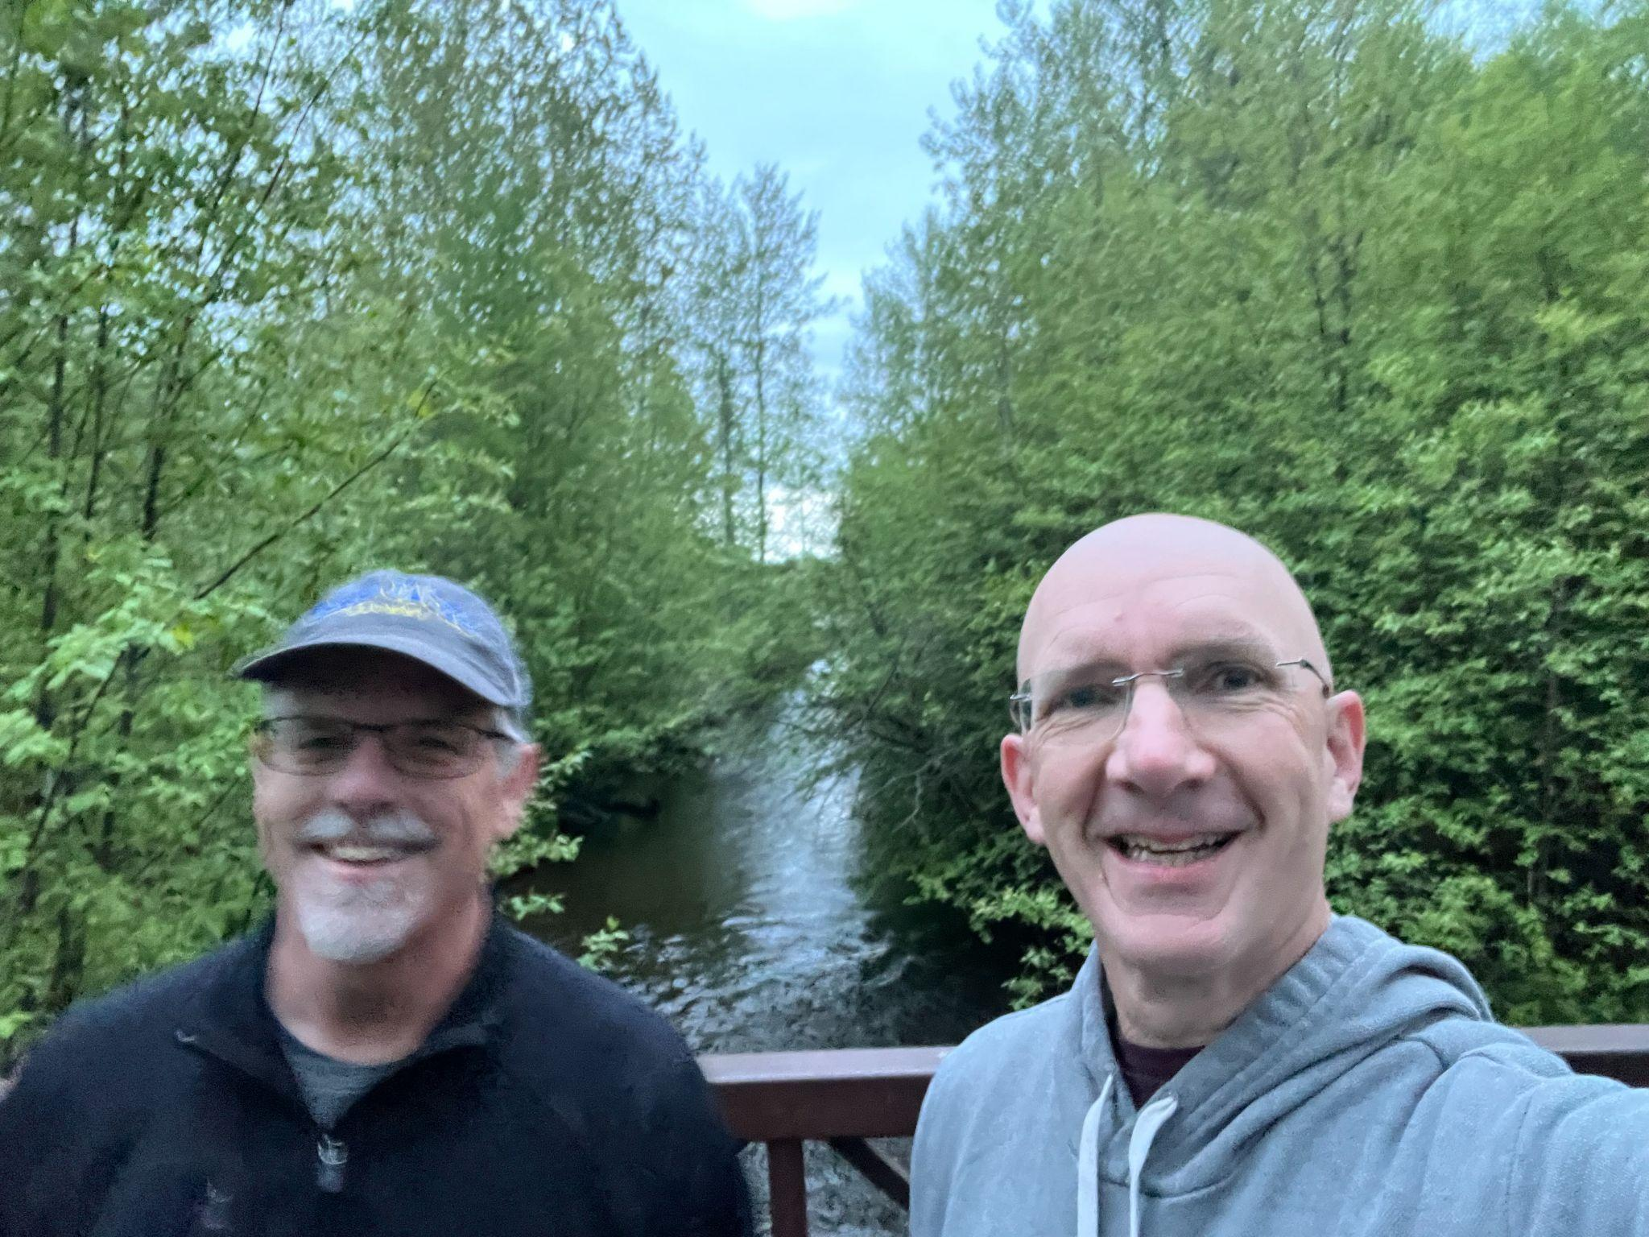
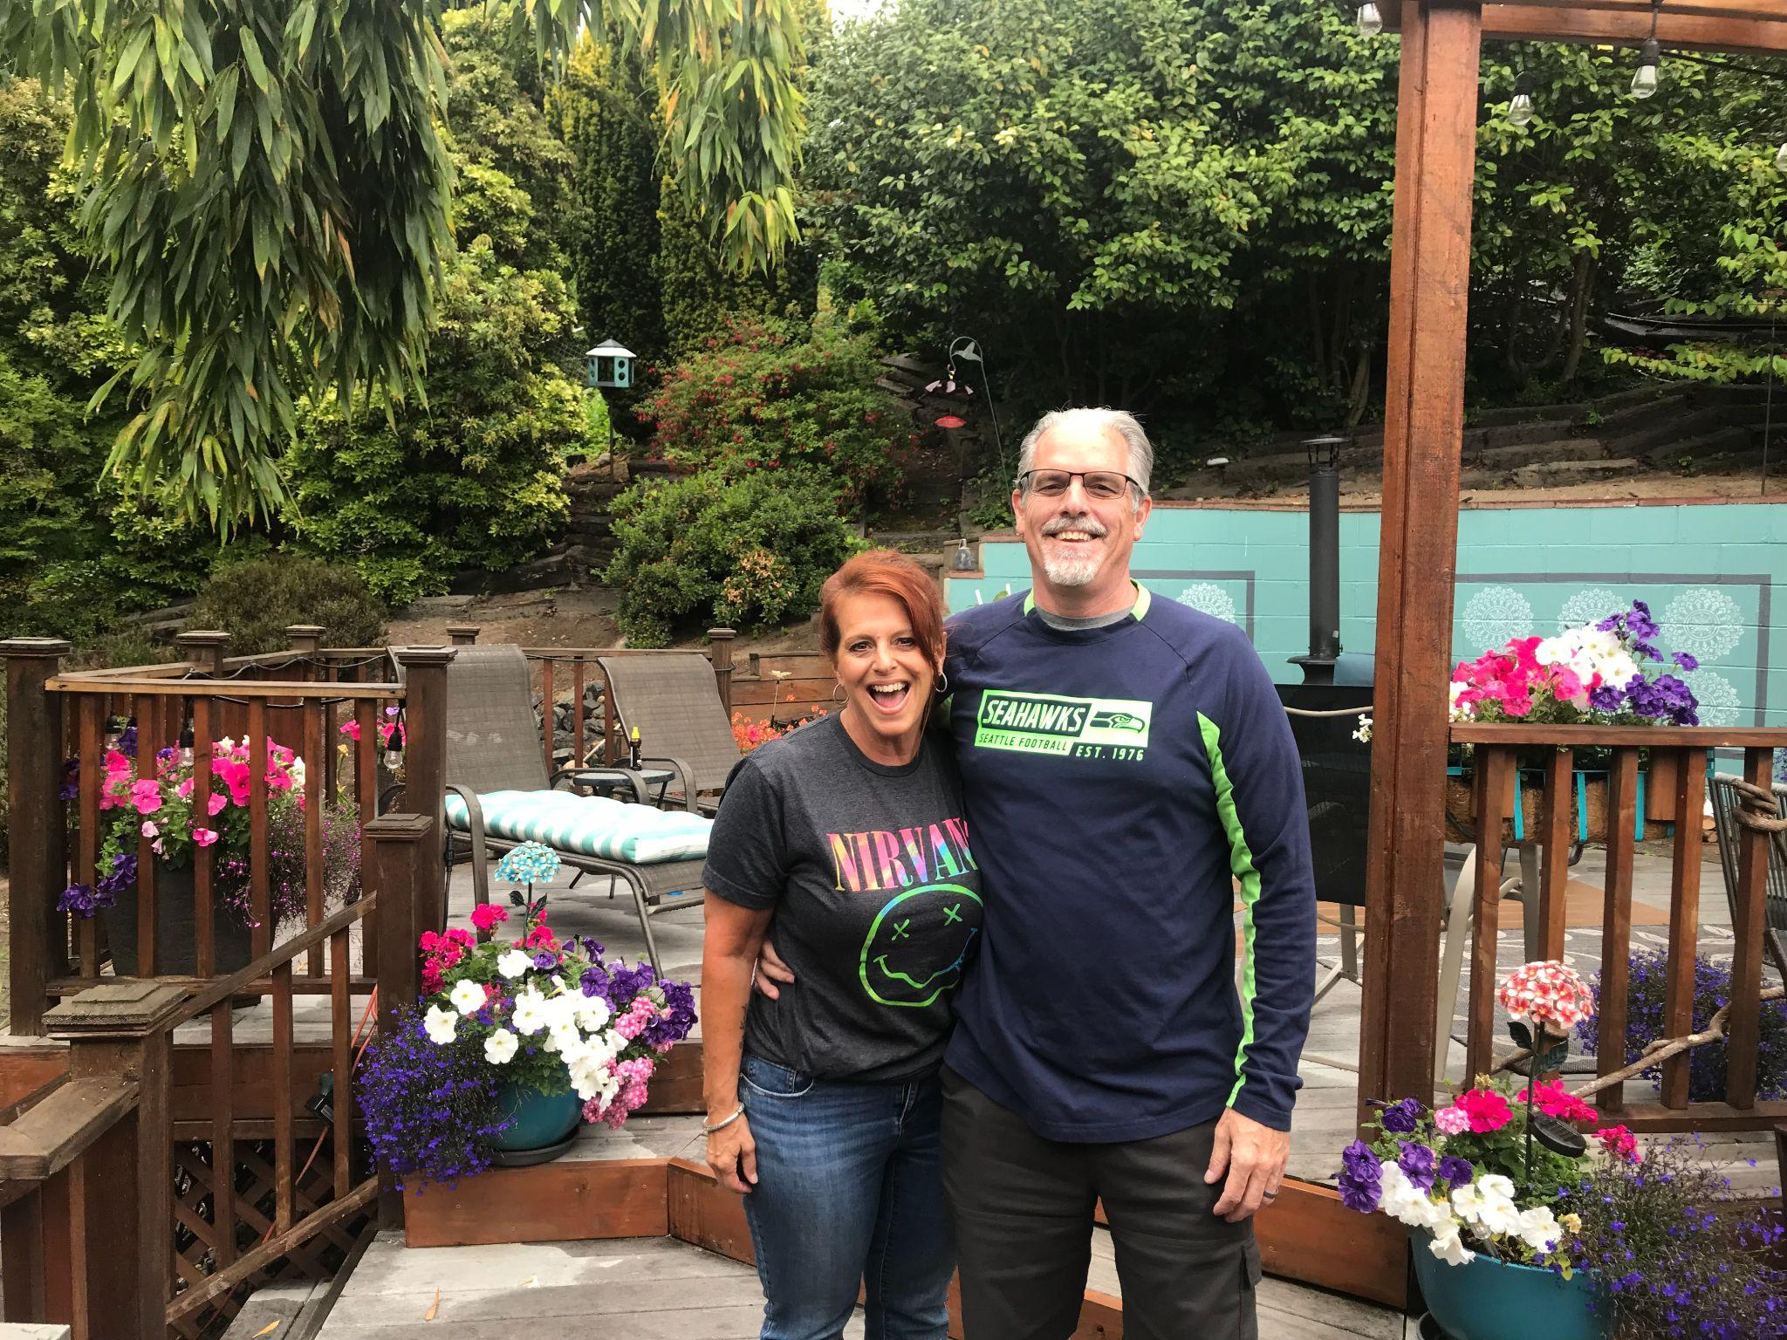
MAKE AWESOME FRIENDSHIPS

Slide 44
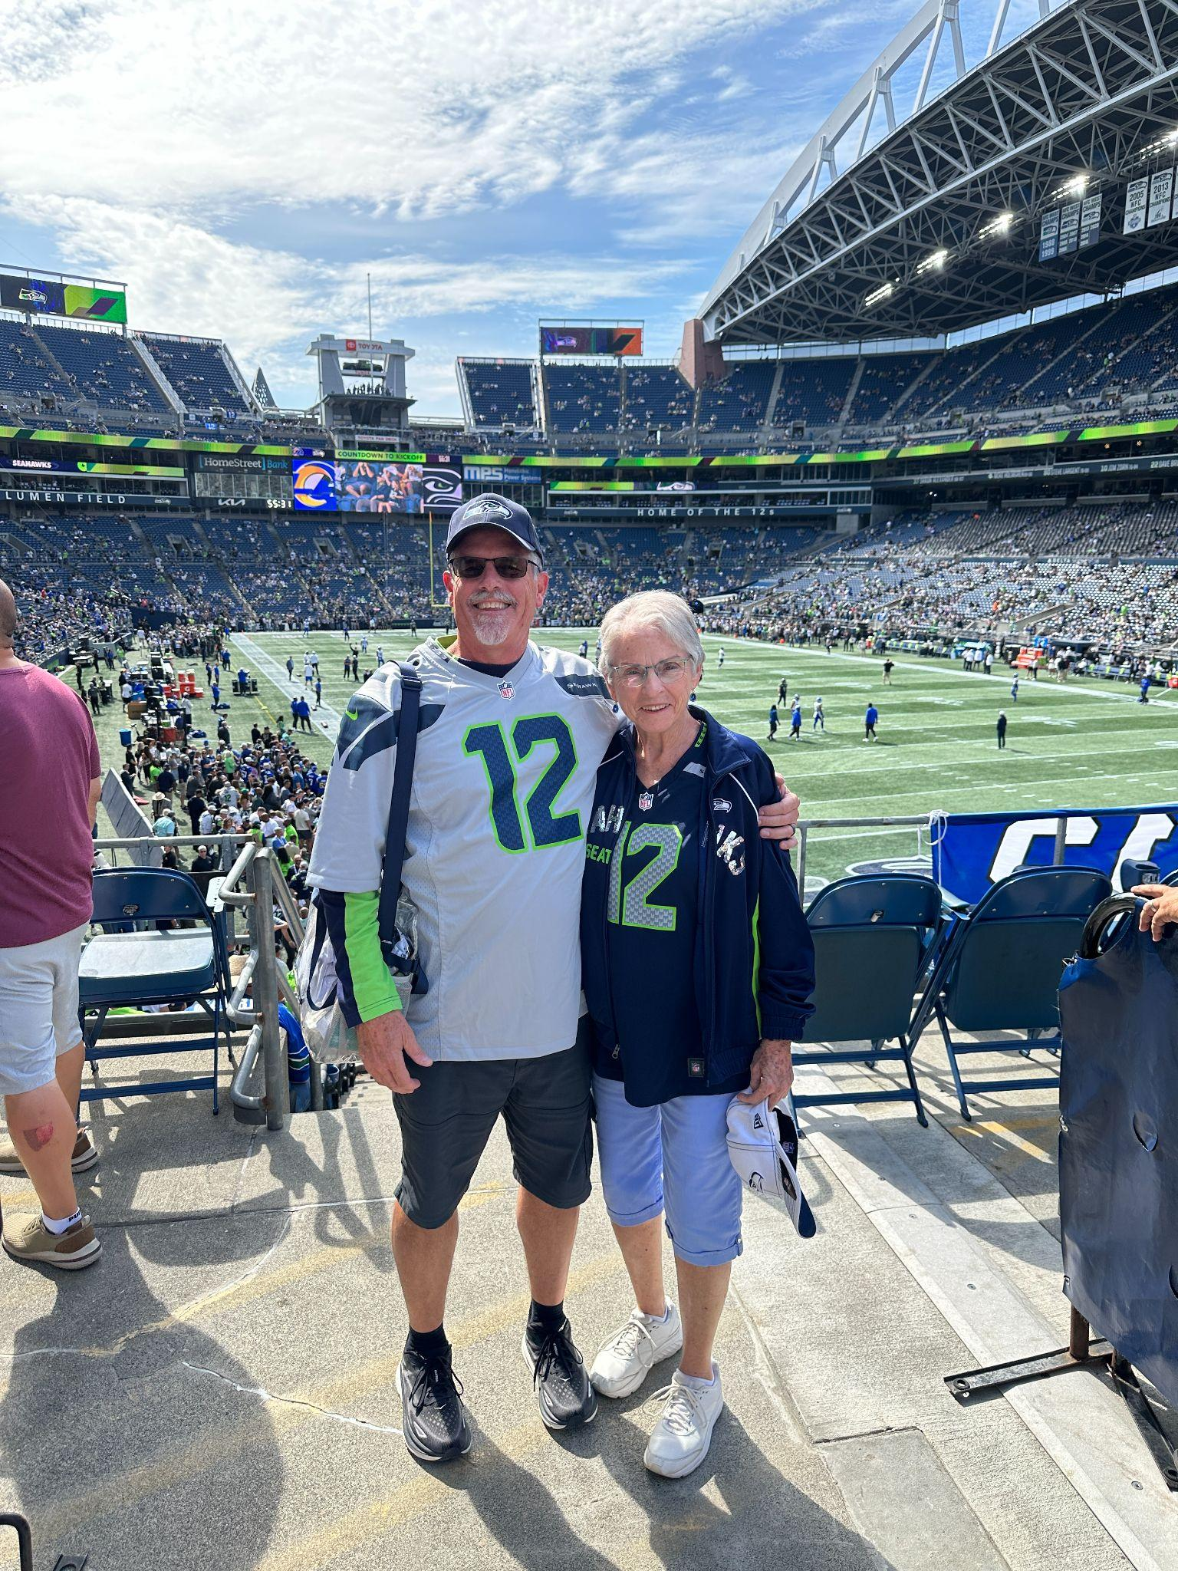
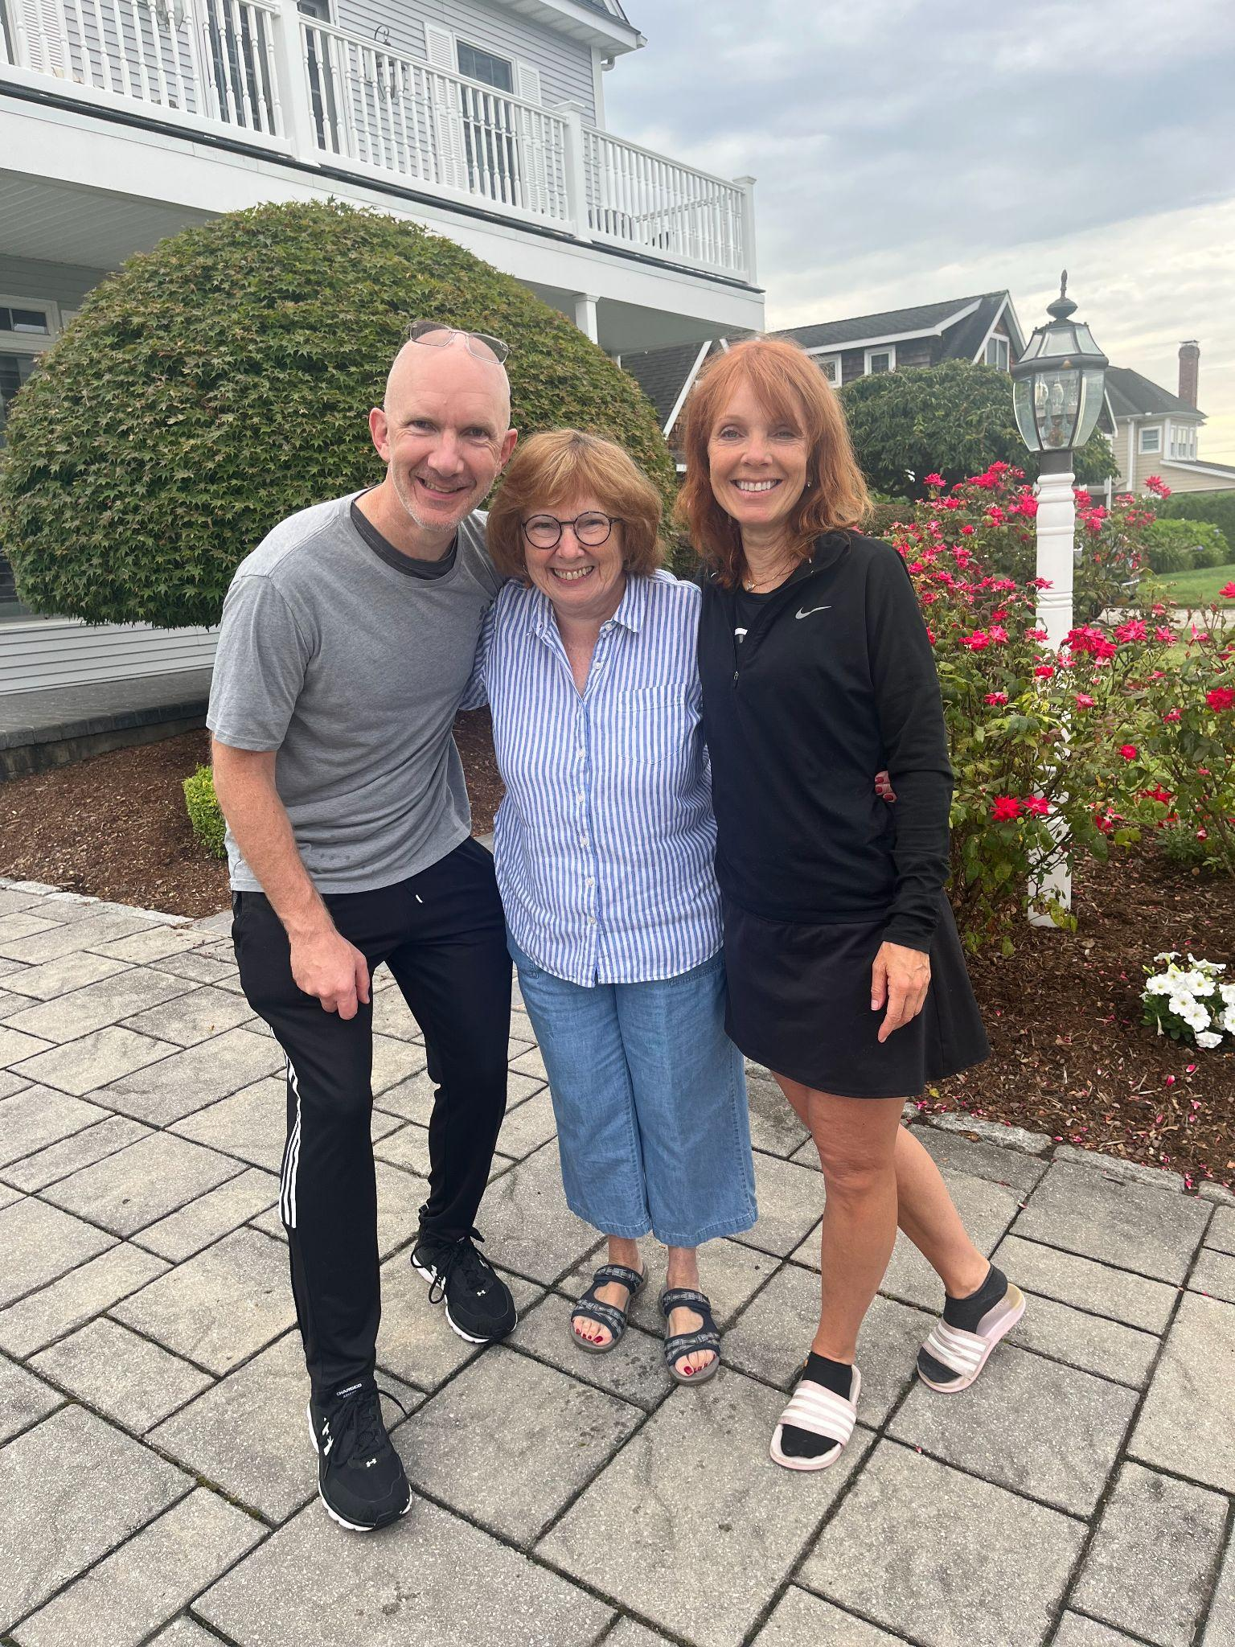
MAKE YOUR MOM PROUD

Slide 45
LIVE STREAM = ABSOLUTE BEST METHOD to….
Build AWESOME Relationships
Become a Content Machine
Capture Exciting Sales Growth Opportunities

Slide 47
Thank You!!!!
Damon@ExitYourWay.com
Curt@B2Btail.com

