Slide 1
Scorecard Sales
Creating & Selling The Customer Experience
Aaron Jacobs; MBA

Slide 2
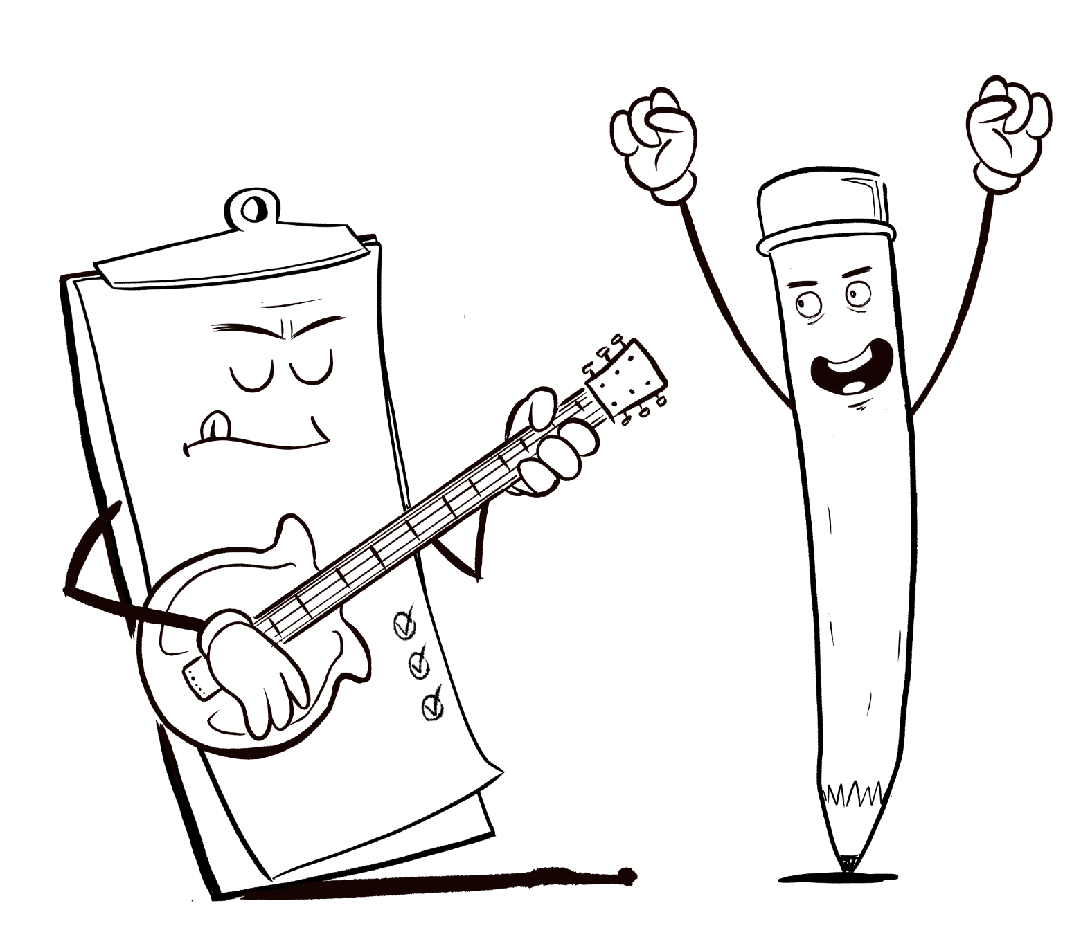
Who Is Aaron Jacobs?
Over 20 years of experience in sales, leadership, and management.
I am passionate about teaching
I am passionate business, sales, leadership
and service.
“Give people a path to success, the tools to get there, and give them a reason to smile along the way.”

Slide 3
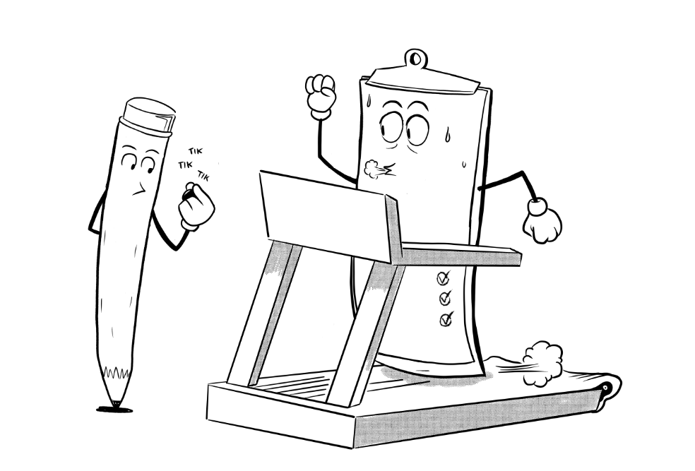
Who is Scorecard?
We are an integrative sales process improvement company.
Increase your productivity and sales.
Tools and processes to generate sustainable revenue for years to come
We optimize sales teams to maximize results

Slide 4
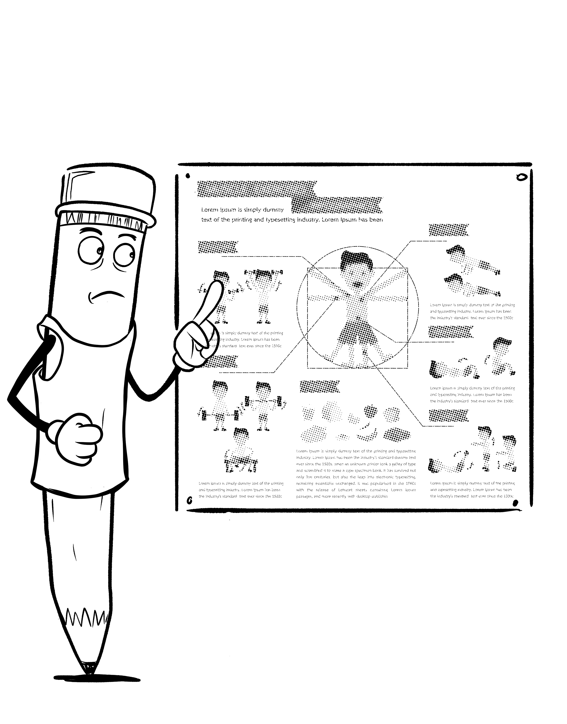
The Agenda
Understanding the customer experience
Customer experience vs. customer service
Q&A Session
Creating a customer experience
Selling the customer experience
Q&A Session

Slide 5
What do you think of when you think of a good customer experience?
What good customer experience did you have with a company?
How did the experience make you feel?
What, if anything, did you learn from that experience?

Slide 6
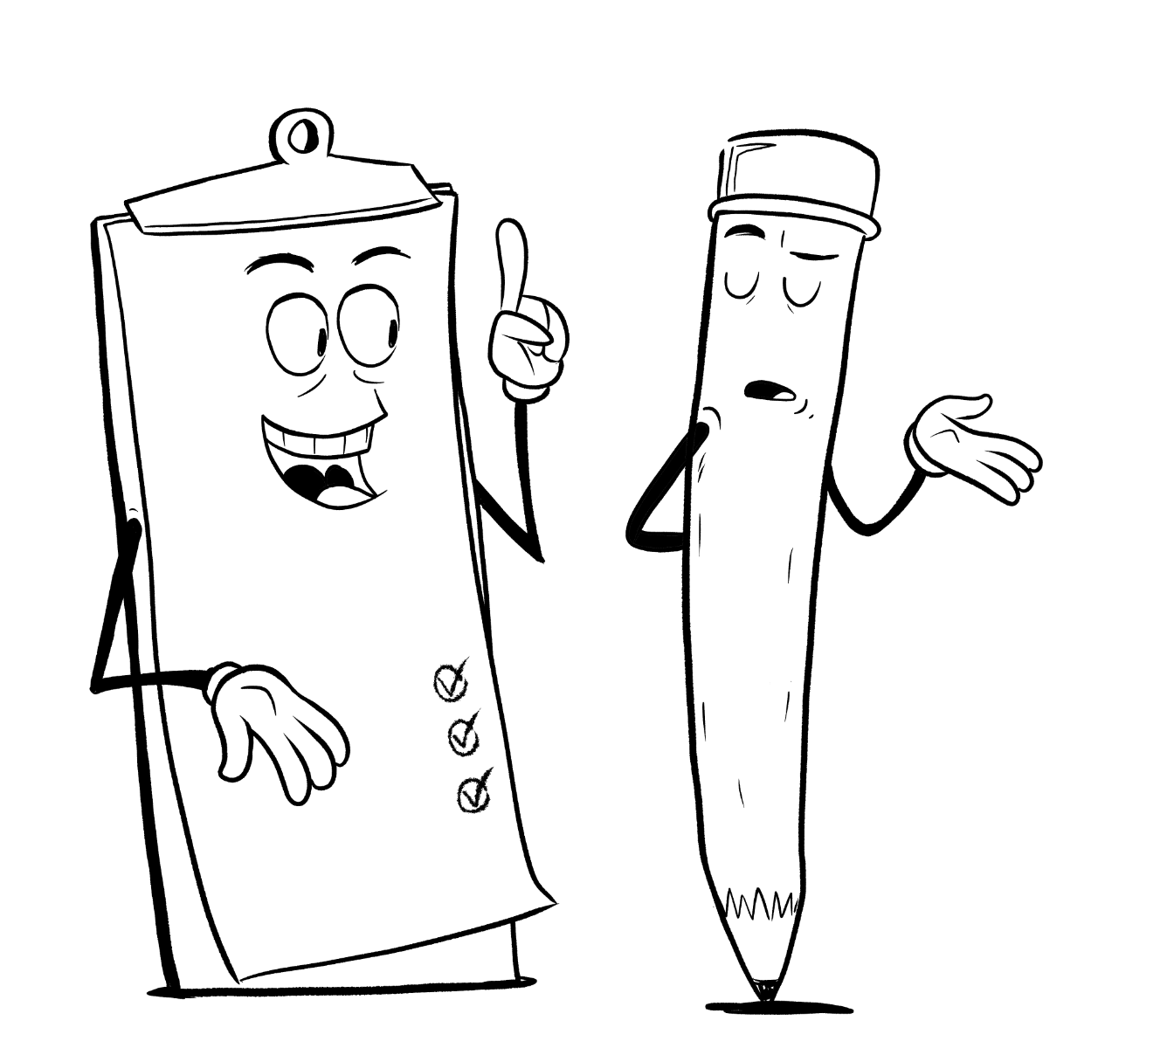
Understanding The Customer Experience

Slide 7
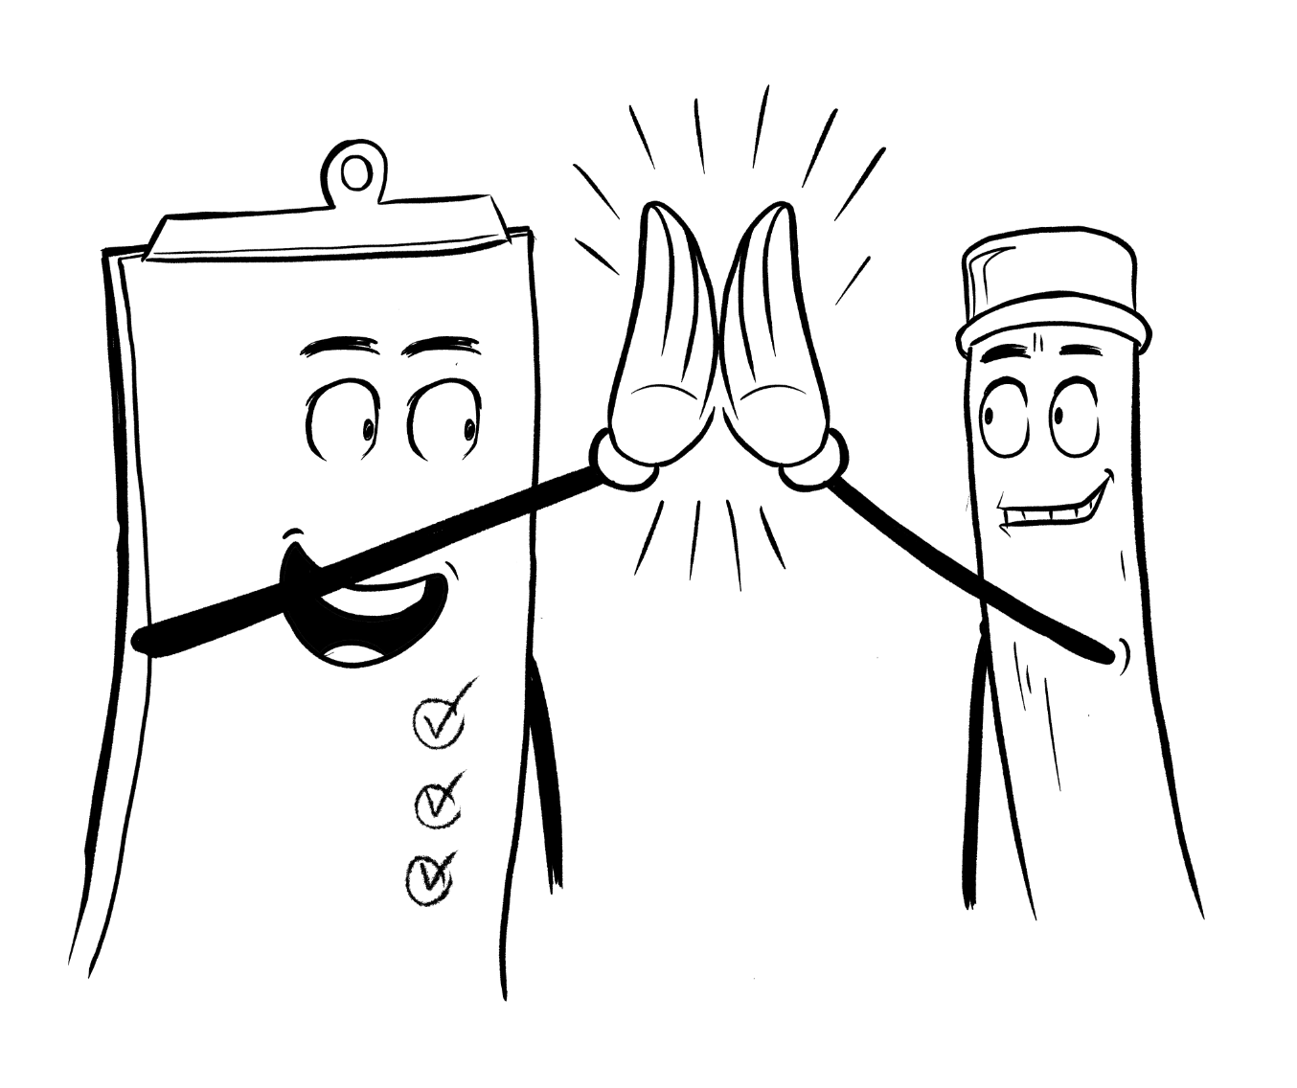
What Is Customer Experience?
A customer experience is the key emotion that is delivered to a customer consistently every time there is a touch point with your company.
Advertisements
Use of service or product
Communication
Purchasing the product or service
Assistance
Appearance
Website navigation
*Just about anything you can think of

Slide 8
Why Is Customer Experience Important?
Creates repeat customers
Creates brand loyalty
Generate word of mouth referrals
It establishes and enforces the brand
It becomes a competitive advantage
*When done properly, it creates an emotional bond between the customer and your company

Slide 9
In Other Words…
Customer Experience is based on everything your company does that creates a feeling for the customer.
First, we feel, then we think
Therefore:
Believing is seeing

Slide 10
Why is this dynamic important?
Once we feel something we begin to believe it.
Once we believe something, we seek out information that supports our notion. This includes:
Things that make us feel good
Things that make us feel bad
Customer experience can help or even hurt you if you are not careful.

Slide 11
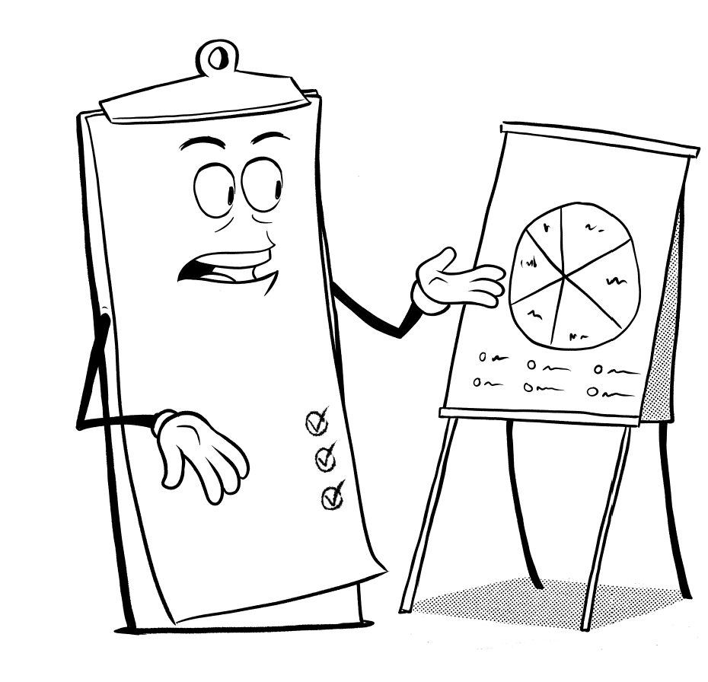
Customer Experience VS Customer Service

Slide 12
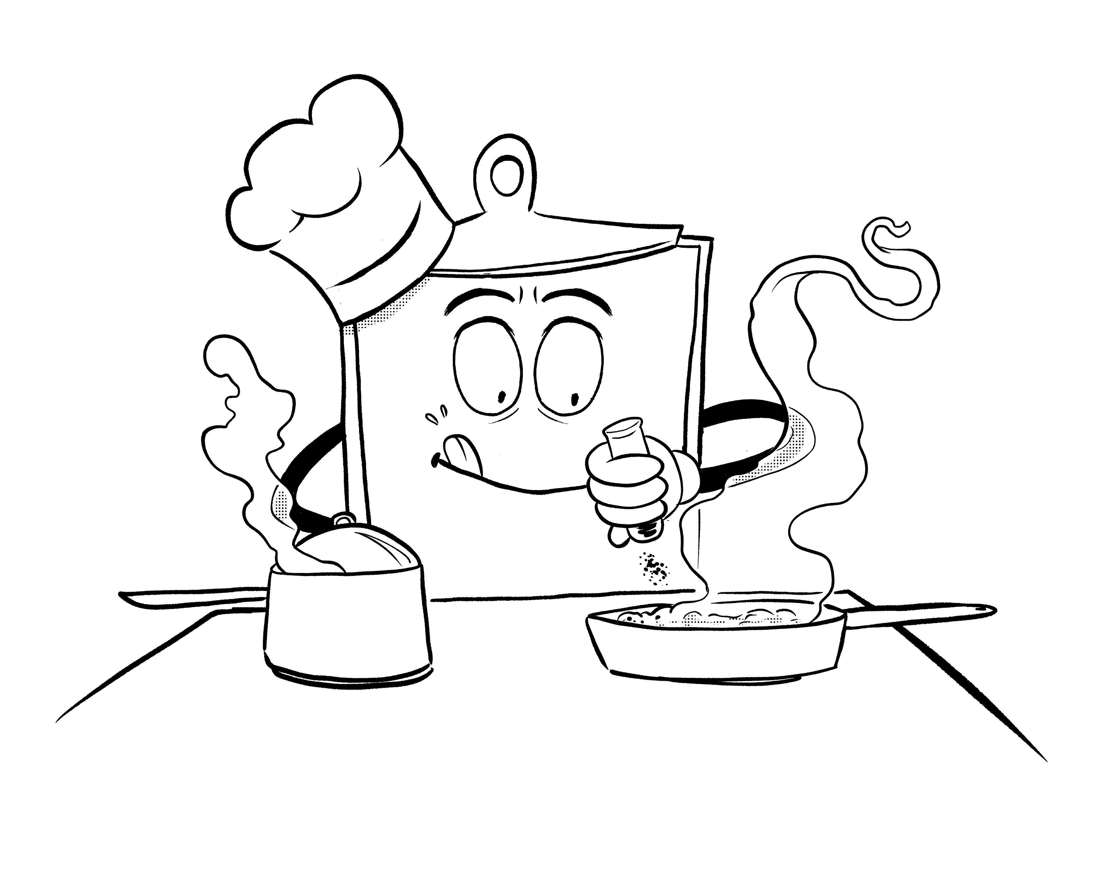
What Is Customer Service
The support you provide a customer before, during and after a sale with elements of:
Process
Communication
Interaction
Availability
Managing/ meeting expectations

Slide 13
So, What’s The Difference?
Customer service is reactive
Responding to customer needs
Connecting with the customer’s expectations
Customer experience is proactive
Responding to customer desires
Connecting with the customer’s emotions

Slide 14
Don’t Get Confused
Customer service is not mutually exclusive from customer experience.
Customer experience can be created with or without customer service.
Customer experience creates the value and customer service enforces it.

Slide 15
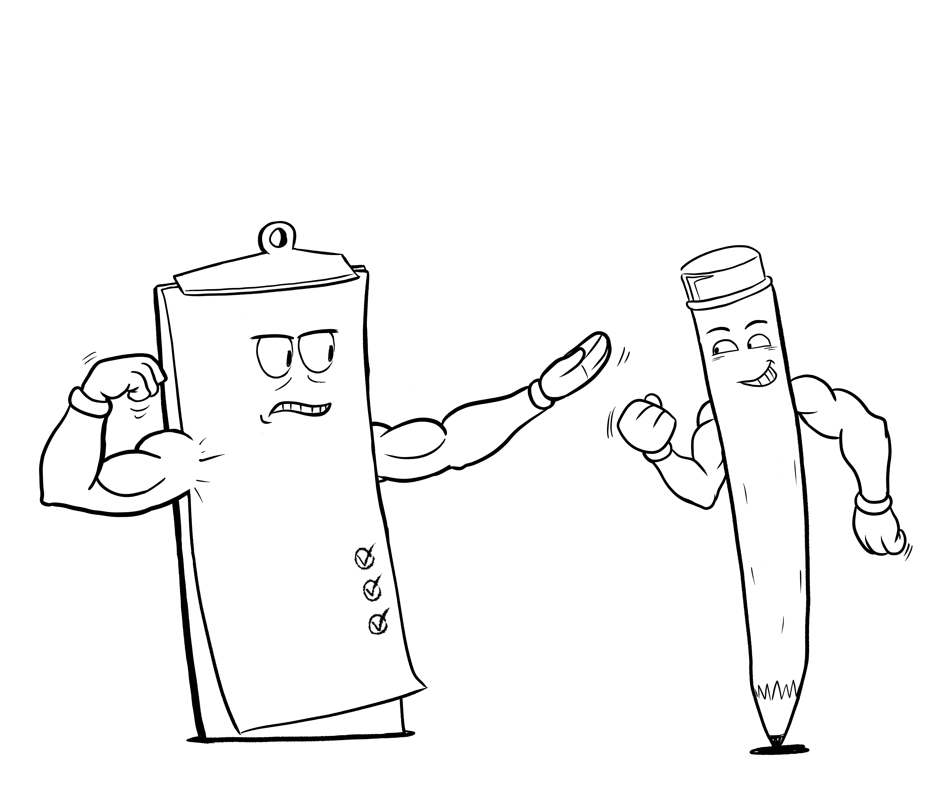
Customers Will Buy The Experience
A good customer experience should make the customer feel like:
They are your most important customer
Make them feel:
Safe
Understood
Special
Desirable
Empowered

Slide 16
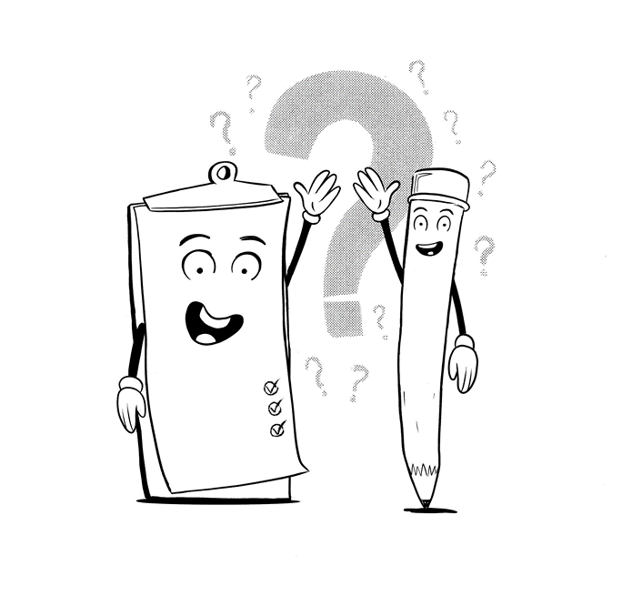
Questions

Slide 17
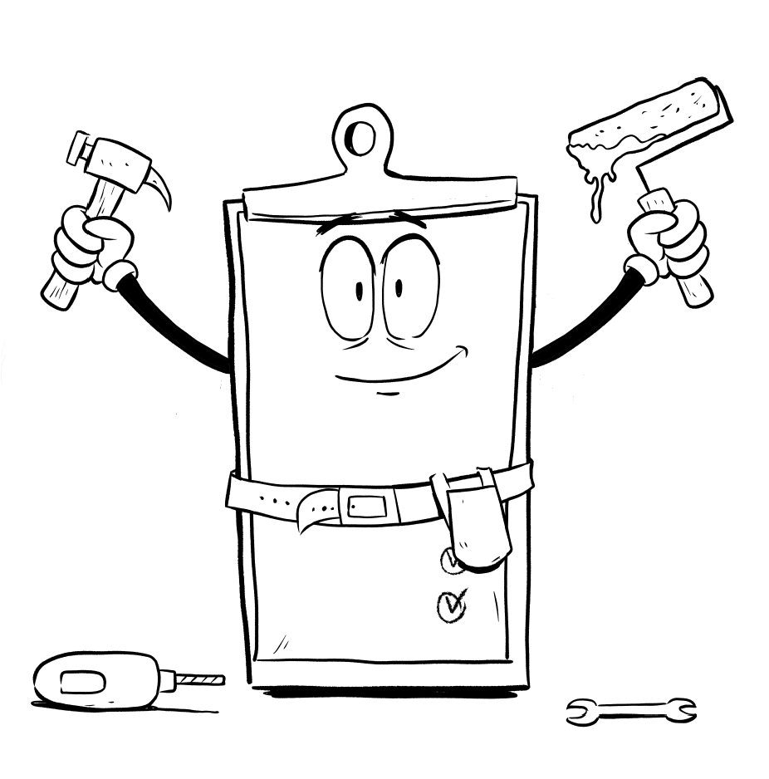
Creating A Customer Experience

Slide 18
If You Do Not Create Your Customer Experience…
One will be created for you.
You already have a reputation with customers.
Is it designed or incidental?
Is it impactful or indifferent?
Does it attract or repel customers?

Slide 19
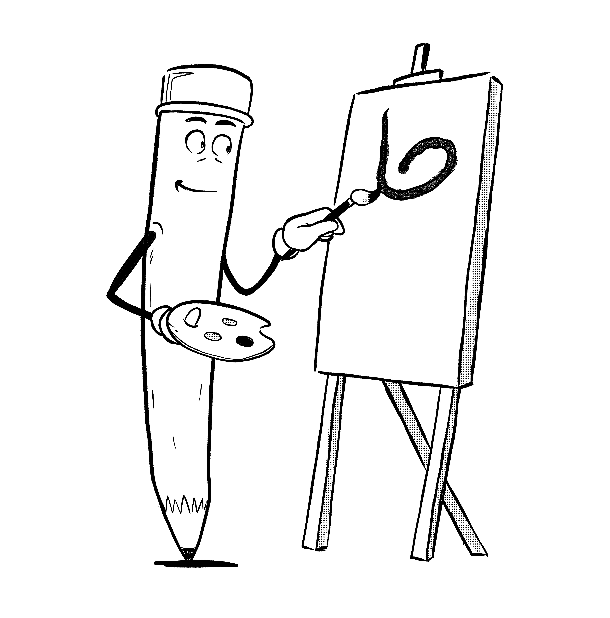
The CX 5-Way Test
Examine every customer facing aspect of your company.
Exceed the need in a way that matters with at least one or more of the following attributes to create a great customer experience
Meaningful
Memorable
Personable
Unique
Pleasant

Slide 20
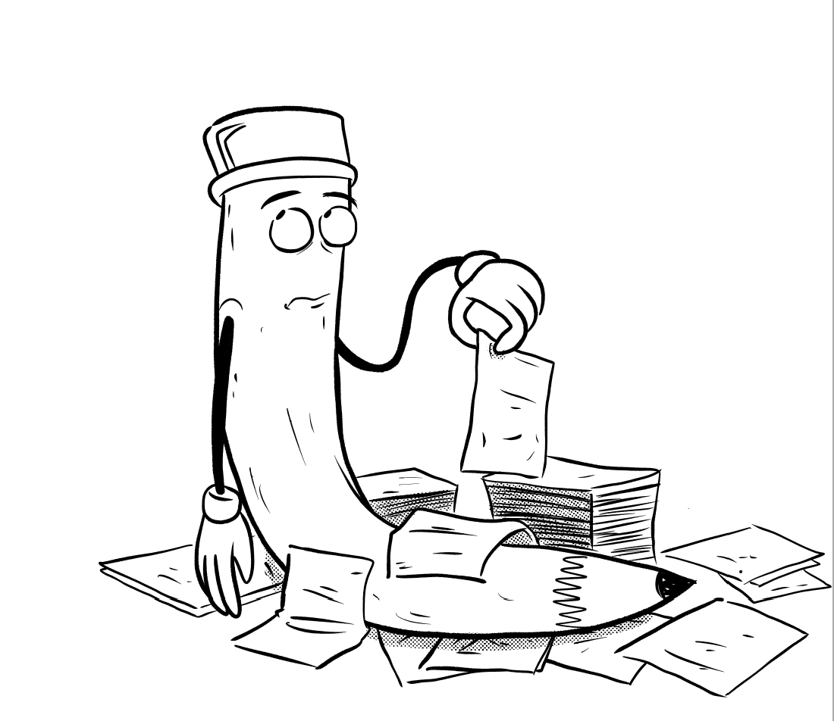
The CX Golden Rule
Never make a customer do for themselves what you can otherwise do for them.
Make the process easy.
Eliminate unnecessary or wasteful steps.
Reduce customer’s time commitment.
Be proactive with communication.
Eliminate as much stress as possible.

Slide 21
Be Consistent
Great customer experiences must be replicable and repeatable to establish itself as a true experience.
Can anyone in the company easily recreate the experience for other customers?
Can it be done in a cost-effective manner?
Can it be captured in a simple process?
Can the company commit to executing it constantly?
Can all customers expect to get a similar experience?

Slide 22
One Step At A Time
Customer experiences will not change over night
Start with something easy.
Listen to what customers are telling you.
Listen to what the team is telling you.
Stick with it
Small changes compound to make a big difference

Slide 23
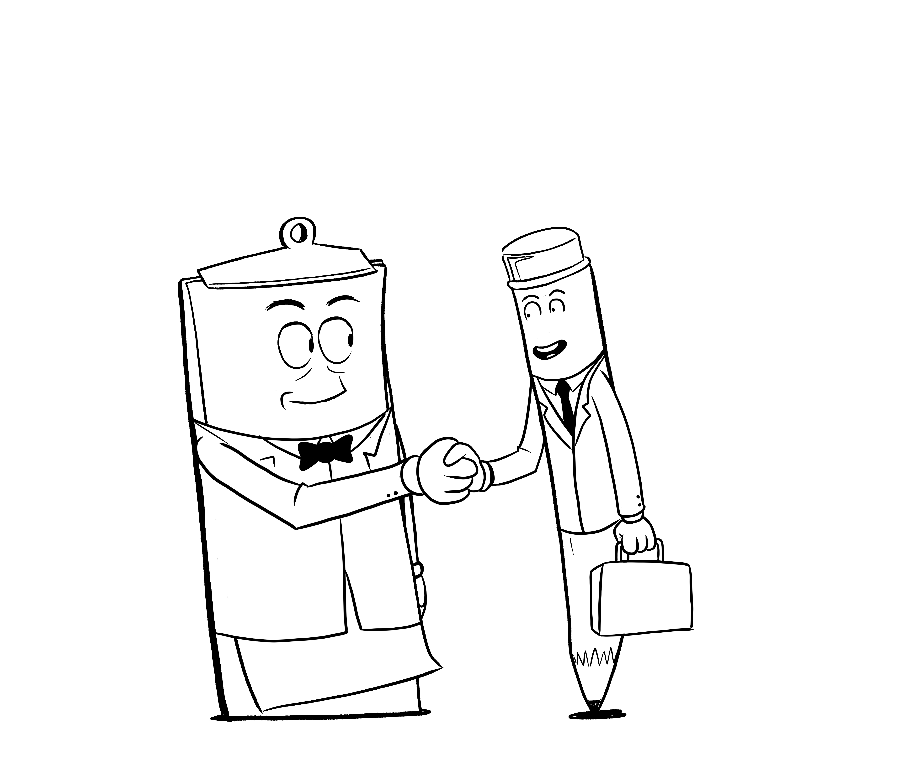
Selling The Customer Experience

Slide 24
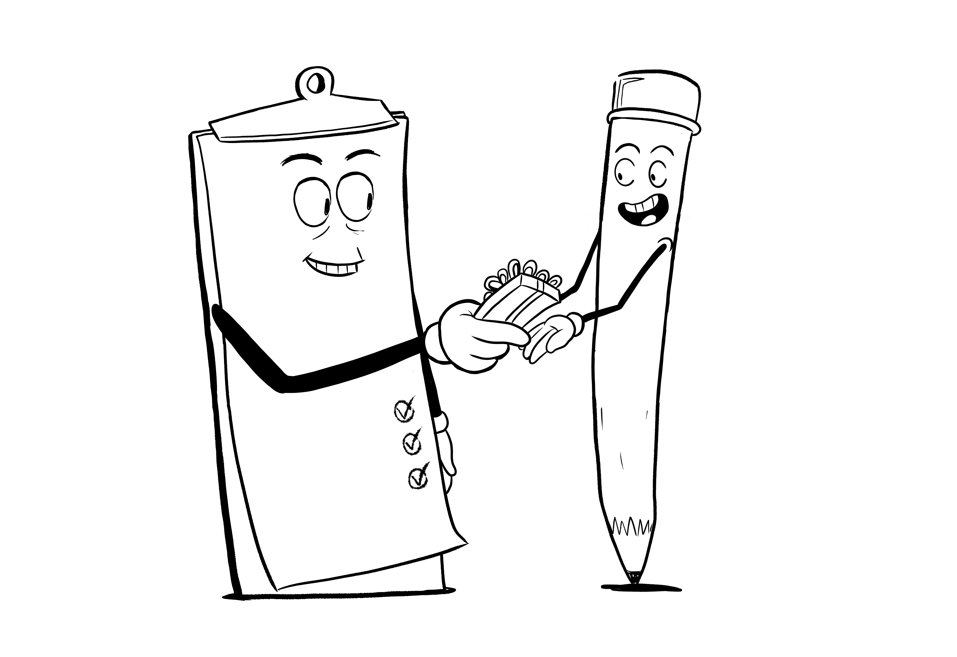
CX As A Competitive Advantage
Customer experience can, and should be, your competitive advantage if it is:
Meaningful
Memorable
Personable
Unique
Pleasant

Slide 25
The Process For Selling CX
Establish the Wow! Factor
Communicate it in a meaningful way
Connect it on an emotional level
Make it easy
Make the customer feel like they are the most important customer

Slide 26
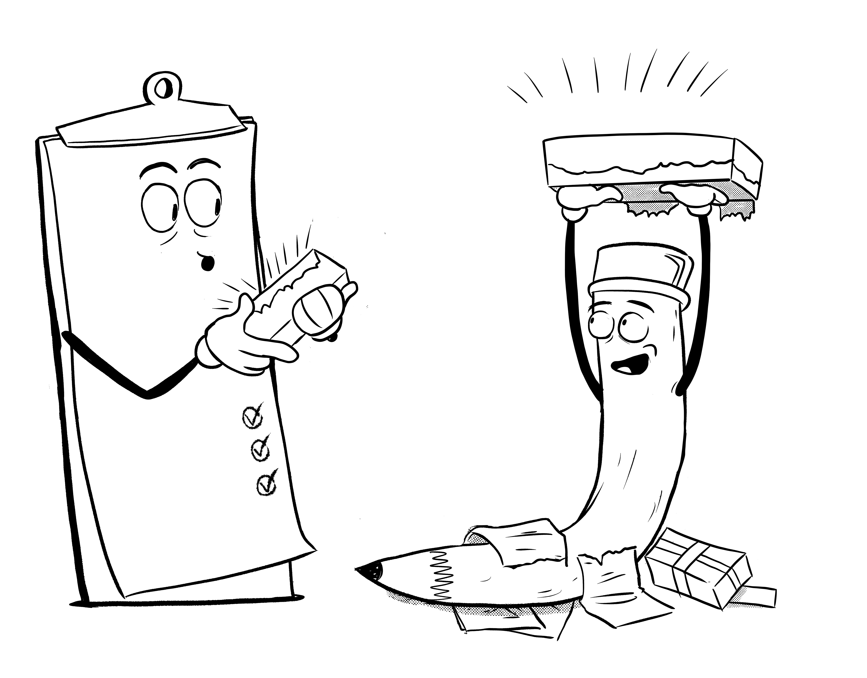
1. Estabish the Wow! Factor
Create the customer expectation that will make their experience special.
Make it a company policy
Publish it on the website
Put in front and center in marketing materials
Train the team on the implementation
Generate the resources necessary to deliver it

Slide 27
2. Communicate It In A Meaningful Way
How can you describe the promise of this experience with the least number of words possible?
Simple is satisfying
Is it slogan worthy?
Does it sound like a promise?
Can anyone in the company state it?
Will every customer understand it?

Slide 28
3. Connect It On An Emotional Level
How will this aspect of the customer experience make the customer feel?
Will it appeal to their ego?
Will it reduce their risk and uncertainty?
Will it make the customer feel understood?
Will it help the customer to be empowered?
Will it make them feel good about their purchase?
Will it make them feel like a part of your brand?

Slide 29
4. Make It Easy
Easy is valuable to everyone
Demonstrate the simplicity of the experience.
Show customers how much time it saves.
Make it easy to understand.
Support their intelligence; don’t insult it.
Create the value to correlate the price.

Slide 30
5. Make The Customer Feel Like Your Most Important Customer
When customers feel special, they will spend more. They should say:
“That felt really good”
“I can’t wait to tell my friends”
“That was better than I was expecting”
“I wish the other places I did business with did that”
“I’m looking forward to doing more business with you”

Slide 31
Selling The Customer Experience
You are not just the products and services of your company.
You are not just the solutions you bring to customers.
You are not just the relationship that the customer appreciates.
You are not just the results that a customer achieves.
You are not just about providing value.
Customers only buy 2 things; solutions to problems and things that make them feel good.
Make the journey for the customer feel good and you will sell the customer experience and win more customers.

Slide 32
Virtual Classroom Summary
First, we feel, then we think.
Customer service is reactive (needs) & customer experience is proactive (emotions).
Customer experience should be meaningful, memorable, personable, unique & pleasant.
Never make a customer do for themselves what you can otherwise do for them.
Sell the customer experience with a Wow! Factor, communicate it meaningfully, connect it emotionally, make it easy and make the customer feel like they are your most important one.
Customers buy 2 things; solutions to problems & things that make them feel good.

Slide 33
Questions

Slide 34
Aaron Jacobs
We can help you with your sales training & sales process.
Let’s keep the discussion going.
ajacobs@scorecardsales.com
Find us on Facebook and LinkedIn
www.scorecardsales.com

