Slide 1
SUSTAINABILITY
FOR
MANUFACTURERS.
4 Ways Sustainability Drives Profitability
Presenter: Todd Weinstein, President and Founder, ESG OWL
February 8, 2024
Notes:
Record for staff not in attendance.
https://imec.box.com/v/TeamHuddlesPast

Slide 2


Introduction
ESG OWL provides Fractional Sustainability services
to enable Small and Medium Size Manufacturers
to boost their bottom line.
Todd Weinstein
Founder, ESG OWL

Slide 3
What is Sustainability?
“
Meeting the needs of the present, without compromising the ability of future generations to meet their own needs.
United Nations Brundtland Commission (1987)

Slide 4
A Typical Manufacturing Process
Inputs
Production
Outputs
Design
Raw Materials
Knowledge
Transform materials
Machining
Skilled Labor
Robotics
Finished Parts / Products
Quality Check
Shipped to Customer

Slide 5
#1
Reduce Inputs

Slide 6
#1 Reduce Inputs
Materials
Identify over-engineered parts
Reduce waste during production
Reduce Costs
&
Reduce Carbon Emissions
Lean
Re-use scrap waste in another process
Reduce excess movement
Energy
Batching and scheduling
Energy efficient equipment
Fix compressed air leaks
Supplier Locations
Purchase raw materials from local suppliers
Reduce fuel for shipping

Slide 7
#1 Reduce Inputs:
Energy Efficiency
Heat Pumps for Heating and Cooling
Heat Pumps for Hot Water
Thermal Solar Panels
(pre-heat water)
Compressed Air Leaks
Insulation
Leverage Waste Heat for other purposes
LED Lighting Retrofit
Fuel Switching
Equipment
Shut-down

Slide 8
#2
Greenify Product

Slide 9

#2 Greenify Product
2x
27%
“
Compound Annual Growth Rate (CAGR) of Sustainability Marketed products compared to conventional products over past 5 years
Price premium for Sustainability Marketed Products
Sustainability can be a source of durable competitive advantage, and the ROI will come from profitable growth from new sustainable offerings.
Georg Winkler,
McKinsey, Senior Partner
Source: NYU Stern Center for Sustainable Business

Slide 10
#2 Greenify Product
Greener Product
Drive sales Volume with a more competitive product with equivalent quality
Increase Revenue
&
Reduce Carbon Emissions
Green Premium
Increase Price with an environmentally-friendly product
Supplier Score
Third-party supplier evaluation tools drive revenue (I.e., CDP, EcoVadis, etc.)
New customers searching for suppliers with high scores

Slide 11
#3
Risk Management

Slide 12



#3 Risk Management is Attractive to Investors
90%
13%
52%
Of Professional Investors use ESG in their analysis
Of Professional Investors see ESG as a “passing fad that will go out of fashion”
Of execs say Science-Based targets boosted investor confidence in their business
Source: Capital Group
Source: Capital Group
Source: SBTi, YouGov survey

Slide 13
#3 Risk Management is Attractive to Investors
Investors
Climate is included on ESG checklist for Private Equity and Venture Capital firms
Higher Company Valuation
&
Reduce Sustain-ability Risks
Risk Management
Understanding and managing ESG risks is representative of a well-managed business
Improved Loan Rates
Select banks will offer discounted loan interest rates for proactive ESG strategies (Sustainability-Linked Loan)
Green Bonds
Raise capital to invest in emission reduction capital investments

Slide 14
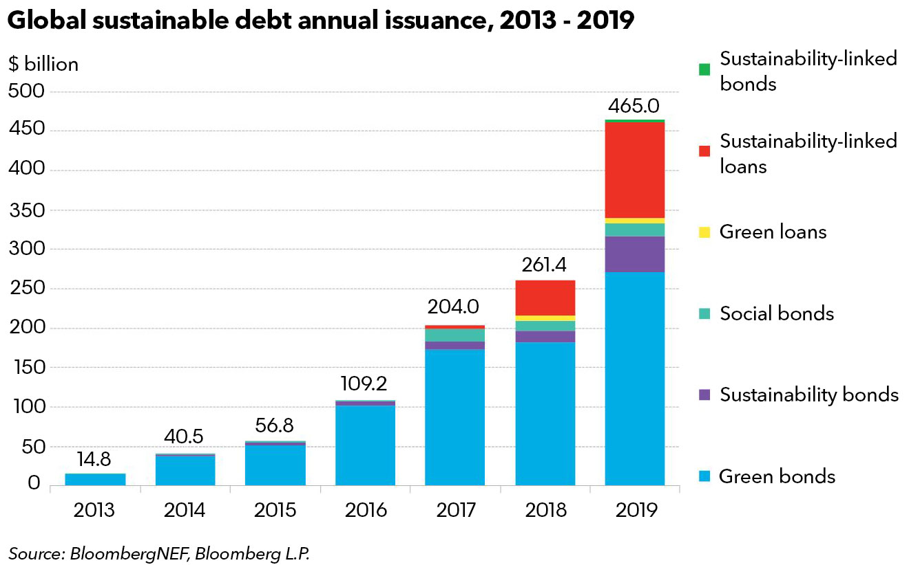
#3 Risk Management is Attractive to Investors

Slide 15
#4
Employee
Well-Being

Slide 16
#4 Employee Well-Being
54%
70%
Gen Z & Millennials % of Workforce
Of Gen Z & Millennials research a company’s environmental policy before accepting a job
Of Employees are more loyal to company that contributes to Sustainability and Social matters
72%
52%
2019
2029
Source: The Deloitte Global 2023
Gen Z and Millennial Survey
Source: Cone Communication Employee
Engagement Survey
Source: Marsh McLennan

Slide 17
#4 Employee Well-Being
Hiring
Strong Sustainability communications and investment attract new hires
Lower Employee Recruitment and Training Cost
&
Reduce Sustainability Risks
Retain Employees
Employees enjoy working for mission-driven companies
Employee
Well-Being
Companies that manage ESG are more likely to provide employee benefits such as healthcare, retirement, living wage, and other benefits.
Hiring cost ranges from $5,000 to $50,000+

Slide 18
Let’s Collaborate!

Slide 19
Collaborate with ESG OWL!
ESG OWL
Carbon
Footprint
1)Measure
3)Act
4)Report
2)Plan
The key steps are familiar
  Identify sources of emissions and focus on largest categories.
  Develop plans and options to reduce emissions. Balance cost/impact/risk/time to implement.
  Execute the plan.
  Report on the progress to interested stakeholders.
  Repeat over multiple years to reach net zero.
ESG OWL
Fractional Sustainability

Slide 20
ESG OWL Fractional Sustainability
Fractional Sustainability services provides you with cost-effective expertise to support your climate initiatives.
Starter
Intermediate
Advanced
Up to 4 hours/month
Write Policies
1 on 1 Executive Level Strategy and Guidance
Participate in Sustainability Committee
Ad hoc sustainability research and tasks
Up to 16 hours/month
Write Policies
1 on 1 Executive Level Strategy and Guidance
Co-facilitate Sustainability Committee
Set Climate Target
Decarbonization strategy
Coordinate sustainability initiatives (CDP, EcoVadis, etc.)
Customer Inquiries/ Questionnaires
Up to 40 hours/month
Write Policies
1 on 1 Executive Level Strategy and Guidance
Lead Sustainability Committee
Set Climate Target
Decarbonization strategy
Coordinate sustainability initiatives
Customer Inquiries/ Questionnaires
Scope 3 Emissions

Slide 21
Recap

Slide 22
4 Ways Sustainability Drives Profitability
#1
Reduce Inputs
Less Expense
#2
Greenify Product
More Revenue
#3
Risk Management
Improved Balance Sheet
#4
Employee Well-Being
Less HR Expense

Slide 23


Q&A
Let’s Discuss Your Questions!
Stay in Touch
Subscribe to ESG OWL Insights newsletter at www.esgowl.com
Follow “ESG OWL” on LinkedIn
1
2

Slide 24
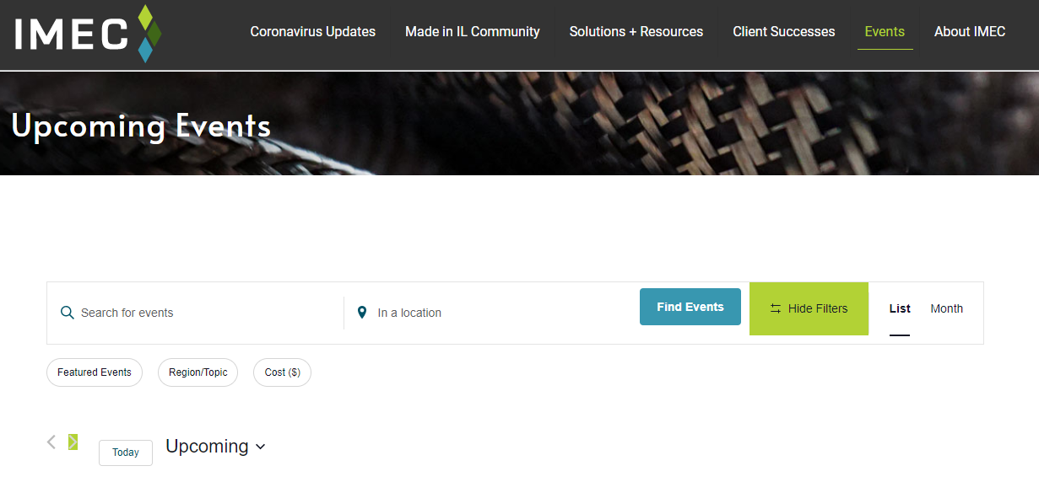
UPCOMING IMEC EVENTS
Visit www.IMEC.org/Events/ for the complete list of upcoming events.

