Slide 1
REMOVE THE ROADBLOCKS
How to get 'Unstuck'
Personally and Professionally
Notes:
EVIE

Slide 2
Today’s Outcomes
Learn the five ways people get stuck & how to break out of the cyclical pattern
Apply these five ways to both your personal & business life breaking free of the ‘glass box’
Identify when you or others are stuck and apply a 4-step formula to help them be more productive
Notes:
TOM
What does stuck look like?
-TOOLS – Our Focus Four Formula are tools that help you move through the stuck zone to take action to move forward.
2

Slide 3
Intention for today
Challenge you to become aware of how you,“really” speak and listen and how you can take advantage of these “rules” to create breakthroughs in your life,
personally and professionally.
Notes:
EVIE
3

Slide 4
How you can“listen” today
“In the beginner’s mind, there are many
possibilities, but in the expert’s there are few.”
-Shunryu Suzuki, “Zen Mind, Beginner’s Mind”
Notes:
EVIE - counter- intuitive (Use the finger trap)
4

Slide 5
Be aware of listening “filters”
They are the real key to ongoing successful performance.
Notes:
Tom - And the first step to getting ‘unstuck’
Do your filters stop you from hearing?
Try this visualization exercise: Imagine going through your day with an Artificial Intelligence (AI) device over your ears. Imagine that in each conversation you experience, the other person's words travel through the AI and it assumes the meaning of the words being spoken to you, based on your individual history.
But this isn’t an exercise. It happens every time you engage in a conversation with another human being, although for the most part, it is unconscious. The point here is to become aware of the (unconscious) listening filters each of us develops early in life and carries with us into adulthood.
I'm bad: For example, if you grew up with a highly critical parent or caregiver, you may have created a self-image filter that now translates as: "I'm bad. I've done something wrong”. This then becomes a listening filter that taints many of the communications you hear, because you’re unconsciously listening out for the other person to make a critical judgment of you.
So, for example, if your boss, a colleague or your partner says to you “I’m feeling upset right now,” you immediately look at yourself and begin to search for what you've done or not done to cause this person to be upset with you rather tha just accepting what they said and taking it in objectively without any self-accusation.
I need to fix you: Another habit that you may have picked up in childhood is the "listening to fix" filter. When this filter is active, you might respond to your boss' or partner’s comment by saying, “Why don’t you sit down and relax for a few minutes," because you feel you need to prescribe to, or "fix" someone.
I need to judge you: If you've grown up with the belief that you have to be a judge of others' actions, your listening filter might lead you to respond, for example, with “You’ve had such an easy morning, what do you have to be upset about?”
Look what just happened to me! : If you have been raised as one who constantly compares yourself to others, you might respond with “You think you’re upset, let me tell you about how upset I am!". This grows out of a need to hijack another's experience and make it your own; the conversation then morphs into a conversation that is "all about me".
Other popular filters include: listening for approval, listening to control (or avoid being controlled), listening to minimize, listening to prove or disprove something.
Listening but not hearing
When we listen through a filter, we are "listening", but we’re not "hearing." When our filters are engaged, we miss the meaning of what is being sadi and the energy underneath the words and the emotional content of the message, we’re likely to react unconsciously rather than respond meaningfully.
The trouble is that when we simply react, we tend to distort the message and its meaning, and direct our conversation and attention to the distortion rather than to what was actually said. And that leaves us unable to connect with another's actual words and experience and unable to respond in a conscious, creative, or supportive way.
Learning to listen
As in all change, awareness is the first step. So the first step toward becoming free of your listening filters is to become aware of them. Most of us have a few primary listening filters and several secondary ones. It may also be that you engage specific listening filters with certain people or in certain situations. For example, you might listen to "fix" with your spouse or partner, and listen "for approval" with your boss, or vice-versa.
The moment you become aware that you’re listening through a filter during a conversation, your awareness expands beyond them. It’s like consciously removing the things that are covering your ears. Suddenly you can hear what other people are actually saying and you start to engage with another on a higher level with real connectivity. So, for example, you might even start to hear someone at work as a real persona rather than a "function".
As your awareness expands beyond your listening filters, you can also make new communication choices. For example, you might respond to “I’m feeling upset right now” with: “I hear that you’re feeling upset. How are you experiencing that right now?” Or “What’s that like for you?” or “Can you say more about that?” These kinds of filter-free communications can meet the other person’s experience and open the door for a conversation to evolve in more constructive ways.
So, be gentle with yourself and give yourself plenty of time to uncover your unique assortment of listening filters. Often as one disappears, another is revealed. Make it a game to notice your filters, love yourself for having them and see how many other ways you can invent to shift out of them. If you’re like me, when you do this, you may experience real "hearing" for the first time.
5

Slide 6
Your results stem from your filters.
Filters
Thoughts
Thoughts
Conversations
Conversations
Results
Notes:
TOM
We discussed counter intuitive nature of communications. Let’s assume you buy our proposal that everyone has filters which are active all the time..
Then before you can even form a thought your filter has determined
Which stimuli to notice/ which to ignore
Which to love/ which to hate
Creates innate motivations: competitive? Altruistic? Ego-given?
Defines how you think
Forges attitudes – optimistic? cynical?
Create all district patterns of thought, feeling and behavior
YOUR FILTER IS UNIQUE
Hence the logical conclusion that filters determine you thoughts which determine you conversations which determine your results.
Everyone tells you to think outside the box, this your box.
How do you get outside of it to think innovatively?
Identifying your filters
Consider the following filters. Do you use one or more of them in your conversations? If you do, there is no way you can be truly and sincerely "present" with the other person.
advising: "I think you should..." "How come you didn't?"
one-upping: "That's nothing; let me tell you what I did..." (also "hijacking")
educating: "This could work out very well for you if you..."
SOME QUESTIONS FOR SELF-REFLECTION
Would your closest friends say you're a good listener?
Can you think of a recent conversation where your filters were engaged? What was that like?
Do you know anyone who listens to you without filters? What is that like?
Can you remember some of your earliest filters growing up?
Did your parents or primary caregivers listen to you with filters? Which ones?
consoling: "Don't blame yourself; you did the best you could..."
story-telling: "That reminds me of the time..." (also hijacking")
shutting down: "Don't worry about it; cheer up!"
sympathizing: "Oh, poor you...."
interrogating: "Well, why did you..."
explaining: "What I would have done is..." (also "hijacking")
correcting: "That's not what happened..."
Peter G. Vajda, Ph.D, C.P.C. is a seminar leader, workshop facilitator and speaker. He is the founding partner of True North Partnering, an Atlanta-based company that supports conscious living through coaching, counseling and facilitating.
EXAMPLES
Flying
Parties
Sports
6

Slide 7
Five Ways People Get ‘Stuck’
Seeing only one path forward….and it’s not the route you want to take
When you have many options…and the thought of choosing paralyzes you
Notes:
EVIE:
Think about being stuck
We’re going to go through these and as we do - think about which one applies to you.
Could be you personally, or professionally, or they may be connected
We’ll give some examples so you can identify which one really applies to you

Slide 8
Five Ways People Get ‘Stuck’
3. You know what to do…but don’t know how to begin
4. You don’t know what to do…and you can’t quite define the challenge
5. When you’re doing it all on your own…and it’s wearing you out!
Notes:
EVIE

Slide 9
Five Ways People Get ‘Stuck’
You see only one path and it’s not
the way you want to take.
Notes:
TOM:
This an interesting and sometimes counter –inuitive scenario. Is there only one-path forward or is that all you want to see? The reasons leaders get stuck in this place is they haven’t fully explored their options, only the options which don’t have unpleasant consequences.
e.g. – Partnerships and legacy employees are often the source of this situation. The mental recognition that the partnership/employment is “over”, due to a multitude of reasons, and yet the partners cling to some long ago fantasy of what the partnership or employee could become. This comes from a improperly placed sense of loyalty, fear of the cost of separation, the impact to the business if they leave. In all cases a facilitated separation leads to a release of positive energy, growth, profitability and satisfaction.

Slide 10
Five Ways People Get ‘Stuck’
2. You have lots of choices or ideas and the thought of choosing one freezes you and you feel powerless.
Notes:
EVIE:
What happens here is you are afraid to choose one. “What if it’s wrong?” “Or doesn’t work?” “Then what do I do?”
Then the entire scenario makes you so over-whelmed you can’t move.
Maybe you have an idea start a manufacturing business. Or you’ve been offered a promotion but in two different areas.
And you’re not sure which one to take.

Slide 11
Five Ways People Get ‘Stuck’
3. You know what to do…..but don’t know how to begin.
Notes:
EVIE:
There’s a woman I work with - this really applies directly to her situation. She happens to be in construction.
She’s very successful at selling a product, but wanted to get more into contracting - so in charge of the entire process.
But she had no idea how to get started.
So we broke down what she needed into baby steps - this years she was awarded a bigger piece of the Obama Library

Slide 12
Five Ways People Get ‘Stuck’
4. You don’t know what to do because you can’t even define the challenge.
Notes:
TOM:
This malaise is typically tied to a lack of reconstituted goals. Often high-performers reach their goals or have had success beyond their imagination and are living somewhat aimlessly in their own mind.

Slide 13
Five Ways People Get ‘Stuck’
5. You’re doing it all
on your own and
it's wearing you out.
Notes:
TOM:
Probably the #1 stuck scenario for our clients who are high performers who don’t know how to turn it off.
e.g. – one of three partners, been in business for 20 + years together, his partner hired me to get him of the “high performers” treadmill. Nationally known technology expert, typical story. Too much work not enough family. After 2 ½ years he was down to working 35 hours a week, got married to the partner he was dating for 5 years, recreated his relationships with his 3 children and started to take vacations. Forever grateful he began to “be” a senior executive strategizing, visioning , coaching and leading and doing far less tactical “doing” activities

Slide 14
Find Purpose, Power & Possibility
Which one(s) apply to you or your business, job or career?
How do break free of the glass box?
Notes:
EVIE:
Take a moment to select one in your head, or even right it down so you can apply it as we go through the upcoming excersize

Slide 15
Focus Four Formula
Focus 4 Lens | Practices for change
Personal Insight | The practice of reflection; self-awareness.
Critical Hindsight | Understanding the effects of the past.
Compelling Foresight | The practice of learning and creating new possibilities.
Collaborative Vision | Compassion and developing a community that supports and challenges you.
Notes:
EVIE:
Personal insight:
Critical hindsight: or Completing the Effect of the Past. Where did those “ways of being” come from and are they still valid for you today as they were when you created them.
Compelling foresight:Create a future which is distinct from your past. Use your knowledge and experience from the past but invent a new future which isn’t going to be predictably attained.
Collaborative vision Create a Community that Supports & Challenges. Develop a learning community whose members not only pursue the realization of their own potential for excellence but also help to bring out the best in every other person

Slide 16
The Focus Four
Formula
#1 Personal Insight
The practice of introspection and self-awareness
Determine what behaviors don’t serve you
Learn to Pause
Notes:
TOM

Slide 17
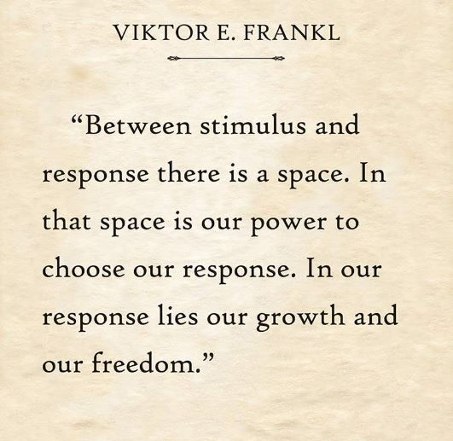
The Focus Four
Formula
Notes:
EVIE:
We’re asking you to be deliberately pause before you to think about actions, or behavioir

Slide 18
The Focus Four
Formula
#2 Critical Hindsight
Understanding the effects of past experiences
A behavior that worked before
Is it still effective?
Be intentionally conscious
Notes:
TOM

Slide 19
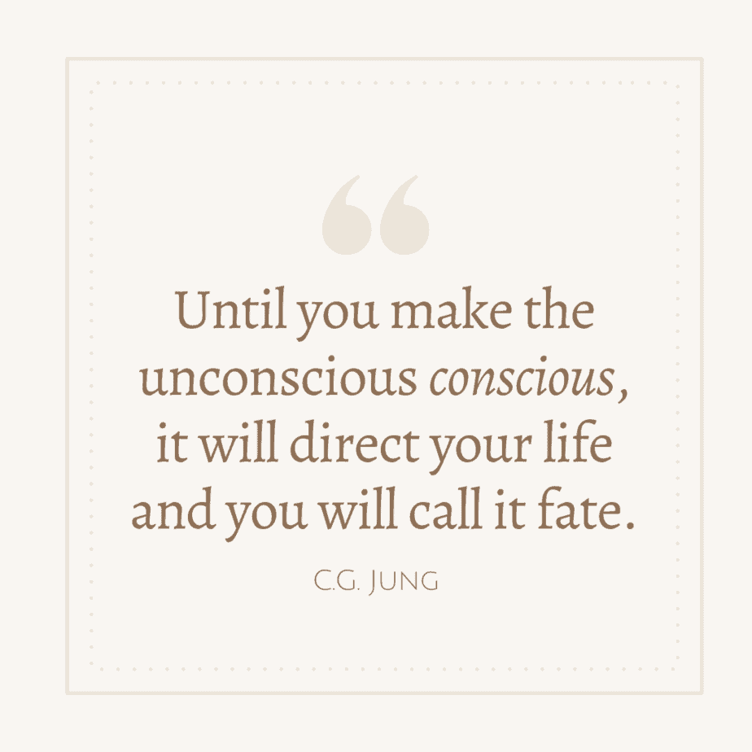
The Focus Four
Formula
Notes:
EVIE: Read the quote
TOM:
Charlie Munger - A simple and easy approach to decision making that prevents us from being manipulated.
Understand the forces at play.
Understand how your subconscious might be leading you astray.
Personally, I’ve gotten so that I now use a kind of two-track analysis. First, what are the factors that really govern the interests involved, rationally considered? And second, what are the subconscious influences where the brain at a subconscious level is automatically doing these things-which by and large are useful, but which often misfunction.
One approach is rationality-the way you’d work out a bridge problem: by evaluating the real interests, the real probabilities and so forth. And the other is to evaluate the psychological factors that cause subconscious conclusions-many of which are wrong.
Dr. Jim Loehr and Dr. Sheila Ohlsson Walker, coauthors of Wise Decisions: A Science-Based Approach to Making Better Choices, call the inner voice that guides you “YODA,” which stands for Your Own Decision Advisor. Unfortunately, it can feed you bad information.
Outer voices, such as those from parents, teachers, or coaches, often inform your inner voice when you’re a child, and YODA becomes an accumulation of them. Ohlsson Walker, behavioral geneticist and senior scientist at the Institute for Applied Research in Youth at Tufts University, calls it “below-the-radar-screen programming that develops over time.” However, your YODA may not have been properly trained to deliver the best advice.
YODA also likes to soothe your ego by making excuses about past bad decisions. “It’s very disturbing when you realize that our brains are a fiction-making machine,” says Loehr, a performance psychologist and cofounder of the Human Performance Institute. “We make up all kinds of crazy things to help us feel better and to justify the decisions that we’ve made. The inner voice is the one who arbitrates a lot of that maneuvering around the truth, so we have to be very careful. It’s a master storyteller and far more important than you may realize.”

Slide 20
The Focus Four
Formula
#3 Compelling Foresight
Path that generates engagement
Develop an end game
Define what you want
Does this inspire you & others?
Notes:
TOM

Slide 21
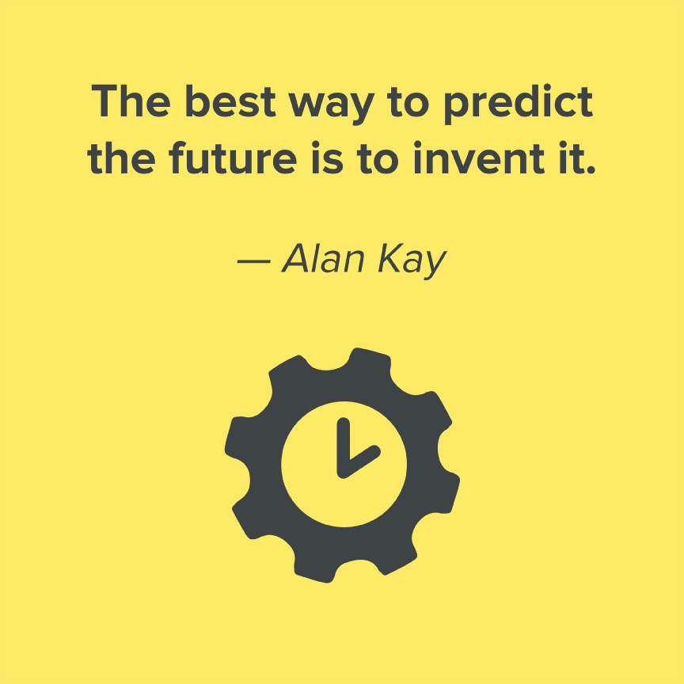
The Focus Four
Formula
Notes:
TOM
Our experience shows the bigger the future the better the results. Now don’t misunderstand us, we’re not saying you should create Pollyanna. The focus 4 are just one component of the equation

Slide 22
The Focus Four
Formula
#4 Collaborative Vision
Develop a community that supports and challenges you
Actions in alignment with your
Compelling Foresight
Make a commitment
Challenge one another
.
Notes:
Evie:
Develop a community….Dr. Davidson
Review actions to take and
Make a commitment to yourself, your team, your family] to focus on that goal
Know you cannot do it on your own

Slide 23
Today’s Outcomes
Learn the five ways people get stuck & how to break out of the cyclical pattern
Apply these five ways to both your personal & business life breaking free of the ‘glass box’
Identify when you or others are stuck and apply a 4-step formula to help them be more productive
Notes:
TOM
23

Slide 24
ON BEING COMMITTED
“Whatever you can do, or dream you can, begin it. Boldness has genius, power and magic in it.”
- Johann Wolfgang von Goethe
Notes:
EVIE

Slide 25
Notes:
EVIE
IMEC BreakThrough Groups
It is proven that peer-to-peer group member companies in the United States have approximately 15% higher growth than companies that don’t participate in peer-to-peer groups.

Slide 26
Evie Caprel
630.918.0760
evie@Break-Through.us
Tom Caprel
630.918.0757
tom@Break-Through.us
www.Break-Through.us
Questions?
Notes:
EVIE

