Slide 1
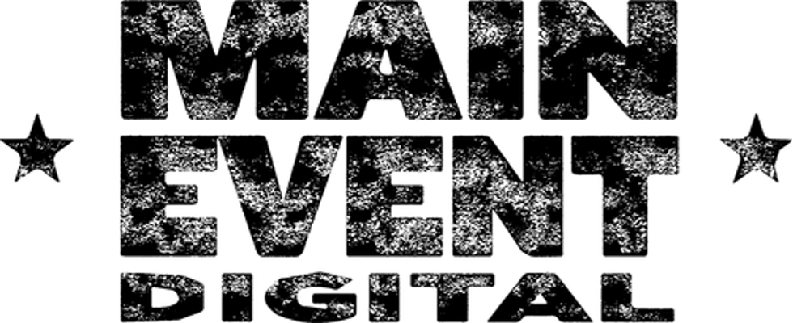
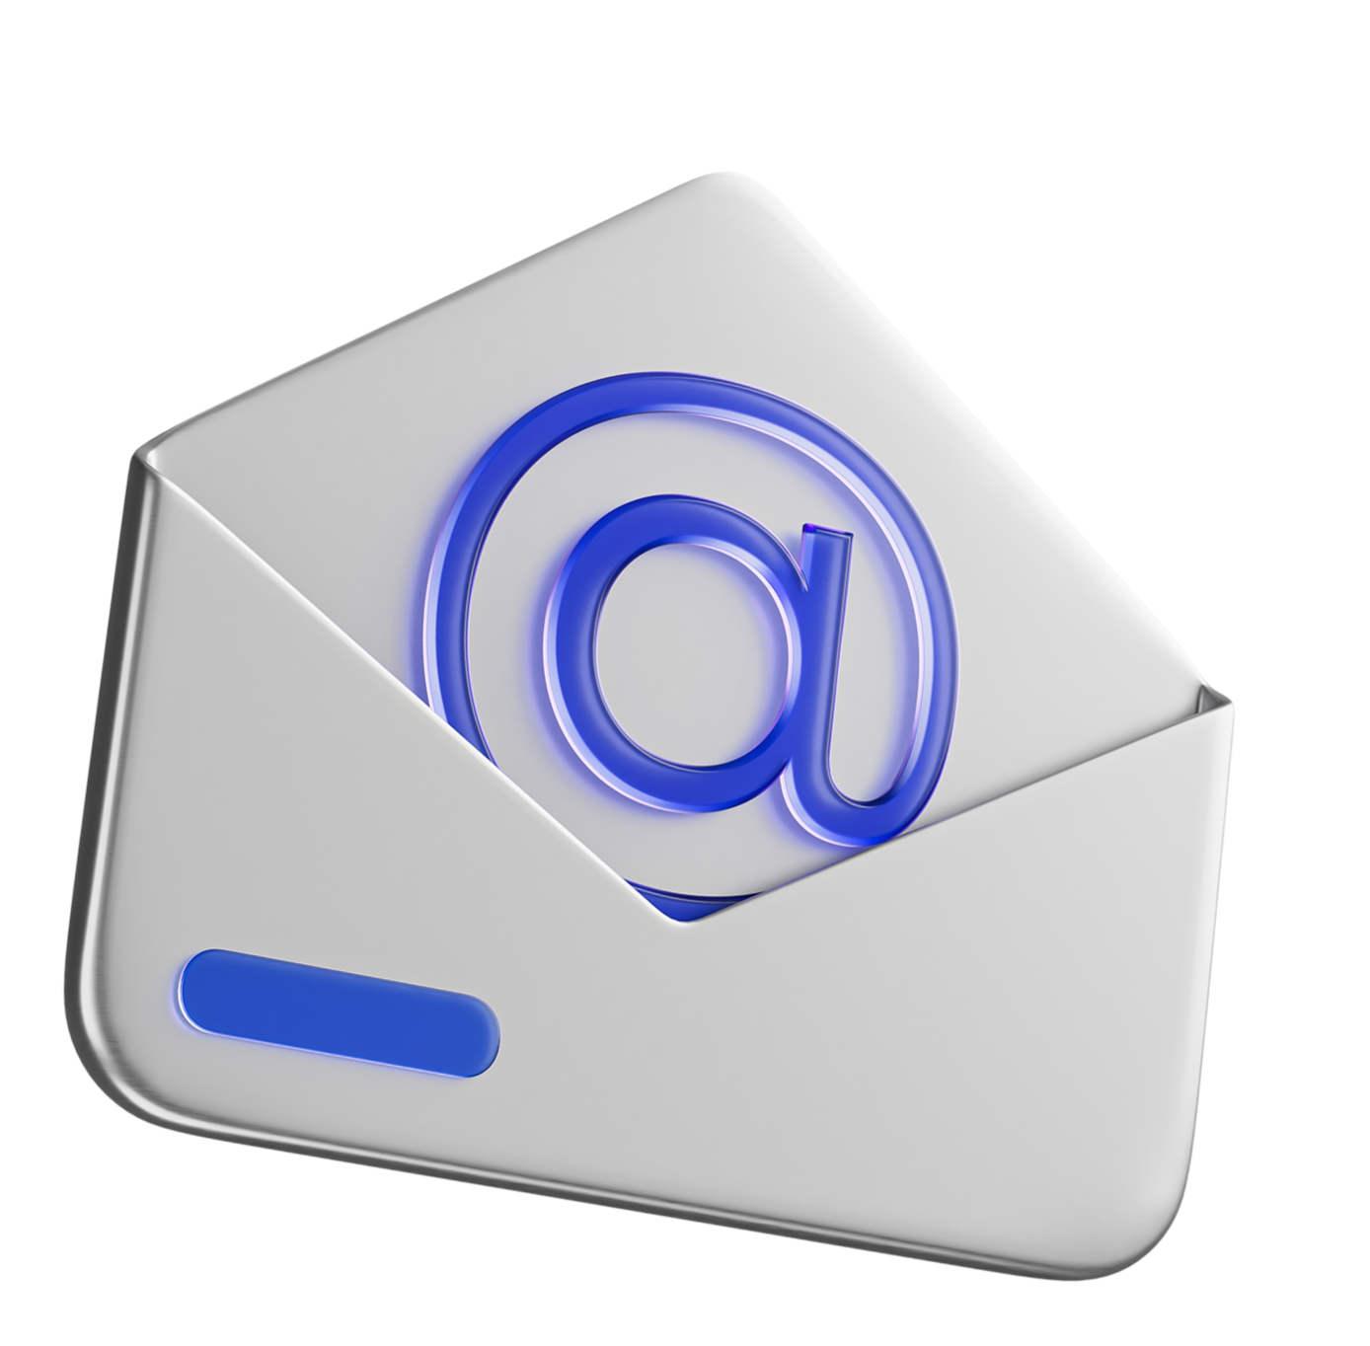
Email Marketing Boot Camp: Inbox Sales and Lead Gen for Manufacturers

Slide 2
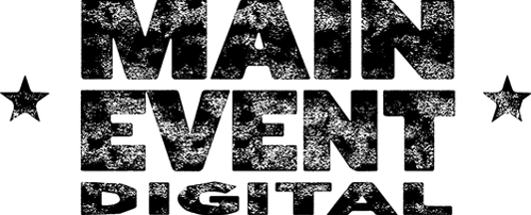
INTRODUCTION
27+ years leading digital transformations for billion-dollar businesses
Mike Mayer
2
Notes:
Now – out of all the ways you can advertise your business, products and services online – email marketing is still one of the most powerful tools in your arsenal.
And it goes far beyond just “sending emails” and hoping someone converts. At Main Event Digital, our clients leverage marketing automation, stunning designs and compelling email content. They are taking advantage of a holistic email marketing strategy to build long-term customer relationships, and ultimately, drive better conversions.
So, whether you're just starting out with email marketing – or hope to uplevel your existing strategy – this webinar is for you. We'll dive deep into the key ingredients of a knockout email marketing strategy – specifically for manufacturing businesses like yours.

Slide 3
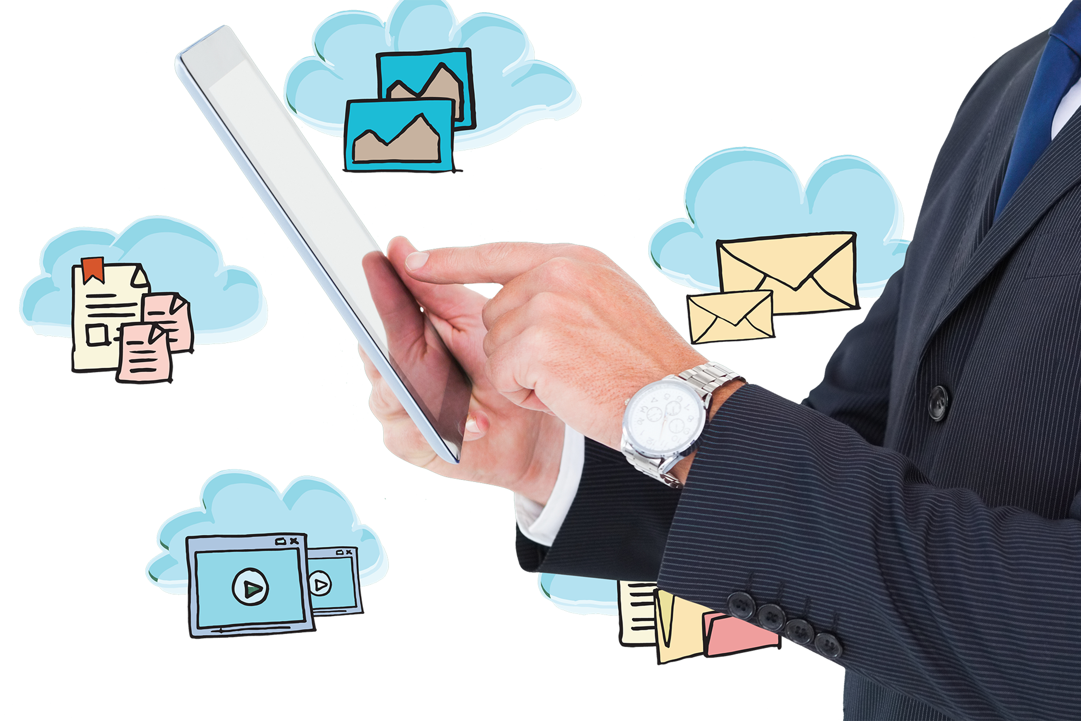
INTRODUCTION
And when it comes to email marketing specifically, manufacturers struggle constantly with things like:
1
Email Content Creation
2
Building an Engaged Email List
3
Standing Out in a Competitive Inbox
5
Notes:
When it comes to email marketing, manufacturers struggle constantly with things like:
Email Content Creation: Most people struggle to create email content that's both informative and engaging for their audience. They lack the resources to create professional visuals or translate complex product features into easy-to-understand language.
Building an Engaged Email List: A targeted and engaged email list is crucial! But gathering qualified leads and convincing them to purchase is exceptionally difficult. Plus, if you don’t already have a strong online presence or ways to capture the right leads, progress can be painfully slow.
Standing Out in a Competitive Inbox: The bottom line? Inboxes are overflowing. You can spend quality time writing your emails – but if your subject lines don’t get noticed – they won’t get clicked.
And not to mention, you’re probably dealing with everything else in your business too!
Despite all of these challenges, email marketing success is possible with the right blueprint. But before I get into that, I’d like to tell you a little story.

Slide 4
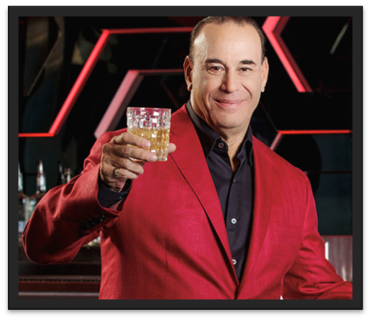
Red Napkin Story
•1st visit, 40% return.
•2nd visit, 42% return.
•3rd visit, 70% return.
Notes:
The strategy was created by Reality TV Host of Bar Rescue, Jon Taffer.
If a first-time restaurant guest has a flawless dining experience, Taffer estimated the statistical likelihood of them returning for a second visit is about 40%.
If they had another great dining experience, the probability of a third visit bumps up to about 42%.
If after that visit they left happy, the likelihood of a fourth visit increases to more than 70%.
But how do you create flawless customer experiences to get them to come back again and again?
This is where the red napkin strategy is deployed. When first-time guests come to the restaurant, they are seated at a table with red napkins, not the usual white napkins. The red napkin signals to all the restaurant staff that this is a first-time customer and for everyone to go the extra mile.
If the staff has done everything right, and the meal was great, the probability that the customer will return for a second visit is now 40%. A smart manager, someone who understands customer lifetime value, will incentivize a second visit. Taffer suggested that the manager approach the customer as they finish the meal and ask them how it was. If the guest was happy with, let’s say, their rib dinner, the manager now says, “Well then, you have got to try my chicken.” And on the back of a business card, hand writes “$5 off chicken.”
When the customer arrives for the second visit, the restaurant staff knows they are a second-time visitor because they have a hand-written card. After the meal, the manager will ask how the experience was, and if it was great, will say, “Man, next time you got to try my cheesecake,” and hand writes on a business card, “free slice of cheesecake.” There’s a 42% chance the customer will return for their 3rd visit.
After a good third experience, now there is a 70% probability of the customer visiting a fourth time for a full-priced meal.
This is an example of how smart operators entice customers to repeat purchase and ease them into the full potential of their lifetime customer value.
So, I loved the concept and wanted to translate this into how we treat and retain B2B customers.
We needed an automated way to stay in contact with our customers and bring them back for future purchases, hence our foray into Marketing Automation.

Slide 5
So, how can email marketing really help your business?
The First Jab is pretty good
Then with a Second Cross, we’re building up to something
And then we’ve got the Knockout Hook!
Email marketing gets your name into customers’ inboxes.
Email marketing turns those prospects into a loyal audience
This is where you drive sales.
6
Notes:
So, how can email marketing really help your business? I’m a boxing fan, so I often relate digital marketing back to boxing.
The First Jab is pretty good… Email marketing gets your name into customers’ inboxes. And consistent, informative emails build brand awareness and generate fresh leads who are interested in what you offer.
Then with a Second Cross, we’re building up to something. Email marketing turns those prospects into a loyal audience. You’re nurturing relationships, providing valuable content, and building trust. People are starting to look forward to what you’re sending them.
And then we’ve got the Knockout Hook! This is where you drive sales. Targeted campaigns promote new products, highlight special offers, and remind customers why they need your solutions. And if these sales are 100% completed online and automated… even better!

Slide 6
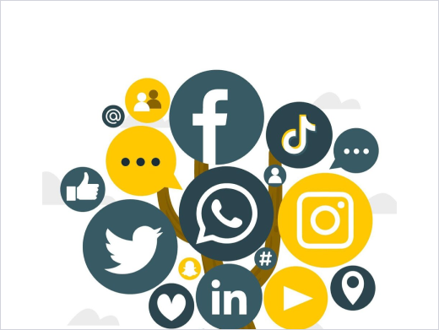
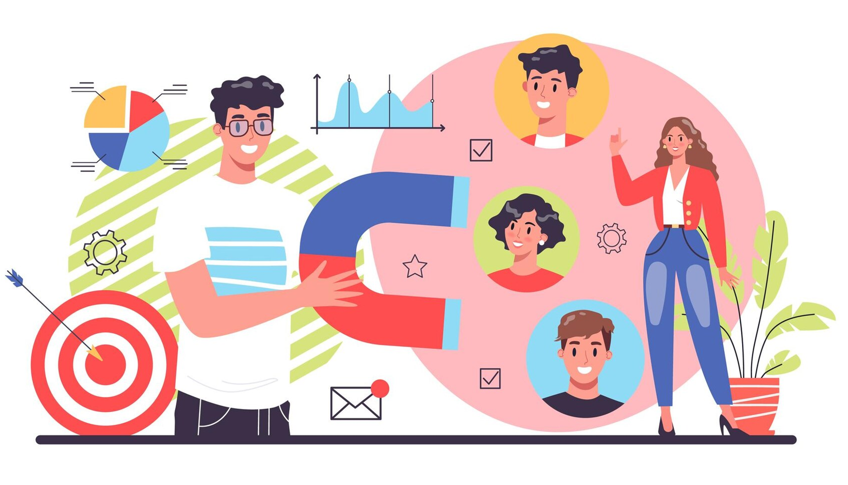
Email marketing is how you build brand awareness, customer loyalty, and increase your sales.
But it isn't a solo act. It's the glue that connects all of your marketing efforts.
Website Visitors
Social Media
Existing Customers
7
Notes:
Email marketing is how you build brand awareness, customer loyalty, and increase your sales. But it isn't a solo act. It's the glue that connects all of your marketing efforts. For example:
Website Visitors: Did someone visit your website? Instead of letting them go back into cyberspace, capture their email with a strategic opt-in form. Now, you can nurture that potential customer long after they’ve been to your site.
Social Media (including LinkedIn): Did someone engage with your post or download your whitepaper? This interaction can turn into an email lead. Social media is a great tool to drive traffic to landing pages where you can collect email addresses.
Existing Customers: Don't forget about your loyal buyers! Email lets you reach out with special offers, personalized recommendations, and win-back campaigns for abandoned carts.
Email marketing keeps the conversation going, no matter how someone interacts with your brand. It's the perfect tool to turn website visits, social media buzz, and past purchases into lasting customer relationships.
And now, what if you could send targeted emails automatically, without lifting a finger? That's the power of email marketing automation.

Slide 7
Email automation lets you:
✉️
Free Up Your Time
What if you could send targeted emails automatically, without lifting a finger?
Trigger Emails
🤔
Segment Audiences
Personalize Emails (at Scale)
8
Notes:
It’s delivering the right message, at the right time, to the right person. Just like having a tireless marketing assistant working 24/7!
Email automation lets you:
Free Up Your Time: Stop wrestling with repetitive tasks like scheduling emails or sending out welcome messages. Automation can handle those for you, giving you back precious time.
Trigger Emails: Set up automatic emails based on specific actions. Someone grabs a discount code? Boom, they get a set of emails with a curated list of products. A customer abandons their cart? A friendly reminder email nudges them to complete the purchase. In fact, just by sending a well-timed abandoned cart email, about 20-30% of those customers will complete the sale that they previously abandoned.
Segment Audiences: Automation lets you group your email list based on interests, purchase history, or any other data point. This way, you can send targeted messages that resonate with each segment, maximizing engagement. For instance: For existing customers, you can send targeted emails about maintenance tips for the equipment they've purchased, or exclusive offers on complementary products.
Personalize Emails (at Scale): Automation also lets you personalize content based on subscriber data. For example: What if a prospect downloads your guide to "Choosing the Right Industrial Saw?" Automation can send a follow-up email highlighting specific saws relevant to their needs.
I like to think of email marketing like a conversation, not a broadcast. Well-crafted emails and strategic automation tools can personalize that conversation, building stronger relationships with each subscriber, and ultimately driving more sales.

Slide 8
BUILDING OUT EMAIL MARKETING AUTOMATION
Okay, so what’s the right email strategy?
Cold Email
Warm Email
Nurturing and Value Emails
Promotional Emails
Confirmation Emails
Abandoned Cart Emails
Back-in-Stock Emails
Price Drop Emails
Order Update Emails
Discount Emails
Future Discount Emails
Best Seller Emails
Cross-Seller Emails
Application and How-To Emails
Testimonial Emails
Referral Request Emails
Value Added Services or Differentiator Emails
“Google My Business” Review Emails
Recently or Most Viewed Product
Local Emails
9
Notes:
But you can’t just blindly use these tools or blindly use AI. Sending out random email blasts won't get you anywhere. In fact, it can backfire – costing you money, losing leads, and even tarnishing your reputation.
You have to still incorporate your business into your automations to ensure you remain relevant and memorable to your audience.
And that’s exactly what will take your email marketing from a “good old college try” to a total knockout.
Okay, so what’s the right email strategy?
Our clients leverage different email campaigns depending on their goals. Let me define some of these campaign types so you have a better idea about what you can do with email:
Cold Email is your initial outreach to potential customers who haven't interacted with your business before. Cold email aims to introduce your company and its offerings, sparking initial interest.
Warm Email is communication with existing leads who have already shown some interest (maybe they downloaded a whitepaper, visited your website). Warm email focuses on nurturing relationships by providing valuable content and special offers.
Nurturing and Value Emails are a series of targeted emails designed to educate leads about your industry, showcase your expertise, and build trust. These email strategies offer valuable content (such as guides or webinars) to nurture them toward becoming customers.
Promotional Emails highlight special offers, discounts, and new product launches to drive sales and conversions. They are often time-sensitive to create a sense of urgency.
Confirmation Emails are automated emails sent to verify actions taken by subscribers (such as account creation, registration or order confirmation). They provide essential information and next steps to improve the customer experience.
Abandoned Cart Emails – as we’ve touched on previously – are triggered emails sent to website visitors who leave items behind in their online shopping cart. Abandoned cart emails aim to remind them about their abandoned purchase and encourage completion.
Back-in-Stock Emails alert subscribers when a previously out-of-stock product becomes available again, generating renewed interest and potential sales.
Price Drop Emails notify subscribers about price reductions on specific products or categories, triggering purchase decisions.
Order Update Emails keep customers informed about the status of their orders (such as processing, shipping or delivery). This provides transparency and builds trust.
Discount Emails offer exclusive discounts or coupons to incentivize purchases. These emails can be targeted to specific customer segments or product categories, all driven by data.
Future Discount Emails provide subscribers with advance notice of upcoming sales or promotions, building anticipation and encouraging early engagement.
Best Seller Emails highlight your most popular products to existing customers, potentially sparking interest in additional purchases.
Cross-Seller Emails recommend complementary products based on a customer's past purchases or browsing behavior, increasing average order value.
Application and How-To Emails provide tutorials on using your products or services, enhancing customer experience and reducing support inquiries.
Testimonial Emails feature positive customer reviews and testimonials to build trust and social proof, influencing buying decisions.
Referral Request Emails encourage existing customers to refer friends or colleagues. This can expand your reach through word-of-mouth marketing.
Value Added Services or Differentiator Emails highlight unique features or services that set your company apart from competitors, positioning your brand as the preferred choice.
Local Emails: For businesses with physical locations, these emails target customers in specific geographic areas, promoting local services or highlighting the expertise of nearby branch managers.
“Google My Business” Review Emails ask customers to leave positive reviews on your Google Business Profile, boosting local SEO and online reputation.
Recently or Most Viewed Product Emails recommend products recently viewed by a customer or those generating high website traffic, capitalizing on existing browsing behavior.
And these are just some example strategies.
Okay, now you might be wondering, “That’s great, Mike, but how do I make my emails effective?!” Let’s get into that now.

Slide 9
BUILDING OUT EMAIL MARKETING AUTOMATION
Popular Platforms
Having the right email marketing platform is your first step to a successful email marketing strategy.
There are many great options available, each with its own strengths.
10
Notes:
First, I want to discuss some considerations for choosing the right email marketing platforms since these platforms are the foundation of your overall strategy.
Then in a little bit here, I’ll share some practical tips to help you craft high-performing emails that pack a punch.
So, having the right email marketing platform is your first step to a successful email marketing strategy. There are many great options available, each with its own strengths.
However, some of the most popular are:
HubSpot: HubSpot is an all-in-one marketing platform with robust automation features. It’s ideal for businesses with complex needs. Plus, it integrates well with other HubSpot marketing tools you might already have.
Mailchimp is a user-friendly platform known for its ease of use, which is perfect for beginners. However, it does have limited automation capabilities compared to other platforms.
ActiveCampaign is a powerful platform with advanced automation features and segmentation capabilities, and is ideal for businesses who are ready to scale their email marketing and leverage all sorts of customer segmentation insights.
And again, you really have so many options… it’s almost overwhelming!
Once you have your platform chosen, you can start building automated workflows. These are essentially pre-programmed sequences of emails triggered by specific actions.
For example: A website visitor downloads your whitepaper – and an automated workflow instantly sends them a welcome email with more resources.
Okay, so you've got your strategy in place, and your automation engine is purring… Now it's time to craft a winning email. But where do you even begin?! How do you know what to write in these emails?!
Think back to those different customer segments we mentioned – prospects, leads, existing customers. Each group has specific needs and pain points.
For example: A prospect might be researching new industrial equipment. Your email should address their concerns – highlighting the benefits your equipment offers. And providing valuable resources like case studies or whitepapers.
On the other hand, an existing customer might be interested in maintenance tips for the equipment they purchased. Your email could offer helpful tutorials or exclusive discounts on complementary products.
The key is to speak their language. Avoid technical jargon and complex sentences.

Slide 10
BUILDING OUT EMAIL MARKETING AUTOMATION
A/B testing allows you to compare different subject lines, email copy, and even calls-to-action (CTAs) to see what resonates best with your audience.
But the secret weapon of email marketing champions? Testing.
12
Notes:
But the secret weapon of email marketing champions? Testing.
You wouldn't launch a new product without testing it first. And you shouldn't send emails without testing them either.
A/B testing allows you to compare different subject lines, email copy, and calls-to-action (CTAs) to see what resonates best with your audience.
And let me tell you: If you think you know which subject line would resonate best with your audience – and you bypass testing – those conversions are going to hurt!
By testing and refining your email copy, you can ensure your emails are landing in inboxes and driving results for your business.

Slide 11
A good sender reputation ensures your emails land in inboxes (and not spam folders)
There are two things that affect your sender reputation:
1
Permission-Based Marketing
2
High Engagement Rates
Allow your customers to opt-in.
People who open and click on your emails tell email providers you're a good sender.
13
Notes:
So, we've talked about crafting winning email content, but getting those emails delivered is just as important. That's where something called “sender reputation” comes in.
It’s essentially your online reputation for sending emails. A good sender reputation ensures your emails land in inboxes (and not spam folders).
There are two things that affect your sender reputation:
Permission-Based Marketing: It’s best to allow your customers to voluntarily opt-in to your emails (via lead forms, website signups and valuable content downloads). You still can use cold emailing – which again, such prospects have no previous contact with your business – but some of the best conversions come from an audience who opts in.
High Engagement Rates: People who open and click on your emails tell email providers you're a good sender. High engagement rates boost your sender score, making sure your emails get delivered.

Slide 12
Some email marketing automation platforms – especially cold email platforms – can actually help you maintain a good sender reputation.
Warm Up Your Email Address
Monitor Your Sender Score
Automatically Remove Inactive Subscribers
14
Notes:
Now, some email marketing automation platforms – especially cold email platforms (we use a platform called Instantly) – can actually help you maintain a good sender reputation. They:
“Warm Up” Your Email Address: They gradually increase the number of emails you send to avoid triggering spam filters.
They Monitor Your Sender Score and alert you to any potential issues.
They Automatically Remove Inactive Subscribers from your list – keeping your list clean and improving engagement.

Slide 13
But there's more you can do too, such as:
Use Branded Domain Emails
Provide Unsubscribe Options
Conduct Regular List Cleaning
Focus on Quality (Not Quantity)
15
Notes:
But there's more you can do too, such as:
Use Branded Domain Emails: Use your company's domain name in your email address. For example: Main Event Digital’s emails read “help@maineventdigital.com” or something similar. This also builds trust and helps you avoid looking spammy.
Provide Unsubscribe Options: Always include a clear and easy way for people to unsubscribe from your list. This shows you respect their inbox.
Conduct Regular List Cleaning: Periodically remove inactive or unengaged contacts. This keeps your list healthy and improves deliverability.
Focus on Quality (Not Quantity): Don't bombard your subscribers. Send targeted emails with valuable content on a consistent schedule. People are busy. Give them a reason to open your emails.
These things help you build and maintain a good sender reputation. And they ensure your knockout email campaigns reach the right inboxes and drive results for your business.

Slide 14
BASIC BACKGROUND CONTENT
👥
"We know email marketing is important, but we just don't have the time to create consistent content."
The goal is to provide a mix of valuable content that caters to different interests and stages of the buyer's journey.
16
Notes:
So… we’ve already covered a lot of ground here, but there’s one more crucial element to building a knockout email marketing program: Consistency!
Many of our clients and potential clients tell us, "We know email marketing is important, but we just don't have the time to create consistent content."
I get it! The key is to develop a regular email sending schedule that works for your business. It could be weekly, bi-weekly or even monthly.
The goal is to provide a mix of valuable content that caters to different interests and stages of the buyer's journey.
Some things you can consider:
Content Calendars: These allow you to plan your emails in advance. You can allocate specific topics for different stages of the buyer's journey.
Professional Help: Consider outsourcing content creation to email marketing specialists. They can craft high-quality content that resonates with your audience.
Email marketing offers incredible ROI, some businesses even seeing an average return of $36 for every $1 spent! (Litmus). That's a powerful return that can make investing in professional support well worth it.
You’ll also want to track key metrics like email opens, clicks, and conversions.
Striving for industry averages is good, but your own customer data is gold. Use those insights to optimize!
For example: Even a small tweak to your subject line can mean big results – we’re talking thousands more in sales from a small wording change!

Slide 15
WHAT MANUFACTURERS STILL NEED TO KNOW
Understand your ideal customer inside and out to craft targeted messages
Master the art of speaking your customer’s language
Navigate constantly changing email guidelines
How to craft eye-catching subject lines and engaging content
Determine what will provide value to your audience – and keep them interested
Determine the appropriate sending cadence
Learn how to craft compelling calls-to-action
Determine how to stand out in a crowded inbox.
17
Notes:
Okay, I know this webinar packed a punch, but to truly achieve knockout results, there's more to it.
For example:
You still need to understand your ideal customer inside and out to craft targeted messages. This reduces the risk of sending generic emails that get ignored.
You still need to master the art of speaking your customer’s language. Using flat, technical jargon leads to poor engagement rates.
You still need to navigate constantly changing email guidelines. Staying up-to-date will help you avoid landing in spam folders and wrecking your email and brand reputation.
You still need to know how to craft eye-catching subject lines and engaging content – which varies greatly for every business. This is crucial for getting people to open and interact with your emails.
You still need to determine the appropriate sending cadence so you can stay present – without becoming a nuisance.
You still need to determine what will provide value to your audience – and keep them interested. People won't open emails with nothing to offer. And they won’t continue opening emails that constantly throw salesly promotions in their faces.
You still need to learn how to craft compelling calls-to-action that get people to convert, whether online or in-person. Because after all, you need more than “interest.” You need sales.
You still need to determine how to stand out in a crowded inbox so you grab the attention of your customers, amidst your competitors – and every other email they’re receiving…
Now I’m making email marketing seem overwhelmingly impossible, right?! It’s hard work, but not impossible.

Slide 16
Email Automation Haymaker - $8,100 $7,560
Services are also available by the hour
Strategy - $600 $560
Warm Lead Nurturing Campaign - $6,000 $5,600
Email Platform Setup
Workflow, Design, Content & Development for 15 Emails
5 Email Sequence (5 emails w/3 variants each)
Cold Email Setup - $1,500 $1,400
Setup of new domains, new email addresses, cold email software and 10,000 verified leads
Notes:
In fact, the email marketing challenges you’re facing in your business are exactly why we created – the Email Automation Haymaker.
It’s an all-in-one solution designed to incorporate everything we’ve talked about today – and more – into a successful email marketing strategy for you.
Now – aside from the benefits of our done-for-you approach – you’ll have an entire team optimizing your email marketing automation – on autopilot – to get you more leads and digitize your sales.

Slide 17
mdmayer@maineventdigital.com
(773) 405-3635
maineventdigital.com
linkedin.com/in/ecommerceexec/
Email Marketing Boot Camp: Inbox Sales and Lead Gen for Manufacturers

