Slide 1


Fill Your Pipeline - Grow Your Prospect Pool Using Digital Marketing
February 28, 2023
Bridgid Johnson
StratMg
Co-Founder & Partner, Marketing Services
bjohnson@StratMg.com

Slide 2

Be a trusted partner, not a vendor
Establish Trust in our Credibility to deliver
How? – Build a relationship
  Be a dependable resource
  Be a partner, not a vendor
  Be honest

Slide 3

Same Principles, Executed Differently …

Slide 4

StratMg –
Our Learnings & Successes
An Introduction
  We do that!
    ‘Before people buy from you, they have to buy into you’
    ‘Leads don’t care how much you know until they know how much you care’
    Our philosophy, “In God we trust. All others bring data.” – W. Edwards Deming
    Results
    $350M+ Revenue Impacts
    200+ Manufacturing Clients
    450+ Projects Executed
    95+% Customer Satisfaction Rating

Slide 5

3 Key Components to an accelerated Sales Cycle
Marketing to adopt a sales-driven methodology

Slide 6

# 1 - Persona Example – Who do we talk to?
Title: Project Manager
Job Function: Engineering
Company Size: $700M +
Motivators:
Create strong differentiation through new innovative technologies Lower costs Minimize downtime Enhance throughput
Challenges/Pain Points:
Technology – must stay on top of new technology to stay ahead of competition Compliance - Regulatory Standards Vendor Mgmt multi-vendor solutions are difficult to manage Engineering support @ vendor Frustrations: Timeliness to delivery Quality Cost
Influencers:
Sales Management Service Management Executive Management
Marketing Message: (Value Prop/Positioning)
Experience – 40 years in business – w/Fortune 100 companies Best in Breed Technology Quality – 99.9% acceptance Rate On-time Delivery – 98.5% on time delivery (expedited delivery available) Quick set-up – 70% faster than avg. competitor Dedicated Engineering department – consultative solutions
Objections:
Risk of unknown Service level Quality Changeover costs Time Training/Learning Curve

Slide 7
# 2 - What do we say to them & When?
Stage 1
Awareness
(Define Interest)
Learn
(Explore Solutions)
Evaluate
(Customer Preference)
Justify
Frequency: 2 Weeks
Frequency: 2 Weeks
Frequency: 2 Weeks
Email 1: Introduction Email
Email 1 – Competitive Analysis
Telemarketing - Qualification
Sample
Email 2 - Customer Testimonials
Email 2 – Case Study
Telemarketing - Qualification
Proposal
Score Increase
Score Increase
Sales
Call
Email 3 – Tips for Selecting a MetalCasting Partner
Email 3 – How easy it is to work with Company XYZ
Telemarketing - Qualification
Negotiation
Lead
Educate
Present
Justify
Marketing
Sales

Slide 8
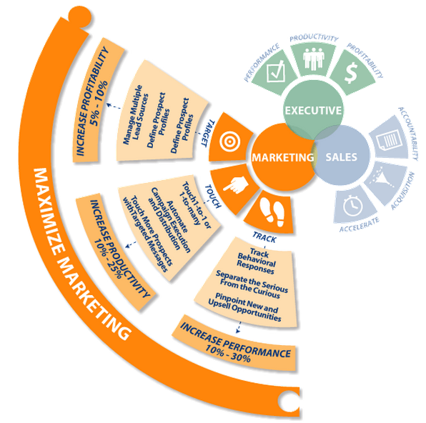
#3 – How do we say it to them?
Leverage a marketing automation platform
Benefits
Executive Staff
Improved lead conversion and ROI
Shortened Sales Cycle
Maximize customer lifetime value through cross-selling and up-selling opportunities
Modular Data: Data is easily exportable, yours to keep if you choose to stop using platform
Sales
Enhanced ability to generate more and better qualified leads.
Better alignment of sales and marketing goals
Use scoring to prioritize your time and attention
Marketing
Increased marketing efficiency
Message cadence: The ability to automate communications based on customer behavior across channels.
Improved segmentation: A central system of record for prospect engagement allows for more personalized and relevant communications (which result in more engagement).
Simplicity: One interface to manage multiple channels and centralize reporting.

Slide 9
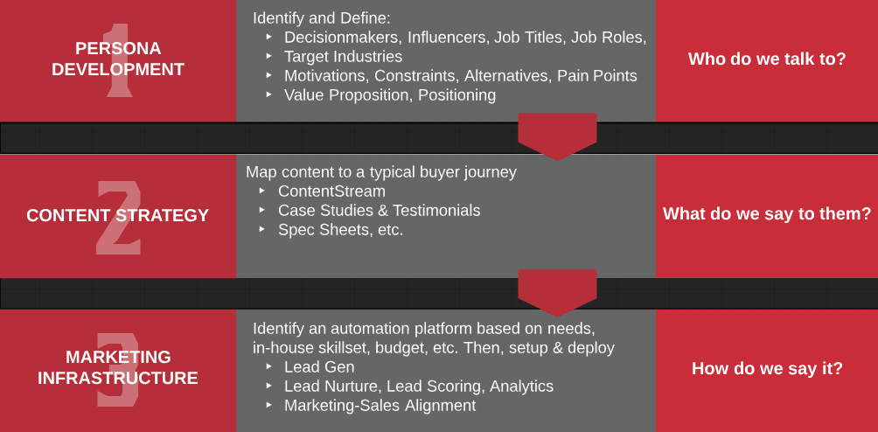
Sales-driven Marketing: Key Components

Slide 10
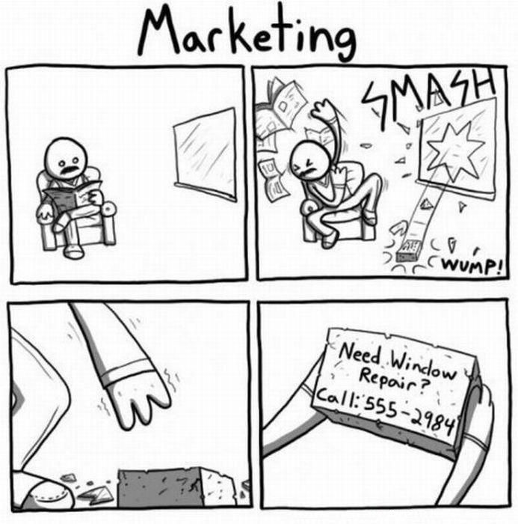
Marketing & Sales Strategy
Right place,
Right time,
Right message …

Slide 11



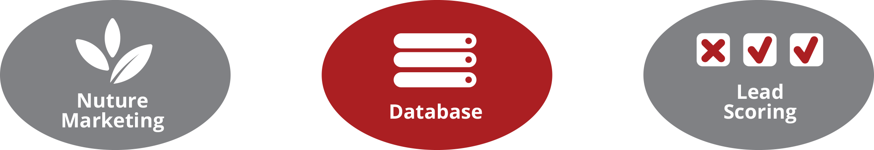

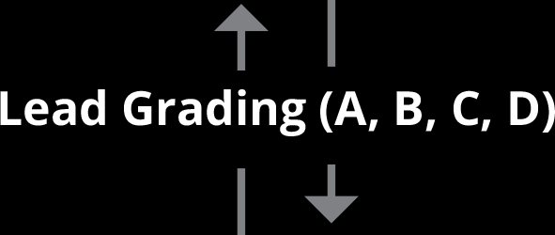



Multi-Channel Execution
Make Leads
Manage Leads
Monetize Leads

Slide 12
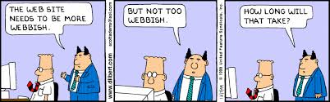
Marketing Channels

Slide 13
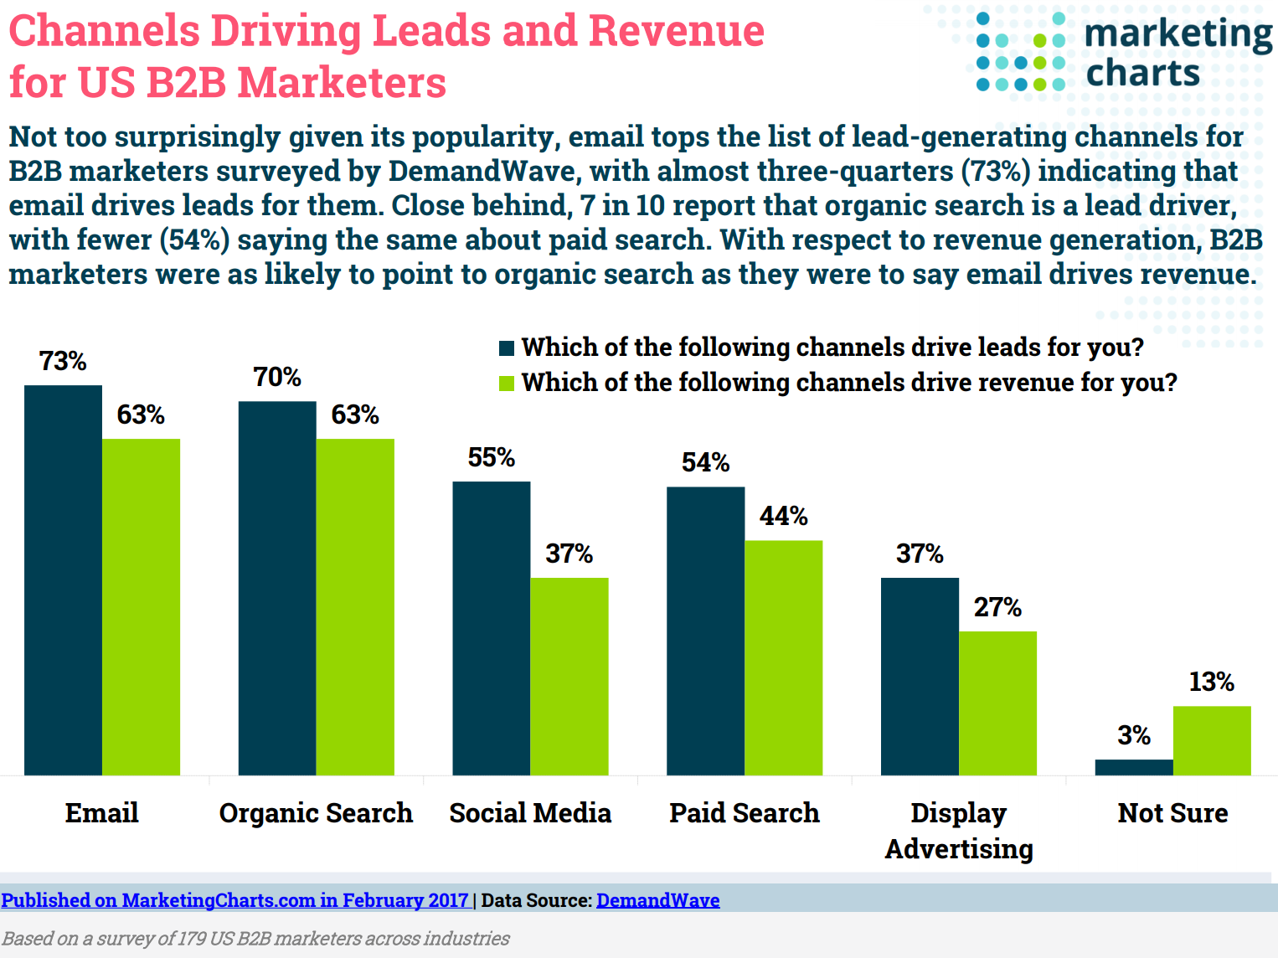
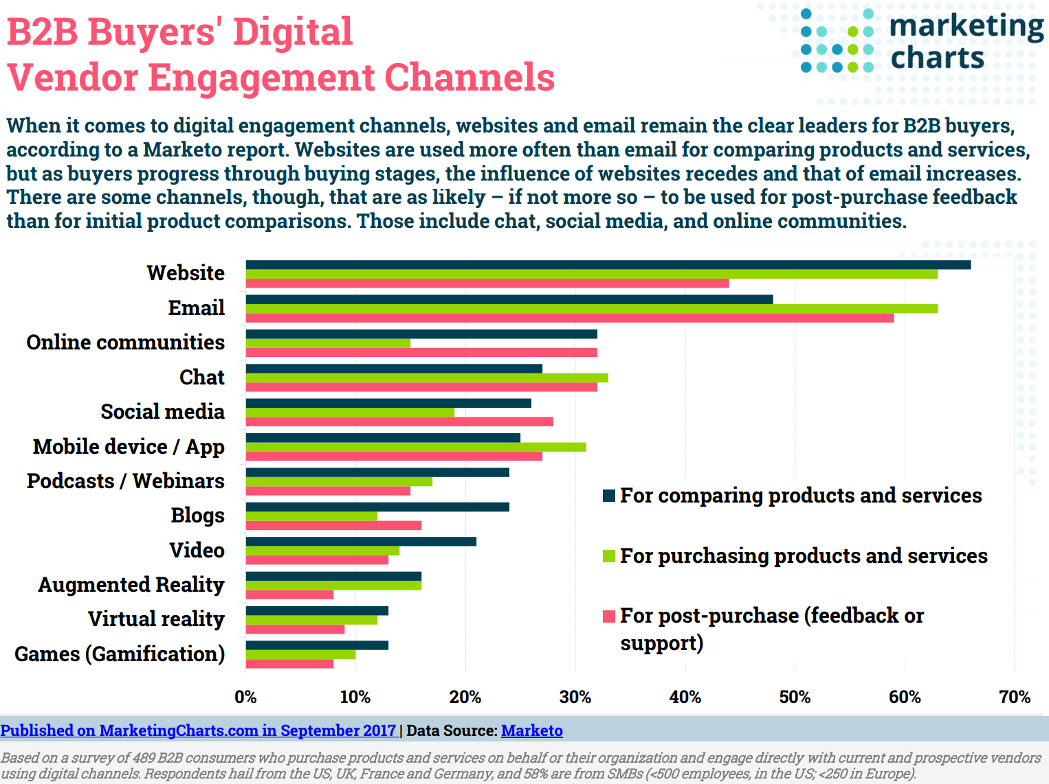
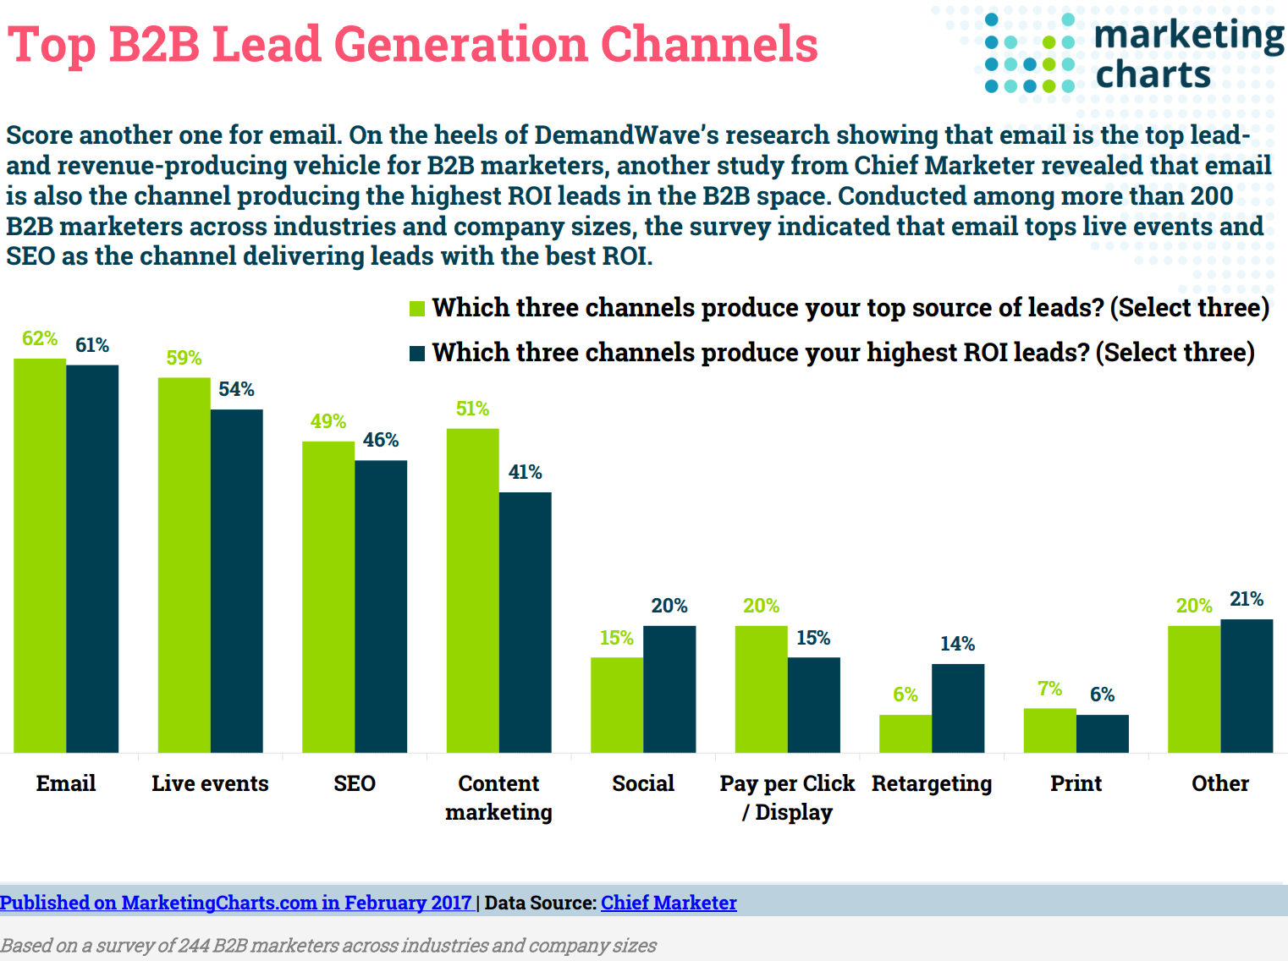
SEO & Email Marketing – Why?
  Research Suggests
    Website & Email are best channels to influence buyers throughout the buying cycle
    Email & Organic Search are the top performing channels to drive leads and revenue
    Email & SEO produce the highest ROI

Slide 14
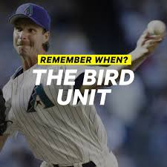

Marketing hunts, Sales closes
Marketing
  Leverage technology to scale prospecting efforts –
    Cost-efficient!
  Quantify contribution
  Solution for a consistent flow of leads – Today & tomorrow
Sales
  Human bandwidth is expensive – spend where you must, save where you can..
  More interested in the ‘today’
  CLOSER! - Bigger bang for the buck!

Slide 15
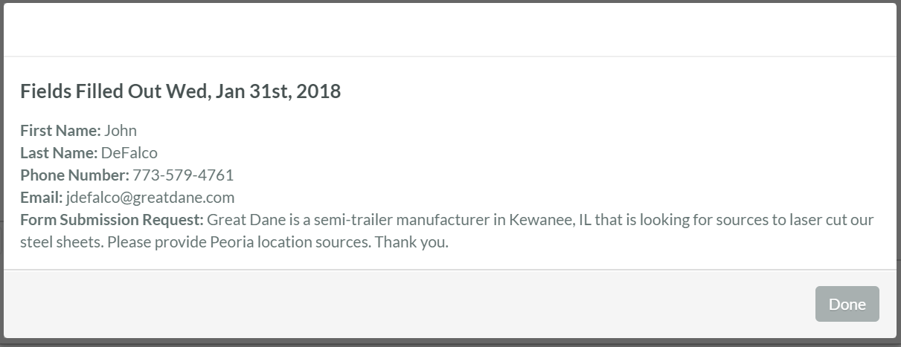
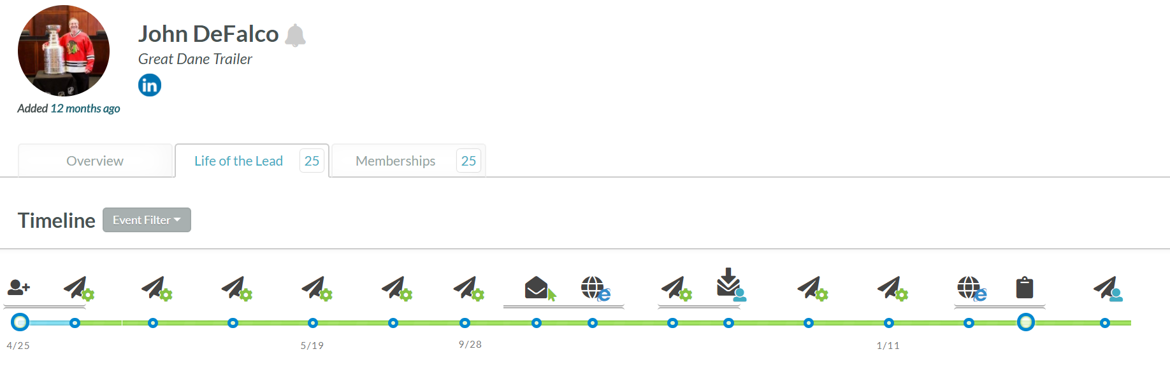
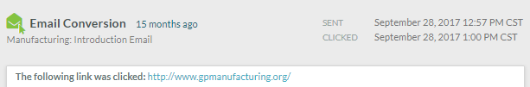
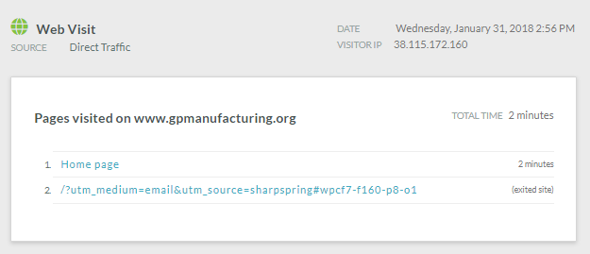
Marketing – Starting Pitcher, Sales – Closer!
Great Dane: Life of a lead example
Form Completed
Supported by Research:
  On average, a lead requires 10 marketing-driven “touches” to convert from the top of the funnel into a paying customer. (Source: Aberdeen Group)
  80% of sales are made on the 5th-12th contact. (Source: Sellingly)

Slide 16

Takeaways

Slide 17
# 1 – Who are we talking to?
Title: Project Manager
Job Function: Engineering
Company Size: $700M +
Motivators:
Create strong differentiation through new innovative technologies Lower costs Minimize downtime Enhance throughput
Challenges/Pain Points:
Technology – must stay on top of new technology to stay ahead of competition Compliance - Regulatory Standards Vendor Mgmt multi-vendor solutions are difficult to manage Engineering support @ vendor Frustrations: Timeliness to delivery Quality Cost
Influencers:
Sales Management Service Management Executive Management
Marketing Message: (Value Prop/Positioning)
Experience – 40 years in business – w/Fortune 100 companies Best in Breed Technology Quality – 99.9% acceptance Rate On-time Delivery – 98.5% on time delivery (expedited delivery available) Quick set-up – 70% faster than avg. competitor Dedicated Engineering department – consultative solutions
Objections:
Risk of unknown Service level Quality Changeover costs Time Training/Learning Curve

Slide 18
Interest
Learn
Evaluate
Justify
Purchase
Search
Begins
Solutions Identified
Solutions Evaluated Against Needs
Short List Assembled
Selection
Made
QUESTIONS
Who are the suppliers for my need?
What’s the scope of potential achievement?
Where do I stand?
How can I easily find out more?
What do they offer?
Are their customers achieving success?
Do they fit my need?
How can I easily evaluate/demo?
Do they meet my expectations?
What do analysts say, are they a leader?
Is Company viable?
How do they compare?
Why should I choose?
What’s the cost?
Leading, solid product/company?
Recommended by customers and analysts?
Meets or exceeds my need?
Can afford to buy & implement?
How can I easily purchase?
Can I purchase via Web site?
Who can I call?
Do they have a partner in my area?
Why buy now?
#2 - What are we saying to them?
EXPERIENCE
eMail & Web
Seminars
Podcasts
Social Media
eMail & Web
Podcasts/Seminars
TM Calls
Social Media
eMail & Web
Social Communities
TM/Sales Calls
Seminars
eMail & Web
Customer, analyst references
Sales calls
eMail & Web
TM & Sales Calls
Partners
CONTENT
Industry white papers
Company product white papers
Customer stories
Assessment tests
Press releases
Company white paper
Seminar Pres
Product spec sheets
Customer stories
Flash Demo
Ind/analyst reports
Educational Tips
Features/Benefits
Gartner Quadrant
Fin. Press Releases
Competitive & Cost Comparisons
Product Awards
Seminar Pres
Product customer reference site
Product Awards
Customer stories
Press releases
Seminar Pres
1800# provided
Company.com product
E-Shop product
Partner locator?
Promotions or deals?

Slide 19
#3 Marketing – Starting Pitcher, Sales – Closer!
Great Dane: Life of a lead example
Form Completed
Supported by Research:
  On average, a lead requires 10 marketing-driven “touches” to convert from the top of the funnel into a paying customer. (Source: Aberdeen Group)
  80% of sales are made on the 5th-12th contact. (Source: Sellingly)

Slide 20
#4 - On-Page SEO Audit Primer
Website Health Check –
  https://www.woorank.com/
    One of the most renowned & accurate platform
    Checks all basic on-page parameters, offers a rating system
  https://search.google.com/test/mobile-friendly - Responsive test
Website Traffic Quality – Google Analytics & Search Console
  Analytics – Bounce rates, Avg duration per page, Entry & Exit pages, etc.
  Search Console – Errors affecting ranking for the website & keywords
Keywords Research: https://ads.google.com/home/tools/keyword-planner/
  Offers a perspective on the demand of a particular keyword(s)

Slide 21
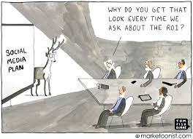
#5 - RoI – Measure, only if it matters!
Key metrics -
  Customer Acquisition -
    Conversion rates –
      Suspects → Prospects
      Prospects → Leads
      Leads → Quotes/Proposals
        KPI – Average sales cycle
    # of leads generated
    Cost per Lead
    Cost per Acquisition
  Customer Retention -
    Cross-sell/up-sell
    Education - Overall capabilities

Slide 22
Questions?
www.StratMg.com
Bridgid Johnson, Co-Founder & Partner, Marketing Services
bjohnson@StratMg.com
630-296-7641

