Slide 1
UNLOCKING THE POTENTIAL: The Evolutionary Impact and Practical Applications of ChatGPT for Manufacturers
Mike Ungar and Jan Pingel
Co-Founders
www.industry40club.com

Slide 2
Mike Ungar
FocalPoint Business Coach and Executive Coach
Jan Pingel
Product Lead, Digital Solutions Ingersoll Rand

Slide 3
The Industry 4.0 Club
A dynamic, growth-oriented community that brings together professionals from diverse backgrounds to foster collaboration, knowledge sharing, and innovation within the realm of Industry 4.0.
Our members include practitioners, technology providers, consultants, and thought leaders united by their passion for the advancement of smart manufacturing solutions.

Slide 4
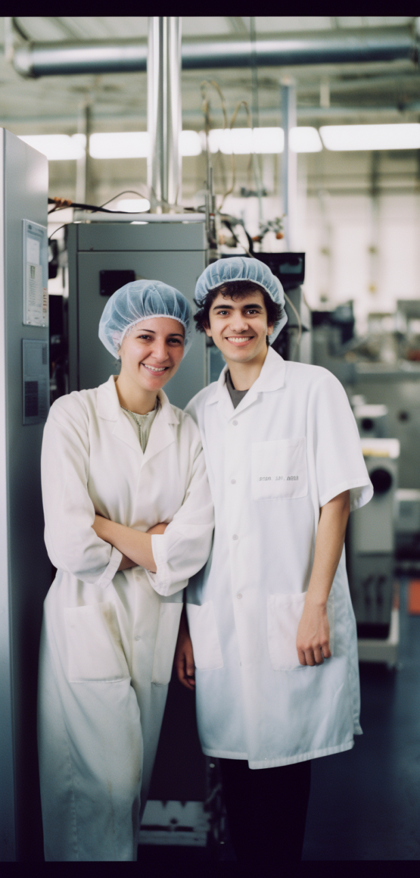
Our Mission
Our is mission is to accelerate the worldwide adoption of Industry 4.0 technologies by connecting diverse talents, fostering collaboration, and inspiring innovation.
Our aim is to bridge the gap between practitioners, technology providers, and thought leaders to drive meaningful change.

Slide 5
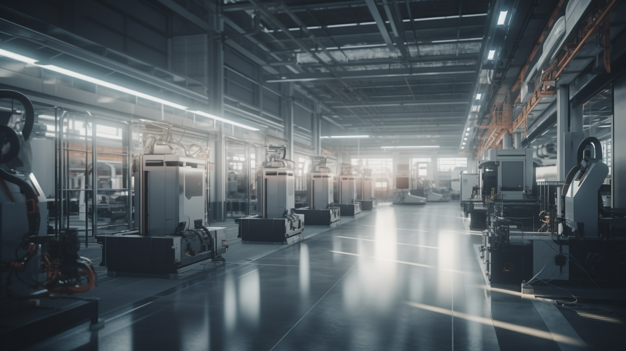
“ChatGPT is scary good. We are not far from dangerously strong AI.”
Elon Musk

Slide 6
ChatGPT:
Scary Growth

Slide 7
What is ChatGPT?
ChatGPT* is an artificial intelligence (AI) chatbot developed by OpenAI. It is built on top of OpenAI's GPT-3.5 and GPT-4 foundational large language models (LLMs) and has been fine-tuned (an approach to transfer learning) using both supervised and reinforcement learning techniques.
[*GPT - Generative Pre-trained Transformer]

Slide 8
What is ChatGPT?
Think about ChatGPT as a software language.
At one level, ChatGPT is to language
as PowerBI is to numbers. Except ChatGPT is smart and PowerBI is dumb.
ChatGPT is generative – it can make itself better

Slide 9
Practically Speaking
ChatGPT can search documentation and extract information
An example:
We gave ChatGPT several PowerPoint summaries of our Industry 4.0 Club Board meetings
From this, it created the bulk of word content for our Website
https://www.industry40club.com/

Slide 10
For the Factory Floor
ChatGPT can reduce training time dramatically
Turn work methods into training documents by taking something complex and create step by step instructions
A trainee can ask questions of the software
Where trainee’s have difficulty learning specific aspects of the job, ChatGPT can observe these interactions and improve the training for the trainee
Training is customized for each individual
ChatGPT is like always having an instructor
alongside the trainee

Slide 11
For the Factory Floor
ChatGPT can improve productivity in the creation of documentation
It can translate documents for a bi-lingual workforce

Slide 12
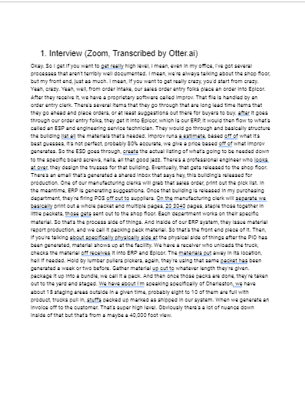
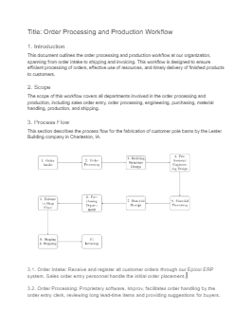
For the Factory Floor
ChatGPT can improve productivity in the creation of documentation
5 MINUTE
INTERVIEW
TRANSCRIPT
ISO DOC WITH FLOW CHART
Example of gpt workflow:
5 min interview to process doc with flow chart

Slide 13
Knowledge Sharing
Baby Boomers are leaving the workforce and taking their experience with them. ChatGPT helps to solve this issue.
Experienced workers can either record their experience or write it down for others
Rather than having to read a document to find a specific point of interest, ChatGPT can find it for the user

Slide 14
Problem Solving
The #1 Challenge to Problem Solving – Getting to the Root Cause
In the past, when using the five why’s, it is like we were digging with a spoon
With ChatGPT, you are digging with shovel
We have been able to delve into quantitative data
With ChatGPT, we can also dig into text

Slide 15
For the Factory Floor
Let’s try it out!
https://chat.openai.com/

Slide 16
The Future
Quality Control
Analyze large amounts of data related to product defects or quality issues
Train the model on historical data to identify patterns and provide insights that can help manufacturers identify potential quality issues before they become bigger problems
Predictive Maintenance
Predict when machines or equipment are likely to fail
Analyze data from sensors and other sources to identify patterns that indicate when maintenance is needed, allowing manufacturers to proactively schedule repairs and minimize downtime

Slide 17
The Future
Supply Chain Optimization
Analyze supply chain data and identify areas where efficiencies can be gained
Analyze shipping routes to identify more efficient routes, or identify potential bottlenecks in the manufacturing process that could be addressed to improve overall efficiency
Customer Service
Personalize customer service to manufacturing customers
Train model on common customer questions and issues to provide quick and accurate responses to customer inquiries, improving customer satisfaction and reducing the customer service workload

Slide 18
Other Key Points
Be careful about confidentiality
- All date given to ChatGPT becomes part of its global knowledge and is accessible to all
- Obtain the API and create your own database of knowledge
Today, ChatGPT can only digest 5 pages of documentation at a time

Slide 19
UNLOCKING THE POTENTIAL: The Evolutionary Impact and Practical Applications of ChatGPT for Manufacturers
Questions and Discussion

Slide 20
Mike Ungar, Industry 4.0 Club Co-Founder
mungar@focalpointcoaching.com
www.industry40club.com
Jan Pingel, Industry 4.0 Club Co-Founder
jan.pingel@irco.com
www.industry40club.com

