Slide 1
IMEC
Revolutionizing Metal Production:
Exploring Additive Manufacturing Applications in Metals and Castings
Mike Vasquez, PhD
CEO
3Degrees, LLC
mike@3degreescompany.com

Slide 2
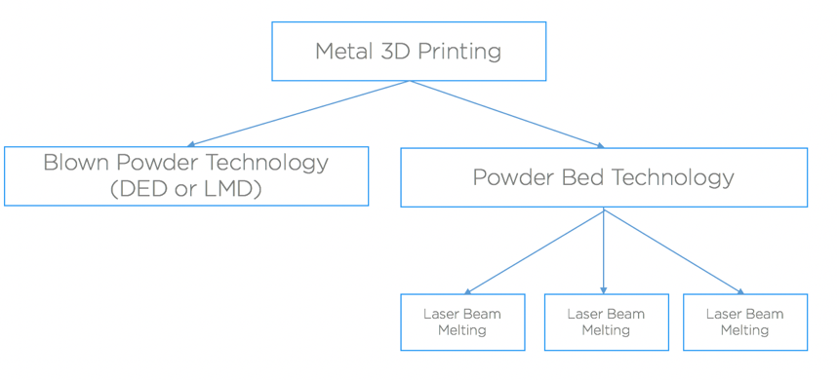
Defining Metal 3D Printing
Within the ASTM F42 3D Printing technology definition subset, there are several 3D Printing modalities that can use metal as its primary feedstock
Powder bed fusion (laser based)
Powder bed fusion (electron beam)
Material extrusion
Binder jetting
Directed energy deposition (large/small puddle)
Material jetting (cold spray processes)
Over the last 3-5 years the 3D Printing industry has seen the most rapid adoption and growth within the powder bed fusion class of technologies with the others playing more of a niche role due to cost, size, and materials available.
Inkjet/Binder Jetting
Electron Beam Melting
Key Takeaway
Because of the large number of technology platforms, companies need to focus on particular applications/technologies/materials

Slide 3
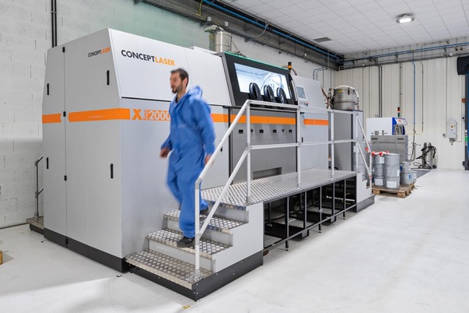
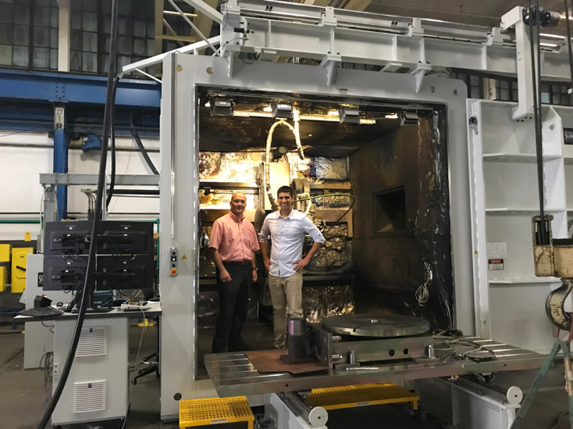
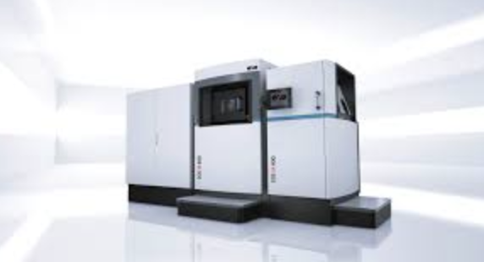
Example Production Metal Systems
Laser Powder Bed Fusion (Concept Laser/EOS)
Electron Beam Welding - Sciaky

Slide 4
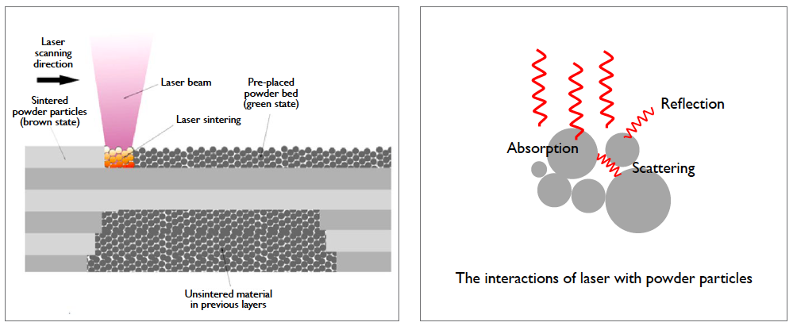
Laser Based Metal Powder Bed Fusion
The predominate focus of the 3D Printing metals industry is metal powder bed fusion technology using either laser or an electron beam to consolidate the material. The material is typically a spherical powder less than 150 microns
Source EPMA

Slide 5
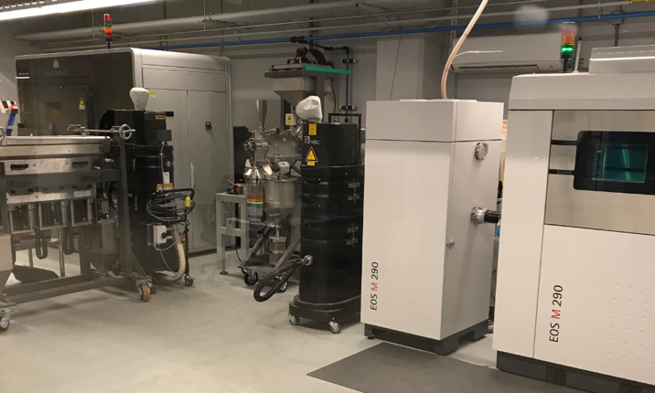
Typical 3D Printing Metal Workflow
Part Construction
Part Design – Design for Additive Manufacturing
3D build model creation
3D build
Stress relief
Build plate removal
Hot Isostatic pressing
Heat treatment
Surface finishing
Plating
Machining
Quality Assurance
X-ray/CT for internal defects – voids
Dye penetrant
Dimensional (CMM, gauging, 3D Scanning)
Chemical analysis
Mechanical testing (tensile, HCF, etc.)
Microscopy
Time Spent during the Process
 | Metals | Polymers
Pre-Processing | 15% | 10%
Printing | 50% | 70%
Post-Processing | 35% | 20%

Slide 6
The appeal of 3D Printing using metal
Ability to engineer and make highly complex end parts and tooling
Designers can choose from a wide range of materials including tool steels, stainless steels, titanium, titanium alloys, nickel based super alloys, cobalt chrome alloys, copper based alloys, gold, silver, palladium, and tantalum
Most 3D Printing metal systems produce parts that are nearly 100% dense that match the properties of a cast part in the same material.
Custom microstructures can be made using powder bed fusion technologies due to the very small working areas in the build chambers
Smaller grain boundaries in metal 3D Printed parts result in more uniform material composition throughout the component.
Hot Isostatic Pressing
Part Size/Weight
3D Printing
Pressing/Sintering
Metal Injection Molding
O
Hundreds of Thousands
Production Volume

Slide 7
The limitations of metal 3D Printing
 | Details
Part Size | Typically most powder bed metal machines are on the order of 250mmx250mmx250mm. Some vendors have come out with larger systems in recent years and DED processes can achieve bigger parts.
Materials | Certainly there are a number of materials that are open to the process however non-weldable do not work and difficult to weld parts need special approaches.
Production Volume | Currently most 3D Printing metal approaches are suitable only for small series due to production time and cost. However, smaller components have been printed in production volumes up to 10s of thousands of parts.
Material Properties | Material properties are generally better than cast parts but not as good as wrought components due to part anisotropy and residual porosity.
Part Design | There are significant design limitations to 3D Printed metal parts including having to consider support materials, overhangs, post processing, and surface finish.

Slide 8
Particle size is tied directly to the type of printing system
Process Category | Vendors | Powder Size (microns)
 |  | 15 |  | 50 |  | 100 |  | 150 |  | 250 |  | 500
Traditional Powder Manufacturing | Multiple
Material Jetting | Titomic Speed3D VRC Systems
Directed Energy Deposition | DMG Mori
Directed Energy Deposition (Small Weld Pool) | Optomec DM3D
Powder Bed Fusion Electron Beam | GE Arcam
Powder Bed Fusion Laser | EOS GE Concept Laser SLM 3D Systems Renishaw
Material Extrusion | MarkForged
Binder Jetting | ExOne Desktop Metal
Notes:
is it possible to have an overlay of the metal powder PSD used in other traditional manufacturing ?
See above

Slide 9
The type of 3D Printing consolidation process has a significant impact on overall properties and post processing
 | Selective Laser Melting | Liquid Metal Deposition
Materials | Limited material selection | Many material options
Part Dimensions | Limited by build chamber | Limited by deposition system
Part Complexity | Nearly unlimited | Limited
Dimensional Accuracy | >0.1mm | >0.1m
Deposition Rate | 1-3 mm³/s | 3-10 mm³/s
Build Surface | Build Plate | 3D Surface
Roughness | 30-50 microns | 60-100 microns
Layer Thickness | >0.03-0.1mm | >0.03-1mm
LENS – Liquid Metal Deposition

Slide 10
Industry Takeaways
There are a variety of reasons companies are investigating 3D Printing metal technologies. Most of which include the ability to cut costs or expand their manufacturing capabilities.
EOS and GE are the market leaders in terms of brand awareness. There is a high cost for machine users to change brands once they start down a certain path of production due to qualification issues.
The main materials in the market now are aluminum and titanium as well as some nickel alloys. Most respondents said that there continues to be a desire for new materials but they need to be targeted towards specific applications.
The major factor that is slowing mass adoption of 3D Printing for metal is the lack of knowledge in how to design for the technology.

Slide 11
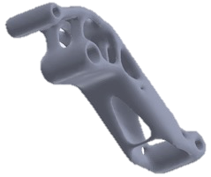
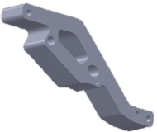
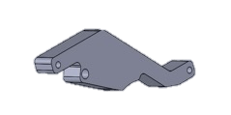
Designing for AM Approaches
REDESIGN
FOR AM
c
MODIFY
EFFORT
c
RECREATE
Producing the part without any design changes specific to AM. Primary benefit is speed due to elimination of tooling.
Modify the part with basic lattice structures or other features to minimize material.
Fully design the part for AM technologies to improve the parts overall performance

Slide 12
The 3D Printing value chain is complex and made up of a number of players at each step of the process
Part Selection
Design
Materials
Machine
Post Process
Testing
& Inspection

Slide 13
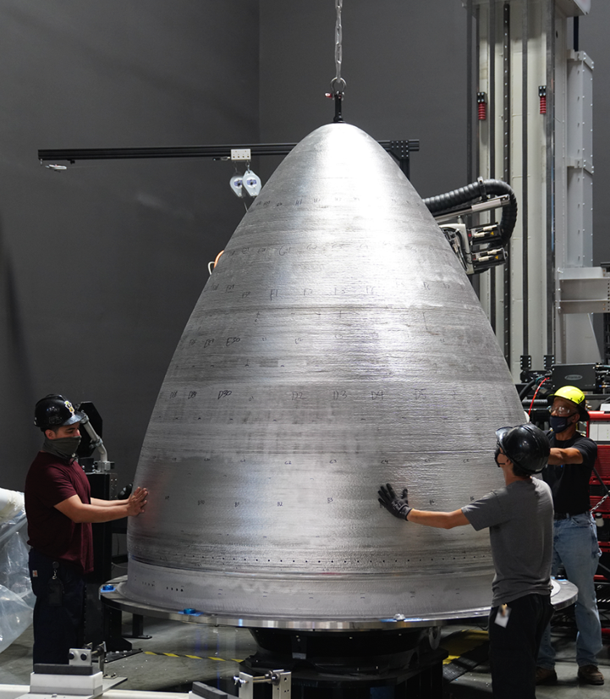
Aerospace
GE Fuel Nozzle to reduce overall parts and assembly points
Industry | Aerospace
Part Description | Fuel nozzle tip for air craft engines
Material | AlSi10Mg
Details and Motivation | Optimized geometry and weight reduction. To-date over 30,000fuel nozzle tips have been shipped
Image (GE)

Slide 14
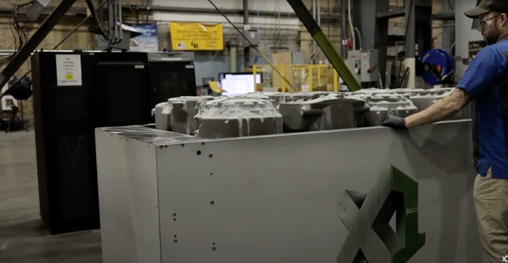
Tooling and Molds
Komet Group rethinks cutting tools for metal 3D Printing
Industry | Tooling
Part Description | Optimized cutting tool heads.
Material | Steel
Details and Motivation | Komet had a need to produce highly complex cutting tools with sophisticated cooling channels. There were no other manufacturing solutions available to make these parts.
Image (GE)

Slide 15
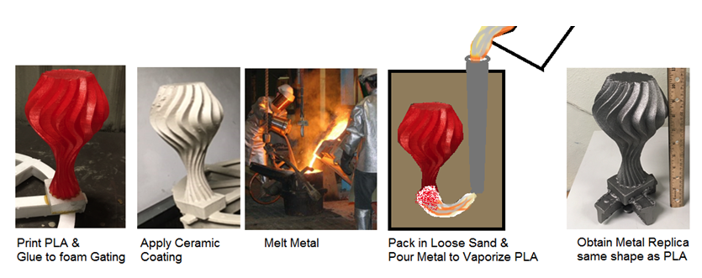
Additive Manufacturing Evaporative Casting

Slide 16
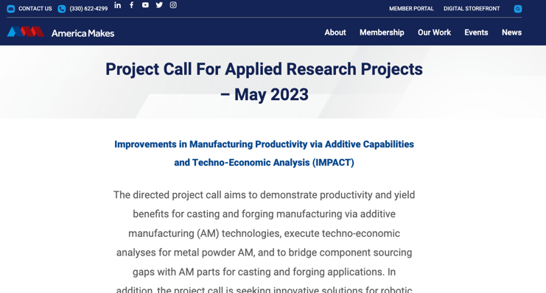
Current Funding Opportunities
Lots of DoD flow down funding opportunities to advance 3D Printing to strengthen the domestic metal and castings industry
America Makes, MxD, Lift
Navy, Air Force, Marines, and Army
Incentives to bring on new equipment and train workforce to develop these capabilities
Dual qualification to strengthen supply chains

Slide 17
3Degrees,LLC
Mike Vasquez, PhD
Email: mike@3degreescompany.com
Phone: +1.651.503.9085
Website: www.3Degreescompany.com

