Slide 1
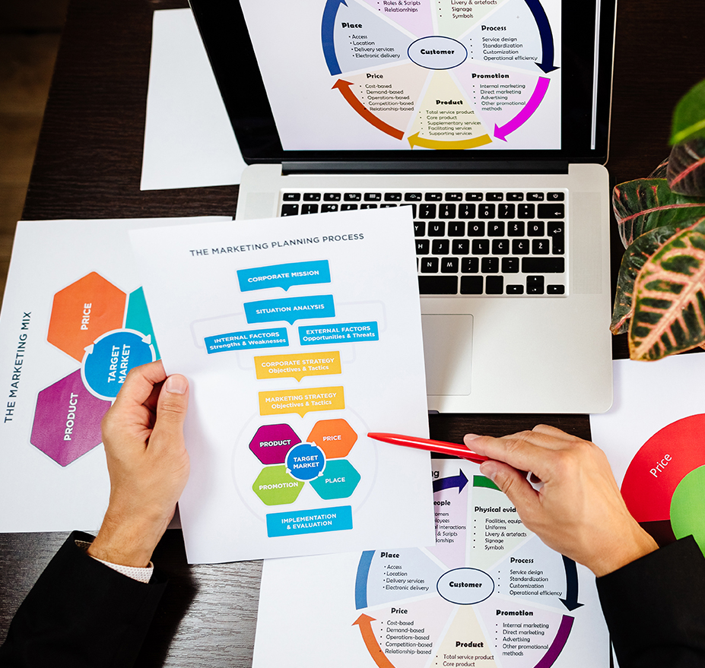
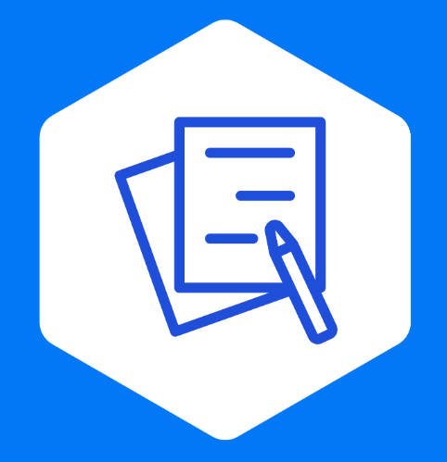
Scorecard Sales
Effective Ways To Close More Deals & Win More Business
Aaron Jacobs; MBA

Slide 2
Who is
Aaron Jacobs?
Over 20 years of experience in sales, leadership, and management.
I am passionate about teaching
I am passionate about business, sales, leadership
and service.
“Give people a path to success, the tools to get there,
and give them a reason to smile along the way.”

Slide 3
Who Is Scorecard?
We are an integrative sales process improvement company.
Increase your productivity and sales.
Tools and processes to generate sustainable revenue for years to come
We optimize sales teams to increase results.

Slide 4
The Agenda
What closing deals does and doesn’t mean
Know your goal post
Q&A Session
How to close deals
What if the deal won’t close?
Q&A Session

Slide 5
What “Closing The Deal” Does & Does Not Mean

Slide 6
Closing The Deal
The point in a sale where negotiating concludes, and all terms are agreed upon, finalized and documented.
This includes:
Commitments
Price
Contracts
Implementation
Details
Eliminating competitors
Eliminating options

Slide 7
Closing The Deal Does Not Have:
Assumptions
Vague agreements
Lack of time commitment
Uncertainty
Contingencies
Room for additional negotiation
Escape windows

Slide 8
What Are Escape Windows?
An opportunity for a buyer or seller to back out of the deal after an agreement is made, but before payments and services have been delivered.
This may appear as:
False positives
A shallow close
Buyer’s remorse
Inability to purchase
Change of heart/mind

Slide 9
Know Your Goal Post

Slide 10
It All Starts With Your Goal Post
Do you know what you want?
Do customers know what you want?
Do you know how to get there?
Do you know how to ask for it?

Slide 11
Where Is Your Goal Post?
Every step in the sales process should have a Predetermined Optimal Outcome.
This is your goal post.
What is the targeted goal for each of your sales process steps with the client/ prospect?
Share that goal at the beginning with your customer with your agenda.
*Without a goal post, the salesperson will run around with the ball forgetting where to shoot. This will confuse the customer as well.

Slide 12
Identifying The Goal Post
“Customer, thank you for meeting with me. Today we are going to review our recommendations based on the needs that you shared and then we will discuss if this is the right solution for you. If it is, we will begin the selection process. We’ll make it our goal together at the end of our conversation today to decide if you’re ready to take that next step. Does that sound fair to you?”
*Your goal is to start the selection process and everything you do drives to that goal post.

Slide 13
You have now set up your shot to close the deal
Your intentions are known and clear
The customer is now looking at the goal with you.
The customer is prepared for you to ask the question when the time is right.
The customer is expecting to make a decision
The customer will also consider which objections you need to manage in the process.
*The sooner you get sales objections, the faster and easier you can deal with them.

Slide 14
Follow Through With Your Shot
Everything you do at this point must take you and the customer towards the goal.
Avoid going backwards to options that were already eliminated.
Focus on the steps necessary to close the deal.
Make certain the customer has the opportunity to ask important questions.
Make certain there are no outstanding objections standing in the way of the deal.
*Remember, the sooner you get sales objections, the faster and easier you can deal with them.

Slide 15
And If You Find Yourself Getting Off Course:
Remember your goal post and do everything to redirect the process back towards it.
Avoid tangents
Avoid unnecessary features and benefits
Avoid procrastinating ask for the sale
Remember, you are in control of the ball (the sale) and it is up to you to get it to the goal.

Slide 16
Questions?

Slide 17
How To Close Deals

Slide 18
Closing The Deal
Asking for the business is the part of the process that many in sales struggle with.
They either do not know how to do it, are afraid of rejection, intimidated by their client or perhaps dismiss it as unimportant.
We worry about coming across as too pushy or aggressive or fear that we will damage any relationship that we have built or are trying to build.
Frequent role playing with a rehearsed script of asking for the business is the best way to overcome any of the above reasons.

Slide 19
How To Close The Deal
Do you want to hear the best deal closing technique?
“Can you think of any reason why we can’t close the deal?”

Slide 20
“Can You Think Of Any Reason Why We Can’t Close This Deal?”
Why does this work?
It is easier for customers to say ‘no’ than it is to say ‘yes’
If they say ‘yes’, learn more about their objection and manage it
If they say ‘no’ close the deal and sign the contract

Slide 21
Close The Deal Or Walk Away
There are 3 options for a customer when you ask for the sale:
1. Yes - Congratulations
2. Maybe - What other barriers do we have to work through?
3. No - Is it really over?
*Can you close the deal or should you walk away?

Slide 22
The 5 Stages Of Assessing The Deal
Maintain your position
Check for fitness
Negotiation
Managing expectations
Assess & decide

Slide 23
1. Maintain Your Position
Don’t immediately back down just because a customer didn’t say yes right away.
Never lower your price until you ask twice.
Don’t go into negotiation mode immediately.
Take the time to listen to what the customer is telling you.

Slide 24
2. Check For Fitness
Are you and the customer trying to fit a square peg into a round hole? If so, is it worth it?
Don’t ignore important cues and clues about what the customer expects and what you are able to deliver.
If there are just a couple of ‘bumps’ that can be worked out, close the deal.
If it is not going to be a good fit, walk away and forgo negotiation.

Slide 25
3. Negotiation
Some sales barriers can be negotiable (price, deadlines, customization, etc.) but is there enough cushion in the proposal to work with?
Are the customer’s objections reasonable and workable?
If so, negotiate to close the deal.
If not, walk away.
Don’t create promises you can’t deliver on for the sake of making the sale.

Slide 26
4. Manage Expectations
A lot of excitement and expectations are created at the time of closing the deal.
Will closing this deal create more problems than opportunities for either or both parties?
If you are confident that you can manage expectations, close the deal.
If closing the deal means that you’ll struggle to meet expectations throughout the process, walk away.

Slide 27
5. Assess & Decide
Examine all variables of the deal closely.
If the net sum of the deal is win/win for both parties, close the deal.
If the deal puts a strain on operations, resources or profit with a low ROI, walk away.

Slide 28
Never Lower Your Price Until You Ask Twice
Price objections are a big weakness for salespeople.
Remember, the sales is almost never just about price alone.
Customers will base their decision on price alone if they perceive no other value.
A price objection usually doesn’t mean the customer is unable or unwilling to pay the offered price.
They want to see what they can get away with.
They want to feel like they have a victory.
They are using you to negotiate with your competitor.

Slide 29
Never Lower Your Price Until You Ask Twice
Never lower your price until you ask for it twice.
This demonstrates that you believed your first price was fair.
Many customers are unwilling to push back a second time and will accept your price.
Most customers will respect you more for holding firm on your price rather than dropping it right away.

Slide 30
If The Customer Wants To Walk Away At This Point:
Empathize: “I understand, price is also important for me when I purchase something.”
Ask the customer if price is the only issue that matters in the purchasing decision (*hint, it’s not).
You can consider negotiating if the deal will make sense for you.
Always let the customer make the next offer.
Never reduce your price first or else you will negotiate against yourself.

Slide 31
Remember, You Want To Close More Deals, But…
You want to close more deals with the right customers
You have an established price because it is worth the value
Not everyone is meant to be your customer
The more opportunities you have for deals and the better you are at closing, your sales will go higher
Can you think of any reason to not start closing more deals?

Slide 32
Virtual Classroom Summary
Closing the deal includes contracts, commitments, details & eliminates options and competitors.
Escape windows are caused by shallow closes, false positives and buyer’s remorse.
Closing the deal starts with a goals post shared with the buyer as a predetermined optimal outcome.
Share the goal in the beginning with the buyer to keep the sale on target at all times.

Slide 33
Virtual Classroom Summary
“Can you think of any reason why we can’t close this deal?” No means yes.
If you can’t close the deal with the first ask, maintain your position, check for fitness, negotiate is necessary, manage expectations and assess/decide.
Never lower your price until you ask twice.

Slide 34
Questions?

Slide 35
Aaron Jacobs?
We can help you with your sales training & sales process.
Let’s keep the discussion going.
ajacobs@scorecardsales.com
Find us on Facebook and LinkedIn
www.scorecardsales.com

