Slide 1
Business Transition Planning
Grant Seshul
grantseshul@apexusfinancial.com
309.472.6683
Disclaimer: The content in this presentation is for informational purposes only, and does not constitute legal, tax, or accounting advice. If you have specific questions about any of these topics, seek the counsel of a licensed professional.

Slide 2
Framework
Personal Financial Planning
Business Transition Planning
Strategic Planning
Notes:
Vision,People,Data,Issues,Process,Communication

Slide 3
Strategic Planning – Vision to Execution
Vision – Develop Short-term to Long-term
People – Right Person, Right Seat
Data – Develop Efficient Monitoring
Issues – Develop process to solve business issues
Process – Document key processes
Communication – Develop clear and consistent communication

Slide 5
Business Transition Planning is a Process, Not an Event
Business transition planning is the conscious effort to maximize enterprise value while enabling the conversion of that ownership into personal financial freedom and peace of mind.

Slide 6
What the Statistics Say about Business Sales
3 out of 4 business owners regret selling
70% to 80% of businesses don’t sell
95% see unrealistic expectations as their biggest obstacle

Slide 7
What the Statistics Say about Family Successions
Only 30% survive into the second generation
12% survive into the third generation
3% survive at the fourth generation and beyond

Slide 8
Considerations for Business Transition
Are you truly personally ready to transition out of your business?
Do you have a third act planned?
Do you know what you want to do after you transition out of your business?
What is the attractiveness of your business if a buyer were to come in?
What are the areas that we can help you improve so you can get maximum value for your business?
What is the business readiness?
How are your financials?
What are your personal financials like?
Can you live off of what you would sell your business for after you transition it?

Slide 9
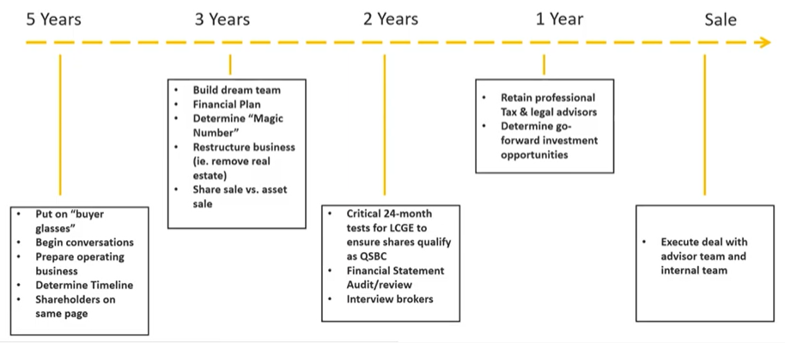
Timeline for business sale

Slide 10
Overview of Succession Planning

Slide 11
Family Specific Succession Planning Tips
Foster familiarity – Give employees time to prepare by being upfront when hiring about the firm’s motivations and intentions to develop trust and cooperation
Raise the bar – Aspiring successors should demonstrate competence and accountability. The firms should also demand longer hours and tougher assignments during the transition to develop nonfamily employee confidence.
Be Inclusive – In addition to the traditional family leader’s hand off of responsibilities, skilled nonfamily employees should be considered a valuable resource for training. The participative culture will help develop a more loyal and devoted workforce.

Slide 12
Areas covered in a Personal Financial Plan

Slide 13
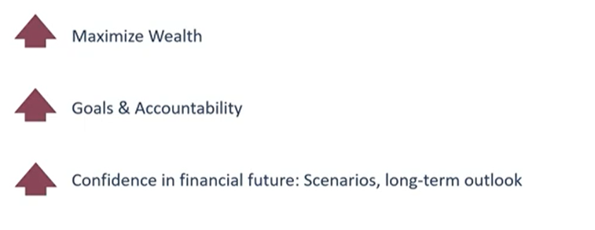
Personal Financial Planning

Slide 14
Financial Planning for Business Sale

Slide 15
Q&A

