Slide 1


PARTNERS
IN
PROGRESS.

Slide 2
AGENDA
Quick Hit: 5 Things for Manufacturers to Know
Industry Talk: Resources Available for Manufacturers
Leaders Table: Questions and Discussion

Slide 3
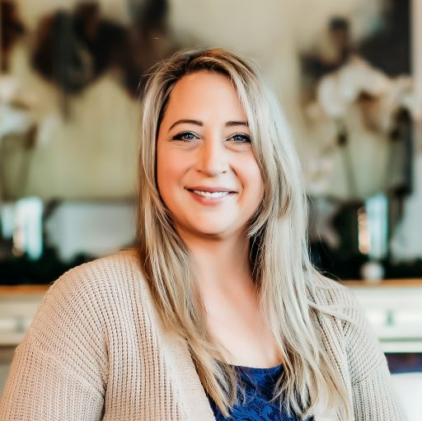
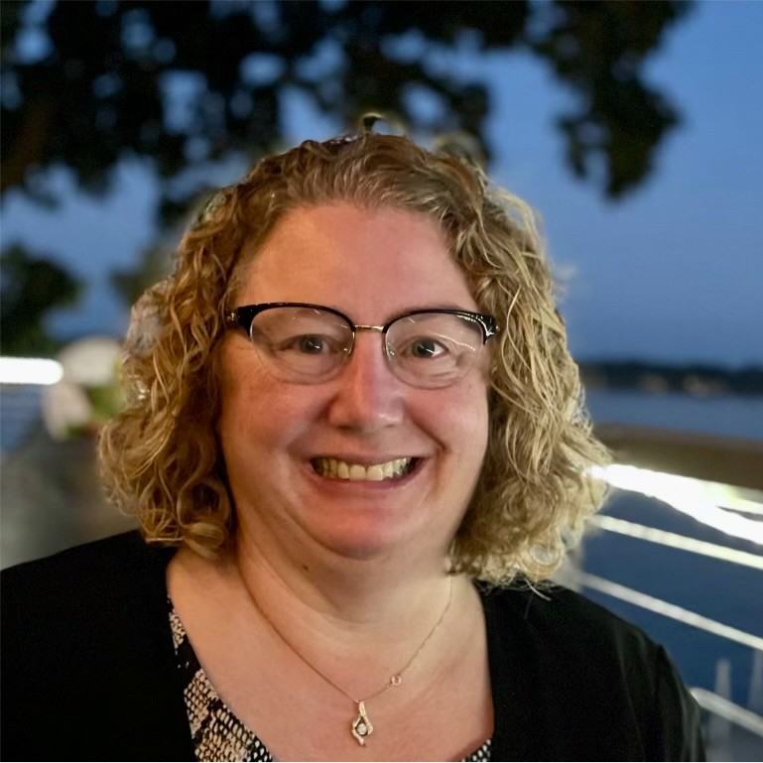
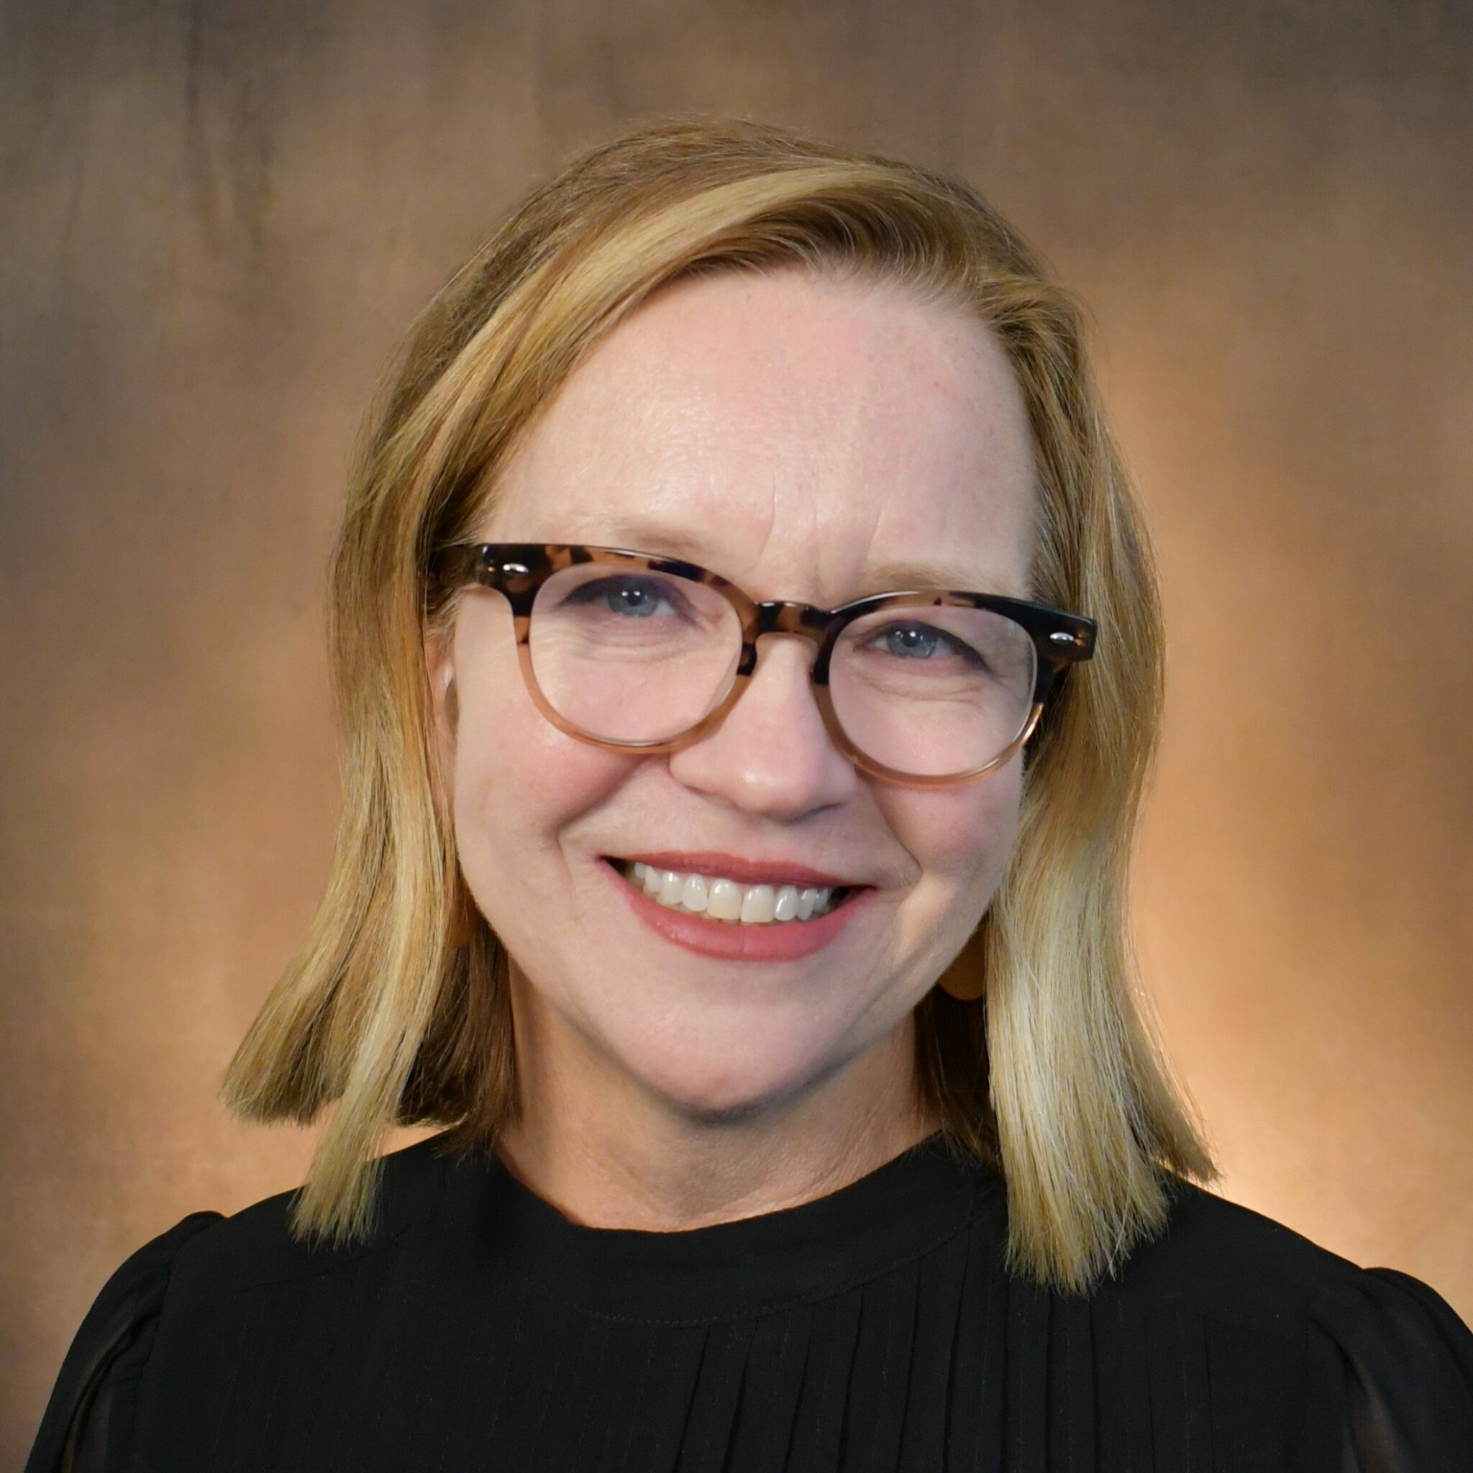
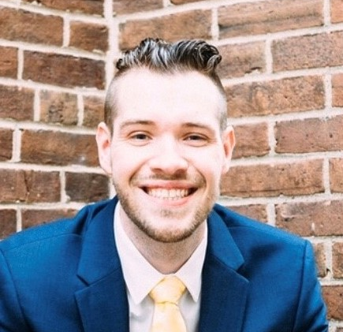
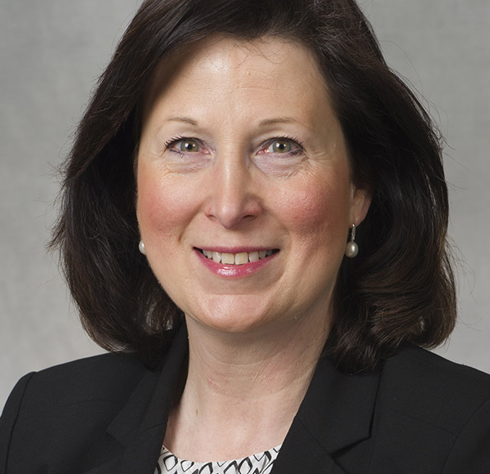
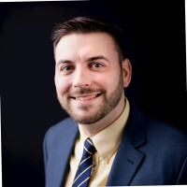
Kristy Johns
Vice President of Marketing
Illinois Manufacturing
Excellence Center
Alyson Grady
Deputy Director
Illinois Department of Commerce
and Economic Opportunity
Maria Moran
Member Engagement
Illinois Manufacturers’
Association
Sean Pritchard
Financial Review Manager
Office of Entrepreneurship, Innovation & Technology
Illinois Department of Commerce & Economic Opportunity
Keli Krueger-Huhra MBA, CPSM
Director llinois APEX Accelerator-Illinois PTAC at Bradley University
Foster College of Business, Turner Center for Entrepreneurship
Stephen Coyle
Assistant State Director for
Illinois Department of Commerce & Economic Opportunity
Illinois SBDC
Notes:
Kristy Johns – Me
Aly Grady is the Deputy Director for the Department of Commerce and Economic Opportunity’s Regional Economic Development Team. With this position, Aly works with local governments, community partners, businesses, and other entities to serve the needs and promote economic development across the state of Illinois. Aly has been working in state government for over 20 years and brings her knowledge and experience into this role to further the mission of DCEO. That mission is to support and maintain a strong economic environment for those served – taxpayers, employers, workers, and communities – by actively recruiting and growing businesses, maintaining a 21st-century workforce, enhancing innovation, and brining jobs and investment to underserved communities throughout Illinois. Aly is a Central Illinois native having grown up in Mattoon and living for over 25 years in the Springfield area.
Maria Moran joined the IMA in 2022 with over 20 years of manufacturing partnerships. She has been a trusted advisor to small and medium business, mid-level and enterprise organizations throughout Illinois, connecting business leaders to the experts and solutions needed to grow. Always curious and eager to learn, Maria enjoys building long lasting relationships that provide value to all stakeholders. Maria is based in Oak Brook and works primarily in Chicago, its suburbs, and the Rockford area.
Aly Grady is the Deputy Director for the Department of Commerce and Economic Opportunity’s Regional Economic Development Team. With this position, Aly works with local governments, community partners, businesses, and other entities to serve the needs and promote economic development across the state of Illinois. Aly has been working in state government for over 20 years and brings her knowledge and experience into this role to further the mission of DCEO. That mission is to support and maintain a strong economic environment for those served – taxpayers, employers, workers, and communities – by actively recruiting and growing businesses, maintaining a 21st-century workforce, enhancing innovation, and brining jobs and investment to underserved communities throughout Illinois. Aly is a Central Illinois native having grown up in Mattoon and living for over 25 years in the Springfield area.
Ms. Krueger-Huhra has been Director of the Illinois APEX Accelerator at Bradley University’s Turner Center for Entrepreneurship for 6 years. As Director, she establishes the center’s strategic direction to deliver critical program resources which reduce barriers for small businesses to become suppliers to the Department of Defense and other government agencies. She develops effective and engaging technical learning experiences to train businesses on performing market analysis and navigating contracting requirements through client consulting and instructing training seminars. Ms. Krueger-Huhra continues her commitment to advance supplier diversity with a focused outreach to small business concerns which are Disadvantaged, Women-Owned, Veteran-Owned, and Minority Institutions.

Slide 4
#1
MADE IN IL:
Grant Opportunity
(with Bonus Cyber-Safe)

Slide 5
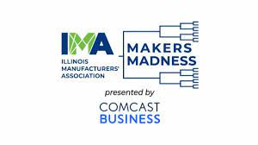
Makers Madness
#2

Slide 6
#3
ADVANTAGE
ILLINOIS

Slide 7

#4
Illinois Small Business Development Centers (SBDC)

Slide 8

#5

Slide 9
Manufacturing
Support:
Round Table
Notes:
Illinois DCEO (Department of Commerce and Economic Opportunity):
1. What specific programs or initiatives does the Illinois DCEO offer to support manufacturers in the state?
2. How does the Illinois DCEO assist manufacturers in accessing funding or incentives for growth and expansion?
3. Can you elaborate on any recent success stories or case studies where the Illinois DCEO played a pivotal role in helping a manufacturer thrive?
4. What resources does the Illinois DCEO provide to help manufacturers navigate regulatory compliance or address challenges related to workforce development?
5. In what ways does the Illinois DCEO collaborate with other organizations or agencies to maximize support for manufacturers?
Illinois Manufacturers Association:
1. How does the Illinois Manufacturers Association advocate for the interests of manufacturers in the state, particularly regarding policy and legislation?
2. What networking or educational opportunities does the Illinois Manufacturers Association provide for manufacturers to connect and learn from each other?
3. Can you outline any specific tools or resources the association offers to help manufacturers improve efficiency, sustainability, or competitiveness?
4. How does the Illinois Manufacturers Association support workforce development and talent retention within the manufacturing sector?
5. What are the top priorities or challenges currently facing manufacturers in Illinois, and how is the association addressing them?
Illinois Manufacturing Excellence Center:
1. How does the Illinois Manufacturing Excellence Center assist manufacturers in improving their operational processes and increasing productivity?
2. Can you share examples of successful collaborations between the Illinois Manufacturing Excellence Center and manufacturers in the state?
3. What types of training or consulting services does the center offer to help manufacturers adopt new technologies or best practices?
4. How does the Illinois Manufacturing Excellence Center support manufacturers in implementing sustainable and environmentally friendly manufacturing practices?
5. What role does the center play in fostering innovation and helping manufacturers stay competitive in an ever-evolving market?
APEX Accelerators:
1. How does APEX accelerators support startups or early-stage companies in the manufacturing sector?
2. Can you provide examples of successful partnerships between APEX accelerators and manufacturing startups in Illinois?
3. What resources or mentorship opportunities does APEX accelerators offer to help manufacturing startups scale and grow?
4. How does APEX accelerators facilitate connections between manufacturers and potential investors or strategic partners?
5. In your view, what are some key trends or emerging technologies that manufacturing startups should be aware of, and how is APEX accelerators assisting them in adapting to these changes?
Illinois SBDCs (Small Business Development Centers):
1. How do Illinois SBDCs specifically cater to the needs of small and medium-sized manufacturers in the state?
2. Can you outline the consulting or advisory services that SBDCs offer to help manufacturers with business planning, marketing, and financial management?
3. How does Illinois SBDCs assist manufacturers in accessing capital or securing financing for expansion or innovation projects?
4. What role do SBDCs play in providing manufacturers with market intelligence or assistance in exploring new markets, both domestically and internationally?
5. How does the Illinois SBDC network collaborate with other organizations or agencies to provide comprehensive support to manufacturers across the state?

Slide 10
Questions / Comments
Illinois Manufacturers’ Association
IMA-net.org
Illinois Manufacturing
Excellence Center
IMEC.org
Illinois APEX Accelerator
Illinois Department of Commerce & Economic Opportunity
dceo.illinois.gov/
Illinois SBDC
Notes:
Strategic Collaboration: In an era of rapid technological advancements and global competition, how can the Illinois Department of Commerce and Economic Opportunity, the Illinois Manufacturing Excellence Center, and the Illinois Manufacturers' Association collaborate strategically to enhance the competitiveness of Illinois-based manufacturers on the national and international stage?
Workforce Development: With the ongoing evolution of manufacturing technologies, how can the state of Illinois ensure a skilled and adaptable workforce that meets the changing demands of the industry? Are there specific initiatives or partnerships in place to address workforce development challenges and ensure a steady pipeline of talent for the manufacturing sector?
Innovation and Technology Adoption: How can manufacturers in Illinois leverage innovation and emerging technologies to stay ahead in the global marketplace? Are there state-level initiatives or resources available to support manufacturers in adopting and integrating new technologies into their operations?
Supply Chain Resilience: Recent global events have highlighted the importance of resilient and agile supply chains. What strategies or best practices can Illinois manufacturers employ to enhance the resilience of their supply chains? Additionally, how can the state support these efforts to strengthen the overall manufacturing ecosystem?
Sustainability and Environmental Practices: With increasing emphasis on sustainability, how can Illinois manufacturers integrate environmentally friendly practices into their operations? Are there state-level incentives or programs to encourage the adoption of sustainable manufacturing processes, and what role can each organization represented at this roundtable play in promoting eco-friendly initiatives?
Trade and Export Opportunities: In the context of global trade dynamics, how can the state of Illinois and its manufacturing community capitalize on international market opportunities? Are there specific programs or support mechanisms in place to assist manufacturers in expanding their reach and navigating international trade challenges?
Regulatory Environment: How can the Illinois Department of Commerce and Economic Opportunity collaborate with the Illinois Manufacturers' Association to create a business-friendly regulatory environment for manufacturers? Are there ongoing efforts to streamline regulations or address regulatory challenges that may impact the industry's growth and competitiveness?
Digital Transformation: As the manufacturing industry undergoes digital transformation, how can Illinois manufacturers embrace Industry 4.0 technologies to improve efficiency and productivity? What initiatives or resources are available to help manufacturers, especially small and medium-sized enterprises, in their digital adoption journey?
Reskilling and Upskilling Programs: Given the rapidly evolving nature of manufacturing jobs, what measures are being taken to implement reskilling and upskilling programs for the existing workforce? How can the Illinois Manufacturing Excellence Center collaborate with industry leaders to ensure that workers are equipped with the skills needed for the jobs of the future?
Access to Capital: Access to capital is crucial for innovation and expansion. What steps can the Illinois Department of Commerce and Economic Opportunity and the Illinois Manufacturers' Association take to enhance access to financing for manufacturers? Are there specific financial programs or incentives aimed at supporting manufacturing businesses, particularly those looking to invest in new technologies or facilities?

