Slide 1


PARTNERS
IN
PROGRESS.

Slide 2
AGENDA
Quick Hit: 5 Things for Manufacturers to Know
Supply Chain: Stronger, Faster, Better
REV Program: EV Supply Chain and Incentives
Leaders Table: Questions and Discussion

Slide 3




David Boulay Ph.D.
President
Illinois Manufacturing
Excellence Center
Sarah Hartwick
Vice President Education & Workforce Policy and Executive Director
IMA Education Foundation
Alyson Grady
Deputy Director
Illinois Department of Commerce and Economic Opportunity
Lisa Clemmons Stott
Electric Mobility & Innovation Director
Illinois Department of Commerce and Economic Opportunity
Notes:
David Boulay is President of IMEC. David’s experiences in family-owned business, manufacturing, universities and non-profits have helped guide IMEC in serving as a catalyst for small and mid-sized company competitiveness. Boulay grew up in a family-owned business, learning first-hand about the trial, challenges, and pride that he sees in companies IMEC works with today. He has also worked in various manufacturing roles in companies such as Frito-Lay and Pillsbury. Boulay has a PhD focusing on high performance work practices in small and mid-sized companies and career pathways for workers. At IMEC he has helped create and implement initiatives to increase the flow of state and federal funding to manufacturers for projects, update worker skills, and help smaller manufacturers adopt new technology and business practices and to improve energy efficiency.
Sarah Hartwick is Vice President Education & Workforce Policy and Executive Director, IMA Education Foundation for the Illinois Manufacturers’ Association. Prior to joining the IMA in 2021, Sarah was previously the Executive Director of ED-RED, a suburban public school district advocacy organization. Sarah has also served as the Co-Director for Legislative Affairs at the Illinois State Board of Education and has worked with education advocacy organizations including Advance Illinois and the Illinois Head Start Association. Sarah has a Master’s Degree in Public Administration and a Bachelor’s degree in political studies with minors in both communications and economics. Sarah has four children.
Aly Grady is the Deputy Director for the Department of Commerce and Economic Opportunity’s Regional Economic Development Team. With this position, Aly works with local governments, community partners, businesses, and other entities to serve the needs and promote economic development across the state of Illinois. Aly has been working in state government for over 20 years and brings her knowledge and experience into this role to further the mission of DCEO. That mission is to support and maintain a strong economic environment for those served – taxpayers, employers, workers, and communities – by actively recruiting and growing businesses, maintaining a 21st-century workforce, enhancing innovation, and brining jobs and investment to underserved communities throughout Illinois. Aly is a Central Illinois native having grown up in Mattoon and living for over 25 years in the Springfield area.
Lisa Clemmons Stott is the Electric Mobility and Innovation Director in the Director’s Office at the Illinois Department of Commerce and Economic Opportunity. She works to grow Illinois’ share of advanced manufacturing in the electric vehicle sector by highlighting the state’s many assets, including one of the most aggressive incentives programs in the nation, the Reimagining Energy and Vehicles Act. She has worked at the critical intersection of community and economic development for nearly fifteen years, including as a founder of her own consulting firm and the executive director of the state capital’s downtown business district. Her career started in the Illinois legislature as a staff person and she has held numerous leadership, communications and change management roles over her career.

Slide 4
#1
Economic Insights:
ITR Monthly & Quarterly Reports

Slide 5
#2
21-Day DEI Challenge
TRANSFORMATIVE INCLUSION JOURNEY

Slide 6
#3
Employer Training Investment Program
(ETIP)

Slide 7
#4
Economic Development for a
Growing
Economy
Tax Credit Program (EDGE)

Slide 8
#5
Business Attraction
Prime Sites
Capital Grant Program

Slide 9
SUPPLY
CHAIN
RESILENCY

Slide 10
In the face of uncertainties, a resilient supply chain not only defends against risks but also empowers manufacturers to adapt, innovate, and thrive in dynamic environments.

Slide 11
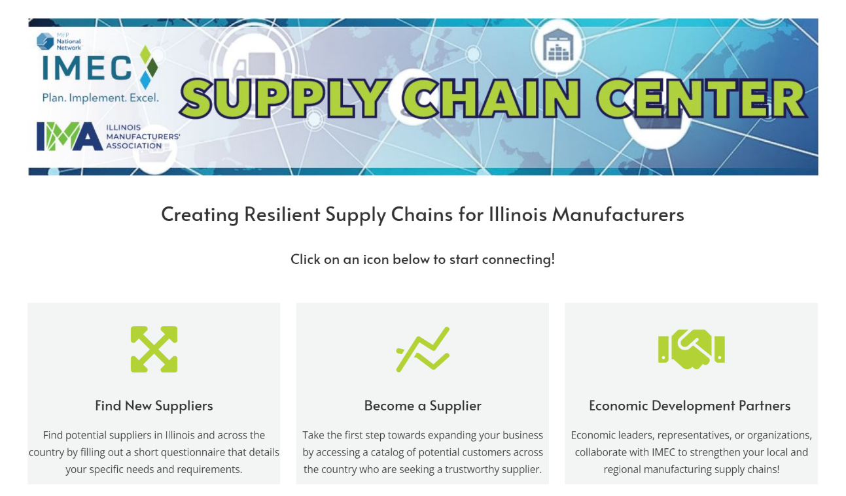

Slide 12
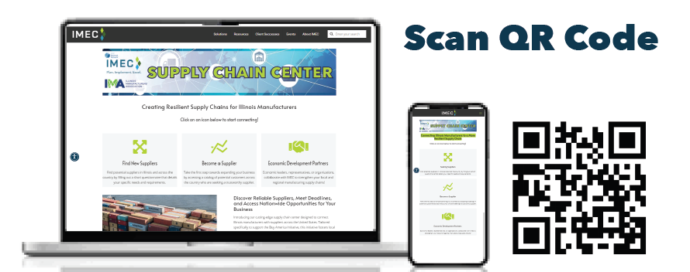
Supply Chain Center
Streamlined connections between Illinois manufacturers and suppliers
Access to an extensive list of supplier opportunities from around the country
Dedicated IMEC Supply Chain Liaison to help identify and manage a solution
Latest tools, resources, and news to grow and maintain a healthy supply chain

Slide 13
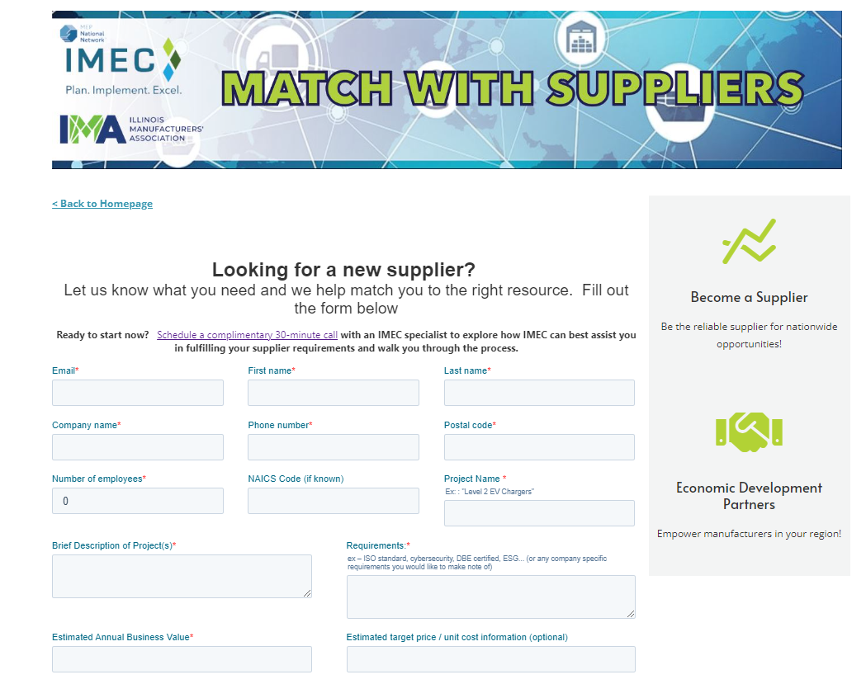
Navigating the Center
Fill out the form with as much information as possible
Once submitted, IMEC will reach out to set up a call
Talk through form submission, needs, deadlines

Slide 14
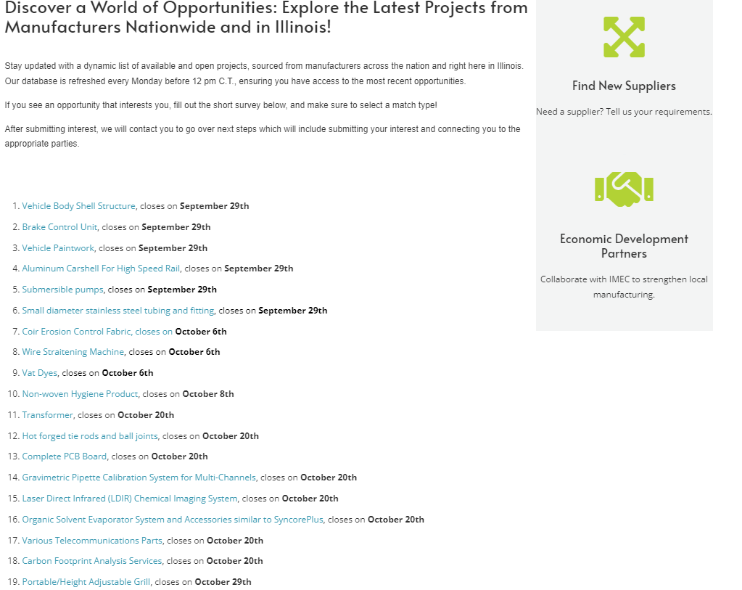
Navigating Open Opportunities
This list is updated every week
Each project is accompanied with a PDF of high-level information
Short form to submit interest

Slide 15
Process to Results
Situation: Company A is seeking phenolic resins, a critical business component.
Process:
  Conducted a 30-minute discovery call to assess their requirements
  Scouted IMEC database with keywords, NAICS codes, and relationships
  Emailed manufacturers who could be good matches for this project
  Shared responses/emails from interested manufacturers
  Facilitated introductions
Results: Within a month and a half, IMEC connected Company A with:
  10 interested and capable manufacturers
  2 highly capable manufacturers

Slide 16

REV in Illinois Incentives
To support the EV
& Clean Energy Ecosystem
November 2023

Slide 17
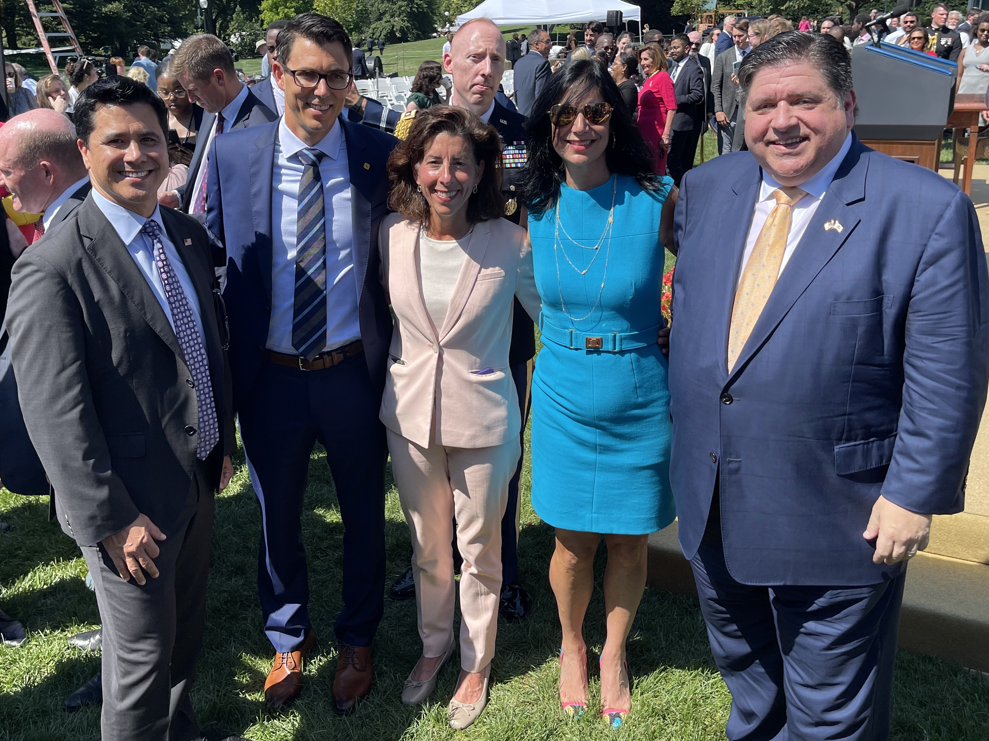

For The Entire Electric Vehicle+ Ecosystem
Electric Vehicle Manufacturers for vehicles exclusively powered by electricity including hydrogen fuel cell or solar technologies
Suppliers of EV component parts (e.g. batteries, cathodes, anodes, power supply equipment)
EV charging station manufacturers
Manufacturers throughout battery lifespan
Renewables manufacturers

Slide 18
overall_1_132373125595848470 columns_1_132373125595848470
What is the Eligibility for REV?
Tiers | Entities | CAPEX Threshold | New Jobs Threshold | Timeframe to be Placed in Service
Tier 1 | Smaller projects in the EV or renewables sectors | $2.5M | ≥ 50 jobs (or 10% of global employment, whichever is less) | Within 4 years
Tier 2 | Electric Vehicle Manufacturer | $1.5B | ≥ 500 jobs | Within 5 years
Tier 2 | EV Component Parts Manufacturer (including batteries) or Renewables Manufacturer | $300M | ≥ 150 jobs | Within 5 years
Tier 2 | Traditional manufacturers converting to EV or renewables production | $100M | ≥ 50 new jobs (or new jobs equivalent to 10% of statewide baseline for taxpayer, whichever is less) | Within 5 years
No “But For” Test required for eligibility
Notes:
"Electric vehicle manufacturer" means a new or existing manufacturer that is primarily focused on reequipping, expanding, or establishing a manufacturing facility in Illinois that produces electric vehicles.
"Electric vehicle component parts manufacturer" means a new or existing manufacturer that is primarily focused on reequipping, expanding, or establishing a manufacturing facility in Illinois that produces any parts for an electric vehicle.
"Electric vehicle power supply equipment" means the equipment used specifically for the purpose of delivering electricity to an electric vehicle, including hydrogen fuel cells or solar refueling techonology.
"Electric vehicle power supply manufacturer" means a new or existing manufacturer that is focused on reequipping, expanding, or establishing a manufacturing facility in Illinois that produces electric vehicle power supply equipment used for the purpose of delivering electricity to an electric vehicle, including hydrogen fuel or solar tech.
NOTE, REV changes:
Removes the need for a component parts manufacturer under the Act to primarily produce EV component parts
• Removes the “substantially” portion of definition of “retained employee” for component parts manufacturers
• Allows production of any component part of an electric vehicle to be considered eligible for the credit

Slide 19
overall_1_132373125595848470 columns_1_132373125595848470
Additional Benefits Depending on Location
  An Underserved Area means any geographic area as defined in Section 5-5 of the Economic Development for a Growing Economy (EDGE) Tax Credit Act.
  “Energy Transition Area” means a county with less than 100,000 people, OR a municipality that contains one or more of the following:
    A fossil fuel plant that was retired from service or has significant reduced service within 6 years before the time of the application or will be retired or have service significantly reduced within 6 years following the time of the application;
    A coal mine that was closed or had operations significantly reduced within 6 years before the time of the application or is anticipated to be closed or have operations significantly reduced within 6 years following the time of the application.

Slide 20
Savings from Income Tax Withholding
  Income Tax Withholdings are in effect, a Grant. Unlike EDGE, these are not credits against the corporate income tax. The taxpayer may retain these credits immediately upon collecting withholding from their employees without remitting them to the state Department of Revenue.
  For new or retained employees, the amount is not to exceed:
    75% of income tax withholdings attributable to employees; or
    100% if in an underserved area or energy transition area.
  Length of REV Credit:
    10 years for Tier 1 REV businesses + another 10 years with renewal
    15 years for Tier 2 REV businesses + another 15 years with renewal

Slide 21
Credits for Training Costs
  Baseline of 10% of training costs for all employees, new or retained.
  An additional 15% for trainees:
    who are recent Illinois graduates, certificate holders or credential recipients
    with training done in partnership with an Illinois higher education institution including 4-year public and private universities, community colleges, vocational/technical schools, Clean Jobs Workforce Network Program, and/or USDOL certified apprenticeship programs
  This a nonrefundable corporate income tax credit with a 5-year carryforward.

Slide 22
Credits for Construction Jobs
  Tax credit against Corporate Income Tax liability in an amount equal to:
    50% of the amount of the incremental income tax attributable to the construction wages paid in connection with construction of the facilities
    75% if project in underserved area or energy transition area
  Requires a Project Labor Agreement for construction
  This is a nonrefundable corporate income tax credit with a 5-year carryforward.
  These match the benefits of the Blue Collar Jobs Act (BCJA).

Slide 23
Investment Credit
  On qualified property (0.5%) for use in the year the property is put in service.
Property Tax Abatement
  REV allows local jurisdictions to abate property taxes for the term of the agreement

Slide 24
Tax Exemptions for Tier 2
  These match the benefits available to Enterprise Zone or High Impact Business (HIB) beneficiaries:
    Exemption on retailers’ occupation tax paid on building materials (5 years).
    Exemption on state utility taxes for electricity and natural gas (10 years).
    Exemption on telecommunication excise tax and waiving of ICC administrative charge.

Slide 25
Requirements
UPON SIGNING THE AGREEMENT AND THROUGH LIFE OF BENEFITS:
  Full-time jobs counted toward REV eligibility totals must have a total compensation equal to, or greater than, 120% of the average wage paid others in same occupation in the county
  Must demonstrate a contractual or other relationship with a recycling facility, or demonstrate own recycling capabilities
  Hiring plan to recruit from underserved areas
AFTER BEING PLACED IN SERVICE:
  Within 24 months of this date, company must certify that it is carbon neutral or has attained certification under at least one green building standard
  Diversity reporting on workforce and vendors
Notes:
BREEAM for New Construction or BREEM In-Use;
ENERGY STAR;
Envision;
ISO 50001 – energy management;
LEED for Building Design & Construction or LEED for Building Operations & Maintenance;
Green Globes for New Construction or Existing Buildings; or
UL 3223

Slide 26
We Prioritize Projects in this Sector!
Expedited Permitting at State Agencies
  Statutory EV Permitting Task Force
  Illinois Department of Transportation, Illinois Environmental Protection Agency and Illinois Department of Natural Resources
Prioritized Infrastructure Needs by IDOT
  Road projects that directly assist in the feasibility of locating an EV facility may be prioritized by the Illinois Department of Transportation
Direct to Consumer Sales for Vehicle Manufacturers
  Illinois allows EV manufacturers to sell their products direct to the consumer. This was reinforced by an Illinois Attorney General’s Office advisory opinion.
Procurement Opportunities for State and Local Fleets
  By 2035 the state will be planning to add to its fleet more than 2,800 electric vehicles, including more than 1,250 electric trucks and buses

Slide 27
Workforce Support for the EV Ecosystem

Slide 28
State Support for Your Workforce Needs
Employee Training Investment Program (ETIP) Grant
  Provides 1:1 match for half of company's expenses related to training full-time employees
Manufacturing Marketing Campaign
  To promote manufacturing, technology, and innovation in Illinois and increase the number of people entering high-demand manufacturing and technology jobs

Slide 29
Growing the EV Workforce through CEJA Hubs
Illinois is utilizing ratepayer funds to spend more than $180M annually on workforce development specifically targeting clean energy industries (CEJA 2021).
Clean Jobs Workforce Network Program
  Training to provide skill sets and certifications for clean energy jobs.
  13 Hubs across the state
  Chicago (South Side), Chicago (Southwest and West Sides), Waukegan, Rockford, Aurora, Joliet, Peoria, Champaign, Danville, Decatur, Carbondale, East St. Louis, and Alton
Clean Energy Contractor Incubator Program
  Mentorship, support with business plans, training, low-cost capital and financial support etc.
Clean Energy Primes Contractor Accelerator Program
  Participants will participate in a five-year course and one-on-one coaching to develop a five-year business plan; operational support grants up to $1m annually; mentorship; help preparing bids; and more.
Returning Residents Clean Jobs Training Program
  Training designed to allow participants to graduate as hirable or enter into programs like Workforce Hubs upon release; they will receive employability skills training along with their vocational training in clean energy. Will also receive job placement support
Energy Transition Navigators Program
  Navigators will conduct outreach, education, and recruitment & work to identify individuals who need upskilling to advance in their careers and help graduates connect to jobs.
Illinois Climate Works Pre-apprenticeship Program
  Three Hub Locations located in Northern, Southern & Central Illinois
  Pre-apprenticeship training and support to prepare workers for employment in the construction and building trades and clean energy to enter an accredited apprenticeship program.

Slide 30
Growing the EV Workforce through Community Colleges
The State continues to work with these important educational levers to build out EV curriculum
Supporting federal applications
  IIN Consortium applied for Ride and Drive dollars
  Create a statewide Industry Collaborative to scale EV Infrastructure Installer/Technician (EVIIT) training to satisfy government standards and market demand for electric vehicle (EV) infrastructure;
  Develop a framework for EVIIT training programs for the EV industry workforce in Illinois and deliver career and technical education (CTE) programs with corresponding credit EV infrastructure certification for related technical instruction and apprenticeships ; and,
  Build a diverse, highly skilled talent pipeline to the EV workforce by establishing high-wage, high-growth career pathways for underserved and under-resourced communities throughout Illinois.
  Illinois Community College Board partnered with IMEC to win a $3M grant to advance clean energy through technical assistance to small and medium-sized manufacturers
Encouraging state applications
  ICCB REV UP grants
    Building Capacity for EV Grants
    EV Technology Development and Expansion
$40+M invested to date in Manufacturing Training Academies
  Climactic Center at Richland Community College
  Heartland EV-ES Manufacturing Training Academy
  SWIC EV Workforce Training Academy
  Part of Gotion’s state package

Slide 31
More Support for REV Projects

Slide 32
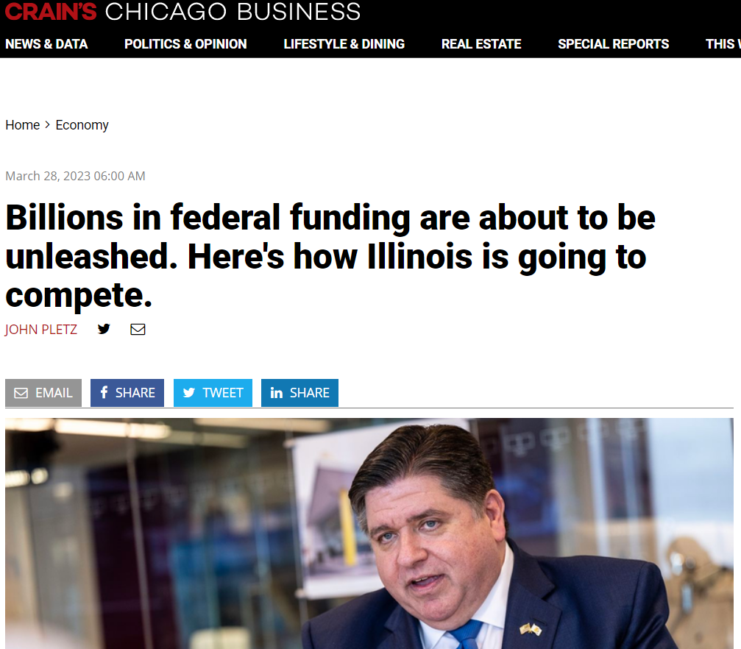
Federal Funding Commitment
Innovate Illinois is a public-private coalition led by Governor Pritzker, Jenny Scanlon the CEO of UL Solutions and UIUC Chancellor Robert Jones, working with industry leaders & our world-class universities

Slide 33
State Support for Upfront Capital Costs
Prime Sites Capital Grant
  Competitive capital grant program for relocating/expanding businesses to help address site readiness
  Half up front, half at Place in Service date
  Grant value is based on number of new jobs

Slide 34
Next Steps
Provide basic numbers to DCEO so that we may generate a general REV incentive estimate:
  Number of New Jobs
  Hiring Timeline/Ramp
  Average Wage
  Capital Investment (broken out between machinery and construction)
  (If eligible for Tier 2) Utility Consumption (electricity and natural gas)
The REV Application is online &/or we can email it to you
Discuss your workforce needs with DCEO

Slide 35
Lisa Clemmons Stott
Electric Mobility and Innovation Director
217-299-8330
Lisa.ClemmonsStott@illinois.gov
Illinois Department of Commerce & Economic Opportunity
EV.Illinois.gov

Slide 36
Roundtable Discussion
Questions / Comments
Illinois Department of Commerce & Economic Opportunity
EV.Illinois.gov
Illinois Manufacturers’ Association
IMA-net.org
Illinois Manufacturing
Excellence Center
IMEC.org
Notes:
Strategic Collaboration: In an era of rapid technological advancements and global competition, how can the Illinois Department of Commerce and Economic Opportunity, the Illinois Manufacturing Excellence Center, and the Illinois Manufacturers' Association collaborate strategically to enhance the competitiveness of Illinois-based manufacturers on the national and international stage?
Workforce Development: With the ongoing evolution of manufacturing technologies, how can the state of Illinois ensure a skilled and adaptable workforce that meets the changing demands of the industry? Are there specific initiatives or partnerships in place to address workforce development challenges and ensure a steady pipeline of talent for the manufacturing sector?
Innovation and Technology Adoption: How can manufacturers in Illinois leverage innovation and emerging technologies to stay ahead in the global marketplace? Are there state-level initiatives or resources available to support manufacturers in adopting and integrating new technologies into their operations?
Supply Chain Resilience: Recent global events have highlighted the importance of resilient and agile supply chains. What strategies or best practices can Illinois manufacturers employ to enhance the resilience of their supply chains? Additionally, how can the state support these efforts to strengthen the overall manufacturing ecosystem?
Sustainability and Environmental Practices: With increasing emphasis on sustainability, how can Illinois manufacturers integrate environmentally friendly practices into their operations? Are there state-level incentives or programs to encourage the adoption of sustainable manufacturing processes, and what role can each organization represented at this roundtable play in promoting eco-friendly initiatives?
Trade and Export Opportunities: In the context of global trade dynamics, how can the state of Illinois and its manufacturing community capitalize on international market opportunities? Are there specific programs or support mechanisms in place to assist manufacturers in expanding their reach and navigating international trade challenges?
Regulatory Environment: How can the Illinois Department of Commerce and Economic Opportunity collaborate with the Illinois Manufacturers' Association to create a business-friendly regulatory environment for manufacturers? Are there ongoing efforts to streamline regulations or address regulatory challenges that may impact the industry's growth and competitiveness?
Digital Transformation: As the manufacturing industry undergoes digital transformation, how can Illinois manufacturers embrace Industry 4.0 technologies to improve efficiency and productivity? What initiatives or resources are available to help manufacturers, especially small and medium-sized enterprises, in their digital adoption journey?
Reskilling and Upskilling Programs: Given the rapidly evolving nature of manufacturing jobs, what measures are being taken to implement reskilling and upskilling programs for the existing workforce? How can the Illinois Manufacturing Excellence Center collaborate with industry leaders to ensure that workers are equipped with the skills needed for the jobs of the future?
Access to Capital: Access to capital is crucial for innovation and expansion. What steps can the Illinois Department of Commerce and Economic Opportunity and the Illinois Manufacturers' Association take to enhance access to financing for manufacturers? Are there specific financial programs or incentives aimed at supporting manufacturing businesses, particularly those looking to invest in new technologies or facilities?

