Slide 1
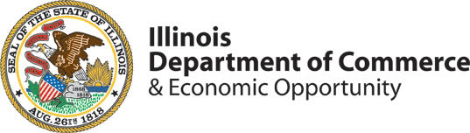

PARTNERS
IN
PROGRESS.

Slide 2
AGENDA
Quick Hit: 5 Things for Manufacturers to Know
Industry Talk: Workforce Resources Available for Manufacturers
Audience: Questions and Discussion

Slide 3
#1
INDUSTY DAY:
Department of Defense Suppliers

Slide 4
#2
WORKFORCE
SUMMIT

Slide 5
#3
ISTEP Program:
Illinois State Trade Export Promotion Program

Slide 6
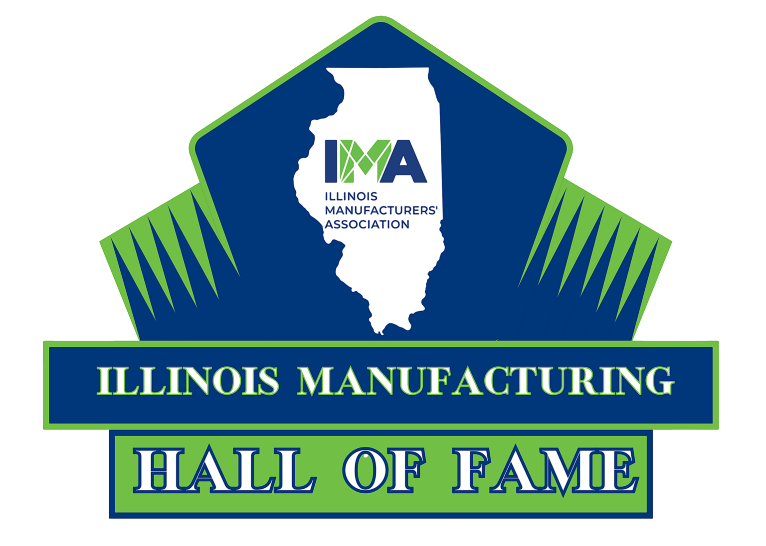
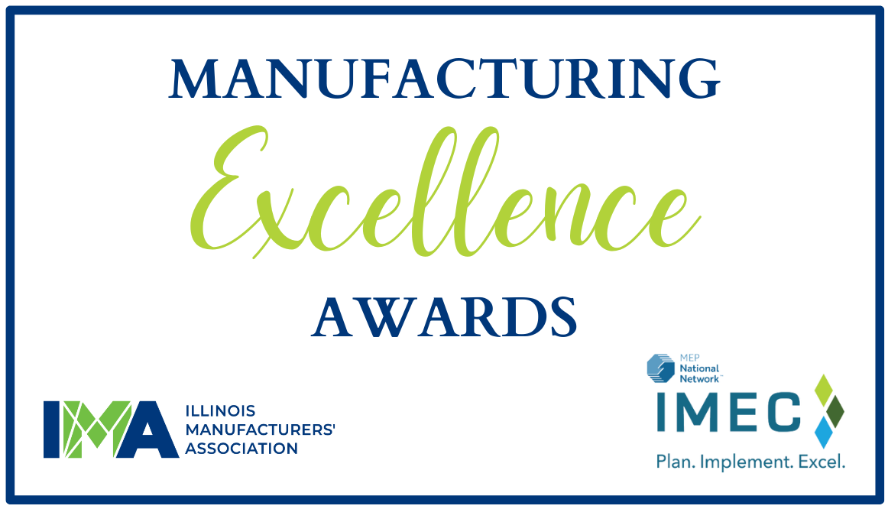
#4
MANUFACTURING HALL OF FAME & EXCELLENCE AWARDS

Slide 7

#5
BizHub

Slide 8
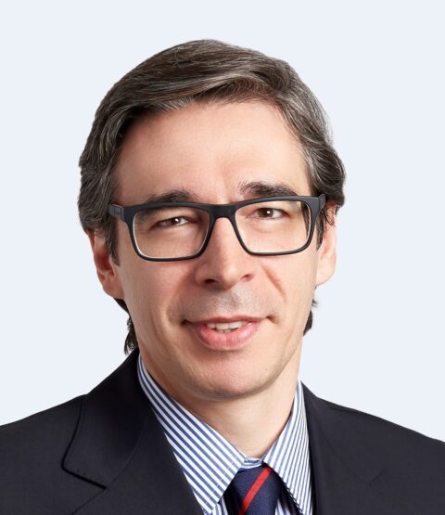
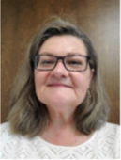
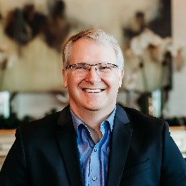
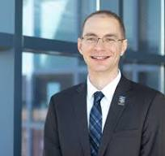
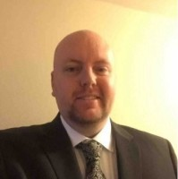
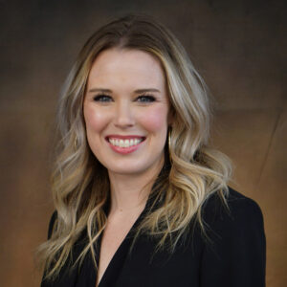
Lauro Arias
Assistant Director of the State of Illinois Office of Trade and Investment
David Boulay Ph.D
President
Illinois Manufacturing
Excellence Center
Annamarie Dorr
Regional Manager of the Office of Employment and Training at the Illinois Department of Commerce and Economic Opportunity
Norm Griffin
Business Service Representative
Career Link
Sarah Hartwick
Workforce Policy and Executive Director
IMA Education Foundation & Illinois Manufacturers’ Association
Curt Rendall
Executive Director
Program Development & Innovation
Heartland Community College

Slide 9
MANUFACTURING
SUPPORT:
Workforce Round Table
Notes:
Workforce Development: With the ongoing evolution of manufacturing technologies, how can the state of Illinois ensure a skilled and adaptable workforce that meets the changing demands of the industry? Are there specific initiatives or partnerships in place to address workforce development challenges and ensure a steady pipeline of talent for the manufacturing sector?
Collaboration and Synergy:
How do you all work together to provide a comprehensive support system for Illinois manufacturers? Can you share a recent example of successful collaboration among your organizations?
Addressing Common Challenges:
So, what are some of the most common hurdles that Illinois manufacturers encounter, and how do your different expertise areas complement each other in tackling these challenges?
Holistic Support for Manufacturers:
It's clear that each of you offers unique resources and support to manufacturers, but how do you ensure that manufacturers get a seamless experience when seeking assistance from multiple agencies?
Adapting to Industry Trends:
In such a dynamic industry, how do you keep up with the latest trends and adapt your services accordingly? Any recent examples where you've had to pivot to meet the evolving needs of manufacturers?
Measuring Impact and Success:
So, how do you know if your efforts are making a difference for Illinois manufacturers? Are there specific metrics or success stories that stand out to you as indicators of your collective impact?
Engagement with Manufacturers:
How do you stay connected with manufacturers to ensure that your support aligns with their needs? Do you have any mechanisms in place for gathering feedback and incorporating it into your programs and initiatives?
Individual Questions:
Curt Rendall | Executive Director, Program Development and Innovation at Heartland Community College:
Curt, could you tell us more about the Manufacturing Academy at Heartland Community College and how it contributes to supporting manufacturers in Illinois?
How does the academy collaborate with other organizations represented here to enhance workforce development in the manufacturing sector?
Lauro Arias | Assistant Director of the State of Illinois Office of Trade and Investment:
Lauro, your office plays a crucial role in helping Illinois manufacturers expand globally. Can you give us a sneak peek into some of the initiatives or programs your team offers to support manufacturers in reaching new international markets?
Any standout success stories you can share where your office's assistance made a significant difference for Illinois manufacturers?
David Boulay, Ph.D | President, Illinois Manufacturing Excellence Center:
David, as someone deeply experienced in manufacturing excellence, what are some of the main challenges you've observed Illinois manufacturers grappling with?
How does IMEC step in to address these challenges?
And could you dive into some specific tools or resources you provide that help manufacturers boost their efficiency and competitiveness?
Annamarie Dorr | Regional Manager of the Office of Employment and Training at the Illinois Department of Commerce and Economic Opportunity:
Annamarie, workforce development is key, especially with industry trends and tech advancements. How does your office collaborate with manufacturers to keep their workforce skills up to date?
Could you give us a glimpse into some training programs or initiatives your office offers to help manufacturers stay ahead in attracting and retaining talent?
Sarah Hartwick | Workforce Policy and Executive Director, IMA Education Foundation for the Illinois Manufacturers’ Association:
Sarah, the role of the IMA Education Foundation seems crucial in addressing the skills gap. How does the foundation go about bridging this gap in the manufacturing sector, and how does it tie into the broader goals of the Illinois Manufacturers’ Association?
Also, could you share some instances where the foundation has partnered with other organizations or agencies to provide a comprehensive support system for manufacturers in Illinois?
Norm Griffin I Business Service Rep, Career Link.
Norm, Career Link offers vital services to Illinois manufacturers. Could you elaborate on some of the key resources or programs you provide that directly support manufacturers in enhancing their workforce capabilities and competitiveness?
Collaboration among organizations is crucial for the success of manufacturers. How does Career Link partner with other entities, such as educational institutions or government agencies, to ensure Illinois manufacturers have access to a comprehensive set of resources and support for their growth and development?

Slide 10
Questions / Comments
Illinois Manufacturers’ Association
IMA-net.org
Illinois Manufacturing
Excellence Center
IMEC.org
Illinois Department of Commerce & Economic Opportunity
dceo.illinois.gov/

