Slide 1
TRAINING
WITHIN
INDUSTRY.
An Overview of Job Methods Training Sessions
Presenter: Ed Huey | Technical Specialist

Slide 2
Ed Huey
Technical Specialist

Slide 3
Introduction
Technical Specialist at IMEC
15 years with IMEC.
TWI, JI, JR, JM Certified instructor

Slide 4
TWI – Training Within Industry

Slide 5
HISTORY
Crisis Created a Need
The TWI Service was one of the first emergency services established during World War II by the U.S. Government War Production Board in the early 1940’s.
A national network of professionals was drafted from industry to develop techniques to quickly ramp up the production of war materials.
The TWI Mission:
To help industry to help itself to get out more materials than have ever been thought possible, and at constantly accelerating speed
The real job had to be done by industry, within industry
By the end of the war over 1.6 million workers in roughly 16,500 plants had received certified training in TWI.

Slide 6
TWI Results
600 companies monitored during WWII…
55% (330)
reduced scrap by at least 25%
86% (516)
increased production by at least 25%
88% (528)
reduced labor hours by over
25%
100%!!
reduced grievances by more than 25%
100%!!!
reduced training time by 25% or
more
“
”

Slide 7
TWI IN JAPAN
Expansion in Japan
Training Within Industry was introduced in Japan during post-war rebuilding. It is still in widespread use in Japan and most notably, in Toyota as part of the Toyota Production System (TPS). It is a foundation to Toyota's success in continuous improvement, standard work and more importantly, in its ability to sustain those improvements

Slide 8
BRING TWI BACK!
In 2001 the Central New York Technology Organization Reintroduces TWI, thousands of people have been Trained in its methods; creating substantial competitive advantages for companies adopting it.

Slide 9
Five Needs for a Good Supervisor
Knowledge of Work
What makes one business different from all other businesses
Knowledge of Responsibilities
Particular company situation regarding policies, rules, regulations, schedules, and organizational structure
Skill in Instructing
How to develop a well-trained workforce
Skill in Improving Methods
Utilization of materials, machines, and manpower effectively
Skill in Leading
Ability to work with people

Slide 10
WHAT IS TWI?
Supervisor’s Job
JOB INSTRUCTION
JOB
SAFETY
JOB RELATIONS
JOB METHODS
Standardized Work
Results Through People
Continuous Improvement
Notes:
The three Original TWI programs work together like a three-legged stool — take one leg away and the stool falls down. JS acts as the seat to hold it all together

Slide 11
TWI- Job Methods
Job Methods (JM) Is a practical plan to help you produce greater quantities of quality products in less time by making the best use of the Manpower, Machines and Materials now available.

Slide 12
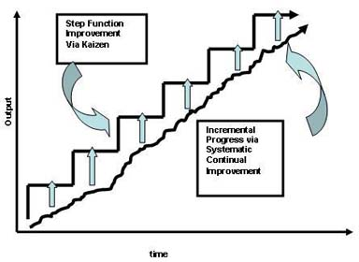
TWI- Job Methods

Slide 13
TWI- Job Methods
Step 1 - Break down the job
Step 2 - Question every detail
Step 3 - Develop a new method
Step 4 – Apply the new method

Slide 14
TWI- Job Methods
Break down the job
List all details of the job exactly as it is done include
Material Handling
Machine work
Hand work

Slide 15
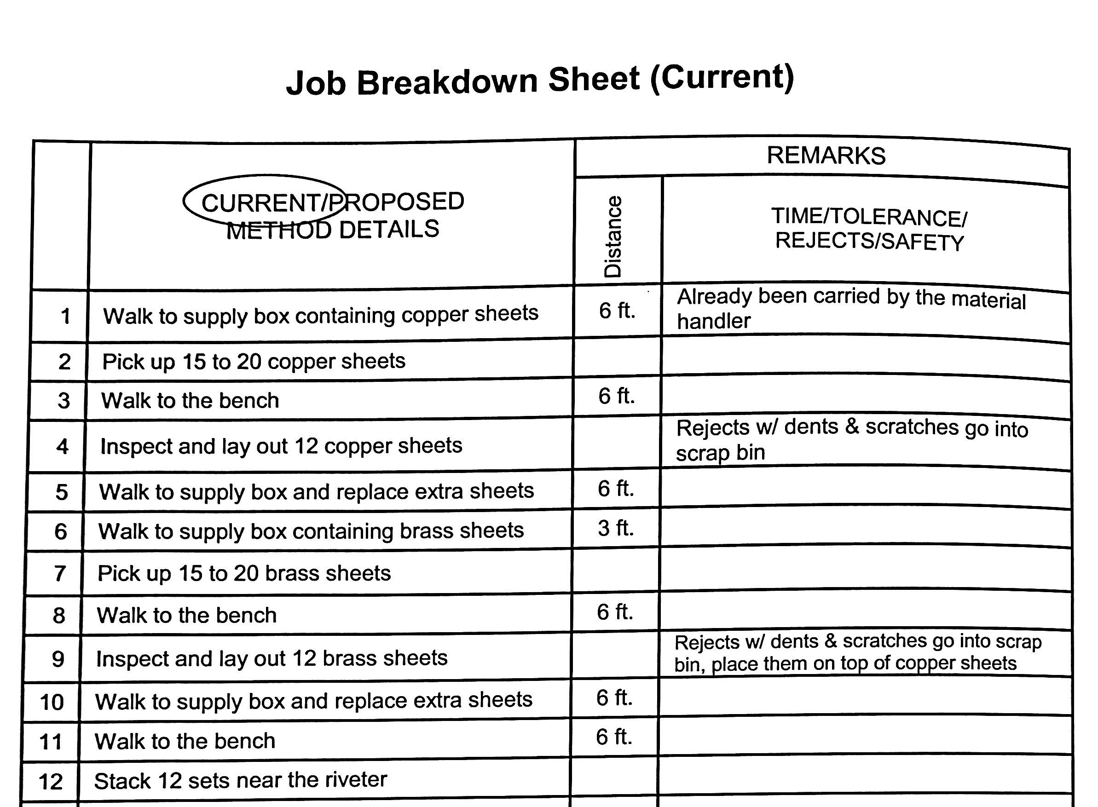
TWI- Job Methods

Slide 16
TWI- Job Methods
Question Every Detail
Why is it necessary?
What is its purpose?
Where should it be done?
When should it be done?
Who is the best qualified to do it?
How is the best way to do it?

Slide 17
TWI- Job Methods
Develop the new method
Eliminate unnecessary details
Combine details when practical
Rearrange details for better sequence
Simplify all necessary details

Slide 18
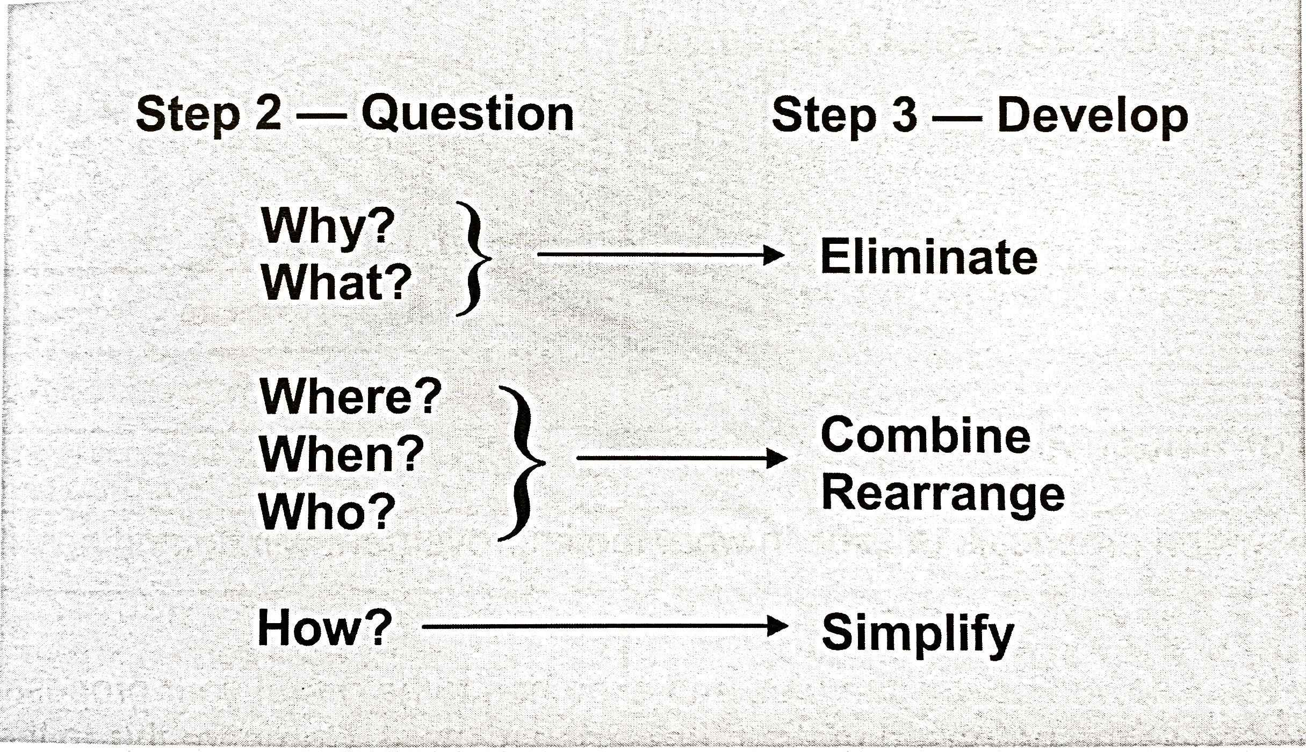
TWI- Job Methods

Slide 19
TWI- Job Methods
Apply the new method
Sell your new method to your leader
Sell you new method to the operators
Get Final approval from other departments
Put new method to work
Give credit where it is due

Slide 20
TWI- Job Methods
Impacts can include
Productivity improvement
Machine use
Reduce quality rejects
Number of operators required
Improve cycle time
Reduced lead time

Slide 21
Thank
You!
info@IMEC.org
888-806-4632

