Slide 1
The Case For Maintenance Excellence
January 2024

Slide 2
The Case For Maintenance Excellence
Scarce maintenance resources dictate a need for getting more from your existing staff:
Planned, as versus reactive work increases ‘wrench time’
Reactive maintenance jobs can take up to 10 times as long as a planned maintenance job
Precision maintenance techniques increase component life
Maintenance value stream mapping, identifies and reduces waste
Total Productive Maintenance empowers production employees to take part in equipment care – and supplements your maintenance staff

Slide 3
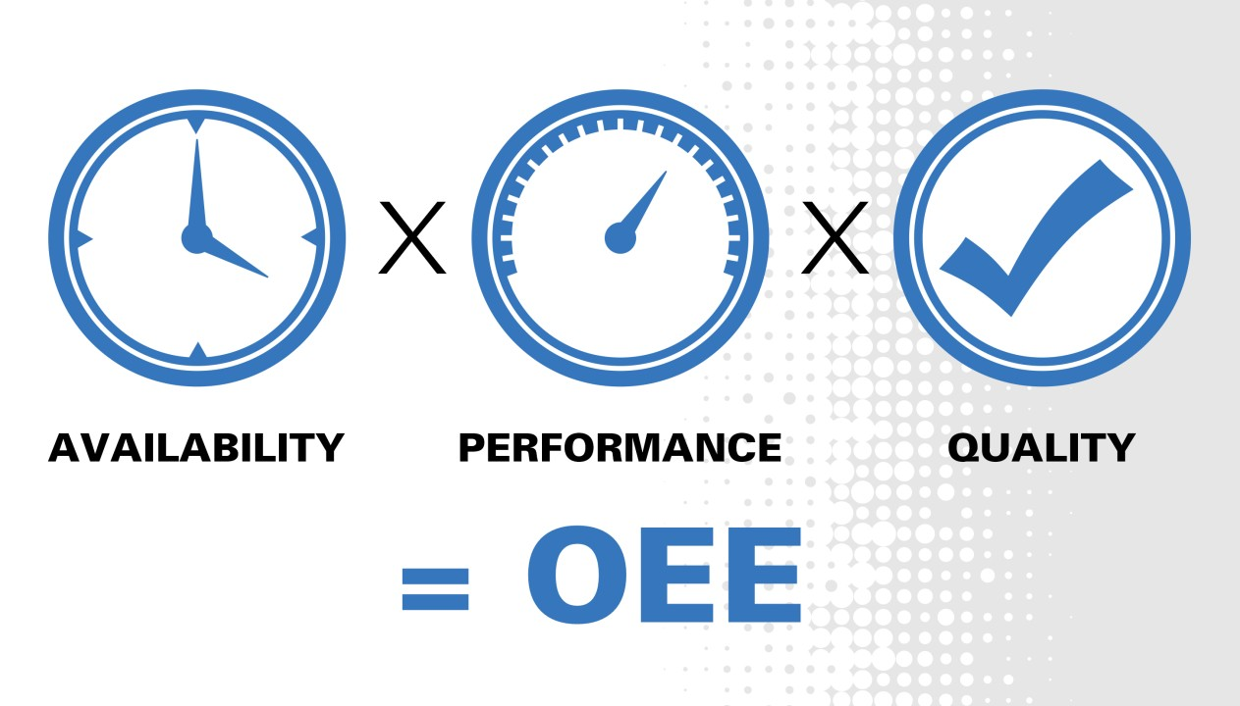
One more reason…

Slide 4
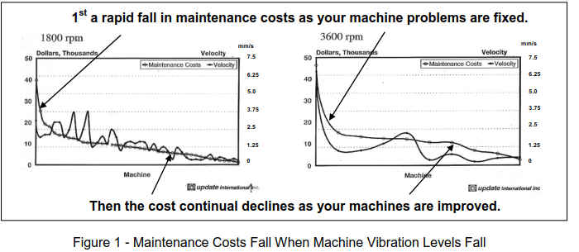
How Much Does Poor Maintenance Cost?

Slide 5
Step 1: Assessment
How do you compare to established Maintenance Excellence best practices?
Where is your “low hanging fruit”
How does it intersect with your business needs?
Safety
Quality
Cost
Delivery
If you don’t have the maintenance staff to support your needs, maybe the answer is developing your existing maintenance staff

Slide 6
Step 2: Execute An Improvement Plan
Maintenance Planning & Scheduling
Maintenance Waste Mapping
Precision Maintenance
Total Productive Maintenance

Slide 7
Planned versus Reactive Maintenance: A Case Study

Slide 8
Un-Planned
Downtime
Production line
breakdown
Walking
Telephone
Electronic
Maintenance
Regular parts
shipment
Emergency air
Shipment
Maintenance Management
Parts
ordering
system
Repairable
spare
parts
Spare parts
Inventory
Fasteners
Plumbing
Adhesives
Office
Supv.
attend.
Skills
matrix
W.O.
System
Failure
history
Equip.
docum.
Manuals,
prints,
etc.
Maintenance
tools :
hydraulic jacks,
bearing puller,
power wash,
drills, saws, etc.
Safety area:
ladders,
slings, lifts,
PPE,
LOTO
center, etc.
Machining
area:
lathes,
drill,
grinder,
arbor press
etc.
Lubrication
area:
Oils, greases,
dispensing
Waste
area:
Rags,
oil, grease,
speedi-
dry
Get signatures
Fly in order
Look for bearing puller
Wrong technician
Tell supervisor – equipment is repaired
Look for bearing
Troubleshoot
Replace
bearing
Troubleshoot
Pull
bearing
D.T. - 32 hours
V.A. - 240 minutes
30 min
60 min
60 min
90 min
24 hours
60 min
30 min
150 min

Slide 9
Potential Future State
Maintenance Map
Production line
Office
Walking
Telephone
Electronic
Maintenance
E-mail to Production Supv
Planner/Scheduler/
Reliability Engineer
Regular parts
shipment
Maintenance Management
Parts
ordering
system
Repairable
spare
parts
Spare parts
Inventory
Fasteners
Plumbing
Adhesives
Office
Supv.
attend.
Skills
matrix
W.O.
System
Failure
history
Equip.
docum.
Manuals,
prints,
etc.
Maintenance
tools :
hydraulic jacks,
bearing puller,
power wash,
drills, saws, etc.
Safety area:
ladders,
slings, lifts,
PPE,
LOTO
center, etc.
Machining
area:
lathes,
drill,
grinder,
arbor press
etc.
Lubrication
area:
Oils, greases,
dispensing
Waste
area:
Rags,
oil, grease,
speedi-
dry
Bearing delivered
Reliability Engineer
determines that this bearing
should be part of a vibration
analysis route. At some point the
bearing starts to fail and is picked
up by the vibration analysis
equipment.
Planner orders bearing
Determine cause of bearing failure
Planner opens job & estimates
Pulled old bearing & installed new
Returned bearing puller
Planner kits
parts
180 minutes
D.T. - 3 hours
V.A. - 300 minutes
45 min
5 min
30 min
30 min
150 min
10 min
30 min

Slide 10
Maintenance Mapping Summary
Value Stream Mapping:
Eliminates maintenance waste
Gets more maintenance work done with the same staffing
Increases production capacity

Slide 11
The Value of Precision Maintenance

Slide 12
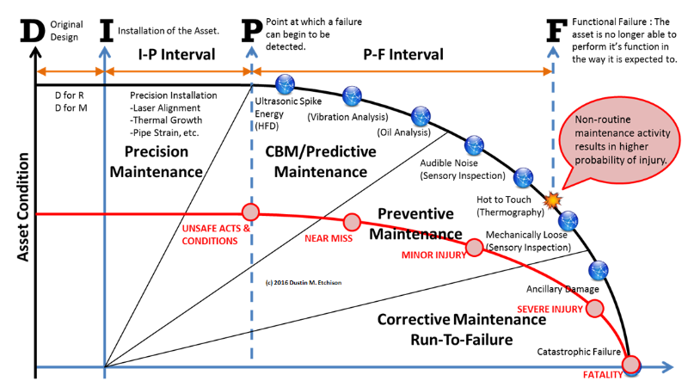
Extension of component life: This is the $ Value of Precision Maintenance

Slide 13
What is Precision Maintenance?
Machines and equipment are repaired and rebuilt so that they will not fail prematurely!
They reduce the need to use subcontractors
They maximize first pass quality production and stop scrap
They have fewer stoppages and slowdowns
Fewer spares are used since their machines don’t need them
Plant availability and productivity is maximized

Slide 14
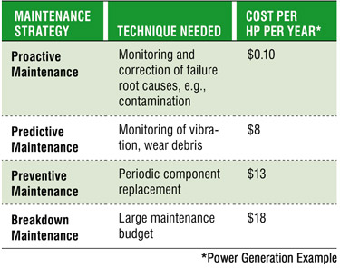
Why is Precision Maintenance important?

Slide 15
Total Productive Maintenance

Slide 16
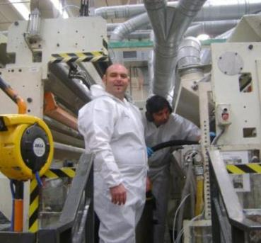
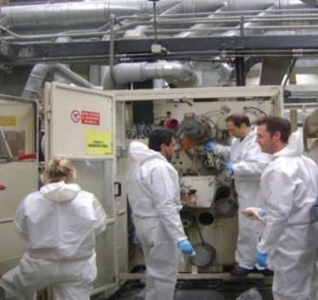
Old versus New Thinking…
The old attitude of:
I operate it and you fix it!
Is replaced with the new attitude that:
We are all responsible for our equipment!
Notes:
This is intended to illustrate the shift in operator involvement.

Slide 17
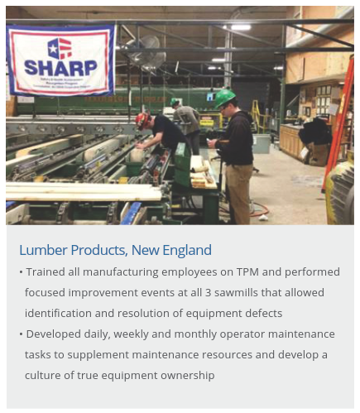

Slide 18
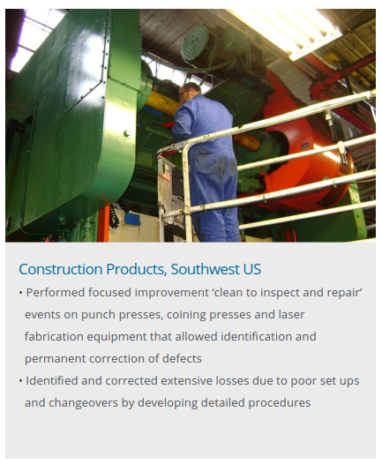

Slide 19
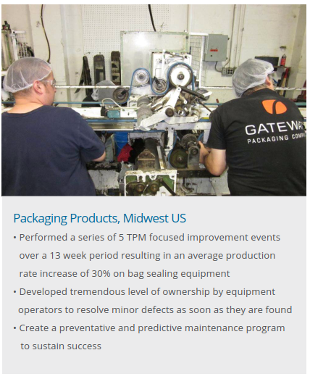

Slide 20
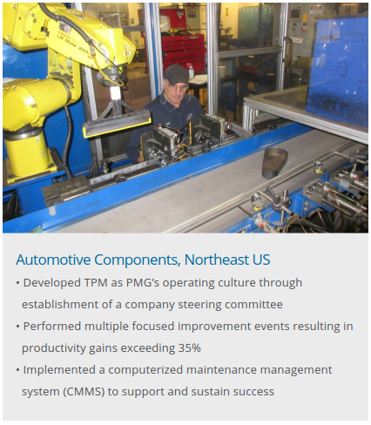

Slide 21
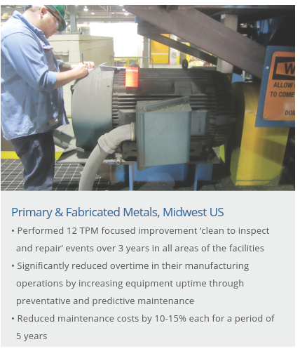

Slide 22
How Do We Start?
Executive sponsor
Set goals
TPM coordinator
Select a machine to focus on
Get stoppage/loss data
Overview training
Schedule a focused improvement!

Slide 23
Keys to Success
Active Steering Committee
Qualified TPM Coordinator
Good Plan (published)
Senior Management Participation
Overview for Shop Floor
Shared Learning
Leaders as Teachers
Single point lessons
“good catch” board
Word of mouth

Slide 24
Keys to Success
Maintenance & Operator Training
Gather, Analyze and Use Data!
Allocate Time & Resources!
Audit Your Processes – Use Leader Standard Work
Focused Improvements – Hot & Heavy!
Establish Autonomous Improvement Teams
Root Out Competing Objectives
Emphasize GOOD maintenance over FAST maintenance

Slide 25
Summary
Removing waste from the process allows companies to perform more maintenance activities with the same number of resources
Precision maintenance reduces the amount of repairs your resource constrained team struggles to stay ahead of
TPM leverages the capabilities of all manufacturing employees to supplement your maintenance team
Maintenance excellence drives improvements in safety, quality, delivery and cost

Slide 26
Final Thoughts…
IMEC in partnership with Fuss & O’Neill provides workshops and training in all of these areas and more.
Our team of professionals have extensive industrial maintenance experience accomplishing these goals.
Let’s chat and discuss how we can provide a customized solution to help you!
Questions?

Slide 27
The information contained in this presentation is Copyright protected and is not intended as a substitute for technical or other professional advice, nor is it intended to supplant any duty to provide a safe workplace, operation, equipment, product, or premises. Fuss & O’Neill Manufacturing Solutions, LLC utilizes information collected from process evaluations and client performance data to assess and understand your operations. Workshops are developed to work with and integrate skills and existing process knowledge to repair, improve and re-establish equipment to original equipment specifications. FOMS’ innovative best-in-class approach to program design, integration, and achievement of results aligns with the needs and expectations of our clients’ unique production and maintenance program needs. With more than 45 years of experience, and offerings in both the US and globally, FOMS provides a structure to industry to establish and maintain immediate and sustainable results.
visit us at www.fando.com.
Protected by Registered Copyright Reg# 1-10746547192

