Slide 1
CONTINUOUS
DAILY
IMPROVEMENTS.
March 27, 2025

Slide 2
Mary Hallock
Vice President of Operations

Slide 3
Webinar Agenda
Overview​
Job Methods tie to Lean Manufacturing​
Job Methods fundamentals​
Success stories​
Next steps
Notes:
Good morning. Today’s webinar is going to be targeted at all you supervisors, managers and leads who are constantly trying to find more hours in your day to handle more and more on your to do list. We’d all like to be able to delegate more and delegate more effectively and it isn’t easy to do. When we delegate we still maintain ownership of the outcome and we want to make sure it is carried out in a timely and effective manner. Just asking someone to do something may not be enough. Sometimes we need an effective process for making sure the task is carried out. Job Methods is a strong tool to help you with your delegation.
I’m going to share an overview of the Training Within Industry methodology of which Job Methods is a part. Then I’m going to help you understand how Job Methods is a part of any Lean Manufacturing and Continuous Improvement method. This isn’t a program of the day. This is something that should be integrated within what you are doing today.
I’ll next share some of the fundamentals of the Job Methods process and some success stories so you can visualize how this might help you.

Slide 4
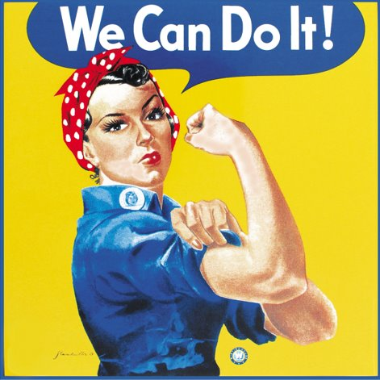
Brief TWI History
Notes:
Job Methods is a methodology within the Training Within Industries toolbox. Training within Industry was developed and implemented during WWII when the workforce turnover was heavy. Women entered the manufacturing facilities to produce munitions and equipment needed for the war effort, while the men were at war. Certainly there was a need for training this new workforce quickly to produce high quality parts safely, helping this workforce understand how to lead others, and giving them the tools they would need to continue to improve the work they were doing. The Training Within Industry Method takes the basic theory of knowledge transfer and makes it practical for the people and shop floors we all work in. By following the processes, factories in WWII realized some strong performance results. Companies adopting the methodology today still benefit by strong impacts on their businesses.

Slide 5
What is TWI Job Methods?
The Job Methods process will help you produce greater quantities of quality products in less time by making the best use of the manpower, machines, and materials now available.
Notes:
This is the definition of Job Methods. The Job Methods process will help you produce greater quantities of quality products in less time by making the best use of the manpower, machines, and materials now available. I highlight now available because this is not about bringing in new technologies or completely changing your product design. This is a method to address some of the low hanging fruit that is within our immediate control. It’s a way to address some of the every day annoyances we face due to inefficiencies that often we overlook because we are focused on bigger challenges.

Slide 6
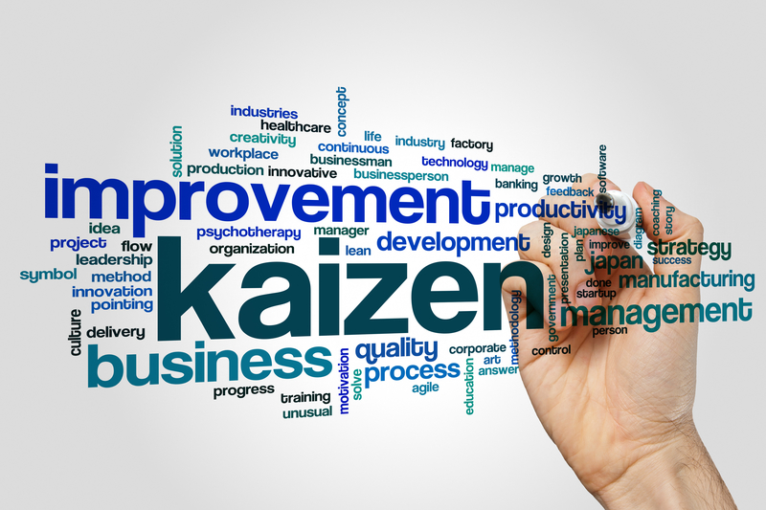
Kaizen = Continuous Improvement
Improvement comes in all sizes​
Value Stream Mapping
5S
Quick Changeover
Job Methods
Notes:
Value Stream Mapping is a great start in any lean journey since it gives you a picture across the value stream. The outcome of a value stream kaizen is often an identification of a bottleneck or problem area that needs to be addressed. So, the next step might be to schedule a team kaizen to take place over several days to drill into the opportunity – such as a 5S kaizen or Quick Changeover kaizen. Typically we engage people from the work area as well as other departments. Often the outcomes include items to implement easily as well as some more challenging changes that require investments and approvals. The Job Methods process takes those same problem solving skills used in larger kaizens and drills further into the details of the day to day work so individual contributors can examine their workplace and feel empowered to make change. In the larger kaizens we might stumble over the low hanging fruit in order to address the challenge at hand. Job Methods hits the low hanging fruit head on.
The idea is to help employees present complete ideas which allows for better prioritization and implementation. It gives you a path for empowering them to implement many of the changes on their own.
The objective of Job Methods from the beginning was to give the supervisor a method for improving production using a practical, everyday approach to continuous improvement.

Slide 7
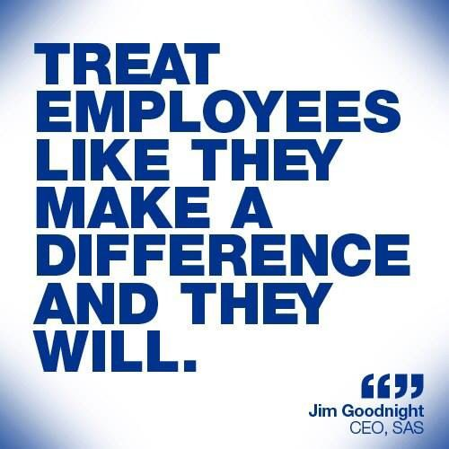
Benefits of JM
Developing problem solving skills​
Engaging individual contributors​
Creating a mindset for waste identification​
Cost savings​
Efficiencies
Notes:
The benefits of JM I have listed apply across the organization
Individual contributors learn how to identify problems and how to take action on them.
You as the supervisor benefit because your employees are now able to address problems they previously handed off to you. Do you ever feel some days like everyone just keeps piling things on top of you? This helps you feel sure that your team has a clear way to tackle problems and conduct good problem solving to end up with strong solutions
Job Methods benefits the organization. By engaging more of your workforce in continuous improvement efforts, you are able to scale up the improvements you make, creating a more competitive organization. In addition, the team members are more engaged and feel more a part of what is going on.

Slide 8
What is the JM process?
Break down the job​
Question every detail​
Develop the new method​
Apply the new method
Notes:
Examine your job with critical eyes. Observe it carefully and capture all the details. Examine how much movement you make – are you walking back and forth to get tools or parts or information? Consider how long it takes you to do something and how difficult it might be to hold parts or move them around. Make sure to capture details such as inspection. You need to identify machine work, handwork and also material handling.
2. Question every detail. This is the problem solving skills that help team members really understand the job. We often take for granted that what we are doing is the only way to do things because that is how we were shown when we first learned the job. In fact, sometimes changes are made that aren’t carried through all the way, so we might be dealing with outdated practices that are ready for improvement.
3. Develop the new method. Often we jump ahead and say we know exactly what needs to be changed without taking a good look at all the steps. So, we might optimize a process that should actually be eliminated. So, the Job Methods process gives the team a way to stop themselves and not jump to conclusions.
4. This may be an obvious step but we don’t want to forget about it. We need to make sure we don’t just develop a new method but that we actually apply it. This may take some cooperation and buy ins from others on the team. We may also have to do a little bit of investigating to understand why we include certain steps. For instance, we may need to seek input from the quality department to better understand some of the product tests we are doing.
In this method we are looking for small changes that involve current manpower, materials and machines now available, that we can all take action on in our day to day work.

Slide 9
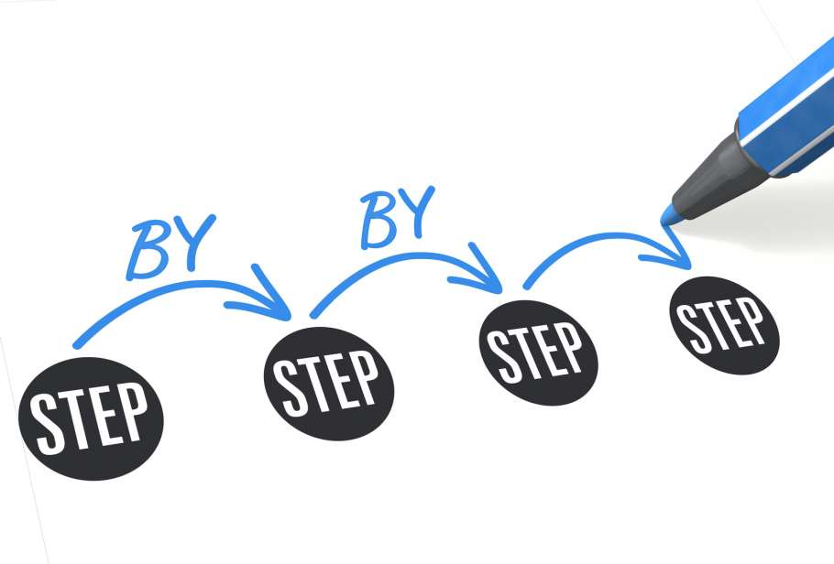
Break Down the Job
Every step​
Detail …​
Material handling​
Machine work​
Hand work
Notes:
When you break down each step of the job we want to focus on any material handling that is being done, all the machine work taking place as well as the hand work involved. It is important to be detailed in the breakdown. In a moment I’ll share an example that will help you understand what I mean by the amount of detail needed.

Slide 10
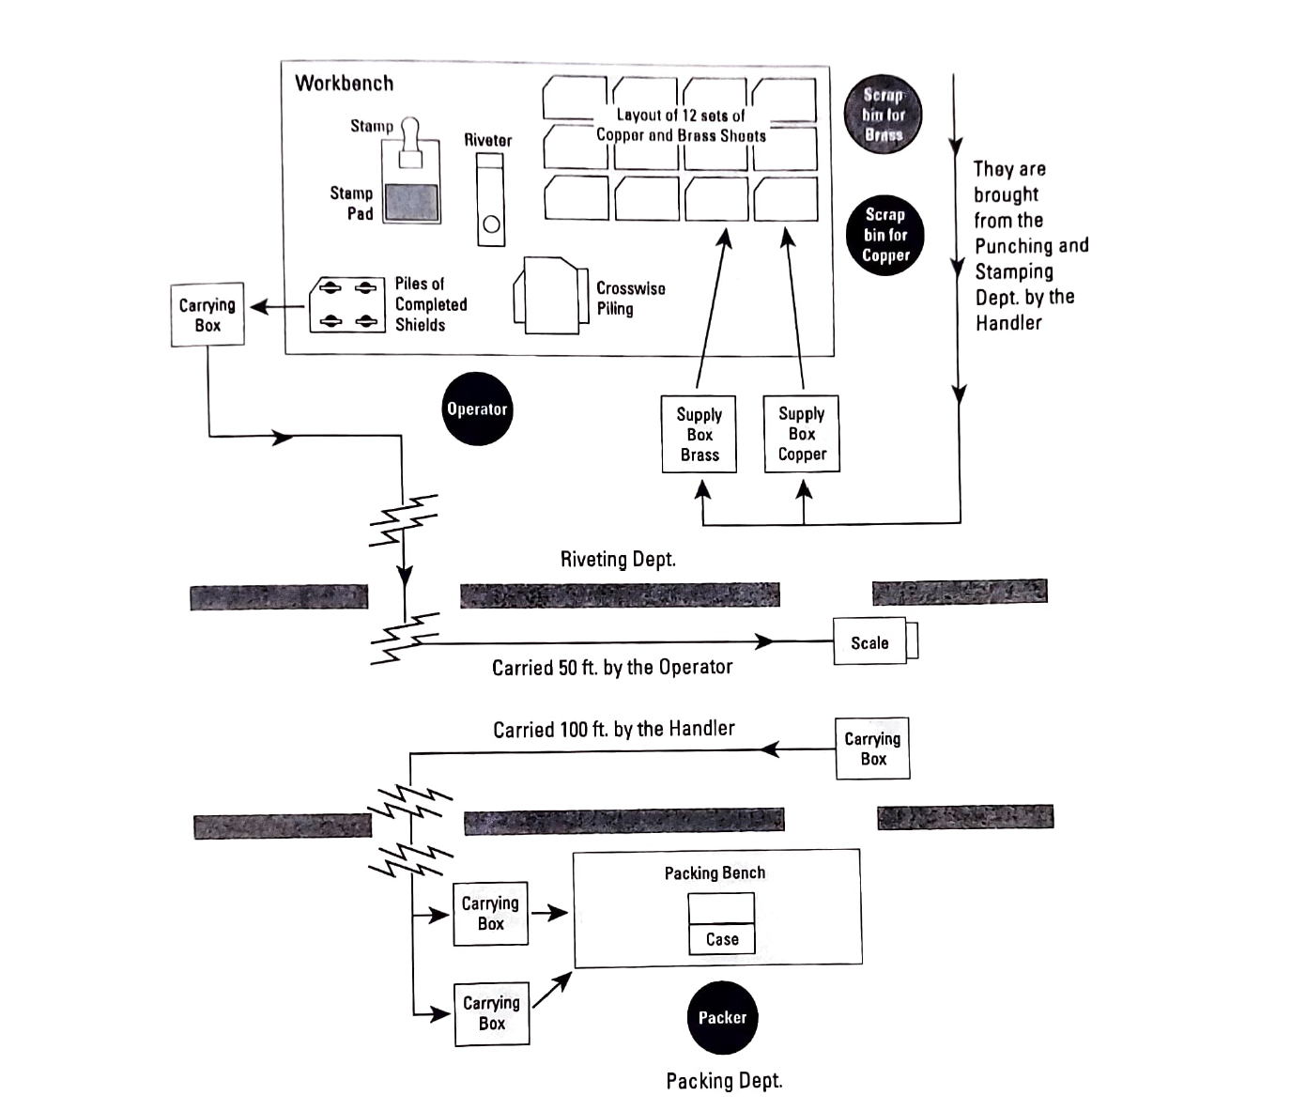
Example Work Area
Notes:
In the Job Methods training class we take a look at Bob Burns’s workplace. You get an idea from this picture that there is quite a bit of walking and material handling that takes place. There are 3 other workers in the department doing the same job so materials are stored at a central location. He does a lot of laying out, inspecting and stacking of the copper and brass sheets he works with. These sheets are easily damaged so the handling causes quality problems. He rivets the sheets together and once he does so he stamps them to indicate the top. After that he stacks them in a carrying box. When the box is full, he weighs the box. The carrying box will then be taken to the packing department where the packaging associate unloads them, inspects them and then counts out the amount needed for the order and puts them in another box.

Slide 11
Example Breakdown
I get the metal sheets​
I assemble the microwave shield​
I rivet the shield​
I take it to packing
Not Enough Detail!
Notes:
Often when we think about the job we are doing we talk about it at a fairly high level. For example, Bob might just say he goes to get the sheets, he rivets them together, stamps top then takes them to packaging. He is telling you what he is doing but not including the detail that will help him identify the improvement opportunities.

Slide 12
Example Breakdown
Step #​ | Method Details​ | Distance/ Time​ | Remarks​
1​ | Walk to supply box containing copper sheets​ | 6 feet​ | Already been carried by material handler​
2​ | Pick up 15 to 20 copper sheets​ | ​ | ​
3​ | Walk back to work bench​ | 6 feet​ | ​
4​ | Inspect and layout 12 copper sheets​ | ​ | Occasionally scraps for dents and scratches​
5​ | Walk to supply box and replace extra sheets​ | 6 feet​ | ​
6​ | Walk to supply box containing brass sheets​ | 3 feet​ | ​
Notes:
Instead, he needs to think through all the small movements and details of the materials and machines. In this case he walks to get copper sheets and it is a 6 foot walk. Then he picks up a stack of sheets of an approximate count. He goes back to his workstation. He inspects and lays out the sheets. Then, because he didn’t take a specific number of sheets he usually ends up having to go back to the storage area and replace the extra. Now we get a much better sense of the amount of movement. Just in these 6 steps he’s had to walk 21 feet. It doesn’t sound like much, but he does this all day long – back and forth, back and forth. We also get a much better sense of the amount of material handling that is taking place. Remember, I said these sheets were fragile and easily damaged, so all this handling contributes to the waste the company is experiencing.

Slide 13
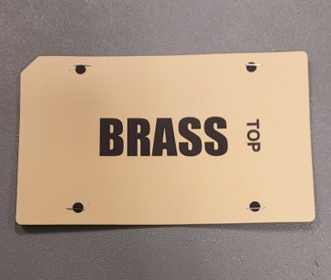
Question Every Detail
Why, What, Where, When, Who, How​
Identify all the problem areas​
Dig for answers
Notes:
Once Bob identified all the detailed steps of the work and created his Job Breakdown, he began to question every detail. He went through all the steps of his process and asked 5 questions. Note they are asked in this specific order Why, What, Where, When, Who and How. If we start asking how to change something first, we are likely to make changes to a process step that should be eliminated. Let me give you an example. Bob Burns rivets a brass and copper sheet together and then he stamps “Top” on the brass sheet. When Bob got to that step of his breakdown he asked Why do I stamp top on the sheet? What purpose does it serve? He thought maybe it was used for the packer, when he was packing the sheets. Or maybe, he thought, it was used by the customer for some reason. However, he really didn’t know the purpose. That was just what he was taught to do on the job. So, Bob went to investigate with engineering. The engineer was surprised that this process was still in place. Quite a while ago they had changed the sheets to add the notch that you see in the top left corner. That notch was a replacement for the Top stamp. So, Bob now knew there was a whole step he could eliminate. Had he asked How instead of Why first, his idea might have been to get a fixture for the stamp to improve the alignment. So he might have improved a process that wasn’t even necessary.

Slide 14
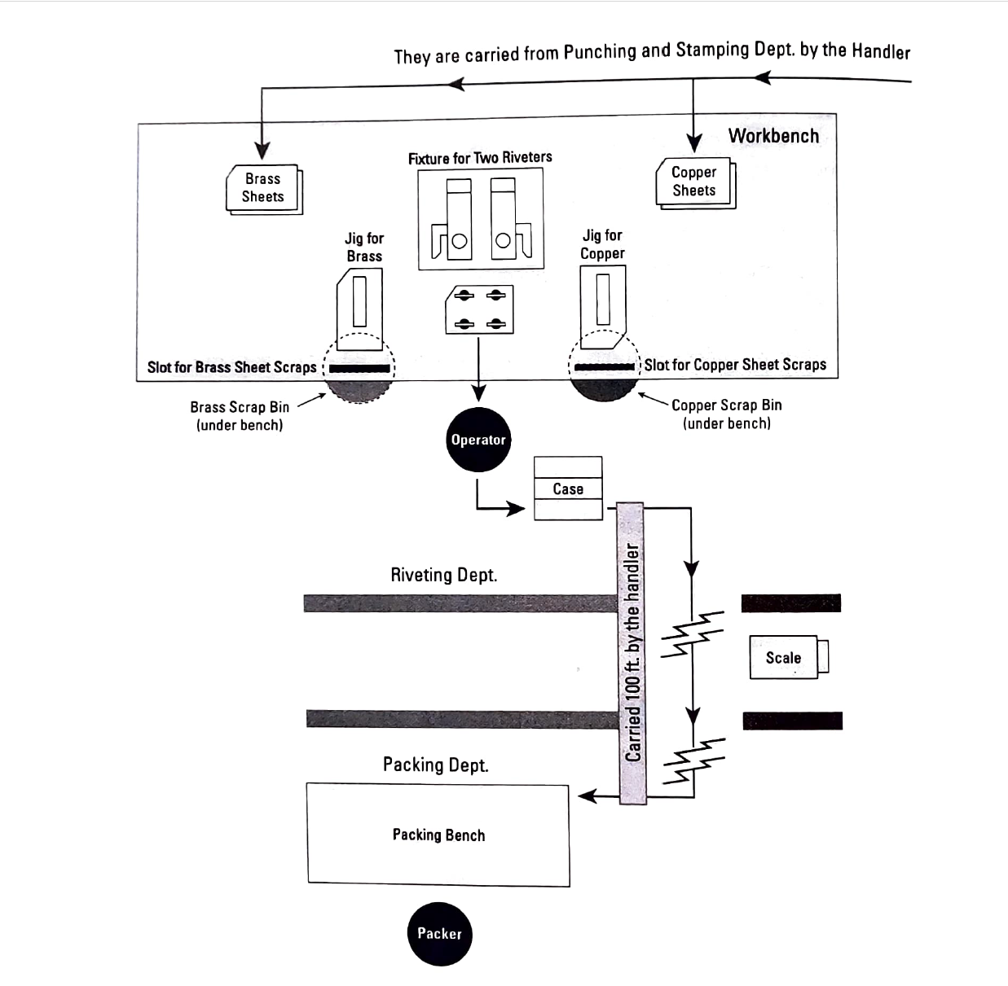
Develop the New Method
Eliminate​
Combine​
Rearrange​
Simplify
Notes:
Now that all the job steps have been questioned, we understand where we have opportunities to make change.
We may be able to eliminate some steps, if we find they are no longer useful or necessary. In Bob’s case when he understood that the product had been redesigned so the stamp was no longer needed, he knew he could eliminate that step.
We may also find opportunities to combine steps or rearrange the work. Perhaps we can move an inspection step to a different part of the process where it is more effective at capturing quality problems. We can often find opportunities to rearrange our work through the identification of excess movement. Instead of walking to another department, can we keep our supplies nearer at hand so they are there when we need them.
Sometimes we can simplify the work we are doing. It is in questioning all the details of the work and asking Why, What, Where, When, Who and How that we uncover the often overlooked inefficiencies in our everyday work that is within our power to change.

Slide 15
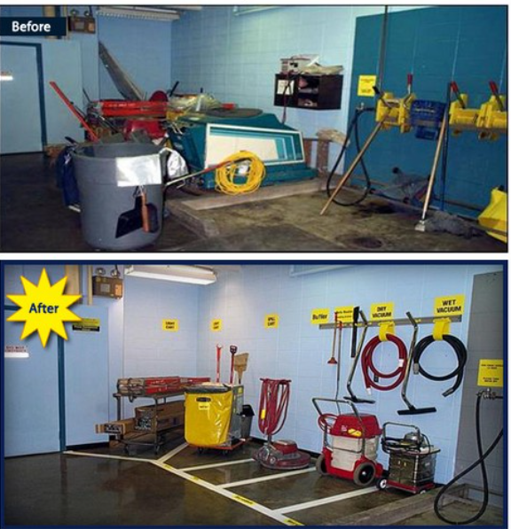
Apply the New Method
Create a proposal​
Get cooperation and ideas of others​
Give credit to all ideas
Notes:
Although many of the changes may be within our control, such as moving materials, rearranging the work, and making it easier to hold tools and parts, we still may affect other people. You may work on a line with multiple shifts. Or, the changes you make could affect another department such as maintenance or the next production cell down the line. We need to make sure to get input and buy-in from our co-workers before we actually make any changes.
Sometimes it might be helpful to create a brief proposal on what you are doing and the benefits it will bring. Identifying what is currently being done, the proposed changes and why these changes will make the work better is a sure way to obtain buy in from your co-workers as well as your supervisor. This way everyone has a clear picture of the changes that are proposed.
We may think we have identified the best solutions all on our own; however, there is a benefit to input from others to build even better ideas. So, don’t forget to ask for help.
Lastly, we do want to make sure we credit others with the input they provide. If you get some ideas from co-workers on other shifts, make sure you let your supervisor know. Sharing the credit with others doesn’t take away from the good work you have done and it is a great way to support teamwork in your department and organization.

Slide 16
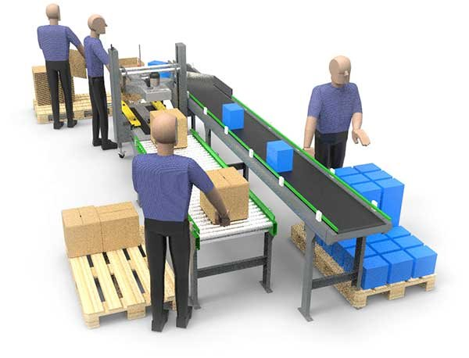
Example: Packing Line
Premade box storage
Notes:
One group I worked with for the Job Methods training had a small packing line similar to what I present here. The operators on the line went through the Job Methods process and noticed that one of their steps was to carry the pre-made boxes from one end of the line to the other when they were running low. Meanwhile there was plenty of storage for these boxes on the wall closest to where they were being used. So, they simply moved the box production and storage to the other end of the line. This seems so obvious a change to us as we are seeing it on the slide. However, these are the types of opportunities we often overlook because we are focused around the bigger changes to the operation or we have the mindset of this is the way I was trained, so this is the way it has to be.

Slide 17
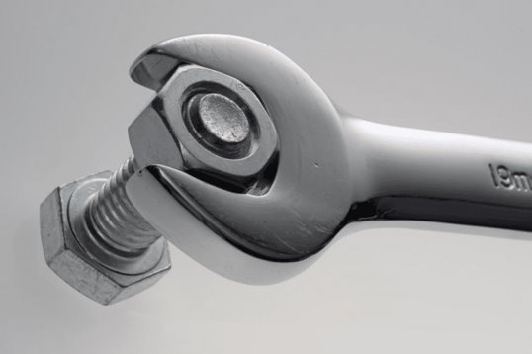
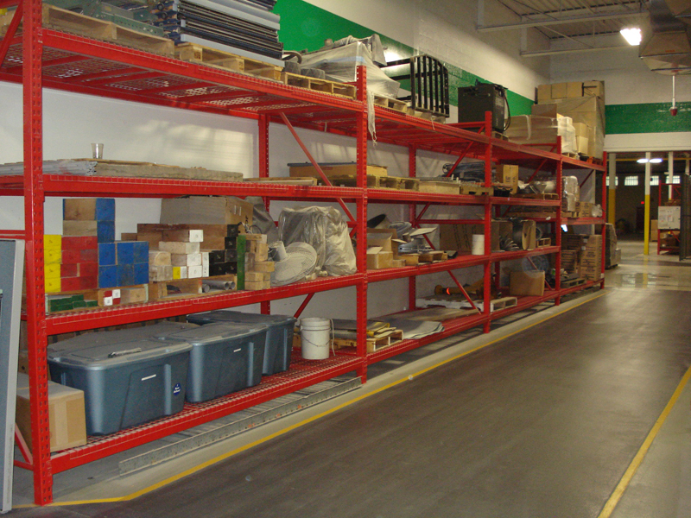
Two More Examples
Maintenance Task
Supply Storage
Notes:
Another example that an employee identified was tightening a bolt onto a part. This is not a picture of the actual part; however it is representative. The part at the back end was a fairly odd shape and the mechanic would put the part on a table to tighten the bolt and the part would move around. It was very awkward and difficult to get a good tight fit. When the mechanic detailed out the steps and asked How is a better way to do the job, he realized that if he created a simple wooden fixture to hold the back end of the part, the job would go much more smoothly. He quickly took some spare wood, created a simple fixture and was delighted with the change in the work. It went faster and more smoothly and he was far less frustrated.
A third example had to do with supplies needed in a production department. The employee identified a step in a job they did several times a day where they had to walk to a separate room for supplies each time they did the job. The employee asked Why they were doing all this walking and decided the walking wouldn’t be necessary if they brought some of the supplies to the work area. She found a spare set of shelving in the facility and found a good space in her work area to locate it. Then she brought supplies for her work area and kept them close by on the shelf. She also took the next step to set up a kanban system so there was a standard way to indicate whey the supplies needed to be replenished.

Slide 18
Job Methods: An Important Skill
Look at your job with a fresh set of eyes​
Continuous small changes leads to big change​
Creates employee engagement​
Drives down costs​
Improves product quality
Notes:
Training your team on the Job Methods process will benefit your employees by increasing their engagement at work. It will help improve safety and quality and will lead to cost reductions all by using the manpower, materials and machines now available on your shop floor. There are always opportunities and this process is something anyone on your shop floor can use and apply to improve the organization.

Slide 19
Notes:
IMEC believes it is important that we bring impacts and strong results to the companies we work with. Here are the results of client-reported impacts for all the work we did in 2024. Job Methods is a tool that can help you drive strong improvements and realize benefits with employee retention and cost savings.

Slide 20
Next Steps
Are You Curious?
Call us to provide on onsite consultation.
Thank You!
© IMEC All rights reserved.
Notes:
Are you curious whether this will really work in your operation? I know it will. I’ve trained enough employees in enough companies in a variety of industries that I know this is an excellent tool to have in your toolbox. Call us for an onsite consultation and we can help you understand how Job Methods can apply to your workplace and drive improvements and employee engagement.

