Slide 1

The AI Advantage: Marketing Tools and Tactics
An IMEC and Simple Machines collaboration

Slide 2
Agenda

Slide 3
Agenda
Overview
Key differences
What it’s good for
Use cases

Slide 4
The future is here

Slide 5
“AI” as we know it today

Slide 6
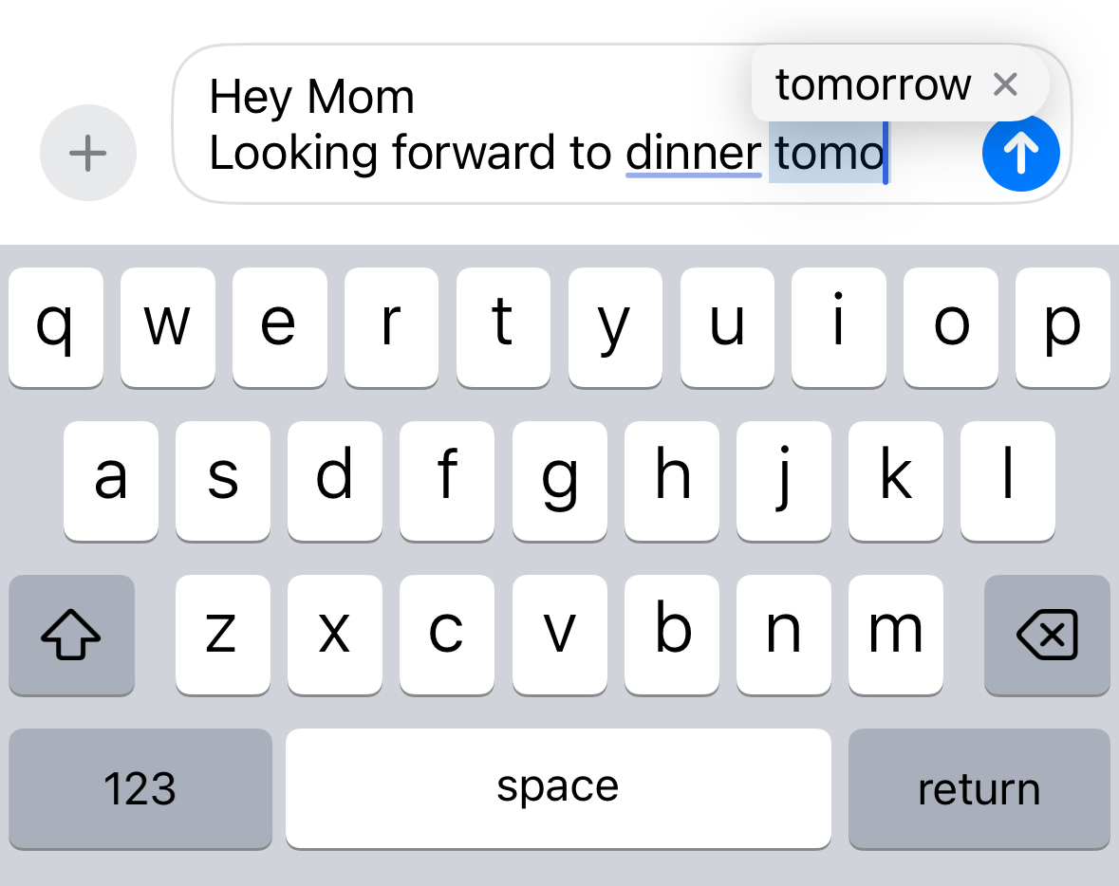
LLM And Predictive Text

Slide 7


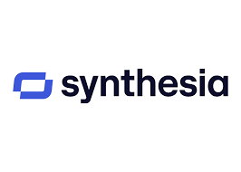
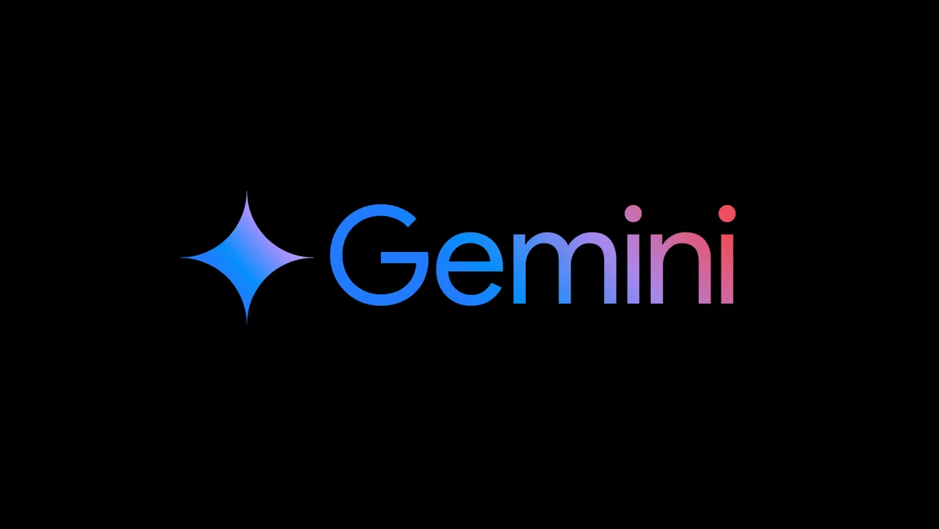
The OG’s

Slide 8
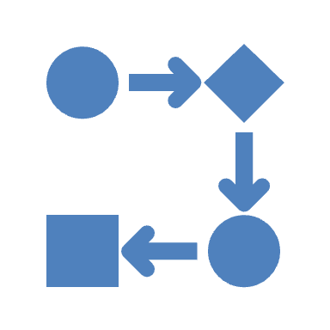
Workflow Automation
Workflow automation follows predefined rules and logic to streamline repetitive tasks. It operates based on if-then conditions and structured processes.
Key Characteristics:
Rule-based: Uses structured workflows with set conditions.
Deterministic: Outputs are predictable based on predefined logic.
Static processes: Requires manual changes to update logic.
Common use cases: Email sequences, data entry, lead nurturing, ticket routing, and approval workflows.
Examples: HubSpot Workflows, Zapier, Power Automate.

Slide 9
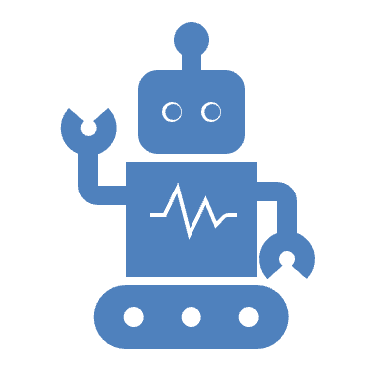
True AI Agents
AI agents operate with autonomy, adaptability, and reasoning, making decisions dynamically based on learning from data.
Key Characteristics:
Adaptive: Can learn from past actions and improve over time.
Non-deterministic: Outputs vary based on context and evolving inputs.
Decision-making: Uses AI models, NLP, and ML to understand, predict, and act.
Common use cases: Chatbots that personalize responses, AI-powered cybersecurity threat detection, predictive maintenance in manufacturing.
Examples: GPT-based chatbots, autonomous customer service agents, AI-powered sales assistants.

Slide 10
Key Differences
Feature | Workflow Automation | AI Agents
Logic | Rule-based | Adaptive, learning-based
Flexibility | Limited to predefined conditions | Can adjust based on new data
Decision-making | Static, follows instructions | Dynamic, makes independent choices
Use Cases | Task automation (emails, approvals, data transfer) | Complex problem-solving (chatbots, fraud detection, process optimization)
Evolution | Requires manual updates | Continuously learns and improves

Slide 11

Good At ✅
Not Good At ❌
Good at:
Pattern recognition
Content generation
Summarization
Translation
Not Good at:
Complex math and equations
Real-time research and fact checking
Understanding sarcasm or humor

Slide 12
Common pitfalls

Slide 13

Poor data hygiene
Lack of data strategy
Personalization at fail vs scale
Over-reliance on automation

Slide 14
Use this stuff to make your life easier

Slide 15
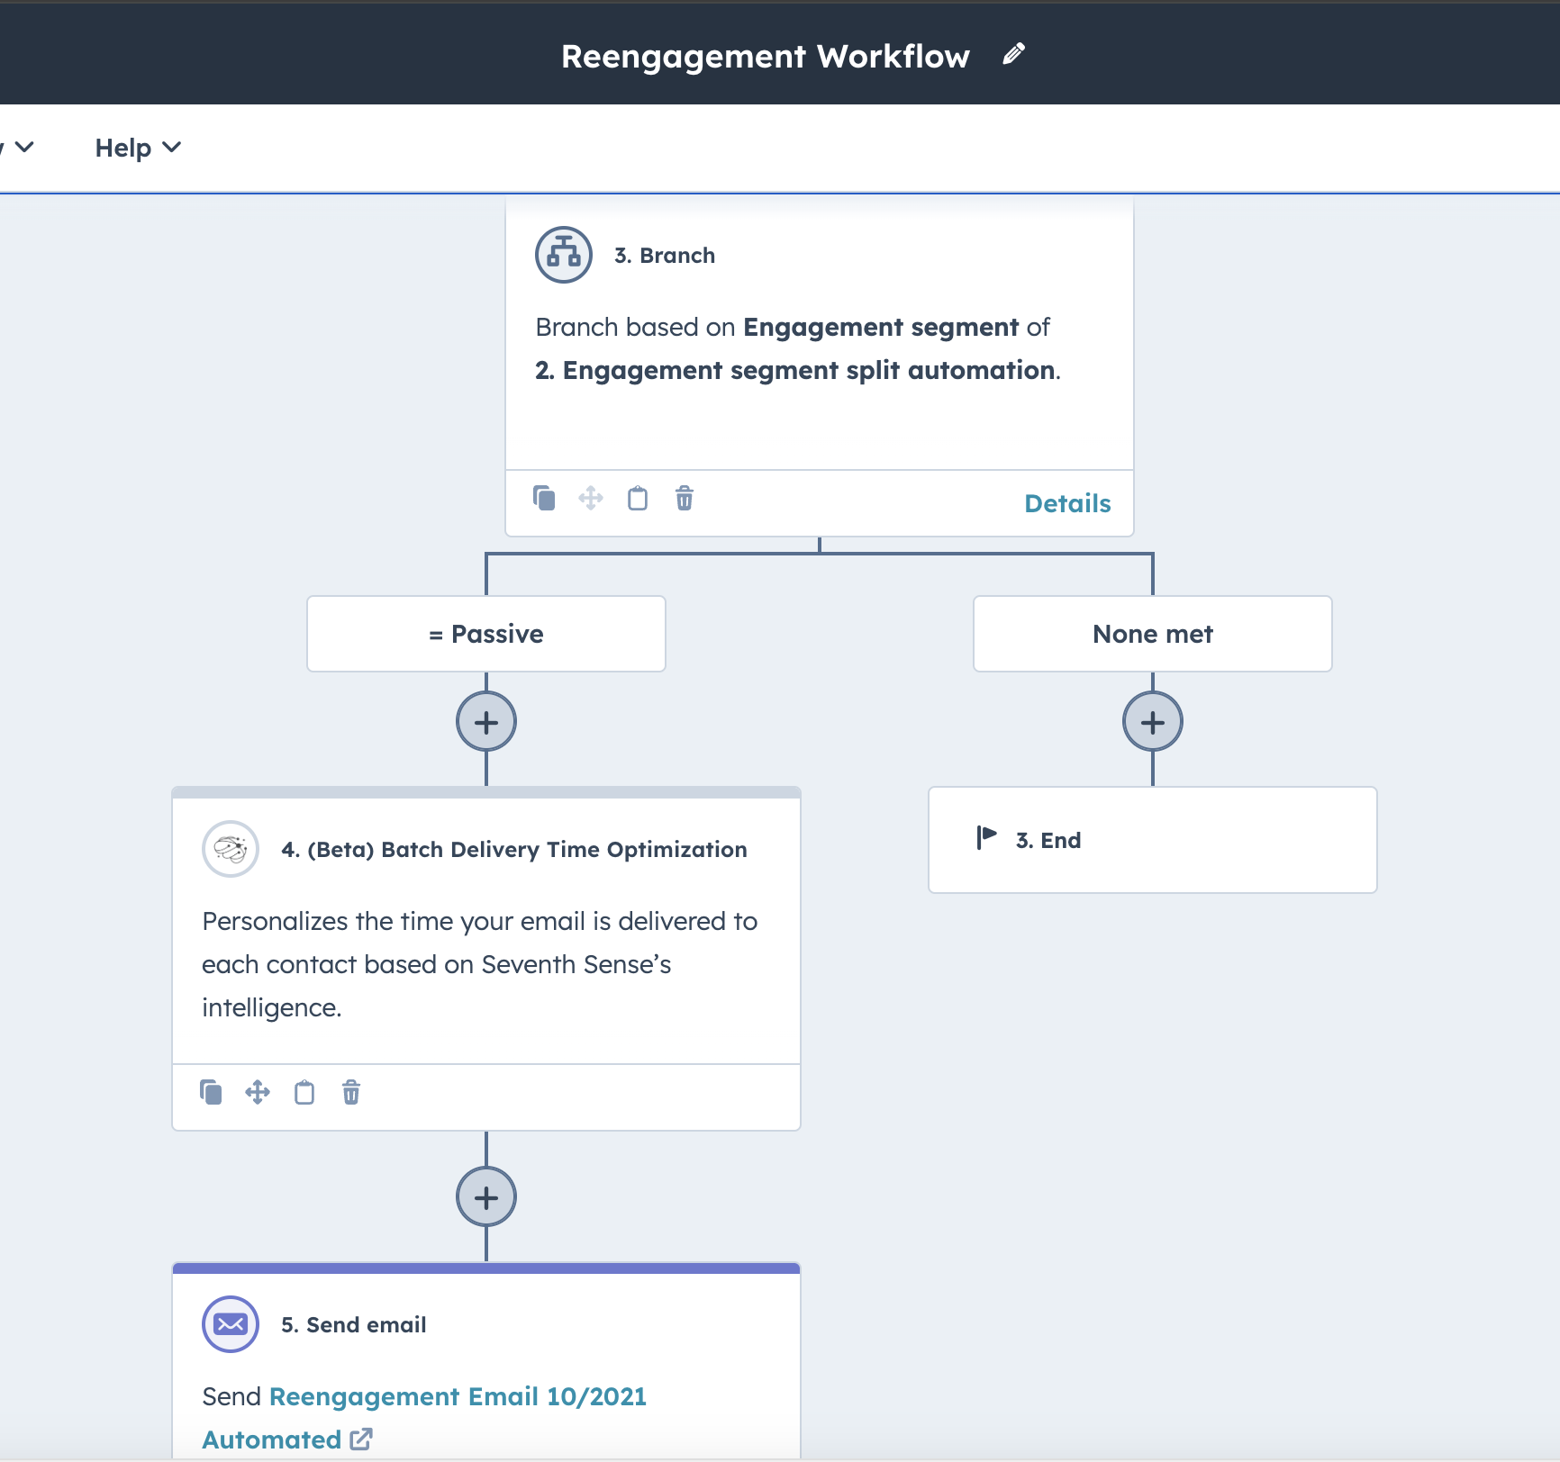
Workflows and Automation

Slide 16
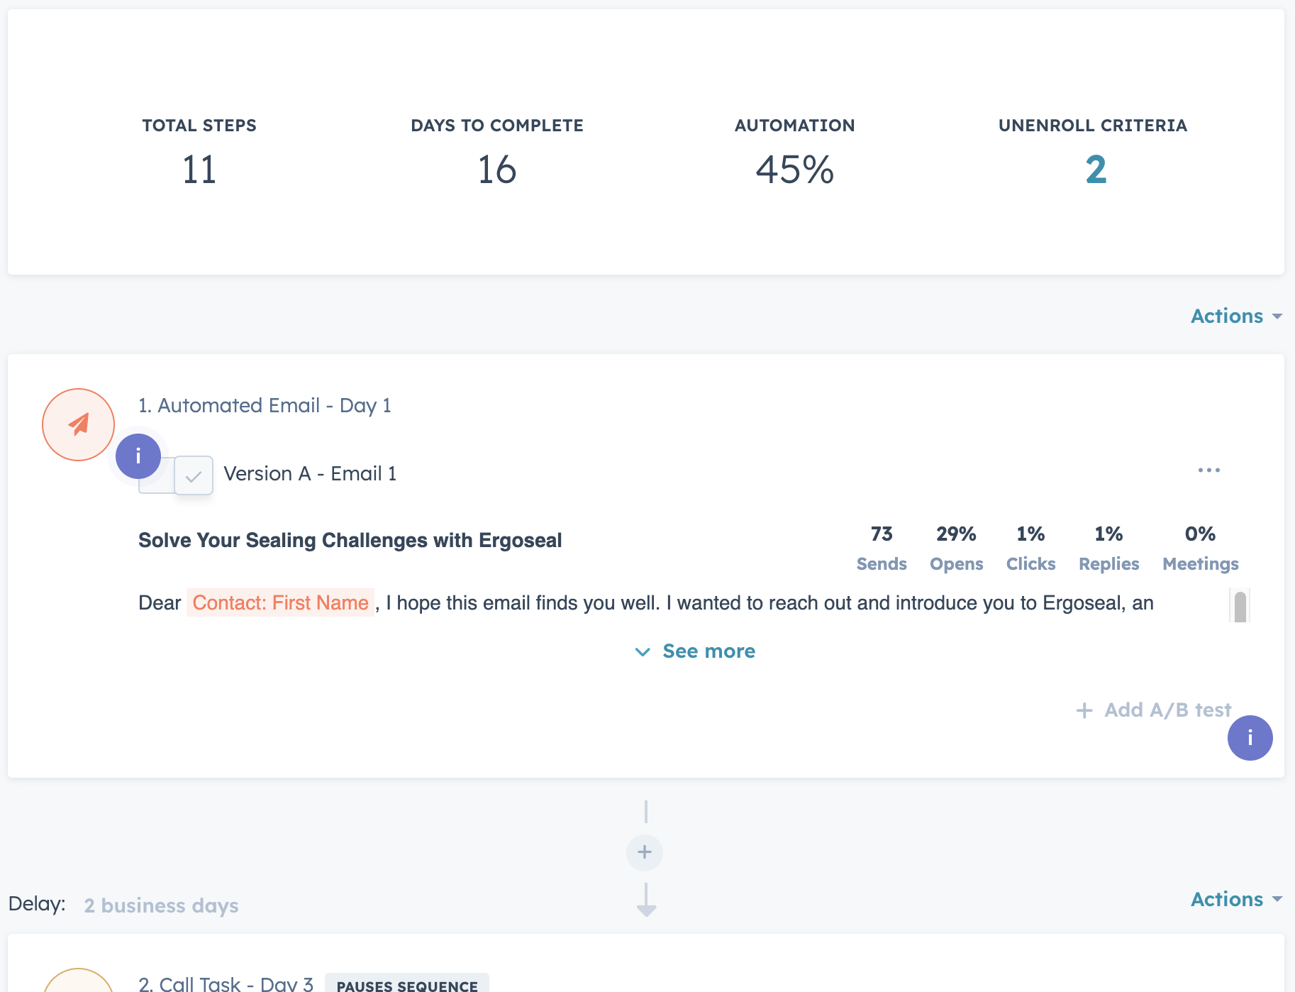
Sales Sequences

Slide 17
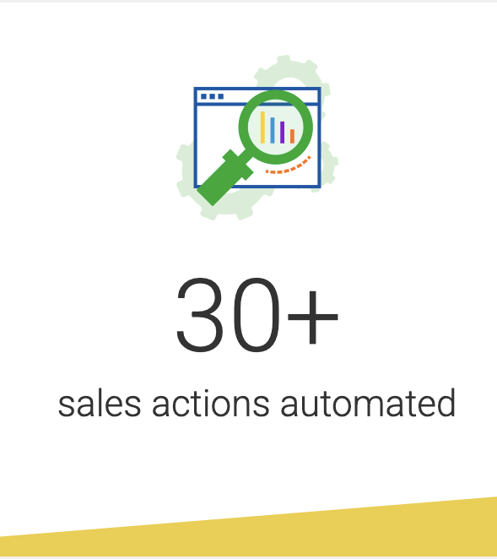
Client success
Wire harness and cable manufacturer automated pipeline stages for deals to update automatically based on activity and prospect behavior leading to improved forecasting

Slide 18
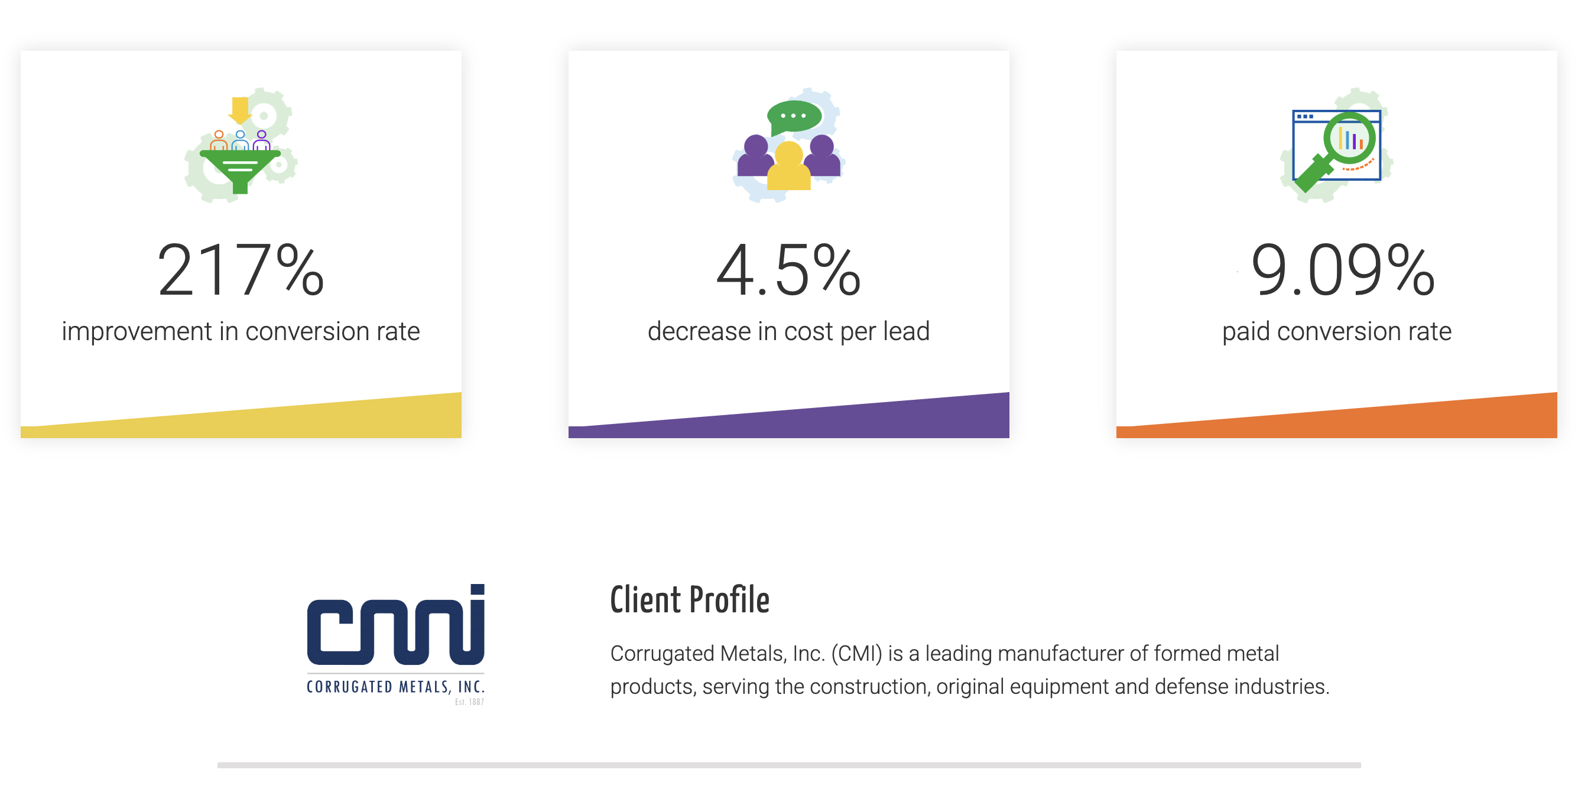
Client Success

Slide 19
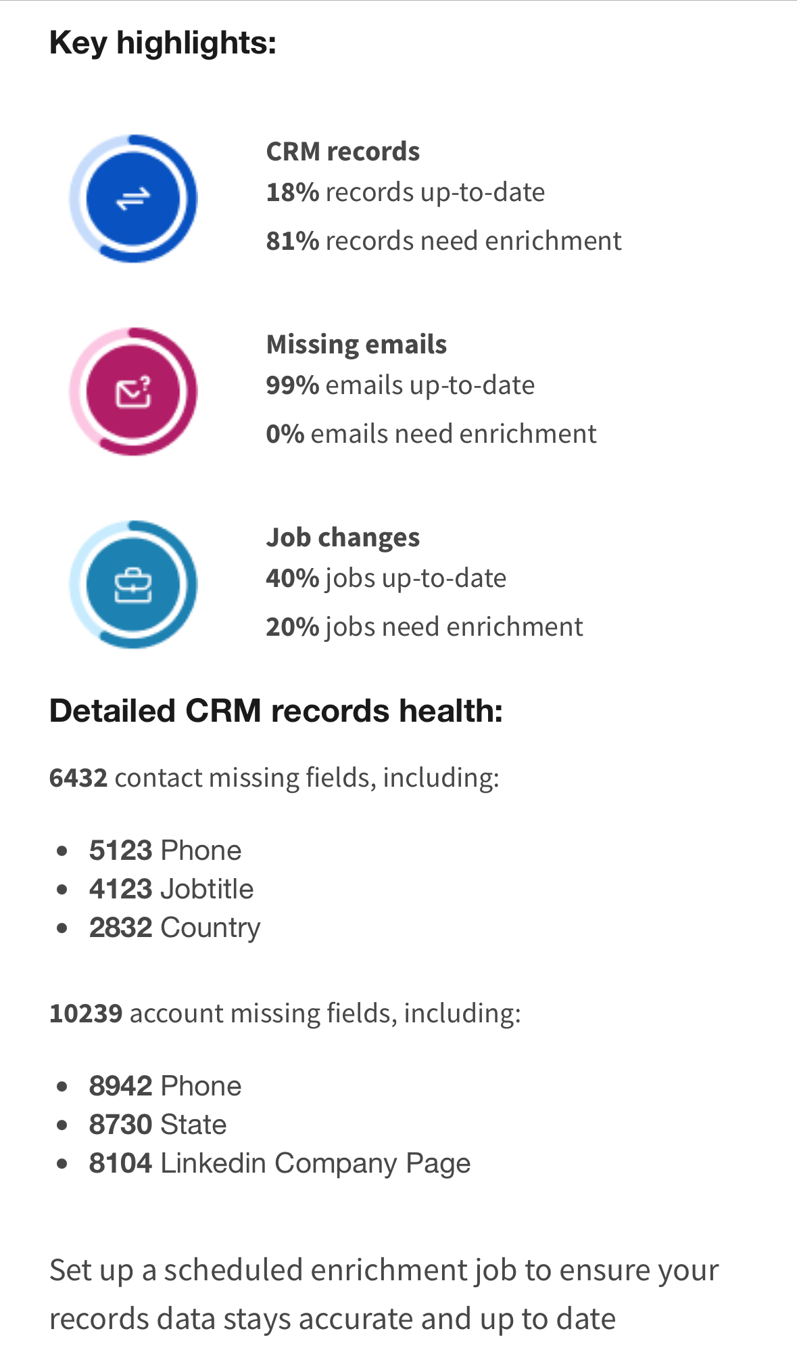
Data Enrichment

Slide 20
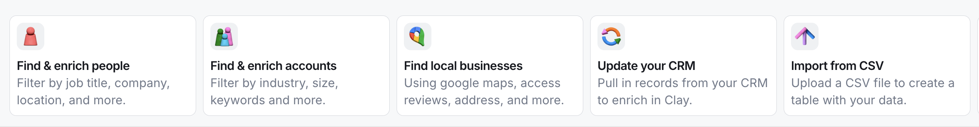
Increase sales and profits
A uniform and complete CRM provides a central source of truth with fields and properties to segment and manage lists for more targeted and personal outreach

Slide 21
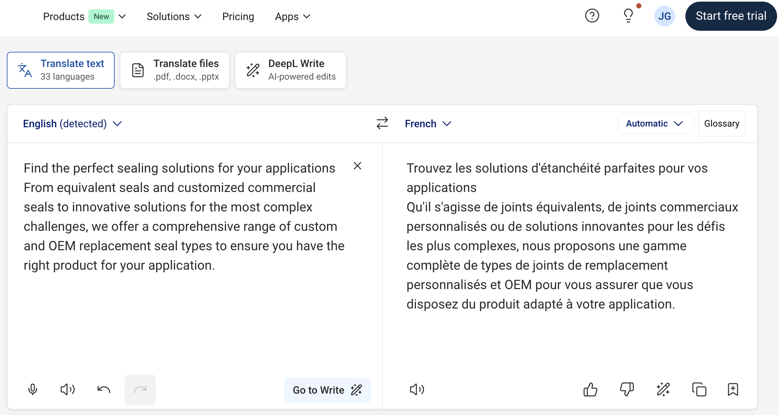
Translation
Use tools like Google Translate and DeepL to translate web copy, PDFs, internal documentation, etc.

Slide 22
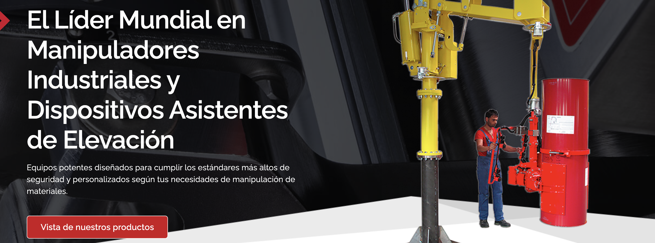
Client success
Spanish translation provided 215% increase in leads from paid and organic search

Slide 23
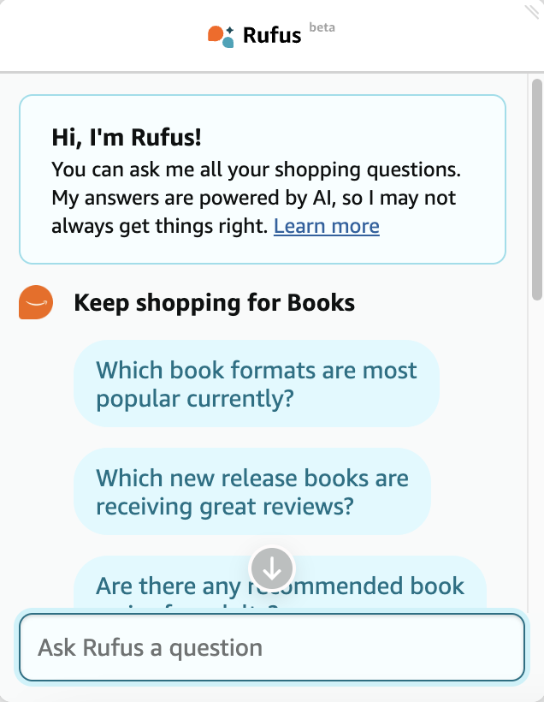
Chatbots
For sales and service
Create chatflows for guided experience

Slide 24

Psst…make sure your website has chat
Operator can perform instructions created by ChatGPT

Slide 25
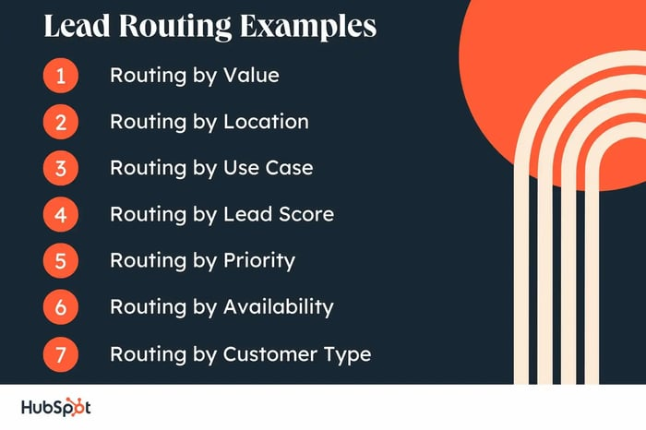
Lead scoring and routing

Slide 26
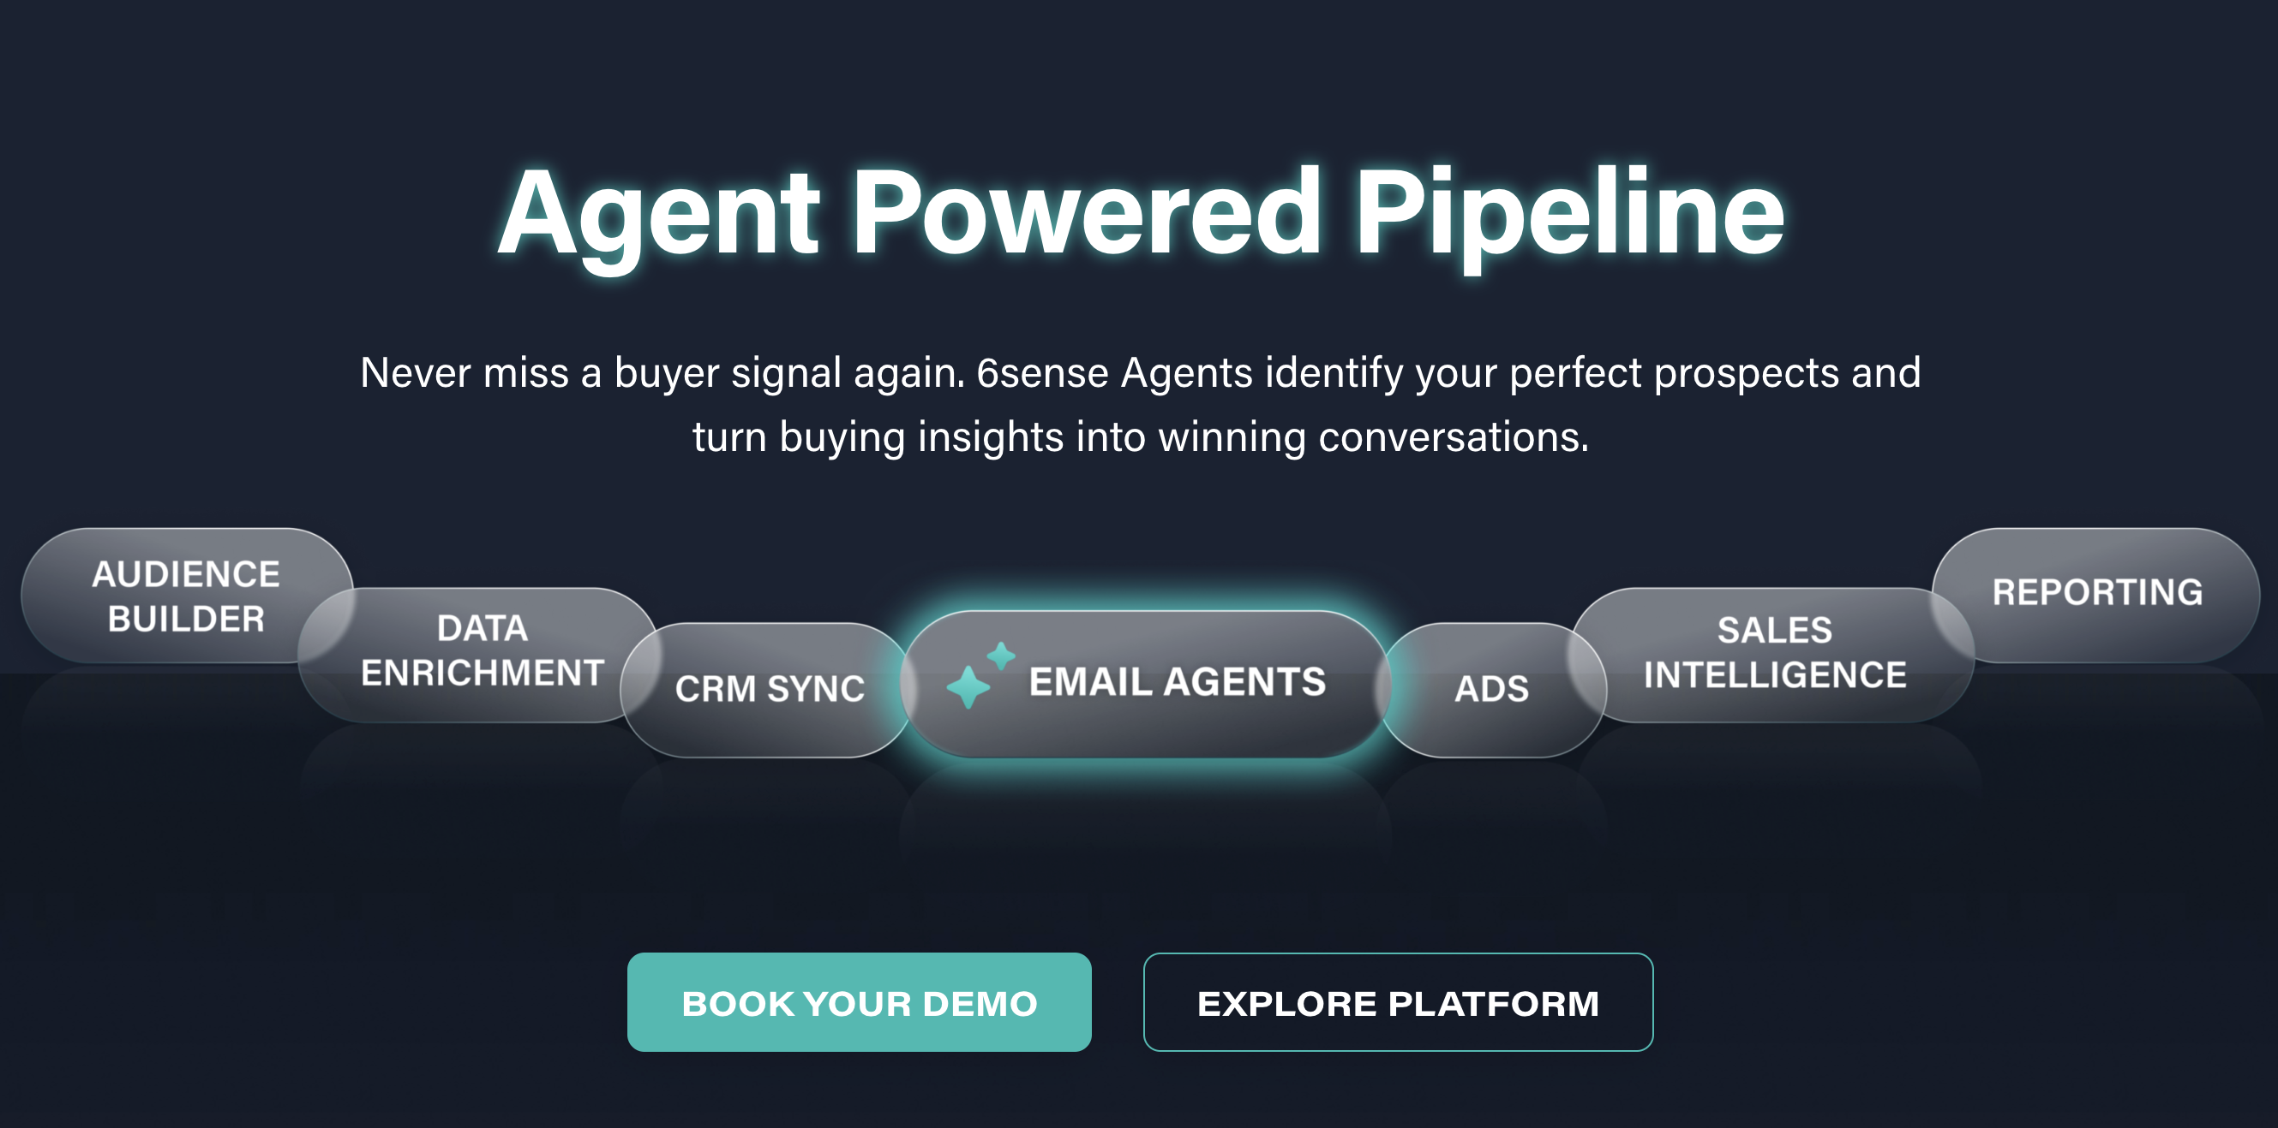
Predictive Analytics
Intent data from predictive tools like 6Sense and Demandbase score and target high-value accounts

Slide 27
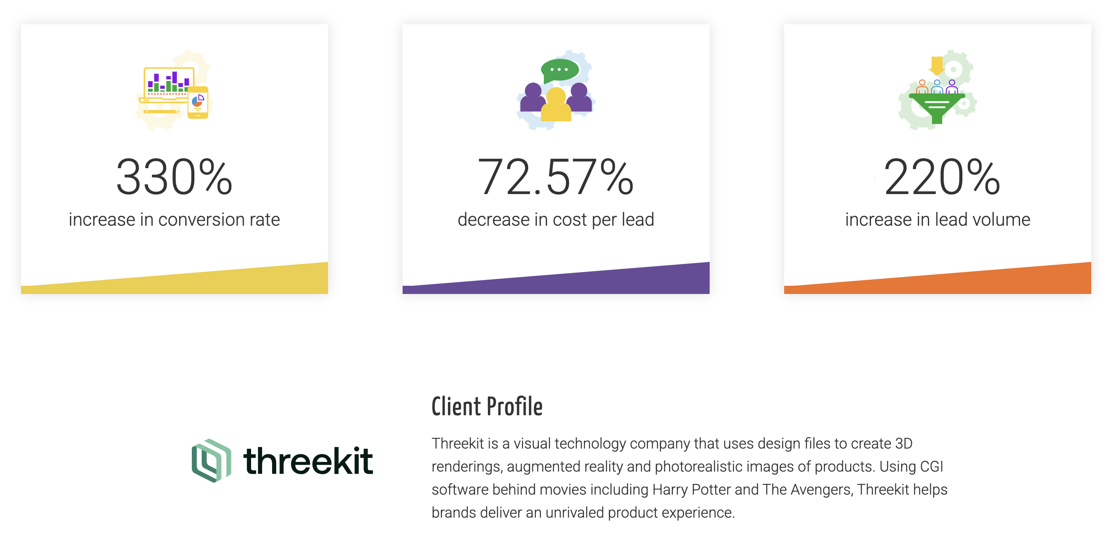
Client Success

Slide 28
Create and train custom GPTs for your brand
Brand enrichment
Trade show prep
Product matches

Slide 29
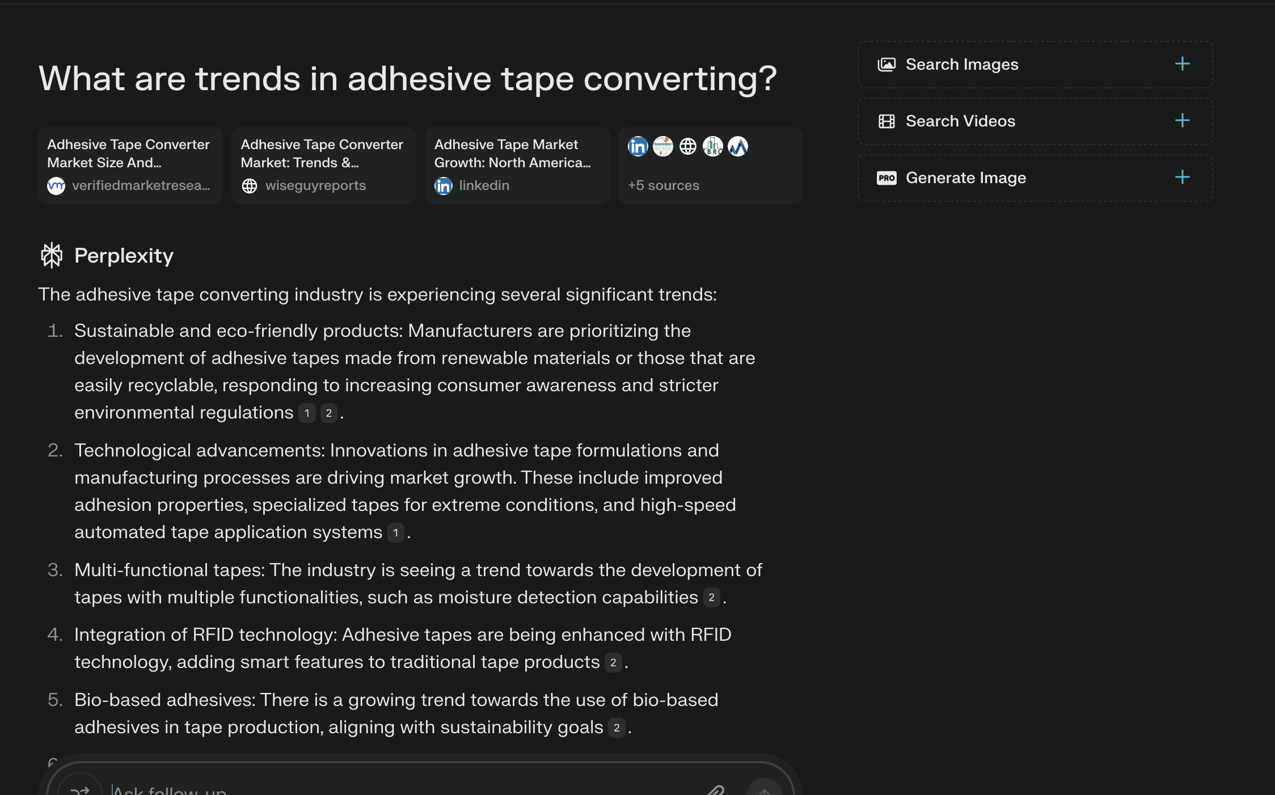
Research

Slide 30
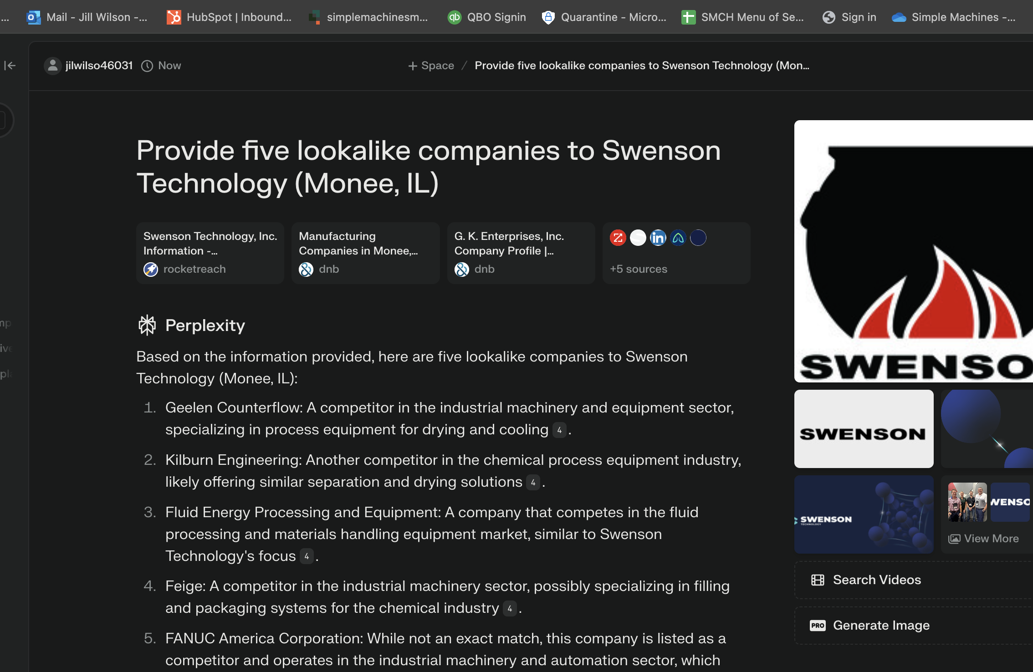
Research and Social Listening
Analyze competitor reviews for strengths and weaknesses to identify potential gaps

Slide 31
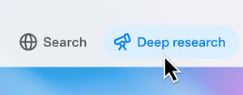
Deep Research
In-depth, multi-step research

Slide 32

Design and Editing

Slide 33
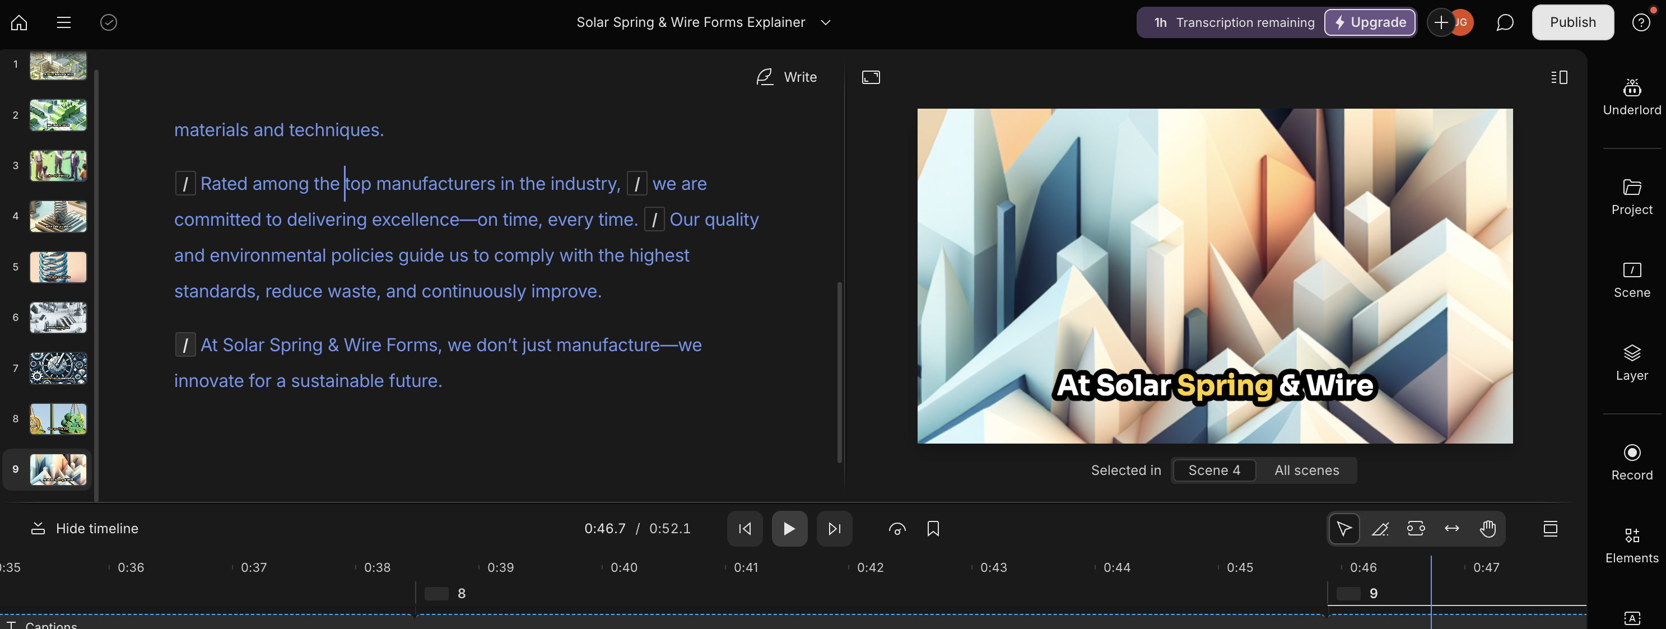
Video Script, Production, and Editing

Slide 34
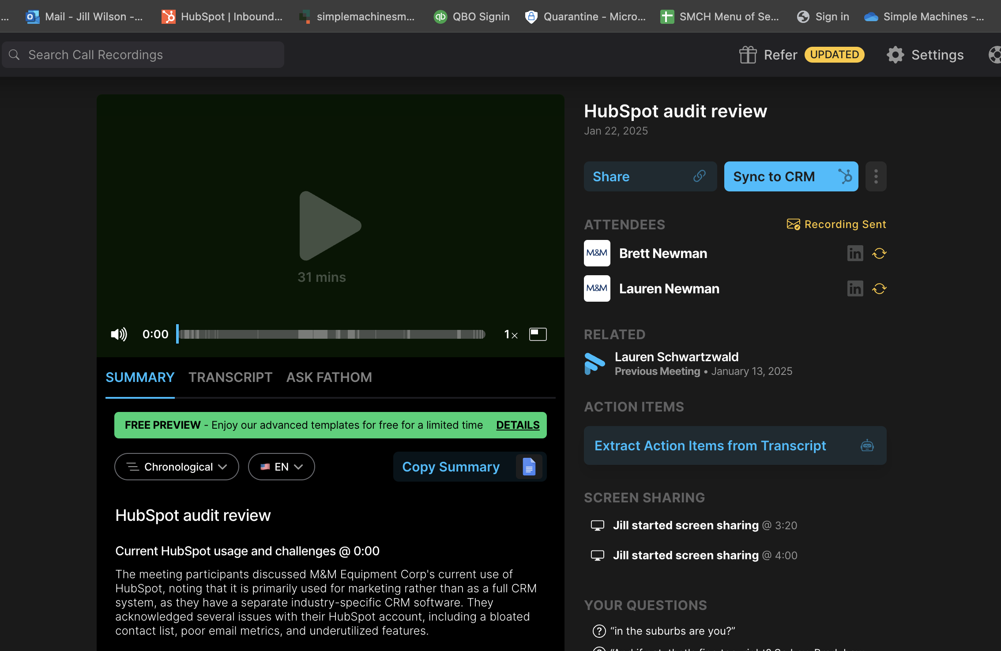
Record everything!

Slide 35
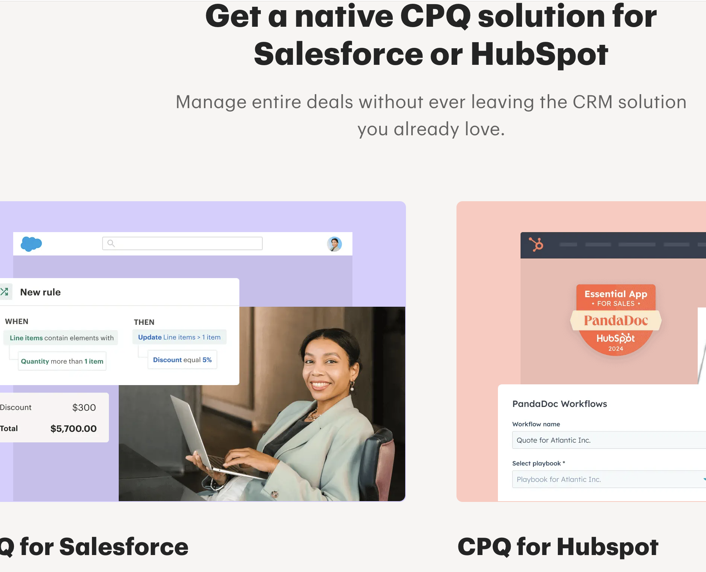
Configure Price Quote

Slide 36
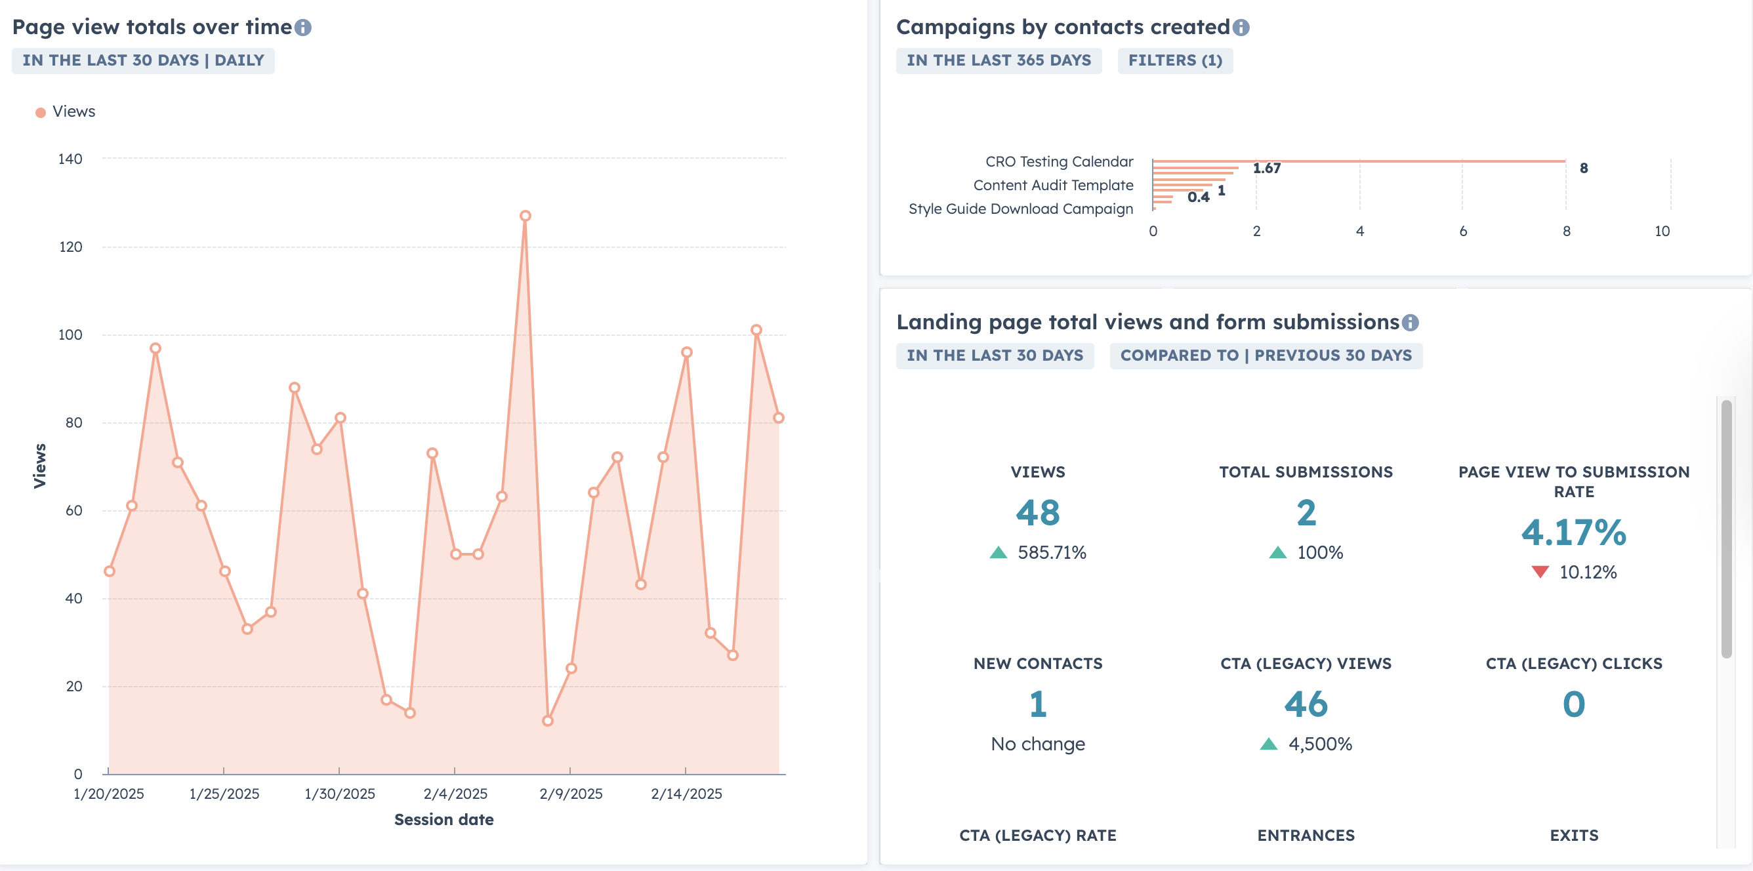
Reporting and Results Analysis

Slide 37
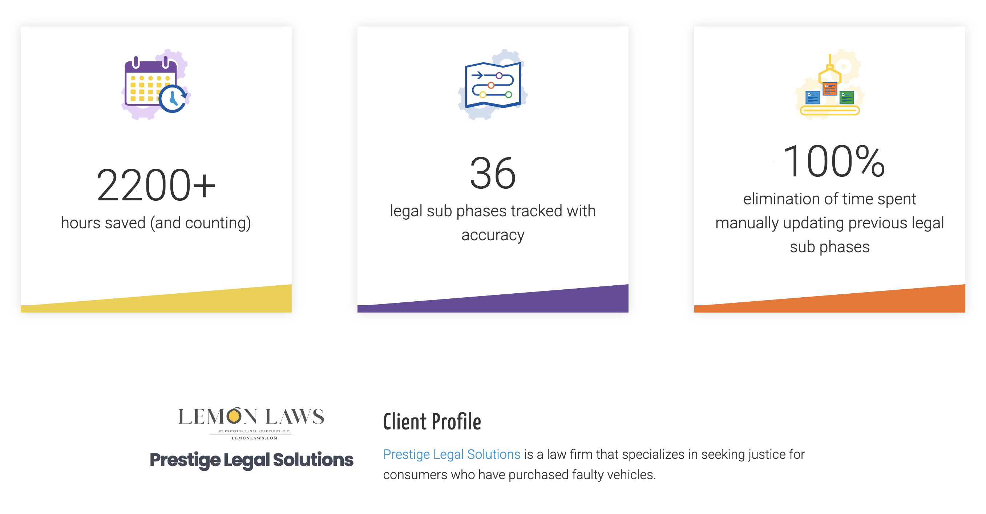
Client success
Clean data + reporting + automation = time saved

Slide 38
That’s a wrap

Slide 39

Summary and Takeaways
Why should I bother to read something that couldn’t be bothered to be written?
Clean data is the foundation for enabling automation
Start small
Test, test, test
AI won’t replace you, but a marketing pro using AI will

Slide 40
What’s left for us mortals?

Slide 41
Do what AI can’t
Cultivate relationships
Collaborate with influencers and customers
Original research
Have a POV
Emotional IQ

Slide 42
Recommended reading

Slide 43

Recommended Reading
Britney Muller, Digital Marketing and SEO Consultant
Andy Crestodina @ Orbit Media
Wil Reynolds @ Seer Interactive

Slide 44
Gratitude

