Slide 1
NAVIGATING
INVISIBLE
BOUNDARIES.
Enhancing Communication when Working Across the Globe
9.8.2026
Paola A. Velasquez, Director of Organizational Culture
Notes:
Today is a preview of the Navigating Invisible Boundaries workshop on Enhancing Communication when Working Across the Globe
Whether you lead teams across the globe, have co-workers across the globe or maybe you don’t currently work across the globe but have coworkers in the United States that are from various countries this webinar/workshop may benefit you.
Below is script from website
Global collaboration brings incredible opportunities but also hidden challenges. Communication, leadership, decision-making, and feedback styles often vary across cultures, creating invisible boundaries that can impact team dynamics and results.
Join us for a preview of this interactive workshop to uncover how social norms and business customs influence collaboration worldwide. You’ll learn practical strategies to adapt your communication and leadership style, helping you build stronger, more respectful working relationships across borders.
What Participants Will Gain:
Insight into how social norms and business customs influence team interactions
Awareness of the underlying dimensions that shape communication, leadership, and decision-making
Strategies to adapt leadership and communication styles in global environments
Whether you lead global teams today or aspire to in the future, this session will give you the tools to navigate cultural differences and collaborate with confidence.

Slide 2
Preview of 4-hour interactive workshop
Uncover some social norms & business customs influence collaboration
Introduction to strategies to adapt communication & leadership style

Slide 3
What Participants will Gain
Insight into how social norms and business customs influence team interactions.
Awareness of the underlying dimensions that shape communication, leadership, and decision-making.
Strategies to adapt leadership and communication styles in global environments.
Tailored dialogue to navigate cultural differences.
Notes:
What participants will gain from the workshop

Slide 4
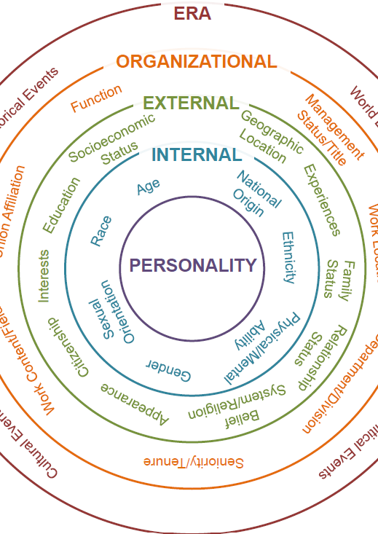
Culture
“…learned patterns of beliefs, values, assumptions, and behavioral norms that manifest themselves at different levels of observability.” (Organizational Culture & Leadership, Edgar H. Shein)
Macro Cultures
Micro or Subcultures
Individual
Notes:
Culture has been studied for a long time by anthropologist and sociologist, resulting in many models, frameworks, and definitions of culture. According to Edgar H. Shein a world renowned expert in organizational culture…
Cultures are READ SLIDE DEFINITION.
Macro Cultures are nations, ethnic groups, occupations, large organizations (such as your company) that have been around for a long time and have formed some stability.
Within the Macro Culture exists micro or subcultures. These are the observable behaviors, the climate, values, norms, unspoken rules, habits, shared meanings, among other things.
At the individual level, various aspects shape or influence our individual culture. The internal circle shows those aspects we have little or no control over, our age, race, ethnicity. And as we move outward, to the OUTER circles, you can see the various dimensions that influence our individual culture.
At the individual level is where we see employees that may not conform exactly to some of the beliefs and behaviors found in a specific macro-culture.

Slide 5
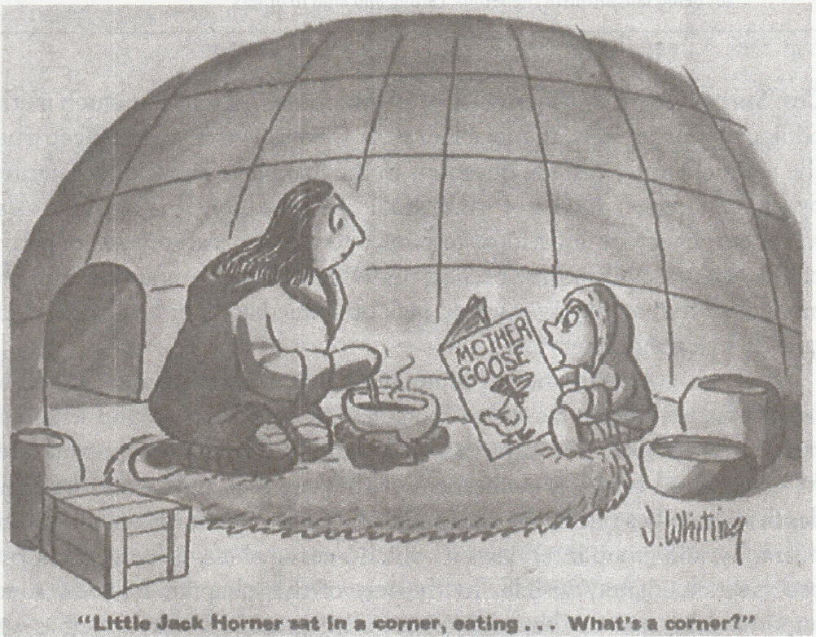
Language & Context
Most obvious cultural dimension is language
We learn culture through what we look at and think about
Language defines what we see, hear, and feel
Language defines what we think about things and the defined meaning
Notes:
One of most obvious cultural dimension is spoken language. The image here portrays it well.
The way we initially learn the culture of our own country is through what we look at and think about.
We don’t necessarily learn what something is by looking it up in the dictionary, per se.
Language defines not only the categories we see, hear, and feel but also WHAT we think about things, and we define meaning.
There are over 7000 languages spoken in the world each with its own defined culture.
Oxford Dictionary has recorded over 500,000 words (English is one of the languages that has the largest vocabulary)
Spanish Royal Academy Dictionary has recorded 93,000 (rely on contextual clues)
-we need to be mindful of subtle cues and nonverbal communication as much as the words being used.

Slide 6
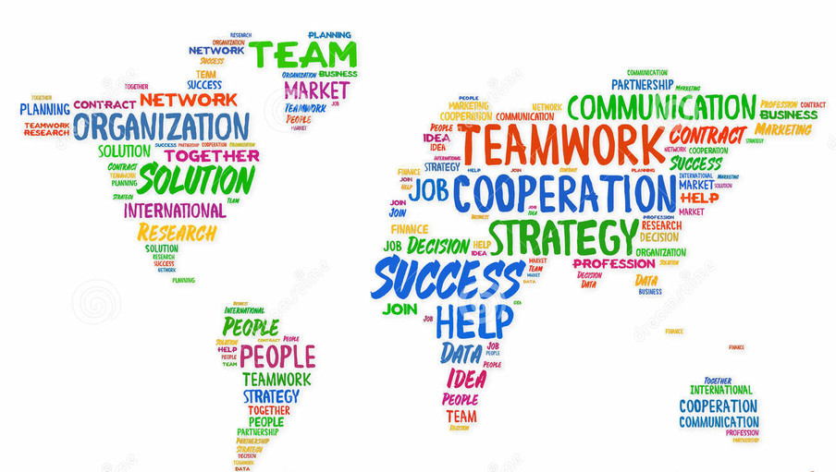
What is your biggest barrier working across cultures?
Notes:
Click for next slide to explain SLIDO

Slide 7
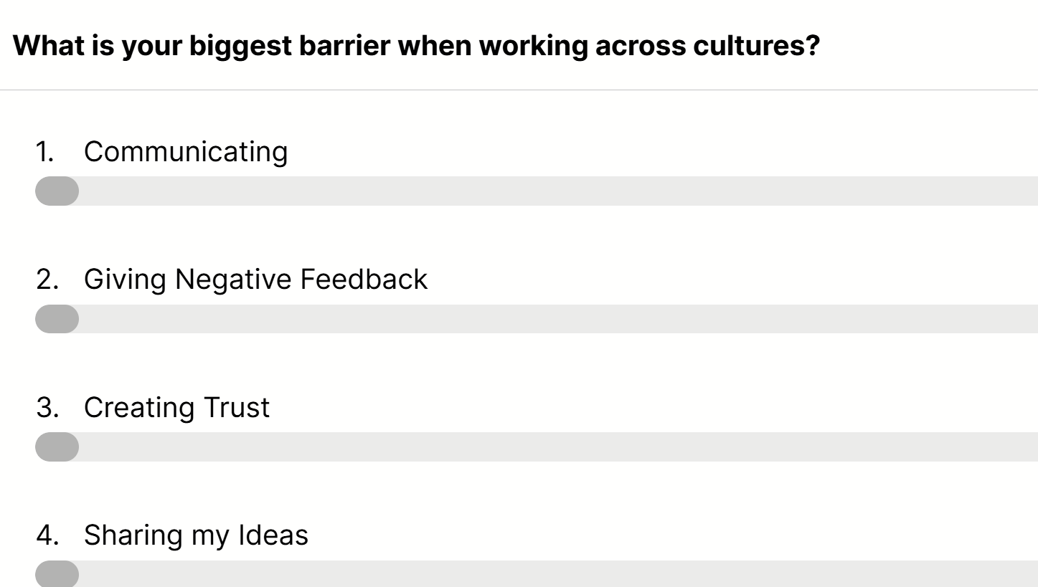
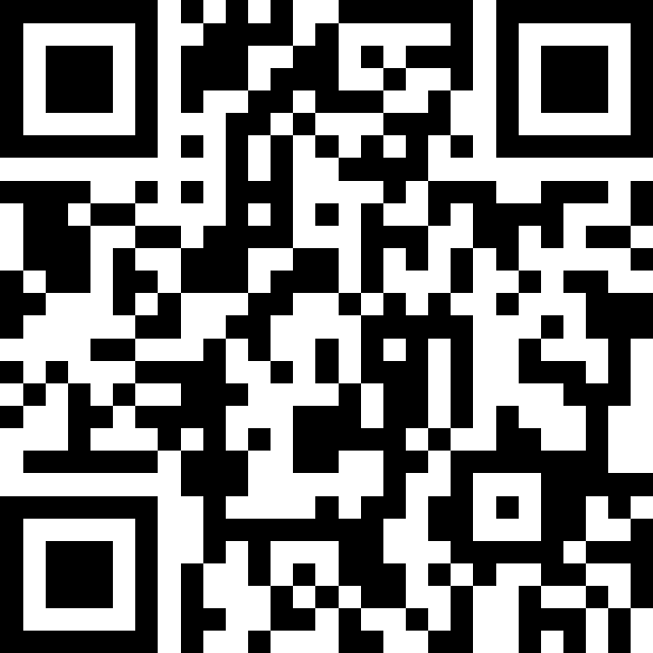
SLIDO
Instructions:
Scan QR code or use link
Respond anonymously to question(s)
Notes:
What is your biggest barrier when working across cultures? https://app.sli.do/event/ew4tko5FZxB8s6v9whAa5s

Slide 8
Cultural Humility
Cultural Intelligence
Cultural Competence
Cultural Competence
Cultural Humility: recognizing that we don’t know everything about every culture and we are open to learning.
Cultural Intelligence: a cursory knowledge of both how culture works and the specific culture(s) you’re interacting with.
Cultural Competence: ability to work effectively in a multicultural environment.
Notes:
The workshops helps us take a step forward to becoming culturally competent. It starts with cultural humility and cultural intelligence.
[CLICK] Cultural Humility: is recognizing that we don’t know everything about every culture and we are open to learning. It’s about accepting our limitations and doing the work to increase our self-awareness.
Most people have an innate belief that their culture is the very best one. It’s an expected feeling because your culture is the one that naturally makes you the most comfortable. It’s a feeling of ease when you are surrounded by your own culture, so it’s understandable that you feel it’s the best one.
At the same time, a culturally competent leader CAN’T successfully adapt to another cultural way of being if they persist in thinking that their culture is somehow superior to others.
[CLICK] Cultural Intelligence: is the cursory knowledge of both how culture works and the specific culture(s) you’re interacting with.
Adapting to a new culture isn’t simply a matter of imitating different behaviors but of understanding how those behaviors serve the culture, or stem from a core belief.
Examples:
Japan: Japanese people may avoid directly saying “no”, opening disagree with someone or criticizing another person in front of a group. In the US we may interpret this as an employee’s reluctance to openly disagree as a lack of confidence or honesty. However, this is deeply rooted in Japanese history of respect for hierarchy, duty, and maintaining relationships. When we understand how the core belief impacts the behavior, we can honor that cultural purpose and identify strategies to enhance communication with our coworkers. Which leads us to… [CLICK]
Cultural Competence is the ability to work effectively in a multicultural environment.
Cultural competence isn’t a destination, it’s a journey, a process that involves constant learning. Language & Culture are ever evolving there is no final destination.

Slide 9
Cultural Competence: 3 Components
Each builds upon the last…
Self-awareness around your own cultural background (the beliefs and behaviors that guide your perceptions and actions)
Knowledge of other cultures (especially those you interact with)
Skills to achieve good communication, collaboration and maximum productivity in the workplace
Notes:
I want to highlight three components to Cultural competence and each of which builds on the last:
Self-awareness around your own cultural background (the beliefs and behaviors that guide your perceptions and actions).
Knowledge of other cultures (especially those you interact with).
Skills to achieve good communication, collaboration and maximum productivity in the workplace. Today we won’t go into specifics of the skills, tools, and strategies due to the time. But at the end, time permitting, I’m happy to share a few we introduce in the workshop.

Slide 10
Let’s hear from you!
You're in a meeting with a colleague who jumps straight into the agenda without any small talk or greetings. How does that come across to you?
Notes:
Let’s hear from you! You’re in a meeting with a colleague… https://app.sli.do/event/ew4tko5FZxB8s6v9whAa5s

Slide 11


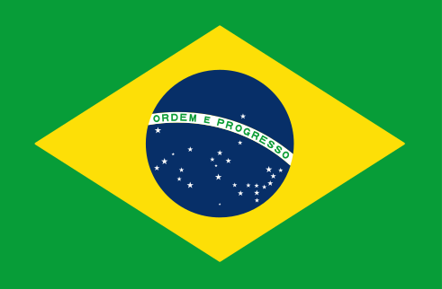


Let’s hear from you!
You're in a meeting with a colleague who jumps straight into the agenda without any small talk or greetings. How does that come across to you?
“It might feel a little bit rude, but nothing major. I could continue with the meeting.”
“Too task-oriented & tactical, with little intention on getting buy in from the group on the topic(s) at hand to discuss.”
“A bit rude. Small talk is part of Brazilian culture. You can keep it short, no problem, but you need to do it.”
“Depends on the relationship (new or old), the meeting agenda, the urgency, and what we're trying to accomplish.”
“Good and efficient.”
Notes:
Let’s hear from you! You’re in a meeting with a colleague… https://app.sli.do/event/ew4tko5FZxB8s6v9whAa5s

Slide 12
Let’s hear from you!
If your colleague sends you a message that says “We need to talk”, what is your immediate reaction?
Notes:
Let’s hear from you: “we need to talk” https://app.sli.do/event/ew4tko5FZxB8s6v9whAa5s

Slide 13
Let’s hear from you!
If your colleague sends you a message that says “We need to talk”, what is your immediate reaction?
“I would understand that it is something important, I would ask more about that conversation.”
“Neutral - it means something needs my attention with that individual.”
“Stay alert because something wrong may have happened.”
“Immediate reaction is that there's an issue.”
“Sure.” “Let’s do it!”
Notes:
Ask to place in chat.
Click after responses

Slide 14
Mapping the Way Forward
Notes:
In the first part of the workshop we dive into what culture is and is not. We define cultural competence. And then we move on to the next section, “Mapping the Way Forward”

Slide 15
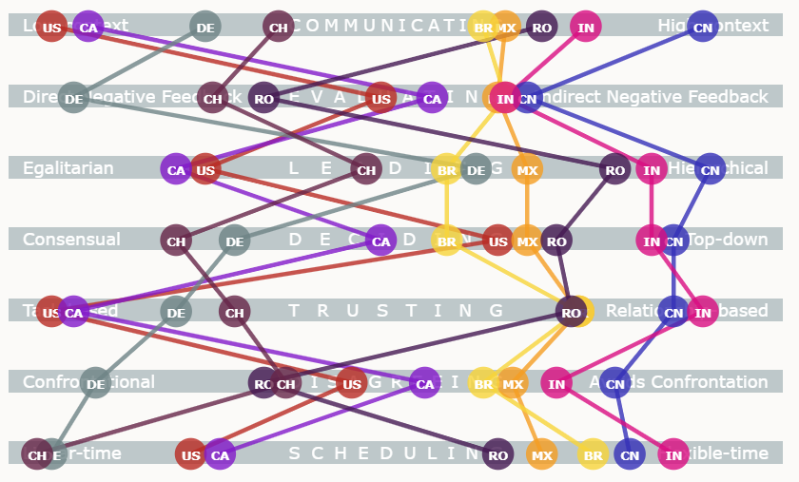
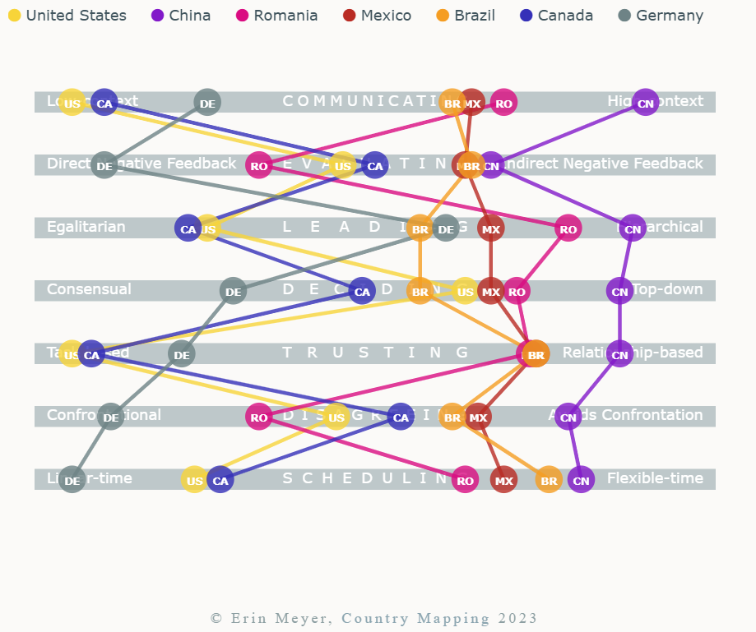
Cultural Relativity
Communicating
Evaluating
Leading
Deciding
Trusting
Disagreeing
Scheduling
Notes:
This research is based off of professor Erin Meyer at INSEAD (a global, graduate level business school) and expert in cross-cultural management and global business studies. Building on her framework, here is the Culture Relativity Map, where I’ve mapped several of the countries organziations engage with.
When we explore this, what matters isn’t where each country stands on the scale, but how they are positioned relative to each other. It’s that relative positioning that shapes how people see and understand one another.
Let’s look at the United States. It’s in red. And let’s look at how it moves across the model and it’s positioning related to other countries.
If we look at the US in relations to Canada, you can see how they are very aligned in many aspects… in communicating, evaluating or giving feedback, and leading,
… then when we look at making decisions, HERE the US is positioned quite further away from Canada.
Then again, they align in building trust and scheduling.
I know this can be overwhelming to look at for the first time, we will dive into some of these scales a bit more in the next slides and I’ll share some examples to put it into context.

Slide 16


Cultural Relativity
“It’s common sense at the end of the meeting to recap what was said followed by an email recap.”
“My boss is German, but my team is Indonesian. Spoken agreement is enough for me. So, when we get off the phone and you send me an e-mail recapping in writing everything we just decided, it sends me a clear sign that you don’t trust me.”
Notes:
Let’s look at an example of different communicating approaches.
A German employee says, “It’s common sense at the end of a meeting to recap what was said, followed by an email recap.”
[CLICK]
An Indonesian employee says,
“My boss is German, but my team is Indonesian. Spoken agreement is enough for me. So, when we get off the phone and you send me an e-mail recapping in writing everything we just decided, it sends me a clear sign that you don’t trust me.

Slide 17
Communicating
Indonesia
US Canada Germany Brazil Mexico
Communicating
Low-context
Good communication is precise, simple, and clear.
Messages are expressed and understood at face value.
Repetition is appreciated if it helps clarify the communication.
High-context
Good communication is sophisticated, nuanced, and layered.
Messages are both spoken and read between the lines.
Messages are often implied but not plainly expressed.

Slide 18
Disagreeing
Germany USA Canada Brazil Mexico
Disagreeing
Confrontational
Disagreement and debate are positive for the team or organization.
Open confrontation is appropriate and will not negatively impact the relationship.
Avoids Confrontation
Disagreement and debate are negative for the team or organization.
Open confrontation is inappropriate and will break group harmony or negatively impact the relationship.
Notes:
The disagreeing scale aligns with confrontation.
Where disagreement and debate is expected and welcome among some cultures especially during sales & negotiating.
During the meeting, the German team members ask many detailed questions about the proposal. They challenge some of the ideas, point out potential problems, and engage in a long discussion about how the partnership would work. The American team may interpret this as a sign that the meeting is going badly. They might think, “They keep questioning our ideas and disagreeing with us, so they must not like the proposal.”
However, from a German cultural perspective, asking questions and carefully discussing disagreements can demonstrate seriousness, preparation, and interest in the proposal. Working through details and potential problems before reaching an agreement can be an important part of building trust and making a good decision.
In this situation, the American team might see debate as confrontation, while the German team may see careful questioning as responsible business communication. Neither interpretation is inherently "right" or "wrong"; they reflect different cultural expectations about how productive communication should look.

Slide 19

Discussion
Tim is an American team leader based in the U.S. who manages a product development team in India. During weekly virtual meetings, Tim typically opens by enthusiastically sharing his ideas and proposed direction for the project. While his intent is to energize the team and show leadership, he notices that his Indian team members rarely offer alternative ideas or challenge his thinking, even when he asks for input.
How do you ensure employees feel valued and heard, while respecting the cultural norms around Leading?
Note: Consider the Leading Scale (Egalitarian vs. Hierarchical distance) as well as the Disagreeing Scale (Confrontational vs. Avoids Confrontation)
Notes:
As I read this scenario, just pause and self-reflect if you have been in a similar situation and how you handled it.
Use this or introduce a different scenario specifically related to confrontation.
Sales meeting, no confrontation – went well, lots of questions, conversation became heated – did not go well

Slide 20
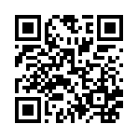
4-hour workshop personalized to your company’s needs
Action plan with or without 30 day check in
Connect with me or one of the IMEC Regional Managers
Questions?
Notes:
READ KEY TAKEAWAYS
Q&A:
What are some of the strategies you introduce during the workshop?
Style-flexing, DiSC, Coaching tools.
What does the Action Plan look like?
You’re beginning with yourself, the individual. Over four weeks, participants will focus on developing one specific behavior to focus on with intention and consistency, to start to form a new pattern of thought and behavior, one that can spark positive momentum across your entire team. Without the 30-day check in – encourage Leaders to follow up with the participants on their action plan. With 30-day check in, our facilitators will meet with the team or individual for a 1.5 meeting to discuss Action Plan, talk through obstacles/challenges, discuss strategies or coaching conversations to navigate challenges.
What are some of the ways you personalize or make it interactive?
Customize it according to the countries your organization works with. We can also customize the questions that you feel are most relevant to your organization and things you’ve heard in the company. We can also customize some of the scenarios that we use during group discussion or for coaching. We include questions, survey, word cloud, partner activity, group discussions, role-play.

