Slide 1
THE
LEAN
ROADMAP:
Driving Value & Engagement for Lasting Change
March 13, 2025
Mark Loscudo, Technical Specialist
Mloscudo@IMEC.org
513-827-5259
Notes:
Record for staff not in attendance.
https://imec.box.com/v/TeamHuddlesPast

Slide 2
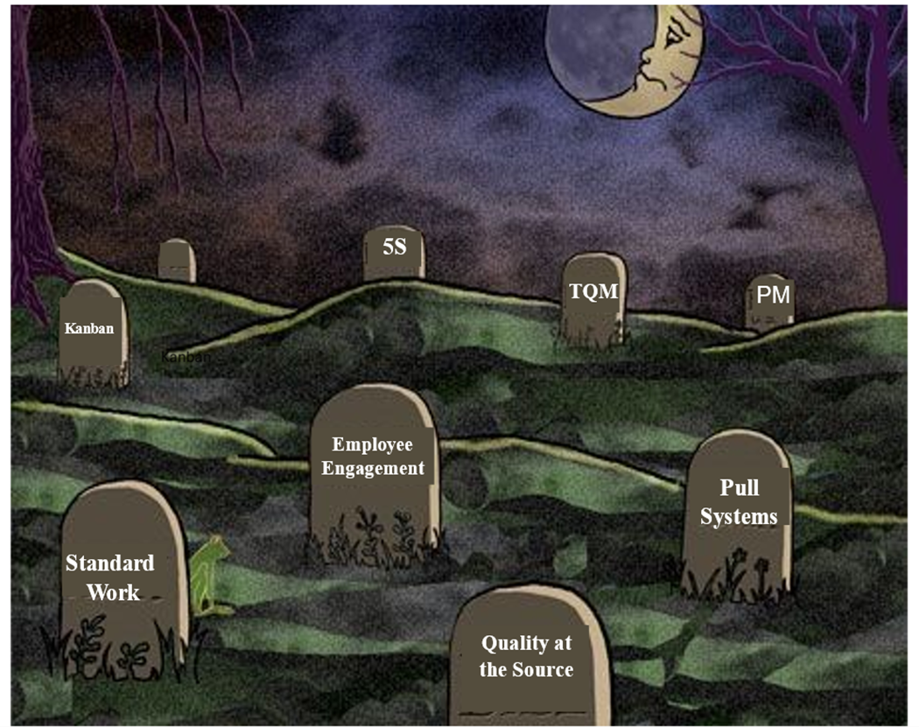
Why Have So Many Lean Transformations Failed?
We spend precious resources training people, teaching them Lean tools.. What we don’t do is Develop People to be lean thinkers and problem solvers. We are left we a graveyard of failures…
Notes:
We all have tried to implement lean initiatives that either failed or did not move the needle

Slide 3
Why Have So Many Lean Transformations failed?
Ryan Tierney, from the UK and Author of “Lean Made Simple”, gives us a clue. He describes Lean “as taking any Process - any Process - and removing anything from it that does not add value”.
He goes on further: “Lean is a mindset that must permeate the thinking of every person in the company. That’s got to start at the top. The number one reason why lean implementations fail is that leadership / senior management doesn't truly buy in and fully support the change“
Notes:
Listening to his podcasts, reading his books His focus was not the lean tools and systems but how to develop his people

Slide 4
Some Basic Understandings:
Who determines value?
Where is value created?
What makes up the cost of creating value?

Slide 5
A True Transformation is About Eliminating or Reducing Waste

Slide 6
Where Do We Start?
Engaged Senior Leaders: Dedicated and Involved at all levels of the organization, making expectations crystal clear, visible, engaged, providing the necessary resources. No handoffs!
Training: Teaching the organization about waste, learning to see waste, and how to apply the right countermeasures at the right time.
Creating True Engagement: A combination of the technical aspect and a people societal process. What’s missing in most transformation efforts.

Slide 7
Where Do We Start?
Keep it simple!
Five Initial Critical Steps of Developing Your People and Creating a Lean Culture:
The Daily Huddle
Schedule time for Improvement
Create Standard Work
Develop a robust 5S Process
Establish your Model Line

Slide 8
Where Do We Start?
Daily Huddle: Where the team comes together every day to engage and execute:
The most important meeting of the day.
Epicenter of critical information coming into the team and out of the team to other stakeholders.
It’s about execution producing what the customer wants, how much they want, when they want it, and agreed on quality.
A critical step for developing people.

Slide 9
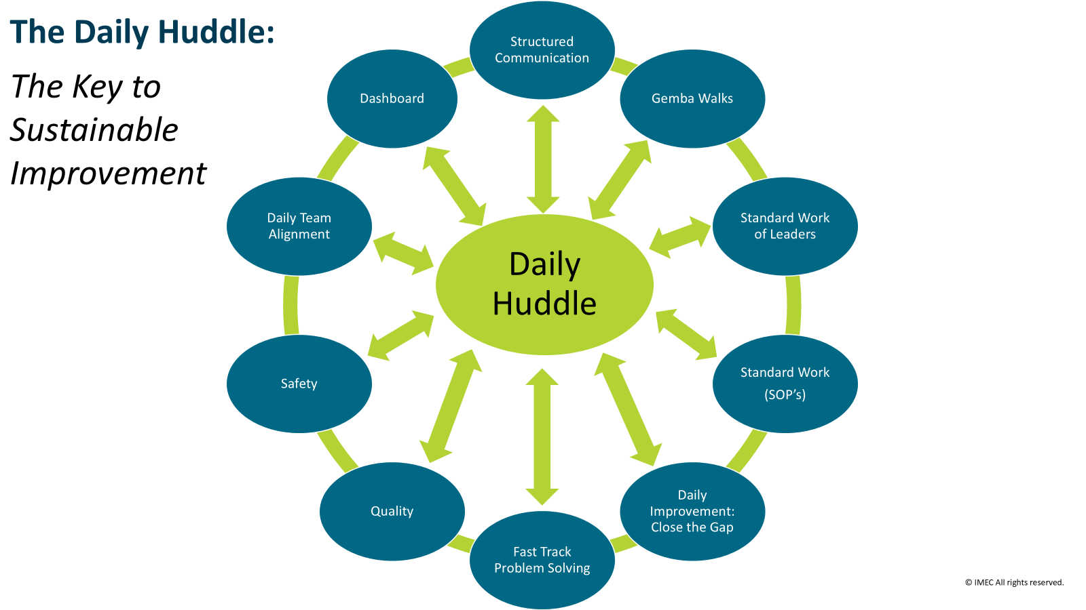
Where Do We Start?

Slide 10
Where Do We Start?
2. Scheduling Time for Improvement:
Most improvements, (Daily Kaizen), are found on the shop floor.
If time is not scheduled, improvement work will not get done.
Giving people time to make improvements will turn them into Lean thinkers, problem solvers, and doers.
Dedicating time for improvement work will more than makeup lost production time.
A critical aspect of developing people.
Don’t let “busy” get in the way of daily improvement!

Slide 11
Where Do We Start?
3.Creating Standard Work:
The number one enemy of continuous improvement is tribal knowledge.
Standard Work is the fundamental basis for continuous improvement on the shop floor
Following standards creates an environment of discipline, stability, and continuous improvement
A critical step for developing people.

Slide 12
Where Do We Start?
4. Develop a Robust 5S System:
Fundamental starting point for daily Kaizen.
Team members learn to see waste, conduct simple problem solving, and countermeasures.
Direct linkage to the Daily Huddle, creating accountability.
A critical step for developing people.

Slide 13
Where Do We Start?
5. Creating Your Model Line:
Creates a controlled area to learn and apply Lean principles, systems, and tools.
Going narrow and deep vs. wide and shallow to develop your best practices and culture before expanding to other areas your production system.
An area of best practices to teach new leadership.
A critical step for developing people.

Slide 14
Your Challenge:
Just get started!
Keep it simple.
Start with the Daily Huddle and begin scheduling time for improvement work on the shop floor (do this first).
Begin creating documented standard and standardize work.
Make 5S your initial area for daily improvement and accountability.
Create your Model Line, your sandbox, to develop your best practices and Lean Culture.

Slide 15
Thank You!
info@IMEC.org
888-806-4632

