Slide 1
MANAGE
YOUR
RISK
April 24, 2025

Slide 2
Jesse Brady
Technical Specialist

Slide 3
Agenda
What is Risk Management
Risk Management’s Role in ISO Standards
Steps in Risk Management
Risk Management Tools

Slide 4
Definitions
Risk Management – Systematic approach for dealing with uncertainty
Risk – Undesired Effect
Opportunity – Desired Effect
Risk Based Thinking – Mindset of incorporating risk management into everyday decision making to achieve intended outcomes

Slide 5
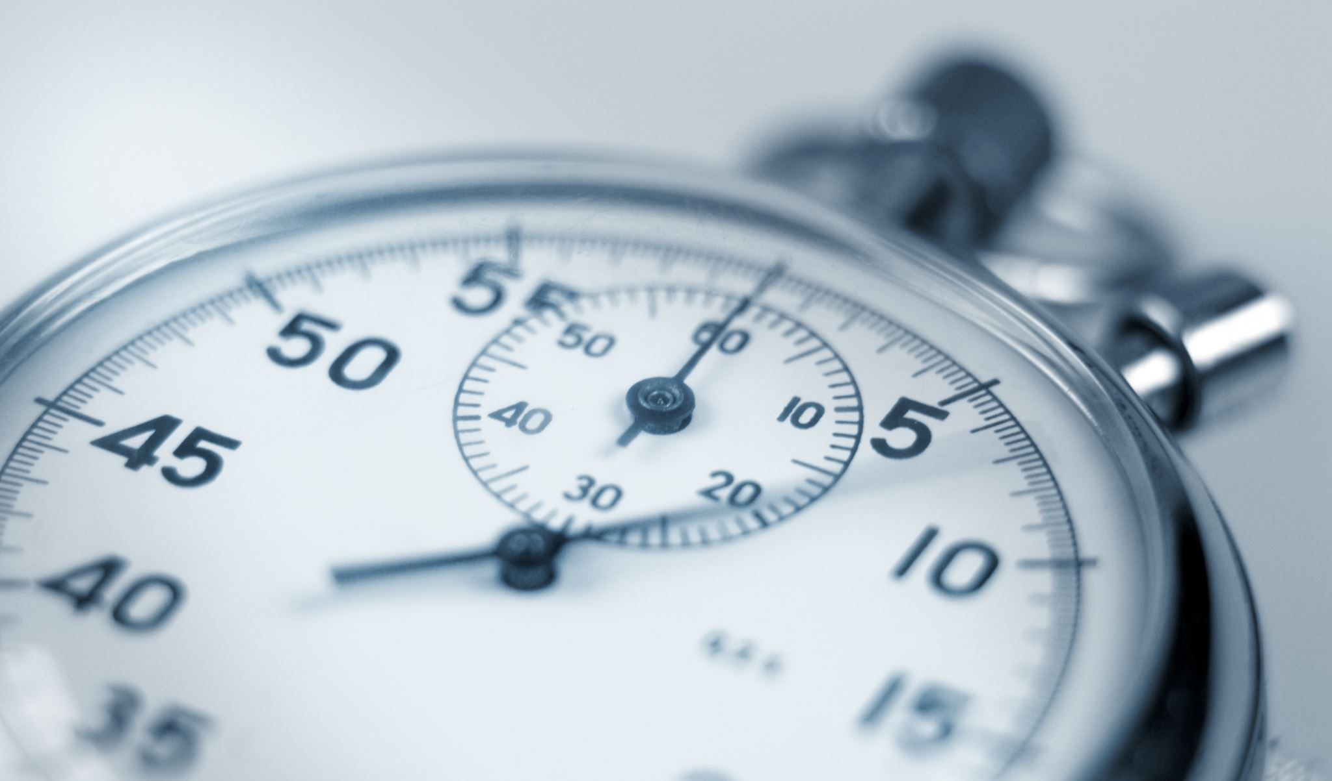
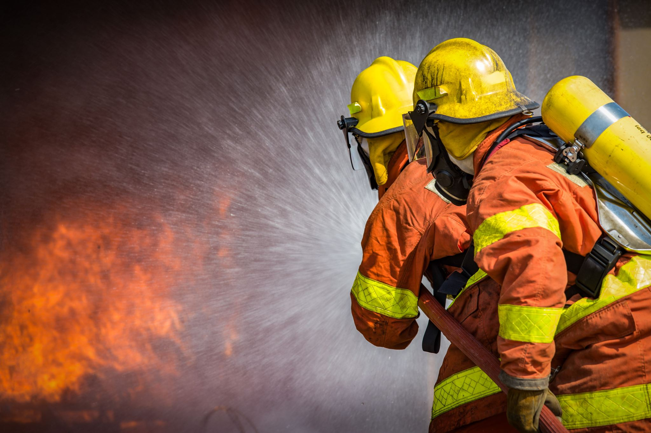
Risk Management
Systematic approach for dealing with uncertainty.
Potential Threats not Corrective Actions
Proactive vs Reactive

Slide 6
Risk in ISO Standards
ISO 9001
Quality Management System
Customer Satisfaction
ISO 14001
Environmental Management System
Environmental Aspects
Compliance Obligations
ISO 50001
Energy Management System
Energy Performance

Slide 7
ISO 9001
Objective: Help organizations consistently meet customer expectations, improve processes and enhance overall efficiency.
Common Risks
Customer Complaints
High Scrap Rate
Workforce Issues
Supply Chain
Unplanned Downtime
Notes:
Risk is mentioned 50 times in the standard

Slide 8
ISO 14001
Objective: Help organizations minimize their environmental impact, comply with legal requirements and continuously improve their environmental performance.
Common Risks
Regulatory fines
Company Reputation
Operational Disruptions
Employee Health
Tribal Knowledge

Slide 9
ISO 50001
Objective: Help organizations enhance energy efficiency, reduce energy consumption and minimize the environmental impact of energy use.
Common Risks
Loss of Business
Loss of Competitiveness
Operational Inefficiencies
Company Reputation
Tribal Knowledge

Slide 10
Risk Management Process
Risk Management
Identify
Assess
Mitigate
Monitor
(P) Identify risks
(C) Assess the effect
(D) Take action to mitigate
(A) Review the effectiveness

Slide 11
Risk Identification
Who should be involved?
At what level are we considering
Business Level
Process Specific
Industry/Regulation Specific
Short term vs Long Term

Slide 12
Risk Assessment
From the trivial many to the vital few.
Considerations:
Likelihood
Has it happened before?
Trend or historical data
Consequence
Safety concern
Loss of contract
Financial loss/fine

Slide 13
Risk Mitigation
What actions are we going to take?
Who will be responsible?
What resources will they need?
When will it be done?
When should we follow up?

Slide 14
Risk Monitoring
Did we achieve the intended outcome?
Are there additional actions we should take?
Do we need to re-assess the risk?
Are there lessons learned we can apply elsewhere?

Slide 15
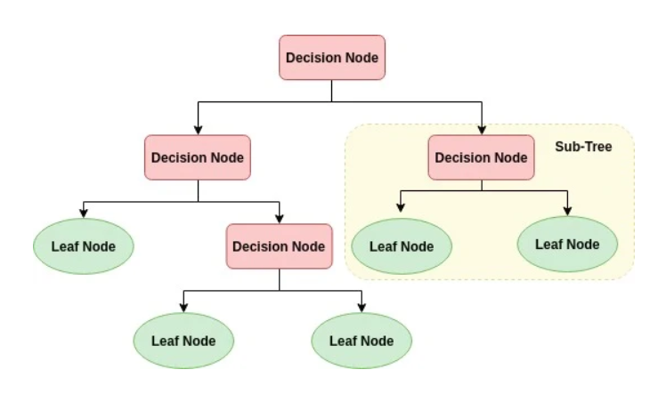
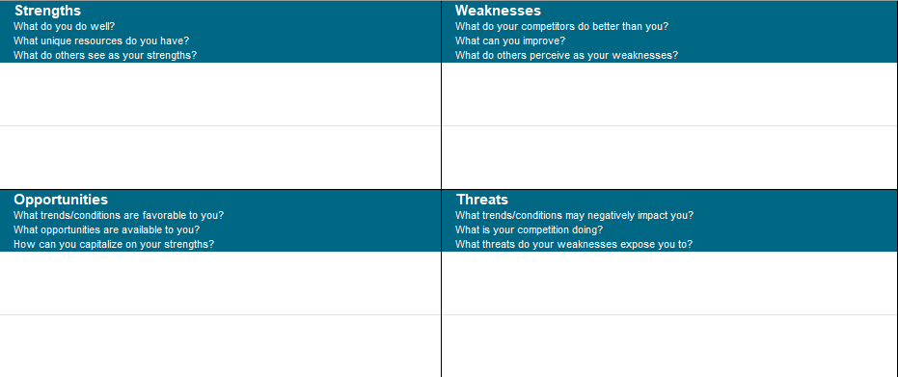
Tools for Managing Risk
Decision Tree
SWOT
Risk Register
This Photo by Unknown Author is licensed under CC BY-SA

Slide 16
Decision Tree
20K/4wks
90%
20K/4wks
10%
25K/5wks
Which Vendor
20K/3wks
50%
20K/3wks
50%
30K/6wks

Slide 17
SWOT Analysis

Slide 18
Risk Register

Slide 19
Recap
What is Risk Management
Risk Management’s Role in ISO Standards
Steps in Risk Management
Risk Management Tools
QUESTIONS?

Slide 20
Thank
You!
info@IMEC.org
888-806-4632

